Slide 1

LCHS4005_BIRM PROFESSIONAL DEVELOPMENT WITHIN HEALTH AND SOCIAL CARE

Slide 2

Introduction
Health and social care form an integral aspect of society as it deals with health implications for people.
The presentation deals with the importance of communication in health and social care.
Notes:
The presentation will discuss communication as a skill in the health and social care context. The presentation also discusses the Johari window model with respect to communication as a skill and its importance in social and healthcare settings.

Slide 3

Describe the chosen skill
Communication refers to the exchange of information between people.
Communication in healthcare can be between different parties involved, between staff, doctors or between staff and patients (arnold and boggs, 2019, p.68).
Notes:
Communication in healthcare is sharing of information and knowledge related to the treatment of patients. Communication between staff and patients ensures that the needs of patients are identified and treatment plans are framed accordingly.
It can be understood that communication as a skill is the exchange of information through the use of different mediums like writing, speaking or other mediums

Slide 4

Relevance of the skill in health and social care
Communication skill in healthcare ensures that patients take an active part in the treatment plan through inputs (baby and swain, 2018, p.67).
Communication skill in healthcare also enables staff healthcare to be availed of critical information that can derive the efficiency of the treatment plan.
Communication is also important in ensuring collaboration among the staff in the health and social care setting
Notes:
From the above presentation it can be understood that communication is an important skill in the health and social care setting enabling the healthcare staff in understanding the issues of the patient.

Slide 5
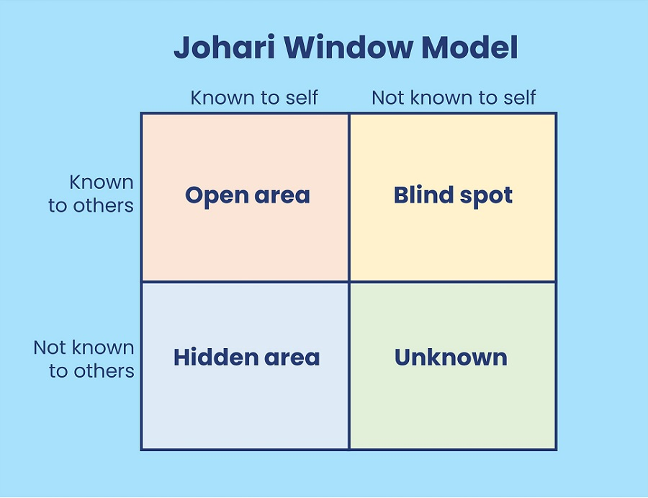
Johari window model
According to koca, and erigüç (2020, p.01), the johari model window is a concept that helps in self-awareness and also develops interpersonal communication skills.
Johari's model through self-awareness of the open-self, blind self, unknown self and hidden self improves communication.
The model can be used in training managers in healthcare to enhance the communication skills of staff working in healthcare.
Notes:
It can be understood from the above slide that the Johari window model promotes quality communication between people which can be used to enhance the quality of services provided in healthcare.

Slide 6
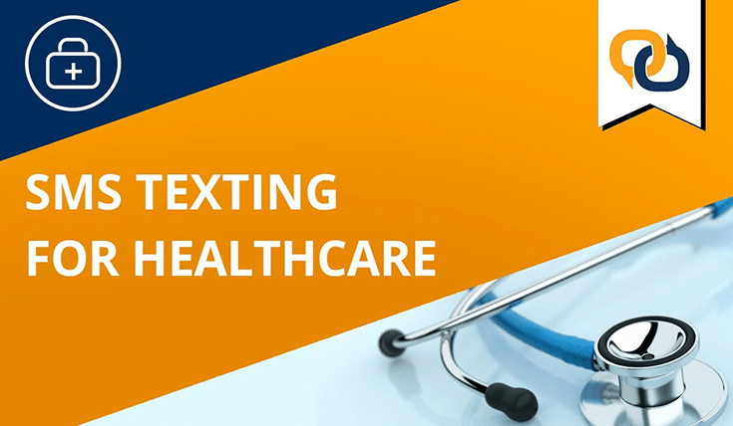
Practical example of the skill in health and social care
There are various methods of communication used in the healthcare setting.
Organisations like nhs uses texts and email for the purpose of communicating with their patients when they are discharged to keep updated with patient’s health (nhs, 2023)
Besides texts and emails, appointment letters, surveys and interactive messages are also used by the NHS to communicate and understand the patient's point of view.
Notes:
Communication is an important aspect of healthcare and it can be understood by the fact that the efficiency of almost every aspect of healthcare depends on effective communication between the various parties involved.

Slide 7

Conclusion
From the following presentation, it can be understood that communication forms a huge part of the efficiency in healthcare.
It is also understood that the practical means of communication in social and healthcare have evolved into emails and messages.
Notes:
The Johari window model can be used by the training managers for the purpose of developing communication skills among the staff.

Slide 8
References
Arnold, E.C. And boggs, K.U., (2019). ‘Interpersonal relationships e-book: professional communication skills for nurses’. Elsevier health sciences. Available at: https://books.Google.Com/books?Hl=en&lr=&id=xc2gdwaaqbaj&oi=fnd&pg=pp1&dq=communication+skill&ots=nqyn5zzkqr&sig=eukbb-jvqmfczpesziwtxf4s9fw
Baby, M., Gale, C. And swain, N., (2018). ‘Communication skills training in the management of patient aggression and violence in healthcare’. Aggression and violent behavior, 39, pp.67-82. Available at: https://doi.Org/10.1016/j.Avb.2018.02.004
Koca, g.Ş. And erigüç, G., (2020). ‘The effects of communication skills levels of health professionals on the dimensions of the johari window model’. International journal of healthcare management, 13(sup1), pp.434-446. Available at: https://doi.Org/10.1080/20479700.2019.1596393
Nhs, (2023). ‘NHS england - transformation directorate’. Available at:
Https://transform.England.Nhs.Uk/information-governance/guidance/email-and-text-message-communications/#:~:text=organisations%20are%20increasingly%20using%20digital,do%20i%20need%20to%20know%3f [accessed on 08th march 2023].

