Slide 1
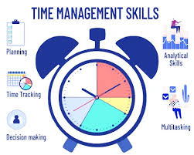
Academic Skills for the Digital Era (BMSW4013)
Evidence of Learning (E-Portfolio)
Component 3 (Individual Presentation)

Slide 2
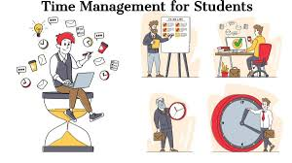
Introduction
As the rise of flexible learning structures and digital tools is evident in the modern higher education context, it has become imperative for students to manage their time efficiently (Stern, 2019).
Based on such context, this presentation aims to explore the importance of time management and offer strategies for students to improve this essential skill, especially with the rise of digital tools.

Slide 3
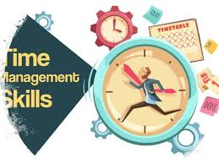
Ways time management contributes to student success
Time management assists in maximising focus and effective prioritisation of tasks for students in terms of their studies and assignments (McMillan, 2021).
In addition, time management can avoid last-minute cramming of students, reducing stress in terms of academic workload.
Students can dedicate more time to preparing for exams, studying as well as completing assignments in the scheduled timeline, resulting in better academic grades.
Time management can result in a balanced lifestyle and improved productivity as students can break down tasks into more manageable steps that allow them to encompass different activities such as interests and extracurricular activities, without forgoing academic commitments that increase productivity (Stern, 2019).

Slide 4

Common challenges students face in managing their time efficiently
Especially in the modern learning environment, the student faces several challenges in managing their time efficiently that affect their academic and personal growth.
Students often struggle to complete or start their tasks in the scheduled time which results in increased stress or procrastination (BBC, 2019).
In addition, digital distractions such as online games and social media further affect productivity and focus on students, resulting in inefficient management of time.
Likewise, CIPD (2022) pointed out that students without a clear schedule and prioritisation of tasks struggle to stay on track, leading to an increased workload. This indicates a lack of ability to distinguish urgent as well as important tasks that result in unfinished work or missed deadlines.

Slide 5
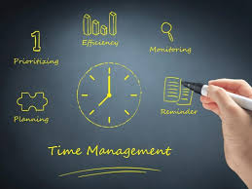
Practical strategies or tools that can help improve time management
Digital tools such as Todoist and Trello can be used by students to manage and schedule tasks which leads to efficient management of time due to increased focus and productivity (Stern, 2019).
Time management techniques such as to-do lists or Eisenhower Matrix can help students to prioritise tasks efficiently in terms of urgency as well as importance.
On the other hand, students can also utilise digital or physical planners for scheduling their study time, appointment, extracurricular activities as well as deadlines. This can assist in accomplishing each task in a timely manner.
However, McMillan (2021) suggested that it is important to set realistic goals while using time management strategies or tools as unrealistic goals can directly result in increased burnout and stress for students.

Slide 6
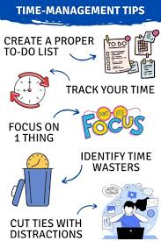
Conclusion
In conclusion, it can be stated that time management is a crucial skill that students require in modern academic settings to achieve growth and success.
However, by leveraging relevant practical strategies or tools, students can address the challenges of efficient time management.

Slide 7
References
BBC. (2019). Time management - Planning and organisation - WBQ National: Foundation KS4 Revision - BBC Bitesize [Online]. WBQ National: Foundation KS4 Revision. Available at: https://www.bbc.co.uk/bitesize/guides/z2yxtyc/revision/8 (Accessed: 6 June 2025).
CIPD. (2022). CIPD | How to Study Effectively [Online]. CIPD. Available at: https://www.cipd.org/en/learning/support-for-students/currently-studying/effective-study/ (Accessed: 6 June 2025).
McMillan, K. (2021). The study skills book: your essential guide to university success 4 th edn. Pearson.
Stern, S. (2019). We all need to get better at time management [Online]. Available at: https://www.peoplemanagement.co.uk/article/1743880/we-all-need-get-better-time-management (Accessed: 6 June 2025).

