Slide 1

Leadership in sports
By Sharnelle Saint

Slide 2
Aims and structure
Structure
Leadership theories
Practical challenge
Evaluation
Key findings
Final perspective
Concluding statement
Aims
The aim of this presentation is to explore existing leadership theories and then analyse them.
The second aim for this presentation is to focus on a challenge faced by leaders in a sports environment.
My final aim for this presentation is to analyse the strengths, weakness and relevance of the theories and challenges in the sporting area.

Slide 3

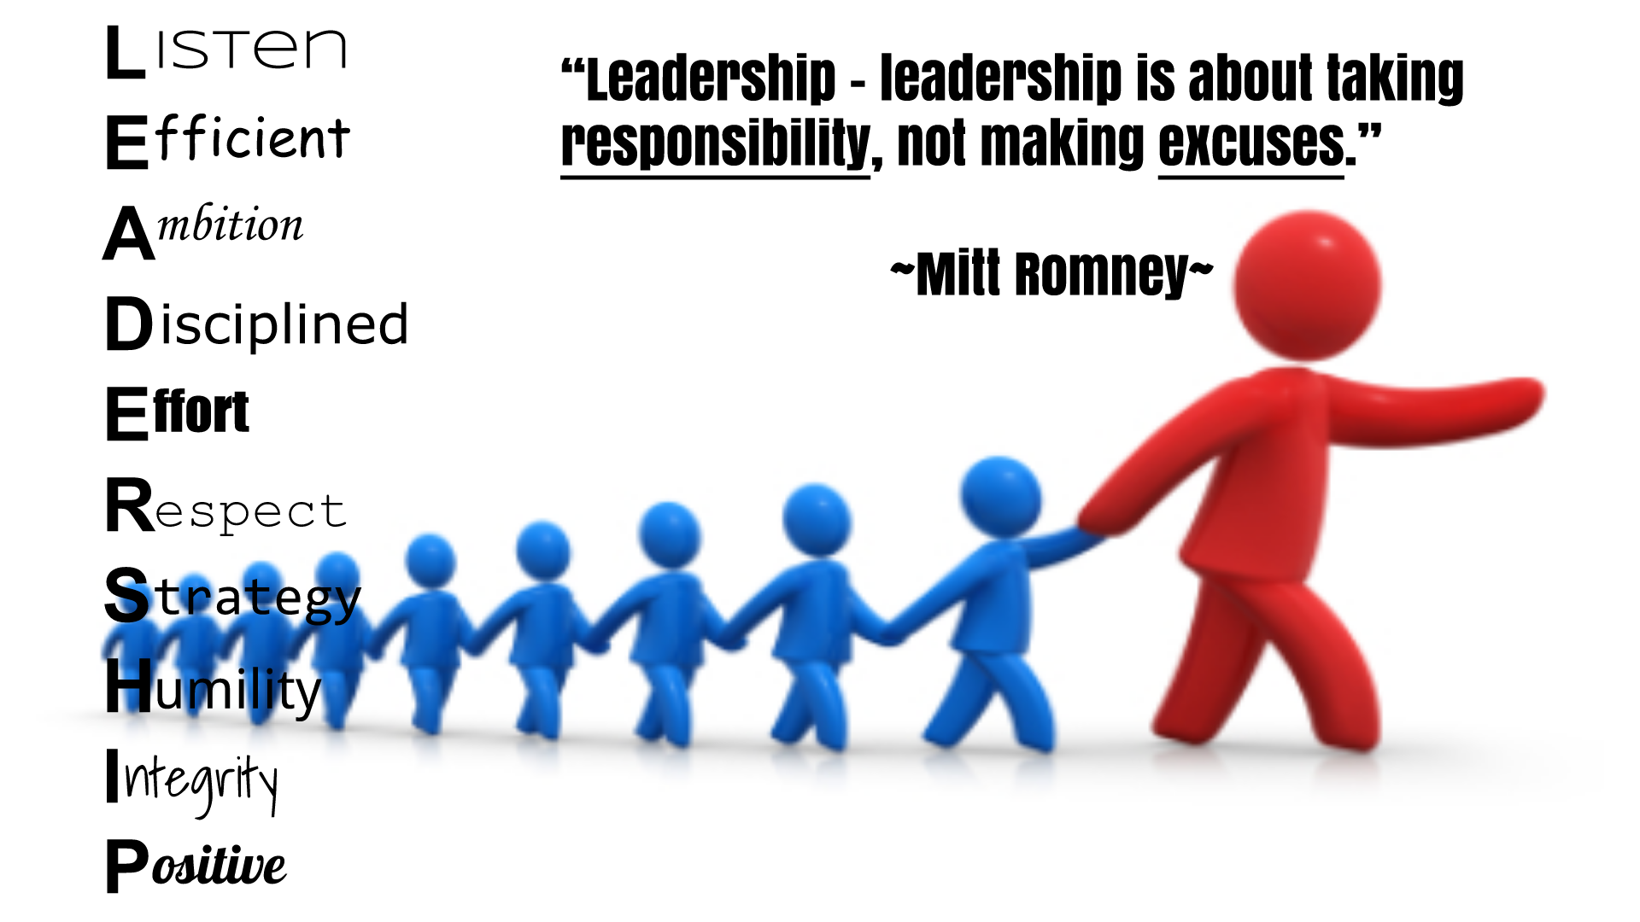
Definition of leadership in sports context
"Guiding players to perform their best, regardless of the sport , by encouraging practice, skill development, and performing well under pressure." (Indeed)
"An individual who holds a formal or informal leadership role within a team and influences other group members in the pursuit of common objectives." (iresearchnet)
"Leadership in sports organisations goes beyond giving orders or making game-time decisions. It is about guiding a team toward a shared vision, fostering a positive culture among each team member, and encouraging individuals to perform at their best while working together. Whether leading a team to victory or managing an entire organisation, sports leaders must be able to motivate, inspire, and create an environment that allows athletes and staff to thrive. This kind of environment can lead to success when it is time to perform" (The University of Kansas)

Slide 4
Leadership theories
Situational theory:
The situational theory emphasizes the fact that effective leadership solely depends on the situation. This requires leaders/coaches to adjust their style to match the teams maturity and specific task requirements.
Personally I think that the situational theory highlights the importance of flexibility, adaptability and a deep understanding of the team and task in achieving effective leadership.
Behavioural theory
The behavioral theory of leadership suggests that a leader’s actions are more important than their traits. It says that leadership can be learned and developed through practice, focusing on what you do rather than who you are.
From my point of view I believe that the behavioral theory offers a valuable perspective on leadership by emphasizing the importance of learned behaviors. While it has limitations, its focus on practical application and development. It encourages us to look at what leaders do and how they can improve, rather than focusing on individual players in the team.

Slide 5
Leadership Theories
Relational theory:
Relational Leadership theories focus is on togetherness and can draw attention to the differences between agency and participation rather than focusing on individual participation.
In my opinion I believe that relational leadership stresses the importance of creating shared meanings, encourage empathy to others and to build trust within a team.
Trait theory:
Unlike the "Great man" theory, which suggests leaders are born, the trait theory focuses on the idea that leadership qualities (physical, mental and social) can be learned and enhanced for bigger success
I believe that overall the trait theory communicates the importance of enhancing your own skills and not following others into what they think is good leadership skills. I.e Like Mohandas Gandhi, Abraham Lincoln, Moses, Joan of Arc Etc.

Slide 6
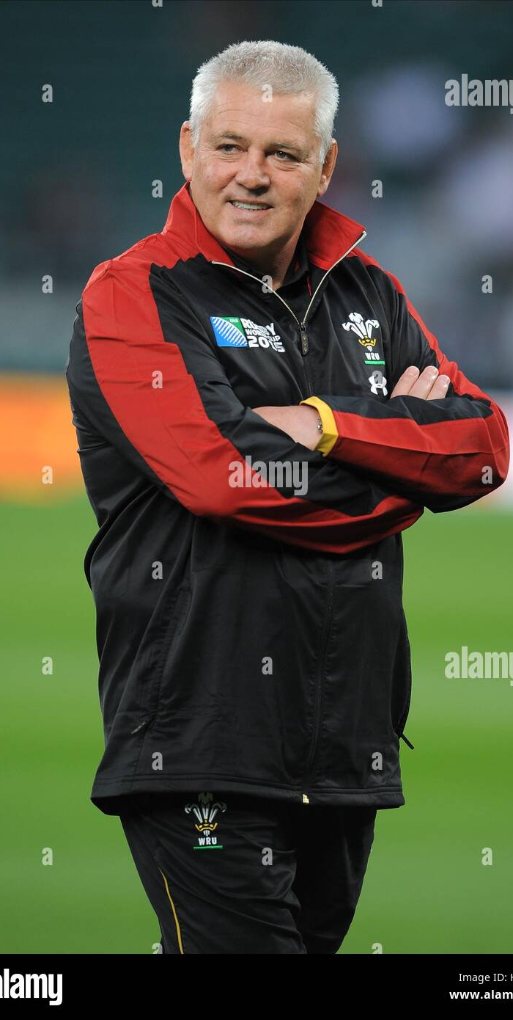
Practical challenges
Warren Gatland had a brand new team at the begging of the season. The players had to learn how to cooperate and comprehend on anothers ability levels, which made this difficult. To succeed, they had to put aside their disagreements, devlop mutual trust, and adjust to the playing styles of the more seasoned players, some of whom had been on the club longer and others of whom had greater communication skills.
Gatland started coaching this new team in 2023 (rugbyworld)

Slide 7
Evaluation
Weaknesses of situational and behavioural leadership theories:
Situational weaknesses: one weakness is the effectiveness of situational leadership heavily relies on the leader’s/coaches ability to accurately read situations and change accordingly in case of emergency or sudden change. Incorrect assessment of employee readiness or situational requirements can lead to the application of an inappropriate leadership style.
Behavioural weaknesses: one main weakness is that just because people learn the practices and behaviours does not mean they will be able to input the theory into their leading and or coaching properly. It is easy to learn why or how to do these behaviours, but knowing when to behave one way or another, and becoming "expert" in these behaviours is a far more challenging task.
Strengths of situational and behavioural leadership theories:
Situational Strengths: It can help to build the confidence of the coach and how they coach their team. Another one is that it can encourage teamwork and reduce the "cliques" that are normally found in big groups like teams.
Behavioural Strengths: Behavioural Theory encourages the idea that leadership traits can be learned through development and experience. This steps away from the “Great Man” Theory by arguing that leaders can be made, and are not necessarily born with traits. Second, this new idea that leaders can be made has allowed more recent leadership theory research that is based on developing the leaders to produce intended results

Slide 8
Evaluation
Strengths of Relational and Trait leadership Theories:
Relational leadership: It drives team collaboration through open communication and respect. Another strength that can occur from Relational leadership is by focusing on both relationships and shared interests, relational leaders effectively guide teams through disagreements.
Trait leadership: It provides a means to evaluate an individual's leadership characteristics. Another strength is that It provides insights into the leader element in the leadership process.
Weaknesses of relational and trait leadership Theories:
One weakness for relational leadership is that there is a Potential for favoritism and bias between the team. Another weakness for this is Overemphasis on relationships in the workplace can lead to various negative organizational outcomes.
Trait leadership weaknesses: Much of the Trait Theory research fails to look at how specific traits influence leadership outcomes such as performance, productivity, and employee satisfaction. Another weakness is that It’s leader-centric, and only focuses on the leader not the follower or the situation.

Slide 9
Key findings
Practical challenges are hard to overcome, some professional coaches may not be able to overcome some challenges that are in their way of success.
The theories encourage coaches to be more successful in their careers.
However, where the theories are not sully adapted, they can cause issues in how they coach or train their teams.
Some of the theories help the team build on their communication skills.

Slide 10
Final perspective
If the theories were fully adapted, it would help with leadership more. As they are not fully adapted they do not present everything that would make leadership fully successful.
Leadership in sport is important, as a leader is needed for most things so everything is to run smoothly and be successful otherwise nothing would go to plan and nothing would be successful.
The advice I would give to a sports leader would be to express how important communication is throughout the team, empathis with the players, and listen to all the players when they need you to listen to them.

Slide 11
Concluding statement
Leadership in sport is important no matter what sport is taking place. This is because in order to have a successful team, they need to have a successful leader, for example, if a leader has good communication skills then it would transfer over to the players, this would happen with many skills they can be transferable to the players off the leader that would be leading them.
Coaches may find it challenging to succeed due to practical issues, and some may find it tough to get past these barriers. By offering helpful tactics and methods, coaching theories can direct coaches and increase their chances of success. However, these theories may cause issues with how coaches manage or train their players if they are not thoroughly understoodor trailed to the demands of the squad. All things considered, when properly implemented, these ideas can assist teams in enhancing critical abilities like cooperation and communication, which are critical for success.

Slide 12
References
Sport Leadership Types You Can Implement (With Definition) | Indeed.com Canada
Sport Leadership - IResearchNet
The Behavioral Theory of Leadership
https://www.managementstudyguide.com/trait-theory-of-leadership.htm
Behavioral Theory: Strengths, Weaknesses, and Current Theorists | LEAD 550 / 600 Traits and Behaviors
Relational Leadership: Definition & Examples | HR Glossary - AIHR
» Trait Theory of Leadership – Advantages and its Limitations
Trait Theory: Strengths, Weaknesses, & Theorists | LEAD 550 / 600 Traits and Behaviors
https://onlinesportmanagement.ku.edu/community/leadership-and-management-in-sports
https://www.rugbyworld.com/countries/wales-countries/warren-gatland-appoints-new-wales-attack-and-defence-coaches-149147

Slide 13

Thank you for your time listening and questions

