Slide 1
Dollar Street

Slide 2
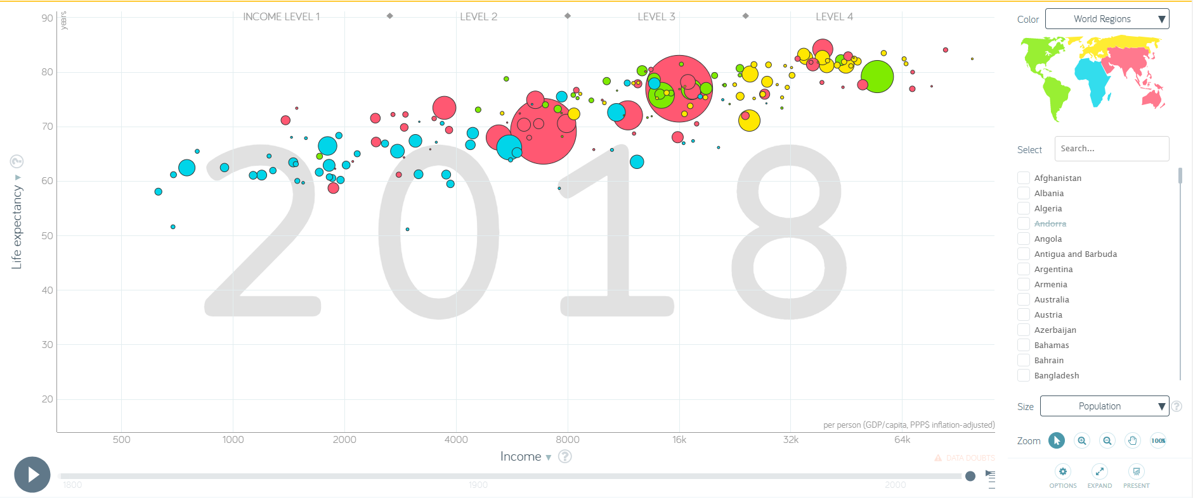

Slide 3
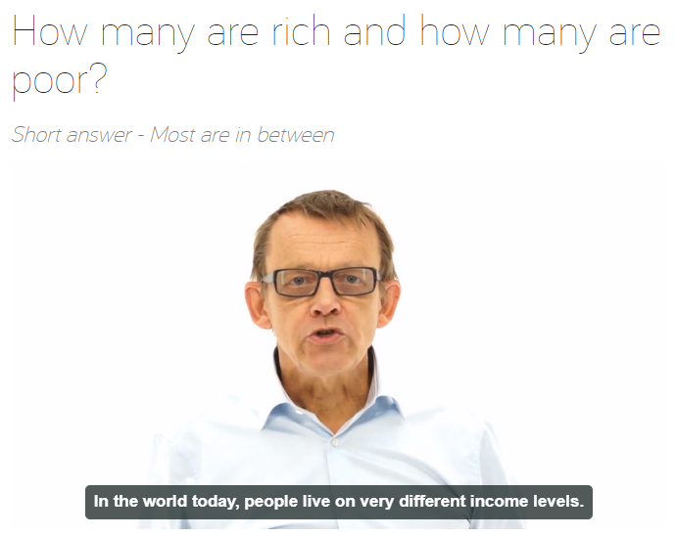
Meet the late Prof. Hans Rosling

Slide 4

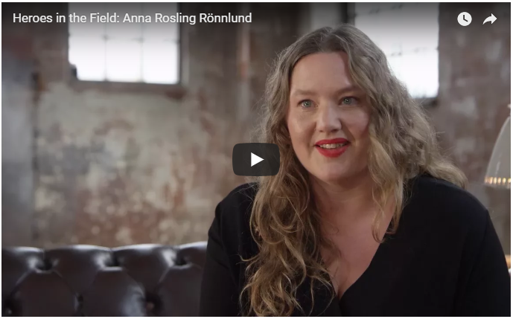
https://youtu.be/ndV1lm97398

Slide 5


