Slide 1

GIBBS SELF REFELCTIVE CYCLE
BMPL4007 sadie france

Slide 2
Gibbs reflective model- TASK
What is his model used for?
How many stages does his model have?
Name the stages of the reflective model

Slide 3
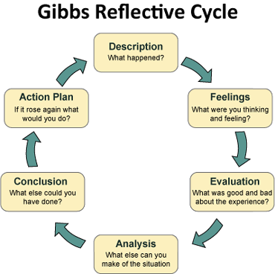
Gibbs self- reflection
https://youtu.be/-gbczr0lRf4

Slide 4

Example of Gibbs self-reflection
Description
For an assessed written group-work assignment, my group (3 others from my course) and I decided to divide the different sections between us so that we only had to research one element each. We expected we could just piece the assignment together in the afternoon the day before the deadline, meaning that we didn’t have to schedule time to sit and write it together. However, when we sat down it was clear the sections weren’t written in the same writing style. We therefore had to rewrite most of the assignment to make it a coherent piece of work. We had given ourselves enough time before the deadline to individually write our own sections, however we did not plan a great deal of time to rewrite if something were to go wrong. Therefore, two members of the group had to drop their plans that evening so the assignment would be finished in time for the deadline.

Slide 5

Feelings
Before we came together and realised we still had a lot of work to do, I was quite happy and thought we had been smart when we divided the work between us. When we realised we couldn’t hand in the assignment like it was, I got quite frustrated. I was certain it was going to work, and therefore I had little motivation to actually do the rewriting. Given that a couple of people from the group had to cancel their plans I ended up feeling quite guilty, which actually helped me to work harder in the evening and get the work done faster. Looking back, I’m feeling satisfied that we decided to put in the work.

Slide 6

Evaluation
The things that were good and worked well was the fact that each group member produced good quality work for the agreed deadline. Moreover, the fact that two people from the group cancelled plans motivated us to work harder in the evening. That contributed positively to the group’s work ethic. The things that clearly didn’t work was that we assumed we wrote in the same way, and therefore the overall time plan of the group failed.

Slide 7

Analysis
I think the reason that our initial division of work went well was because each person had a say in what part of the assignment they wanted to work on, and we divided according to people’s self-identified strengths. I have experienced working this way before and discovered when I’m working by myself I enjoy working in areas that match my strengths. It seems natural to me that this is also the case in groups. I think we thought that this approach would save us time when piecing together the sections in the end, and therefore we didn’t think it through. In reality, it ended up costing us far more time than expected and we also had to stress and rush through the rewrite. I think the fact we hadn’t planned how we were writing and structuring the sections led us to this situation.

Slide 8
I searched through some literature on group work and found two things that help me understand the situation. Belbin’s (e.g. 2010) team roles suggests that each person has certain strengths and weaknesses they bring to a group. While we didn’t think about our team members in the same way Belbin does, effective team work and work delegation seems to come from using people’s different strengths, which we did.
Another theory that might help explain why we didn’t predict the plan wouldn’t work is ‘Groupthink’ (e.g. Janis, 1991). Groupthink is where people in a group won’t raise different opinions to a dominant opinion or decision, because they don’t want to seem like an outsider. I think if we had challenged our assumptions about our plan - by actually being critical, we would probably have foreseen that it wouldn’t work. Some characteristics of groupthink that were in our group were: ‘collective rationalisation’ – we kept telling each other that it would work; and probably ‘illusion of invulnerability’ – we are all good students, so of course we couldn’t do anything wrong.
I think being aware of groupthink in the future will be helpful in group work, when trying to make decisions.

Slide 9

Conclusion
I learned that when a group wants to divide work, we must plan how we want each section to look and feel – having done this would likely have made it possible to put the sections together and submit without much or any rewriting. Moreover, I will continue to have people self-identify their strengths and possibly even suggest using the ‘Belbin team roles’-framework with longer projects. Lastly, I learned that we sometimes have to challenge the decisions we seem to agree on in the group to ensure that we are not agreeing just because of groupthink.

Slide 10

Action Plan
When I’m working with a group next time, I will talk to them about what strengths they have. This is easy to do and remember in a first meeting, and also potentially works as an ice-breaker if we don’t know each other well. Next, if we decide to divide work, I will insist that we plan out what we expect from it beforehand. Potentially I would suggest writing the introduction or first section together first, so that we have a reference for when we are writing our own parts. I’m confident this current experience will be enough to remind me to suggest this if anyone says we should divide up the work in the future. Lastly, I will ask if we can challenge our initial decisions so that we are confident we are making informed decisions to avoid groupthink. If I have any concerns, I will tell the group. I think by remembering I want the best result possible will make me be able to disagree even when it feels uncomfortable.

Slide 11
Assignment 2- part 2
2.​ | Produce a Personal Development Plan (PDP) using the template provided, to outline how you intend to address the gaps in your skills which you identified in your reflection, and how these will contribute to your future aspirations. The plan should be in the region of 750 words, and you should reference appropriate sources to support your work. Your plan should demonstrate the application of SMART objectives to the development goals you set.​

Slide 12
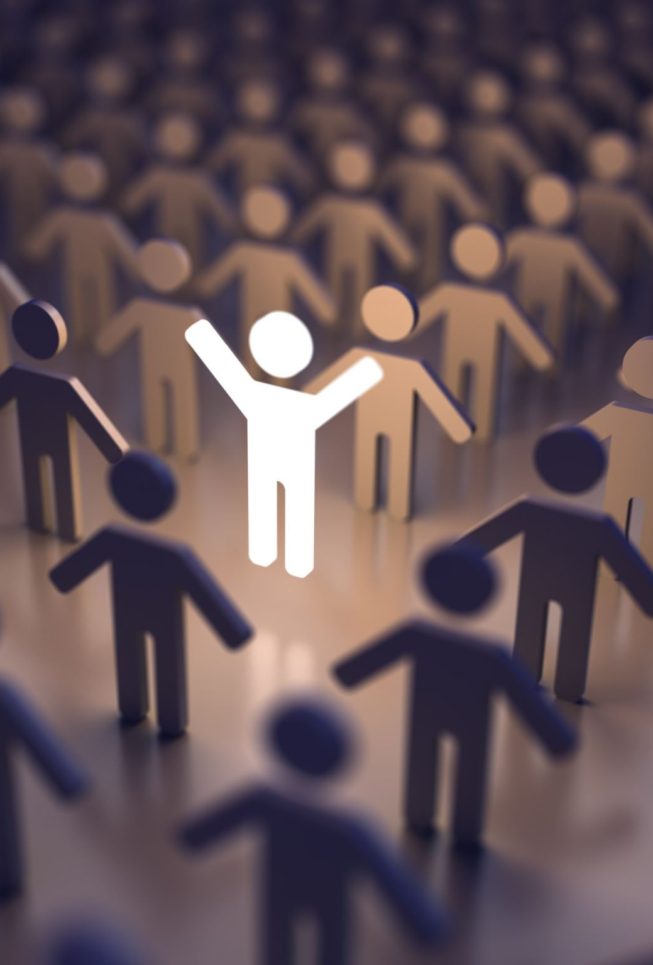
Benefits to a PDP
provides you with clear goals.
helps you to identify your strengths and weaknesses.
improves your employability.
improves your performance.
increases your motivation.
helps track your progress.
improves your sense of purpose.
enhances your mental wellbeing and reduces stress.

Slide 13
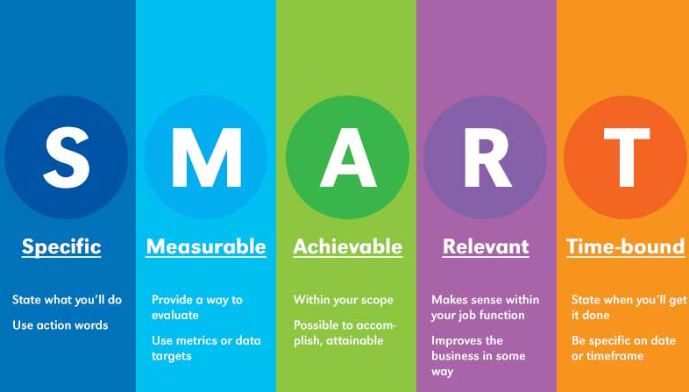

Slide 14
Example of SMART
SMART goal for running a marathon
Specific: I’d like to start training every day to run a marathon.
Measurable: I will use my Apple Watch to track my training progress as my mileage increases.
Attainable: I’ve already run a half-marathon this year, so I have a solid base-fitness level.
Relevant: I value my health and wellness, and this goal will help me sustain that.
Time-bound: The marathon is a year away, so I need to be ready by then.
(Wool, 2022)

Slide 15
Example of SMART
SMART goal for writing a book
Specific: I’d like to write a novel.
Measurable: I want to write at least 2,000 words a day for three months.
Attainable: I’m retired now, so I have more time to dedicate to this project.
Relevant: Reading and writing have always been a passion of mine.
Time-bound: I’ll start writing in the first week of July and finish my first draft by December.
(Wool, 2022)

Slide 16
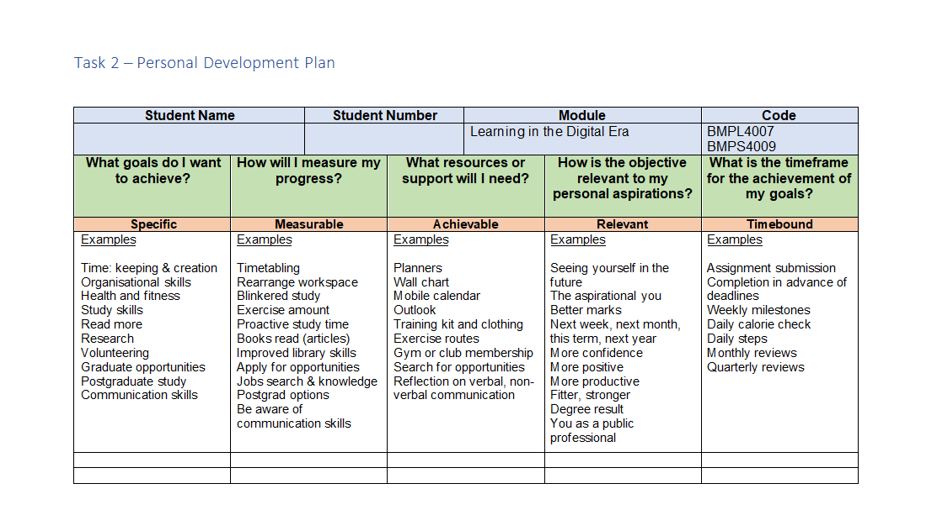
PPD (Personal Development Plan)

Slide 17


