Slide 1

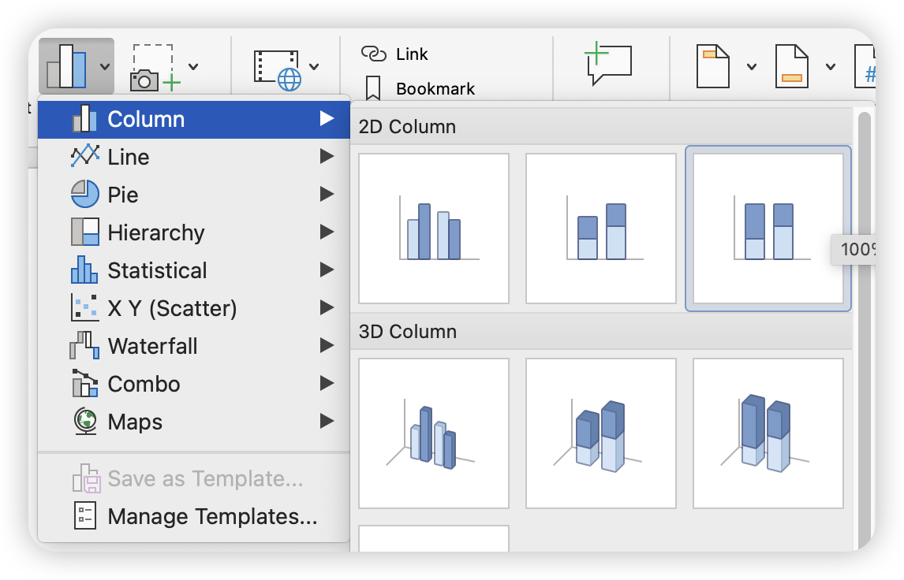
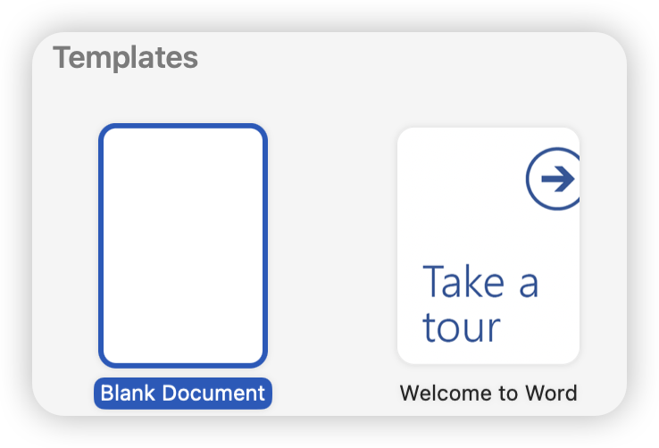
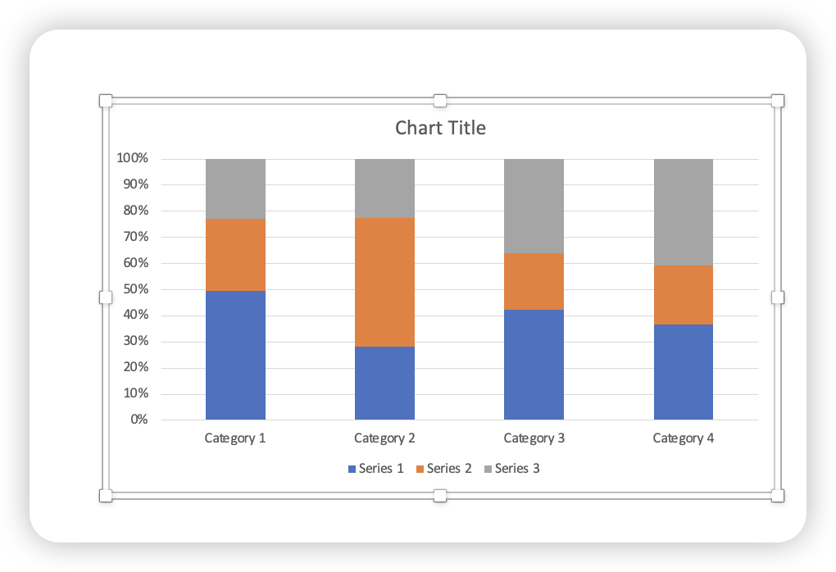
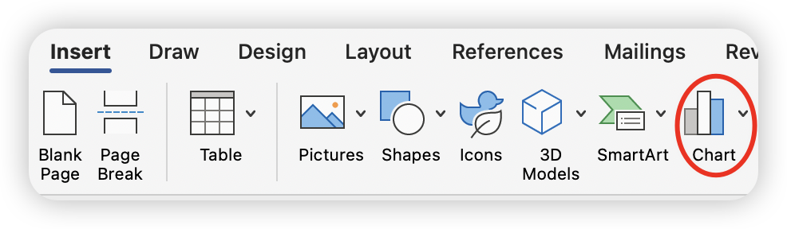
Mariia Stupnitska
Group 4
Student ID:2429769
How to create charts in Microsoft Word
1. Chose option “blank document” to create new document.
3.Select column chart view among the submitted options.
4. The result will be look like this and then you can edit this column in Excel depending on the data i have.
2. Select the chart option in the insert tab to create a chart

