Slide 1
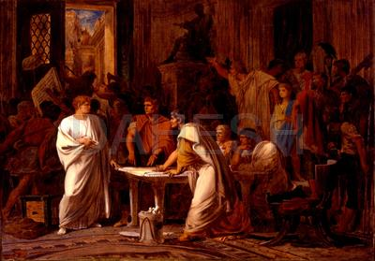
Julius Caesar and His TImes
Unit 1 – The slow and by no means inevitable rise of Gaius Julius Caesar
CLAH7002

Slide 2
Welcome to the Module
Unit 1: The slow and by no means inevitable rise of Gaius Julius Caesar
Unit 2: Getting one’s hands dirty, or: Caesar and Catiline
Unit 3: The First Triumvirate
Unit 4: Caesar in Gaul
Unit 5: Caesar as a writer
Unit 6: Talking to Rome
Unit 7: Before the Rubicon
Unit 8: In the thick of the Civil War
Unit 9: After Pharsalus: Building a Mediterranean Empire
Unit 10: Caesar’s Monarchy

Slide 3
Assessments and the Forum
Everybody:
5,000 word essay on a topic of your choice, relating to the module. You must get approval for question with me before proceeding.
Deadline is the 17th January 2020.
Distance Students:
distance students should write a 1,000 word post and put it on the discussion forum, as well as writing a suitably lengthy reply to the post of another distance student. The idea this that your post will be related to one of the focus questions given in one of the ten units. However, you can be broad and flexible in your response to / engagement with these questions.

Slide 4
Approaching the Module
Units have links to articles in the library catalogue / on JSTOR and the occasional library scan of a chapter.
  I have checked the links so in theory they should all functioning, however, if you do come across a non-functional one let me know.
Students should try to do some at least of the reading for each of the units.
I will try to provide short 5 to 15 minute overviews of the themes and material covered in a unit.

Slide 5
The slow and by no means inevitable rise of Gaius Julius Caesar

Slide 6
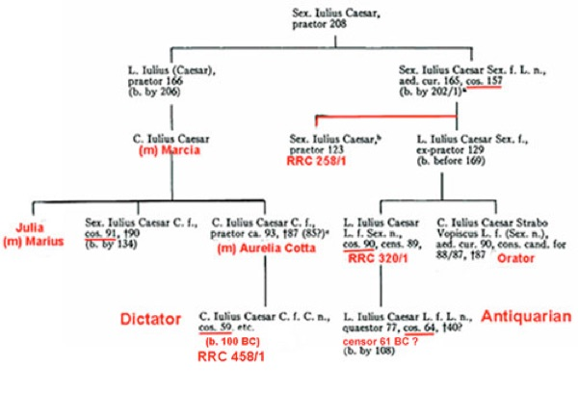
Birth and Ancestry
Julius Caesar was born on 12th/13th July 100 BC.
Caesar senior died in 85 BC when his son was still a teenager.
Connections with the Marian factor on his father’s side, but also with the Sullan faction on his mother’s side (Aurelia Cotta).

Slide 7
“Therefore besides being punished by the loss of his priesthood, a his wife's [Cornelia] dowry, and his family inheritances, Caesar was held to be one of the opposite party. He was accordingly forced to go into hiding, and though suffering from a severe attack of quartan ague, to change from one covert to another almost every night, and save himself from Sulla's detectives by bribes. But at last, through the good offices of the Vestal virgins and of his near kinsmen, Mamercus Aemilius and Aurelius Cotta, he obtained forgiveness.” – Suetonius Divus Caesar 1.2.

Slide 8
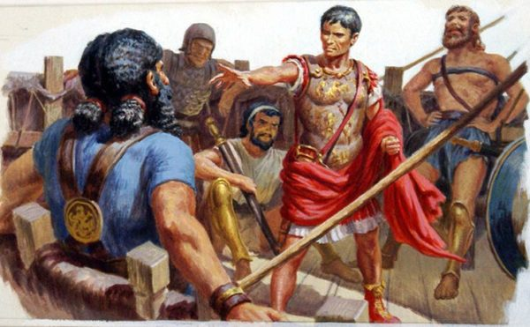
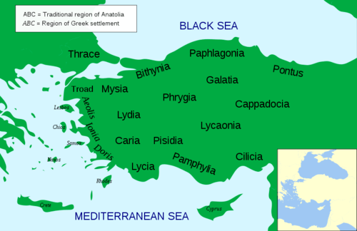
Caesar’s Early Career
On the staff of the propraetor of Asia, M. Minucius Thermus.
77 BC – one of the “prosecutors” of Cn. Cornelius Dolabella and C. Antonius (charged with extortion and embezzlement in Greece).
Went to develop his rhetorical skills in Rhodes with the orator Molon.
Caesar captured by pirates.
Rallying troops in Asia Minor to fight against Mithridates.

Slide 9
Back in Rome
Death of the pontiff C. Cotta in 74 BC open up the position for Caesar to be co-opted into the religious college.
  Implications later in the 60s when the holder of the office of Pontifex Maximus dies.
Caesar took steps to associate himself with Pompey – support for reforms of 70 BC – support for motion of A. Gabinius (67) – and for Manilian law (66) – backed a bill to propose honours for Pompey (63).

