Slide 1

Childrens Rights
Children and young people have 42 rights under the United Nations Convention on the Rights of the child (UNCRC). These rights help support and protect young people and give them what they need to grow up safely, healthily and happily. In 2011 Wales become the first country in the UK to make the UNCRC part of its domestic law. Children’s rights include the right to health, education, family life, play and recreation, an adequate standard of living and to be protected from abuse and harm. Children’s rights cover their developmental and age-appropriate needs that change over time as a child grows up.
(Childrens Rights Alliance)

Slide 2

Clwych 2004
The Clywch inquiry, led by the Children's Commissioner for Wales, Peter Clarke, was set up in the wake of Owen's suicide in October 2001 while he was awaiting trial for sexually abusing boys in his care. Peter Clarke was appointed Wales’ first Children’s Commissioner in March 2001. Much of his time since taking up his post has been spent listening to children and young people and finding out more about their expectations of his role. His office has also handled a large number of individual cases arising through contacts made with his office by children, young people or their parents
- Children In Wales

Slide 3
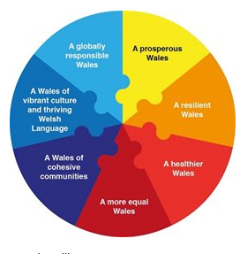
7 Core Aims
1. have developed a flying start in life and the best possible basis for their future growth and development
2. have access to a comprehensive range of education, training and learning opportunities, including acquisition of essential personal and social skills
3. enjoy the best possible physical and mental, social and emotional health, including freedom from abuse, victimisation and exploitation
4. have access to play, leisure, sporting and cultural activities
5. children are listened to, treated with respect, and are able to have their race and cultural identity recognised
6. have a safe home and a community that supports physical and emotional wellbeing
7. is not disadvantaged by child poverty
- (Play Wales)

Slide 4
References
https://www.playwales.org.uk/eng/sevencoreaims
www.childreninwales.org
Childrensrights.ie
www.newport.gov.uk
www.childcomwales.org.uk

