Slide 1
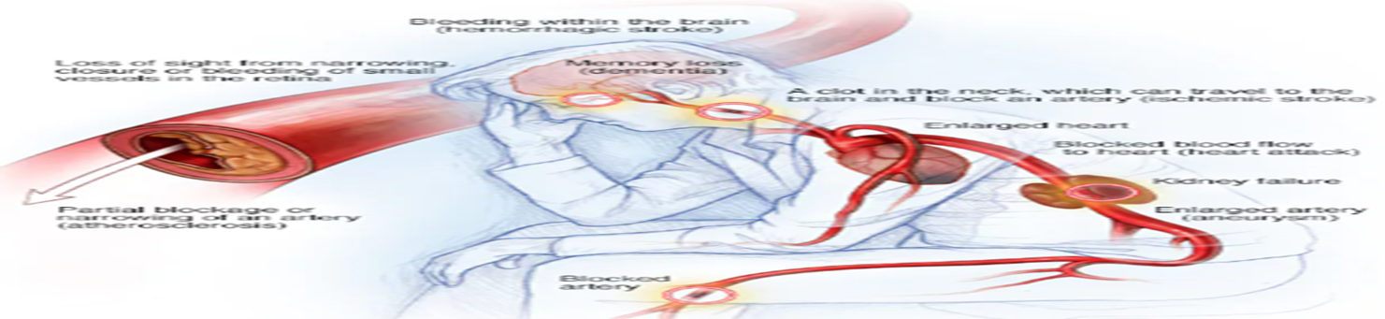
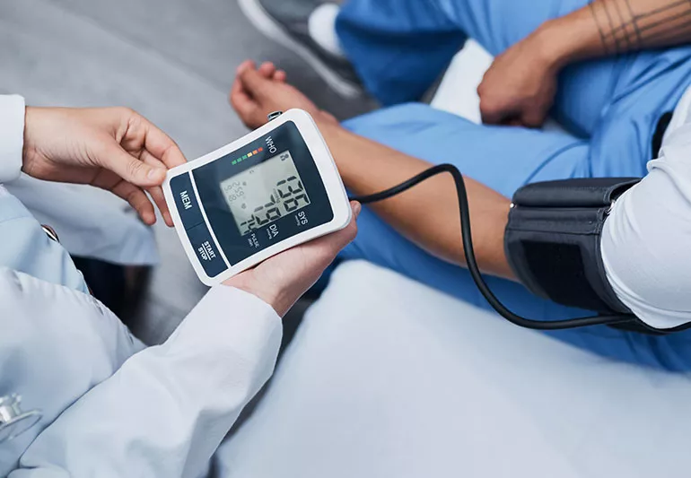
MSC PUBLIC HEALTH AND SOCIAL CARE IN PRACTICE
MODULE CODE AND TITLE: LCHS7003 COMMUNITY CARE AND MANAGEMENT OF LONGER-TERM CONDITIONS
COMPONENT 2
ASSIGNMENT TITLE: Individual Presentation on High Blood Pressure
STUDENT NAME: Vidhi Prajapati
STUDENT NUMBER: 2506527
LECTURER’S NAME: Dr Aishat Bakre
Notes:
Good [morning/afternoon], welcome to my presentation, and today I am going to take you through High Blood Pressure (Hypertension). Risk factors, management, and prevalence of the hypertension condition are the most crucial issues to be discussed in this session. The problems associated with problematic care models, the importance of early detection and treatment, as well as the challenges of patient outcomes, will also be addressed. We will also discuss raising awareness about high blood pressure and its associated health consequences. Our efforts will focus on ensuring that it does not hurt the health system and the people. One can begin reading about the most pressing issues related to hypertension and its impact on the global arena.

Slide 2

Introduction
Hypertension is a persistent elevation of blood pressure and is reportedly present when the clinic data read 140/90 mmHg.
Any systolic blood pressure of 130 mmHg and/or any diastolic blood pressure over 80 mmHg is termed as hypertension (Kidwai et al., 2024).
https://www.welcomecure.com/diseases/high-blood-pressure-hypertension/introduction
Notes:
The blood pressure may be reduced significantly by educating a person about the early changes in lifestyle, including salt intake, weight regulation, and alcohol restrictions. The encouragement of patients to check readings at home, have frequent check-ups, and learn about personal triggers will enable them to be in charge and achieve better long-term results. In case of women menstrual cycle have a significant impact on developing high blood pressure (Mishra et al., 2025).

Slide 3
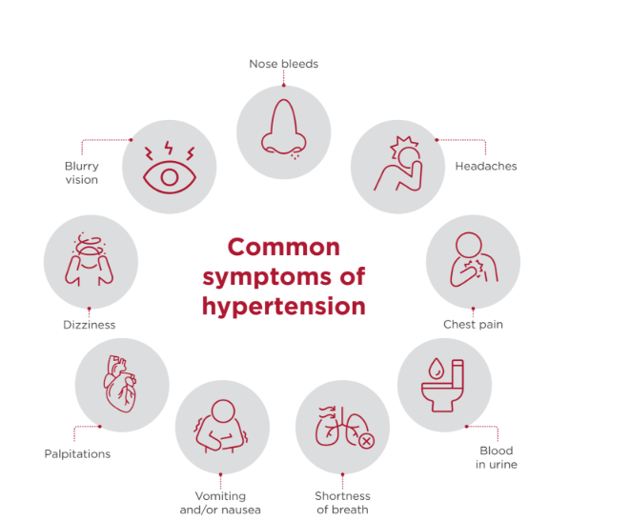
Signs and Symptoms
  Headaches
  Dizziness
  Blurred vision
  Chest discomfort and others
  Nosebleeds
  Shortness of breath.
https://www.wilmingtonhealth.com/blog/maintaining-heart-health-understanding-hypertension-risk/
Notes:
Hypertension or high blood pressure is a disease that does not present any apparent symptoms, and in this case, the only means of early diagnosis and management of the disease is by screening. This is diagnosed by ensuring that the clinic's blood pressure measurements are higher than those confirmed by ambulatory measuring or home monitoring to determine their accuracy. The significant risks of high blood pressure are smoking, diabetes mellitus and lipid metabolic disorders. Such conditions can aggravate hypertension and lead to additional cardiovascular risks and damage to organs (Poznyak et al., 2022). The initiation and proactive management are critical in reducing the impact of hypertension in the long term on the population.

Slide 4
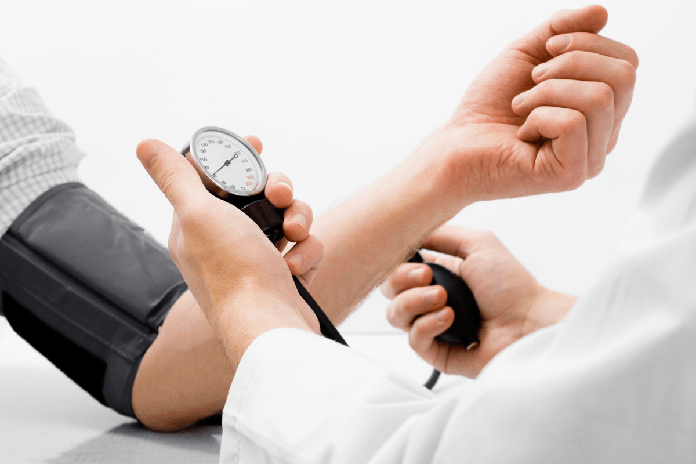
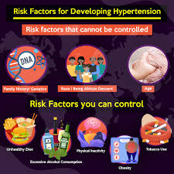
Aetiology (Risk factors)
Aetiology (Modifiable)
  Smoking: Nicotine causes blood vessels to constrict
  Alcohol: It increases the release of stress hormone.
  Obesity: Extra fat increase cardiac workload.
  Inactivity and others: Lack of movement leads to poor heart efficiency.
Aetiology (Non-modifiable)
  Age: Arteries become stiffer with age.
  Genetics: Inherited genes influence salt activity.
  Ethnicity and family history: Men have a high risk of high blood pressure.
https://regencyhealthcare.in/wp-content/uploads/2018/06/1-1200x800.png
(SVG Health, 2020)
Notes:
Poor diet, absence of physical exercise, and alcoholism are some of the significant factors that can influence hypertension or high blood pressure, as well as genetic factors and age. It is one of the most severe health problems, and at the same time, it is something that has been underestimated, with people not seeing the doctor regularly but only when the problem worsens. Regular check-ups must be done as untreated high blood pressure may turn out to be catastrophic to the health of an individual, such as heart ailment, stroke and kidney failure. These risks are to be met through widespread awareness, education and providing more access to healthcare and improving the overall management(Poznyak et al., 2022).

Slide 5
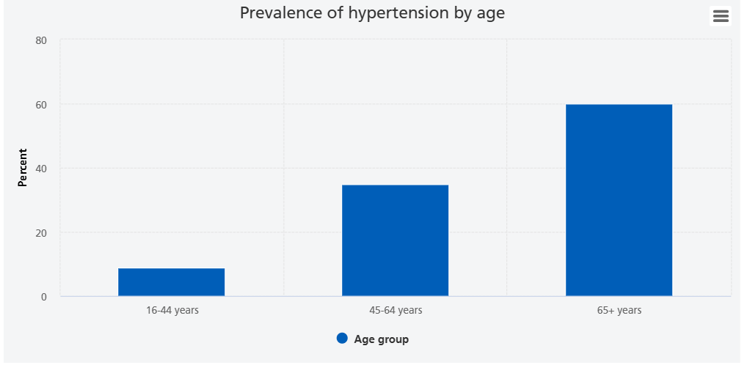
Prevalence of High Blood Pressure in the UK
1 in 4 adults in the UK suffer from high blood pressure.
In 2017, 26.2% of adults aged 16+ in England were diagnosed with hypertension, affecting 11.8 million people (Public Health England, 2017).
Ethnic minorities, particularly South Asians and Black populations, are at higher risk.
Prevalence rates can vary by region, ranging from 16% to 33.8% in different Clinical Commissioning Groups (CCGs).
https://digital.nhs.uk/data-and-information/publications/statistical/health-survey-for-england/2021-part-2/adult-health-hypertension
Notes:
Hypertension (blood pressure) is common in 1 in every four adults in the UK. In the year 2017, the distribution of hypertension diagnosis among adults aged 16 and above in England was 26.2, which is equivalent to 11.8 million adults (Public Health England, 2017). The South Asians and the blacks, especially, force the ethnic minorities on the grounds of genetic issues, lifestyle, and socioeconomic factors. The occurrence of hypertension is also vastly different when it comes to areas because it stands at 16- 33.8 percent in the various Clinical Commissioning Groups (CCGs), which exposes health outcomes disparities in the UK.

Slide 6
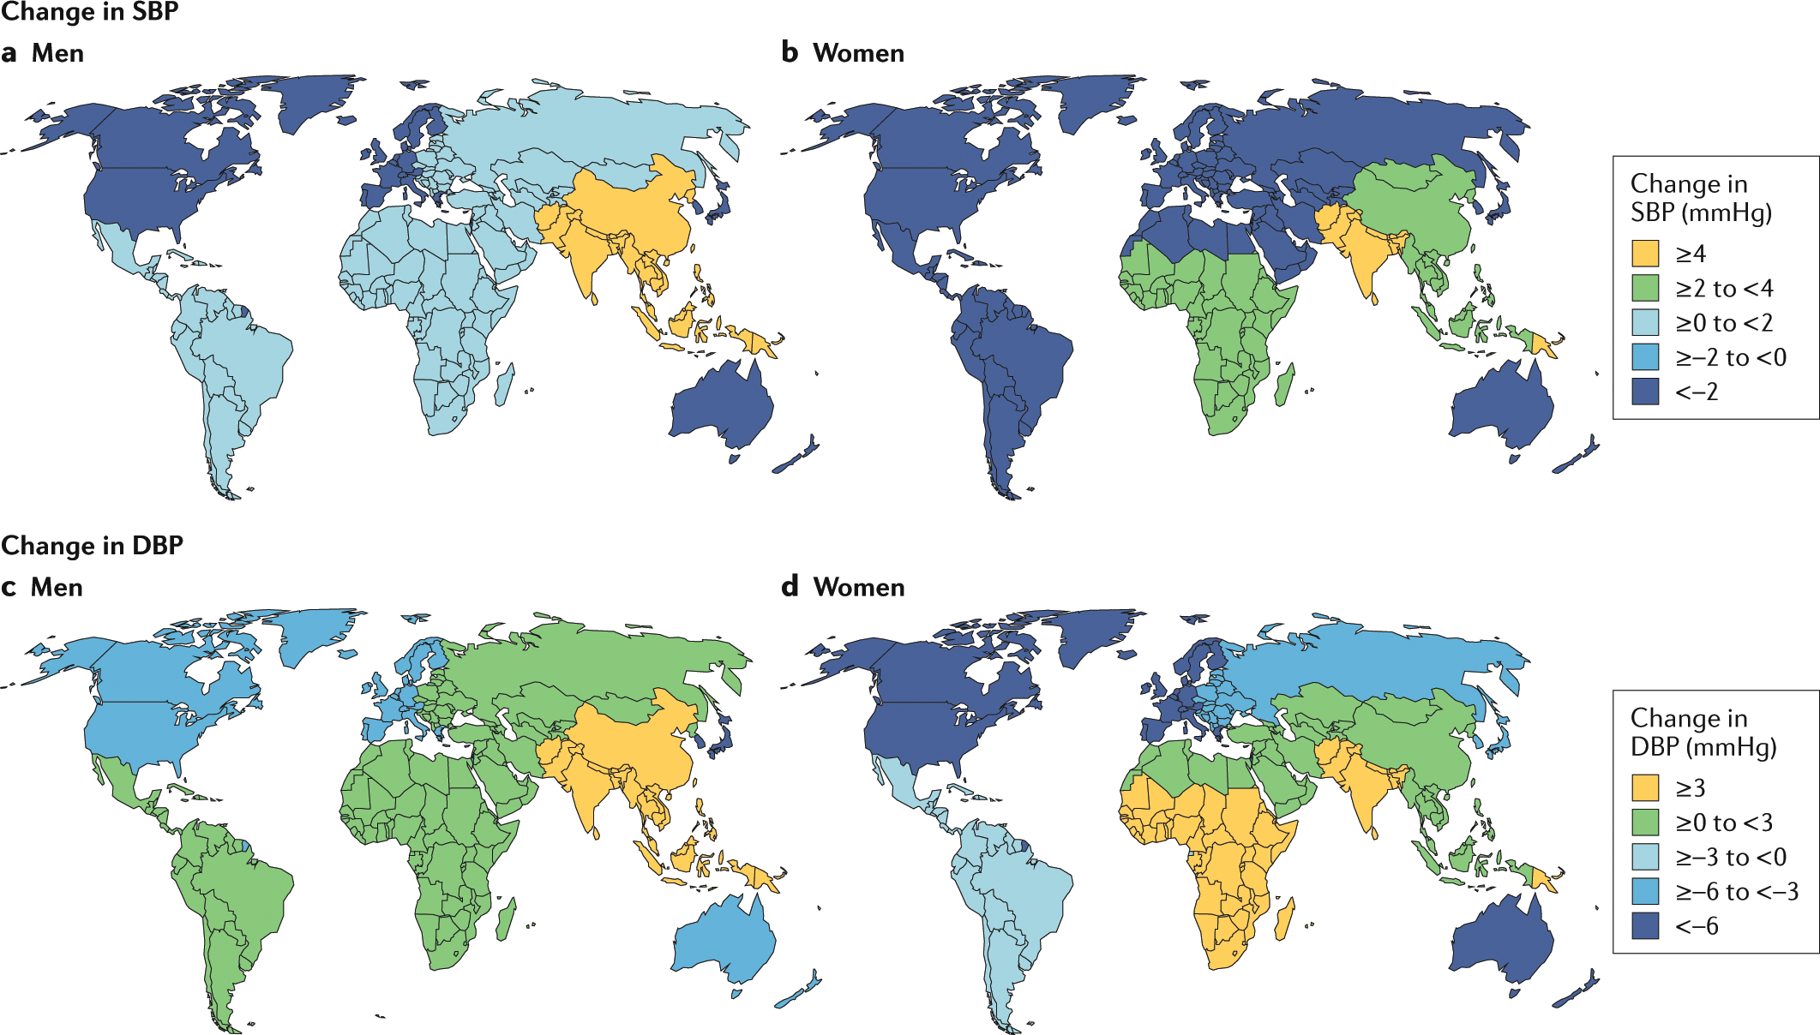
Prevalence of High Blood Pressure worldwide
Around 1.13 billion people globally have high blood pressure (World Health Organization, 2023).
The prevalence of hypertension is rising, especially in low- and middle-income countries.
Higher rates are found in urban areas due to lifestyle changes, poor diet, and lack of physical activity.
Increasing global focus on prevention as part of the World Health Organization's non-communicable diseases (NCDs) strategy.
https://doi.org/10.1038/s41581-019-0244-2
Notes:
It is estimated that there are 1.13 billion victims of high blood pressure in the world (World Health Organization, 2023). It is, in fact, rising, especially in the low and middle-income nations, where the affordability of healthcare and prevention strategies could be restricted. The growth of hypertension has also been caused by urbanization because lifestyle changes like nutritional imbalance and physical inactivity are becoming popular in the urban setting. The prevention and control of high blood pressure have been highlighted by the World Health Organization (WHO) as part of their non-communicable disease(NCDs) strategy of reducing the burden of disease in the world(Li et al., 2023.

Slide 7
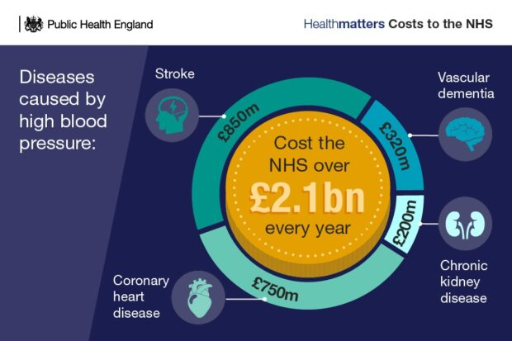
Economics of High Blood Pressure
Massive Economic Cost: Over £10 billion spent annually on diabetes treatment in the UK.
Reduced Quality of Life: Leads to serious complications like heart and kidney disease.
Increased Healthcare Strain: Places heavy demand on hospitals and long-term care services.
Productivity Loss: Results in significant absenteeism and reduced workforce output.
A clinical and economic burden, hypertension continues to increase throughout the globe (Mancia et al., 2023).
https://ukhsa.blog.gov.uk/2021/09/06/blood-pressure-are-your-pipes-in-good-working-order/
Notes:
Hypertension has effects on individual, family and healthcare system health. The complexity of the conditions, such as stroke, increases the cost. The overall economic potential of hypertension (direct and indirect expenses) was US$514,232 (Sorato et al., 2022). Some of the social implications include a lack of independence, burden to the carers and loss of work productivity in general.

Slide 8

Social burden of High Blood Pressure
It reduces the productivity level and increases the absenteeism and disability of workers.
One of the pre-eminent avoidable mortality and disease burden cardiovascular illnesses is high blood pressure (Zhou et al., 2021).
Constant attendance demands and stress of the finances, and the emotional strain it puts on the family.
https://cdn-prod.medicalnewstoday.com/content/images/articles/319/319319/blood-pressure-heart-attack.jpg
Notes:
The long-term conditions, such as hypertension, impose a financial burden not only on the health care systems but also on the family. When individuals get complications like a stroke, they usually take a long leave or need lifelong care services(Zhou et al., 2021). Through enhanced early coaching, lifestyle management, and periodic follow-up, we assist the patients to live independently, lessen the dependency on social care, and enhance the well-being of the community.

Slide 9
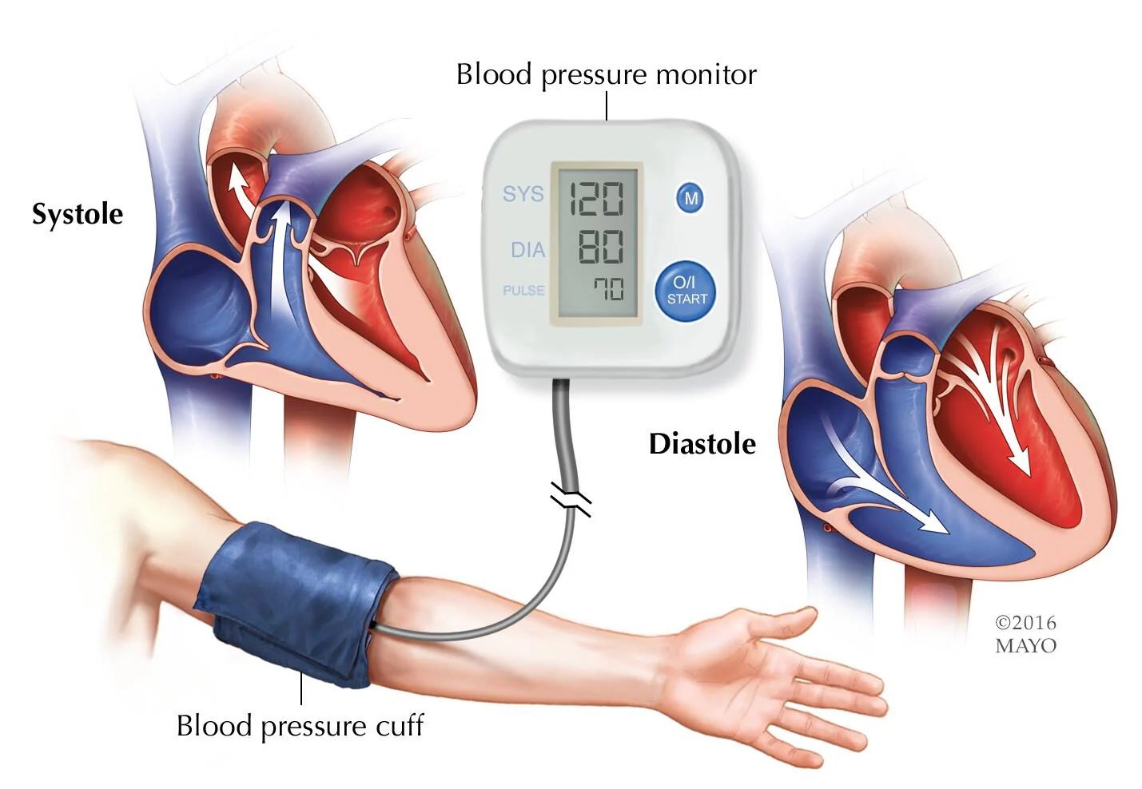
Diagnosis of High Blood Pressure
The current methods of measuring the BP have low reproducibility since the BP values are constantly fluctuating, and it is difficult to medically define hypertension (Schutte et al., 2022).
Where there are readings of 140/90 mmHg or above, it should be proven through ambulatory or home monitoring.
Fasting blood glucose test (≥7.0 mmol/L indicates diabetes)
HbA1c test (≥48 mmol/mol indicates diabetes)
Oral glucose tolerance test (OGTT)
https://www.mayoclinic.org/content/dam/media/en/images/2023/02/10/blood-pressure-measurement.jpg
Notes:
Home monitoring and proper measurement of blood pressure should be put in place in either an ambulatory setting. It is essential to measure cardiac function parameters and blood pressure to monitor the cardiovascular situation during its early stages, diagnose, and intervene in the conditions of cardiovascular diseases in time, which will be able to effectively reduce the risk of cardiovascular-related mortality and improve the quality of life (Li et al., 2023).

Slide 10
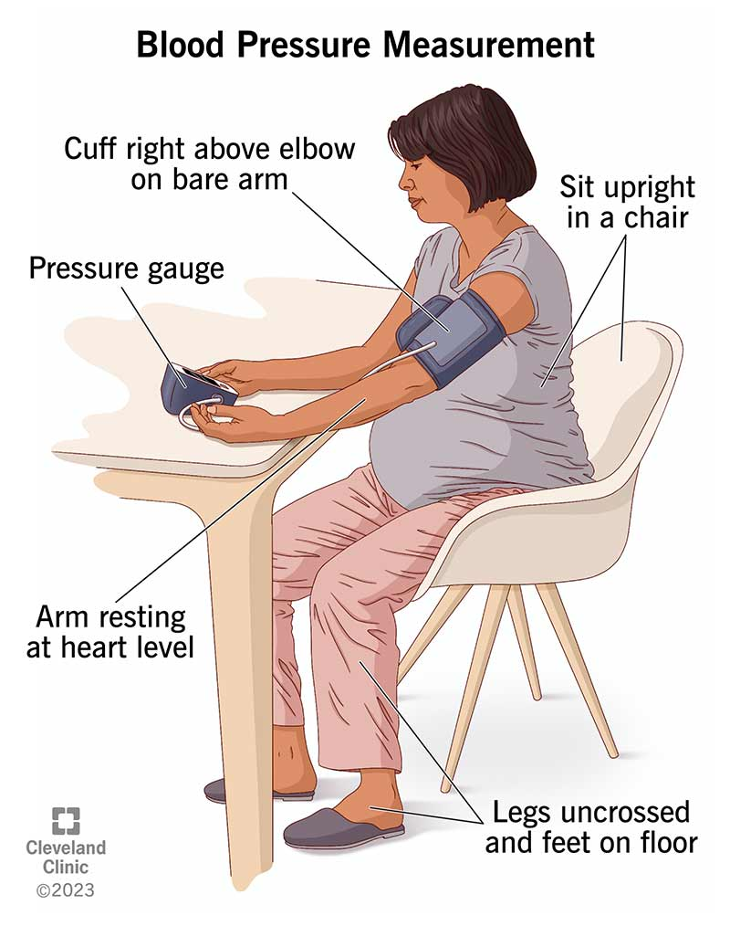
Initial assessment of High Blood Pressure
Continuous blood pressure (BP) monitoring in the nonclinical arteries.
A disease linked to hypertension cannot be prevented or diagnosed without the input of environmental determinants (Li et al., 2023).
The initial tests include lifestyle analysis, tests and cardiovascular risk score using QRISK.
NICE recommends a combination of lifestyle changes and medication to manage high blood pressure (nice.org.uk, 2023).
Initial Assessment: Includes assessing risk factors (BMI, family history, blood pressure), screening for comorbidities (e.g., hypertension, dyslipidemia), and establishing patient baseline metrics (Diabetes UK, 2023).
The clinical blood pressure is the initial step of the diagnosis procedure, and it is correctly measured.
https://my.clevelandclinic.org/health/diagnostics/25068-blood-pressure-measurement
Notes:
Primary analysis involves tests and lifestyle analysis that are applied to detect cardiovascular risk and strategise on the application of treatment to the patients. There has to be accurate monitoring of blood pressure(Li et al., 2023. Differences in stress or improper use of cuffs may confuse the clinicians, hence checking high readings out of the clinic is crucial. The evaluation also investigates food, drug history, and comorbidities, which assists in forming a more concise image. This helps to implement personalised intervention and avoid unnecessary treatment in case of the momentary effects that blood pressure presents(Li et al., 2023.

Slide 11
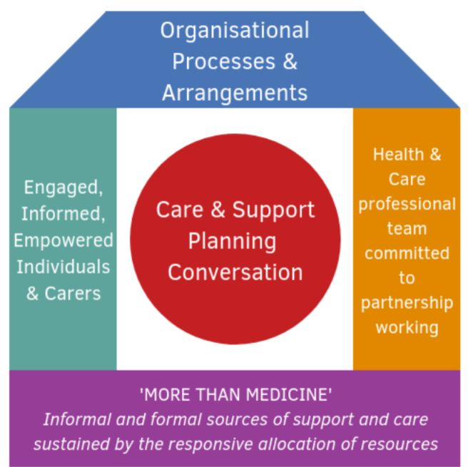
House of Care Model High Blood Pressure
Focuses on personalized care to meet individual health needs.
Tailors interventions to the patient's unique situation(Sorato et al., 2022).
Emphasizes patient involvement in health decisions.
Aims to reduce hospital visits and improve long-term outcomes(Sorato et al., 2022).
https://www.alliance-scotland.org.uk/past-work-and-projects/scotlands-house-of-care/the-house-of-care-model/
Notes:
The House of Care Model focuses on personal care, and this considers the individual health needs whereby the care plan of all patients is determined based on their circumstances. It customizes the interventions according to the case of the patient, and this is useful in realizing improved outcomes(Sorato et al., 2022). The model places a lot of focus on the patient in health decisions, in which both the patients and the health care providers make decisions related to health. By enabling the patient to have proactive control over his health, the House of Care will be able to reduce the number of hospitalizations and increase the long-term health outcomes of the patient(Sorato et al., 2022).

Slide 12
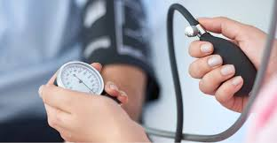
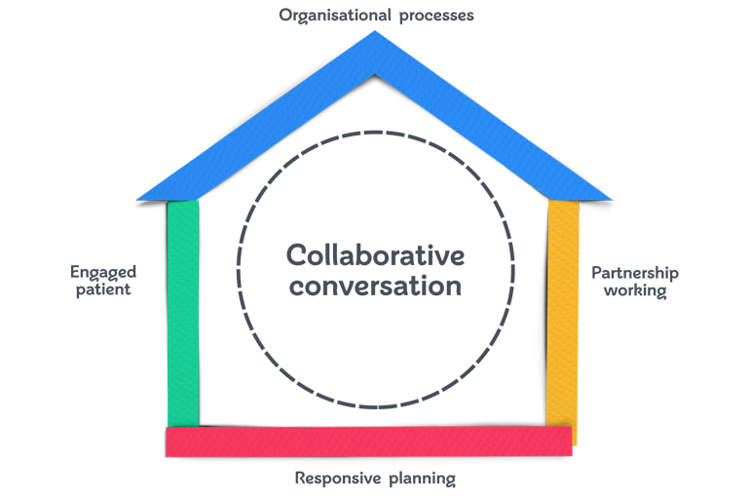
Management of High Blood Pressure
According to NICE NG136, lifestyle interventions and medications are used based on the BP measurements and cardiovascular risks (nice.org.uk, 2023).
The House of Care in Scotland vision supports person-centred collaborative care and support planning in Primary Care to individuals with long-term conditions (Hendry, 2020).
The House of Care Model promotes shared decision making, self-management and individual care planning.
The multidisciplinary teams assist in improving the BP control by education, setting goals, and follow-ups.
https://www.bhf.org.uk/-/media/images/for-professionals/healthcare-professionals/innovation-in-care/person-centred-care-and-the-house-of-care/person-centred-care_diagram-of-the-house-of-care-framework_770x510.jpg?rev=a09d77ef866a4a6395eaa226df5a9bc8&la=en&h=510&w=770&hash=DB08625640EFB57CF1E7B4DD2993F314
https://www.tmh.org/sites/default/files/2024-09/Hypertension%20Banner.png
Notes:
The management will guide its practice based on the guidelines included in the NICE and use the House of Care Model to involve the patients in the decision-making process. There is a need to add that a clinical pathway to identify and treat high BP is suitable to follow, whether the patient referral is specific to the high BP management (hypertension) (Schultz et al., 2022). The plan focuses on the individualised care planning, lifestyle modification and working together of the professionals with the patient(Khatri et al., 2023).

Slide 13
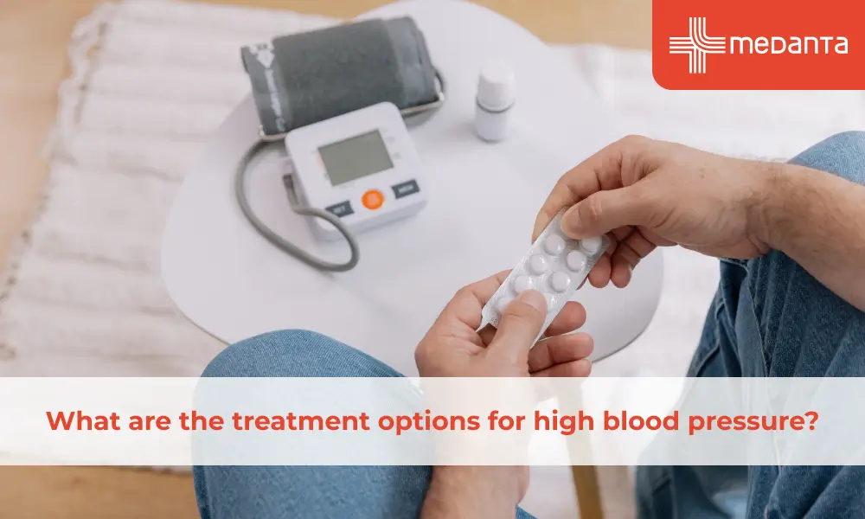
Treatment options available for High Blood Pressure
Depending on the age and ethnicity, the initial agent will be ACE of ARBs, calcium channel or thiazide diuretics.
The given drugs are angiotensin-converting enzyme (ACE) inhibitors, which are prescribed to treat hypertension (HTN) and other chronic diseases (Cutrell et al., 2023).
Combination therapy is used when targets have not been attained.
The first form of hypertension management is a lifestyle change, which includes weight loss, a healthy eating habit with low sodium consumption and high potassium consumption, physical activities, and restraint or alcohol abuse (Carey et al., 2022).
The treatment also involves structured lifestyle support and regular observation.
https://www.medanta.org/patient-education-blog/what-are-the-treatment-options-for-high-blood-pressure
Notes:
The most effective drug class to be used in the treatment is selected based on age and ethnic backgrounds. Initial triple-combination therapy taking into account parenteral prostacyclin is said to be applicable with a higher survival prevalence in hypertension and particularly regarding the youngest high-risk patients (Boucly et al., 2021). Other drugs are used together in case one of them fails. Lifestyle change is a requirement in the course of treatment(Cutrell et al., 2023.

Slide 14
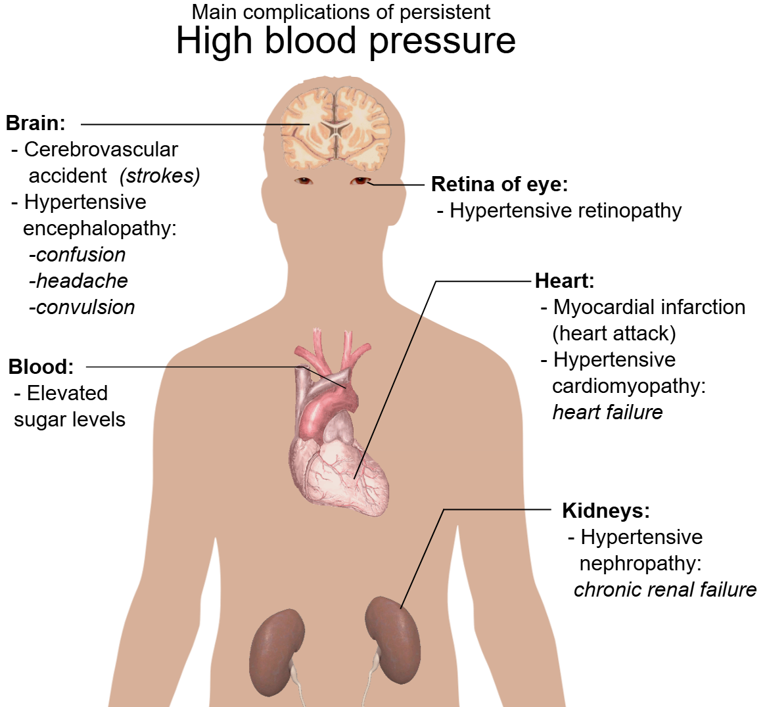
Highlighting the comorbidities that can accompany High Blood Pressure
High blood pressure is a risk factor for stroke, heart failure and myocardial infarction.
Hypertension is the most common risk factor for the development of hypertensive heart disease (Masenga and Kirabo, 2023).
It is normally accompanied by diabetes, chronic renal illness, as well as obesity.
These comorbid conditions worsen the prognosis; they require the multiservice coordination of care.
https://upload.wikimedia.org/wikipedia/commons/8/87/Main_complications_of_persistent_high_blood_pressure.svg
Notes:
The significant risk factors of atherosclerosis and cardiovascular disease (CVD) formation should be mentioned as diabetes mellitus (DM) and hypertension (HTN) (Yen et al., 2022). There are other long-term conditions that are likely to co-exist with hypertension.

Slide 15
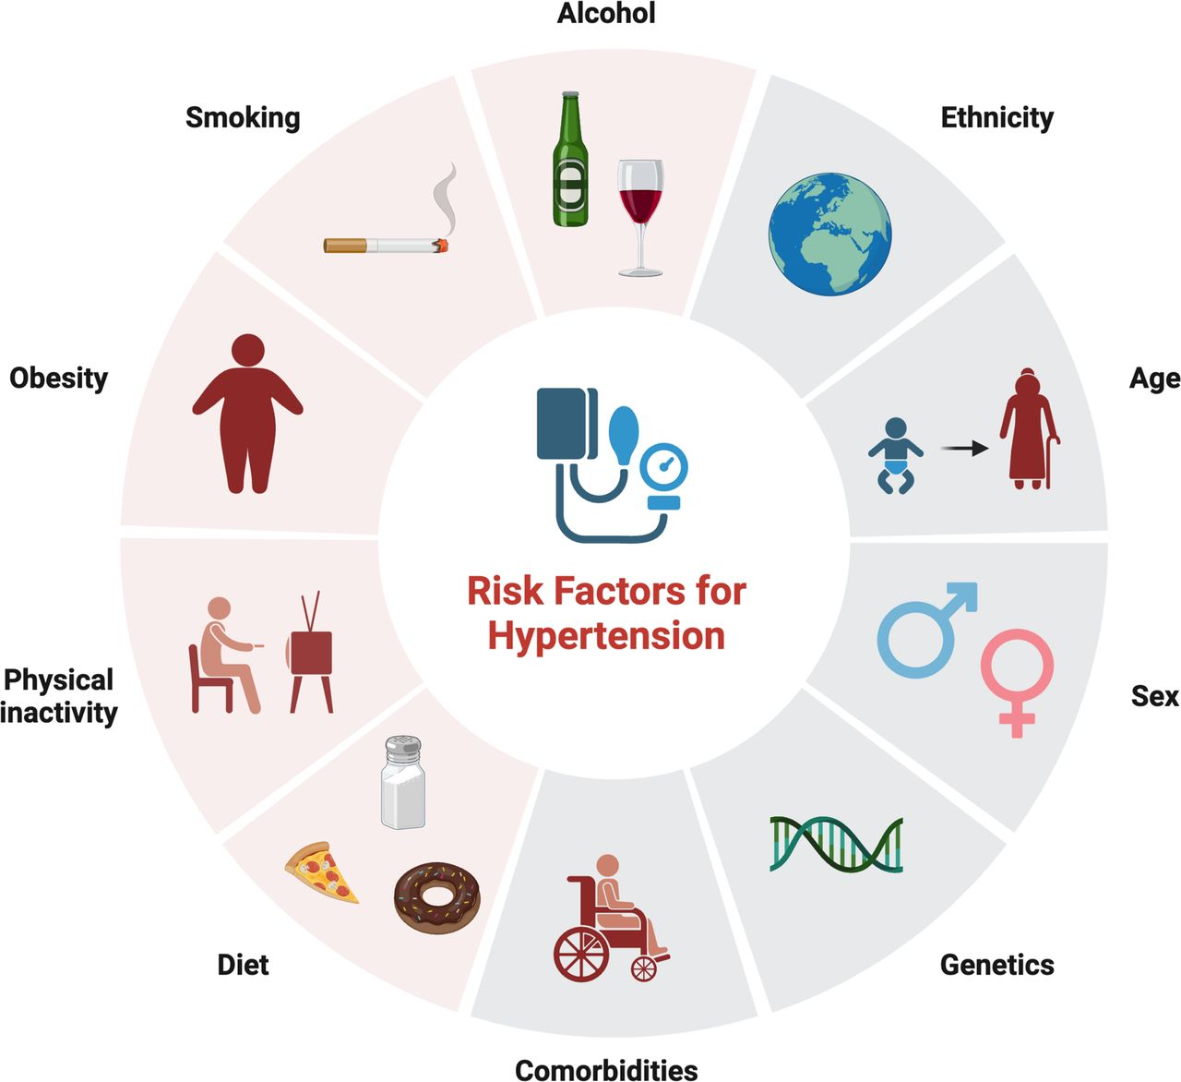
Contd.
Stroke: Hypertension is leading prevalent causes of stroke.
Heart failure: Long-term hypertension leads to heart failure.
Chronic kidney diseases: Hypertension is the key causes of several Kidney issues.
Diabetes: Diabetes and hypertension often occur together.
https://pn.bmj.com/content/practneurol/25/2/143/F1.large.jpg
Notes:
High blood pressure is a major risk factor for many cardiovascular disease outcomes and the major cause of death across the globe, with an estimated number of deaths of 10.4 million due to high systolic blood pressure in 2017 (Aune et al., 2021). Early identification can be used to avoid complications such as kidney failure or stroke and improve the general quality of life.

Slide 16
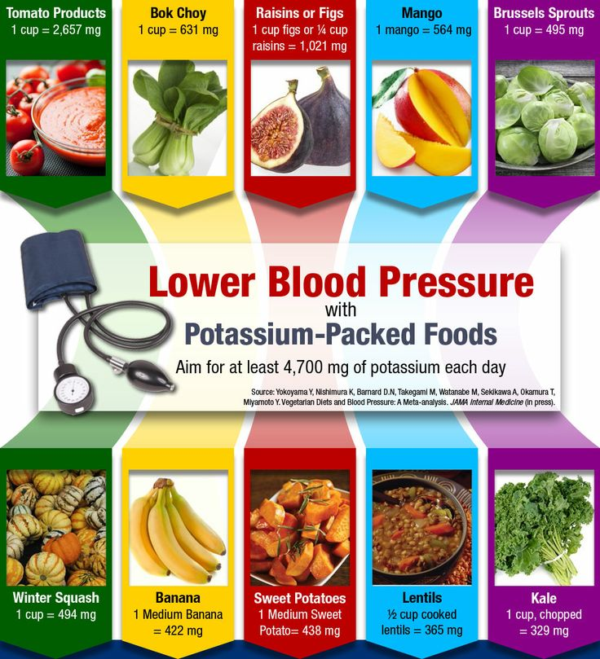
Prevention strategies for High Blood Pressure
Restrict salt and weight, exercise.
Hypertension management should be based on a holistic perspective of personal and population prevention, and non-pharmacological interventions are to be implemented across the lifespan (Zhou et al., 2021).
Limit alcohol, stop smoking, and follow either the DASH or Mediterranean-based diet.
https://www.pcrm.org/news/blog/lower-your-blood-pressure-naturally
Notes:
Prevention has a focus on lifestyle change and preventive disease strategies that focus on the population. Foods that are worth mentioning as Indo-Mediterranean are the pulses, porridge, spices, and millets; fruits such as guava and blackberry, and vegetables, which may also reduce BPs (Singh et al., 2022).

Slide 17
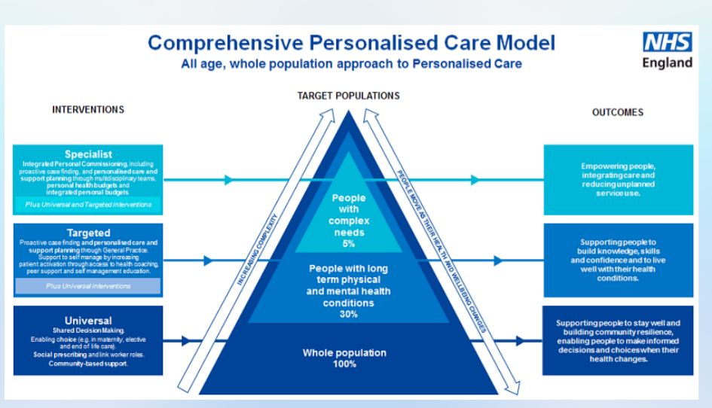
Comprehensive Model of Personalized Care
Medication & Monitoring: Manages conditions with prescriptions and regular check-ups.
Lifestyle Adjustments: Promotes healthy diet, exercise, and weight control.
Emotional Support: Addresses mental health and provides coping strategies(Cutrell et al., 2023..
Patient Empowerment: Educates patients on self-management of their condition.
Holistic Approach: Integrates medical, psychological, and social factors(Cutrell et al., 2023..
Team Coordination: Ensures seamless care through provider collaboration.
https://www.happyhealthylives.uk/integrated-care-board/resources-and-services/personalising-care-for-our-people/what-is-personalised-care-the-comprehensive-model-and-the-six-components/
Notes:
The model of approach that will imply the combination of many aspects of patient care will be the Comprehensive Model of Personalized Care. It entails management of long-term illnesses by using medical management, which is backed by lifestyle modification, such as diet and exercise. Psychosocial support experienced by the patients handles the emotional problems. The most substantial will be the education, which will assist the patients in coping with their condition(Cutrell et al., 2023.. It is a comprehensive theory where mental and physical health are taken into account. Lastly, integrated care teams are oriented towards delivering consistent care to the patient in a manner that unites their entire health in totality to achieve superior results(Cutrell et al., 2023..

Slide 18
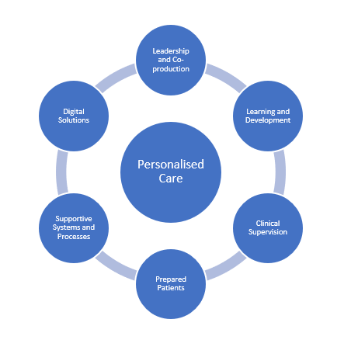
Skills required to provide co-productive care to a person suffering from High Blood Pressure
Skills: Active listening, empathy and joint decision making.
People with enduring physical ill health may be vulnerable to mental health issues to a greater degree, and there may be a compounding effect, and co- and multi-morbidity concerns increasing the likelihood of developing mental health problems (Russell et al., 2021).
https://lh5.googleusercontent.com/jX1nu7AaoTy5w0Pl5R-DbUUVfcgX9myJTod4SNjwiRK9dXZ1a4tfQEFCFGXFfJhSfarV9hzqXUIGeqcidZjgrjsHuMWKkKiWHLFuIni_54URcp_MDouxesjSOC4MEpAfGcmo9TzfOqGJRoF5w1ftyg
Notes:
The personal decision and care for an individual increase compliance with the treatment plans. Patient-centred care aims at attaining a functional life through the ethical principle of respecting an individual and justice, attempting to make the health system more responsive to the needs of the health services (Khatri et al., 2023).

Slide 19
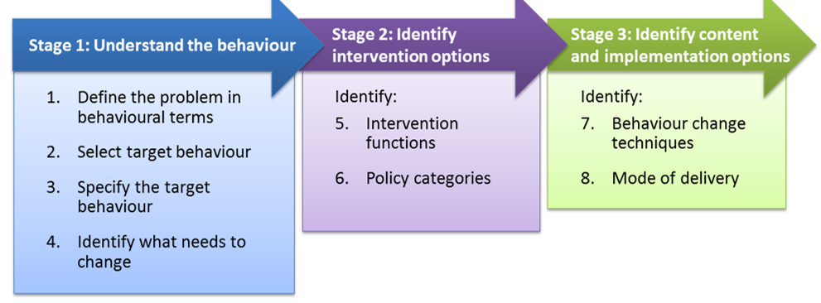
Behaviours required to provide co-productive care to a person suffering from High Blood Pressure
Respect and Empowerment: Acknowledge the patient’s choice and empower them to actively participate in managing their health.
Effective Communication: Foster clear communication between the patient and care team to build trust and collaboration.
Patient-Centred Approach: Ensure that care plans reflect the patient’s individual preferences and needs.
Collaboration: Encourage teamwork among healthcare providers, especially primary care physicians, for effective management.
Continuous Support: Offer ongoing education and resources to help patients manage and monitor their condition independently.
https://www.dunnhumby.com/resources/blog/ai-science-data/en/the-behaviour-change-wheel-using-psychology-to-encourage-healthier-and-more-sustainable-choices/
Notes:
The personal decision and care for an individual increase compliance with the treatment plans. Patient-centred care aims at attaining a functional life through the ethical principle of respecting an individual and justice, attempting to make the health system more responsive to the needs of the health services (Khatri et al., 2023).

Slide 20
Values required to provide co-productive care to a person suffering from High Blood Pressure
Values: Respect for the patient, his or her choice and empowerment in self-management.
Communication between the care team improves interaction and builds trust.
Primary care physicians are the most significant stakeholders to mention, as the ownership and involvement of these stakeholders is the most important to any successful system-level initiative (Taglione and Brown, 2023).
https://lh5.googleusercontent.com/jX1nu7AaoTy5w0Pl5R-DbUUVfcgX9myJTod4SNjwiRK9dXZ1a4tfQEFCFGXFfJhSfarV9hzqXUIGeqcidZjgrjsHuMWKkKiWHLFuIni_54URcp_MDouxesjSOC4MEpAfGcmo9TzfOqGJRoF5w1ftyg
Notes:
The concept of high blood pressure is a co-productive care where the emphasis is laid on the respectful approach towards the patient and giving them the power to look after themselves/. Communication has the potential to establish trust and enhance collaboration between the patient and medical staff. Personal care is a requirement, where the individual's needs are also put into consideration, keeping in mind the cultural factor and any special needs(Taglione and Brown, 2023). Educating the patients is essential because they will make informed decisions and adhere to the treatment. Coherent and integrated care is one of the most significant strategies of healthcare teams and, more specifically, primary care physicians operating in collaboration with each other, which will ultimately result in improved patient outcomes and, ultimately, the creation of long-term management of high blood pressure(Taglione and Brown, 2023).

Slide 21
Recommendations and Conclusion
The aspects of the holistic model of personalised care, shared decision-making, personalised care planning, self-management support, social prescribing, choice of care options, and joined-up care are the aspects that need to be considered by primary healthcare providers.
These components and programmes should be offered as an integrated package and simultaneously with key enablers that bring about the needed culture change, such as good leadership of the systems, co-production and the input of the workforce throughout the health and care system and collaborating with the voluntary and community sector (england.nhs.uk, 2025).
Promotes self-sufficiency and an increase in BP management.
Reduces the number of hospital admissions and enhances the quality of life.
Notes:
The application of all the aspects of personalised care helps the patients manage their hypertension. Compliance failure can lead to uncontrolled blood pressure, complications and increased healthcare costs due to hospitalisation and additional treatment (Ruswati, 2024). Thus, through the education of the patients and the coordinated care, the empowerment will lead to improved care, which is long-term and decreases hospital admissions. The lifestyle changes related to blood pressure reduction may also be supplemented by mindfulness meditation and deep breathing (Elendu et al., 2024).

Slide 22
References
Aune, D., Huang, W., Nie, J. and Wang, Y., (2021). Hypertension and the risk of all‐cause and cause‐specific mortality: an outcome‐wide association study of 67 causes of death in The National Health Interview Survey. BioMed Research International, 2021(1), p.9376134.https://doi.org/10.1155/2021/9376134
bloodpressureuk.org, (2025). Blood pressure facts and figures. Available at: https://www.bloodpressureuk.org/news/media-centre/blood-pressure-facts-and-figures/ [Accessed 3 November 2025]
Boucly, A., Savale, L., Jaïs, X., Bauer, F., Bergot, E., Bertoletti, L., Beurnier, A., Bourdin, A., Bouvaist, H., Bulifon, S. and Chabanne, C., (2021). Association between initial treatment strategy and long-term survival in pulmonary arterial hypertension. American journal of respiratory and critical care medicine, 204(7), pp.842-854.http://dx.doi.org/10.1164/rccm.202009-3698OC
Carey, R.M., Moran, A.E. and Whelton, P.K., (2022). Treatment of hypertension: a review. Jama, 328(18), pp.1849-1861. Available from: https://jamanetwork.com/journals/jama/fullarticle/10.1001/jama.2022.19590?utm_campaign=articlePDF%26utm_medium=articlePDFlink%26utm_source=articlePDF%26utm_content=jama.2022.19590 [Accessed 3 November 2025]
Cutrell, S., Alhomoud, I.S., Mehta, A., Talasaz, A.H., Van Tassell, B. and Dixon, D.L., (2023). ACE-inhibitors in hypertension: a historical perspective and current insights. Current hypertension reports, 25(9), pp.243-250.https://doi.org/10.1007/s11906-023-01248-2
Elendu, C., Amaechi, D.C., Elendu, T.C., Amaechi, E.C. and Elendu, I.D., (2024). Dependable approaches to hypertension management: A review. Medicine, 103(24), p.e38560.http://dx.doi.org/10.1097/MD.0000000000038560
england.nhs.uk, (2025). Comprehensive model of personalised care. Available at: https://www.england.nhs.uk/personalisedcare/comprehensive-model-of-personalised-care/ [Accessed 3 November 2025]
Hendry, A., (2020). House of Care: Enabling integrated care through collaborative care and support planning in different context and cultures. International Journal of Integrated Care, 21(S1), p.352. Available from: https://ijic.org/articles/10.5334/ijic.ICIC20469 [Accessed 3 November 2025]
Khatri, R.B., Wolka, E., Nigatu, F., Zewdie, A., Erku, D., Endalamaw, A. and Assefa, Y., (2023). People-centred primary health care: a scoping review. BMC primary care, 24(1), p.236.https://doi.org/10.1186/s12875-023-02194-3
Kidwai, S., Haris, M., Bilal, A., Saleem, S., Imran, H., Anwar, A., Hashmi, A.A., Haris Sr, M. and Bilal, A., (2024). High Blood Pressure-Associated Symptoms: Insights From a Population-Based Study in Pakistan. Cureus, 16(7). Available from: https://assets.cureus.com/uploads/original_article/pdf/268299/20240824-1030522-41xj2c.pdf [Accessed 3 November 2025]

Slide 23
References
Li, J., Jia, H., Zhou, J., Huang, X., Xu, L., Jia, S., Gao, Z., Yao, K., Li, D., Zhang, B. and Liu, Y., (2023). Thin, soft, wearable system for continuous wireless monitoring of artery blood pressure. Nature communications, 14(1), p.5009.https://doi.org/10.1038/s41467-023-40763-3
Li, S., Wang, H., Ma, W., Qiu, L., Xia, K., Zhang, Y., Lu, H., Zhu, M., Liang, X., Wu, X.E. and Liang, H., (2023). Monitoring blood pressure and cardiac function without positioning via a deep learning–assisted strain sensor array. Science advances, 9(32), p.eadh0615. Available from: https://www.science.org/doi/pdf/10.1126/sciadv.adh0615 [Accessed 3 November 2025]
Makhmirzaeva, G.G., Golubkina, E.S., Airapetyan, A.D., Root, V.A., Uran-oolovich, O.K., Kuzhuget, A.A. and Aliyeva, K.M., (2025). The importance of early screening in preventing chronic diseases. Revista Latinoamericana de Hipertension, (1). Available from: https://www.revhipertension.com/rlh_1_2025/8_the_importance_early_screening.pdf [Accessed 3 November 2025]
Mancia, G., Cappuccio, F.P., Burnier, M., Coca, A., Persu, A., Borghi, C., Kreutz, R. and Sanner, B., (2023). Perspectives on improving blood pressure control to reduce the clinical and economic burden of hypertension. Journal of internal medicine, 294(3), pp.251-268.https://doi.org/10.1111/joim.13692
Masenga, S.K. and Kirabo, A., (2023). Hypertensive heart disease: risk factors, complications and mechanisms. frontiers in cardiovascular medicine, 10, p.1205475.https://doi.org/10.3389/fcvm.2023.1205475
Mishra, G.D., Jin, C., Chan, H.W., Doust, J. and Dobson, A., (2025). Trajectories of menstrual symptoms and blood pressure in midlife: a prospective cohort study on Australian women. Journal of Human Hypertension, pp.1-7. Available from: https://www.nature.com/articles/s41371-025-01070-0.pdf [Accessed 3 November 2025]
nice.org.uk, (2023). Hypertension in adults: diagnosis and management. Available at: https://www.nice.org.uk/guidance/ng136/chapter/recommendations [Accessed 3 November 2025]
Poznyak, A.V., Sadykhov, N.K., Kartuesov, A.G., Borisov, E.E., Melnichenko, A.A., Grechko, A.V. and Orekhov, A.N., (2022). Hypertension as a risk factor for atherosclerosis: Cardiovascular risk assessment. Frontiers in cardiovascular medicine, 9, p.959285.https://doi.org/10.3389/fcvm.2022.959285
Ramsey, L., (2023). 4.2 million people in England have undiagnosed hypertension, report shows. Available at: https://www.news-medical.net/news/20230508/42-million-people-in-England-have-undiagnosed-hypertension-report-shows.aspx [Accessed 3 November 2025[
Russell, R., (2021). Psychological aspects of holistic approaches to healthcare: the roles of co-production and ACT for self-management in the care of long-term conditions. Available from: https://ueaeprints.uea.ac.uk/id/eprint/82329/1/2021RussellRClinPsyD.pdf [Accessed 3 November 2025]

Slide 24
References
Ruswati, R., (2024). The Role of Nurses in Enhancing Medication Adherence and Patient Outcomes in Hypertension Management. International Journal of Nursing and Midwifery Research, 2(3), pp.78-87. Available from: https://journals.iarn.or.id/index.php/ners/article/view/286 [Accessed 3 November 2025]
Schultz, M.G., Currie, K.D., Hedman, K., Climie, R.E., Maiorana, A., Coombes, J.S. and Sharman, J.E., (2022). The identification and management of high blood pressure using exercise blood pressure: current evidence and practical guidance. International journal of environmental research and public health, 19(5), p.2819.https://doi.org/10.3390/ijerph19052819
Schutte, A.E., Kollias, A. and Stergiou, G.S., (2022). Blood pressure and its variability: classic and novel measurement techniques. Nature Reviews Cardiology, 19(10), pp.643-654. Available from: https://www.nature.com/articles/s41569-022-00690-0.pdf [Accessed 3 November 2025]
Singh, R.B., Nabavizadeh, F., Fedacko, J., Pella, D., Vanova, N., Jakabcin, P., Fatima, G., Horuichi, R., Takahashi, T., Mojto, V. and Juneja, L., (2022). Dietary approaches to stop hypertension via Indo-Mediterranean foods, may be superior to DASH diet intervention. Nutrients, 15(1), p.46.https://doi.org/10.3390/nu15010046
Sorato, M.M., Davari, M., Kebriaeezadeh, A., Sarrafzadegan, N. and Shibru, T., (2022). Societal economic burden of hypertension at selected hospitals in southern Ethiopia: a patient-level analysis. BMJ open, 12(4), p.e056627. Available from: https://bmjopen.bmj.com/content/bmjopen/12/4/e056627.full.pdf [Accessed 3 November 2025]
Taglione, M.S. and Brown, J.B., (2023). Primary care engagement in health system change: a scoping review of common barriers and effective strategies. BMC Primary Care, 24(1), p.157.https://doi.org/10.1186/s12875-023-02117-2
Tapela, N., Collister, J., Clifton, L., Turnbull, I., Rahimi, K. and Hunter, D.J., (2021). Prevalence and determinants of hypertension control among almost 100 000 treated adults in the UK. Open heart, 8(1), p.e001461. Available from: https://openheart.bmj.com/content/openhrt/8/1/e001461.full.pdf [Accessed 3 November 2025]
WHO, (2021). More than 700 million people with untreated hypertension. Available at: https://www.who.int/news/item/25-08-2021-more-than-700-million-people-with-untreated-hypertension [Accessed 3 November 2025]
Yen, F.S., Wei, J.C.C., Chiu, L.T., Hsu, C.C. and Hwu, C.M., (2022). Diabetes, hypertension, and cardiovascular disease development. Journal of translational medicine, 20(1), p.9.https://doi.org/10.1186/s12967-021-03217-2
Zhou, B., Perel, P., Mensah, G.A. and Ezzati, M., (2021). Global epidemiology, health burden and effective interventions for elevated blood pressure and hypertension. Nature Reviews Cardiology, 18(11), pp.785-802. Available from: https://pmc.ncbi.nlm.nih.gov/articles/PMC8162166/pdf/41569_2021_Article_559.pdf [Accessed 3 November 2025]

Slide 25

Any question?

