Slide 1
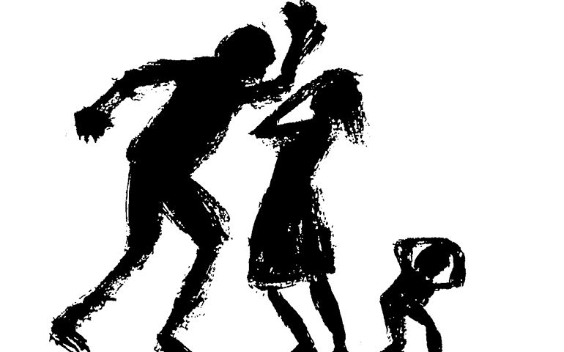
Children, Young People and Families. Group Presentation
Family - e
Elena Todorova – 2124115
Athene Hamilton - 21200333
Olga Jarmusevica – 2115871
BMHP5004_BIRM
Rachael Rivers
24/02/2023

Slide 2

Content Page:
Introduction
Risk Factors
Mother
Mum analysis
Implication on the case study
Children
Antisocial behaviour
Children analysis
Teams and Services
Father
Verbal and emotional abuse
Father analysis
Actions and Recommendations
Conclusions
Reference List

Slide 3

Introduction:
The following presentation will critically analyze and evaluate case study to understand the family situation and create recommendations on how to improve the whole family well – being. The children (boys; one in primary school age and one of secondary school age). Some of the risk factors raised in the case are:
- Rent areas
- Domestic violence
- Abuse of the children from dad
- Mom alcohol problem
- Boy’s antisocial behavior/ school attendance
Following will be discussed: policies, laws and procedure such as:
UNCRC/ Safeguarding of children
Human rights
Mental health/ addiction
Criminal behavior concerns
Wellbeing concern
Relationship ending
Financial struggle concern/ housing
Furthermore, what professional agencies can get involved to enhance whole family well – being. Also, explained why the services are involved and what we need to consider.
(Hale, 2017; Guthrie and Driscoll, 2021)

Slide 4

Related Risk Factors:
Domestic Abuse
Children Safeguarding
Financial Difficulties
Antisocial Behaviour/ School Attendance
Addictions
Mental Health/ Childhood Trauma
Lack of Employment
Family falling apart
(Velleman etc, 2008; Stewart, 1996; Kaysen etc, 2007)

Slide 5

Mum: “Woman can also begin to abuse substances through their relationship with men or from wanting to escape the reality of intimate partner violence.” ( Campbell, 2002)
Problems:
Domestic violence
Parenting issues
Alcohol problem
Health (physical, mental, developmental)
Employment/ Finances
Education
Support network
Service available for support:
Police
Early intervention support
Assessment and referral to suitable root for recovery
Family support worker/ LA
Job centre/ Job shops/ Employment fares
Social services
Woman Aid/ Victim Support
#YouAreNot Alone

Slide 6

MUM analysis:
The issue of domestic violence has been increasingly recognized as a persistent social and public health problem, particularly because of the tremendous, negative effects it has on victims' health and children's well-being (Carlson, 2003).
DV​
Mental health/PTSD​
Alcohol​
Parenting/neglect​
Employment/education/finance​
Self-love/self-care/self esteem​
Social life
Elena Todorova
Notes:
Experiencing DV may impact mums' mental health and lead to her turning to alcohol so she can escape the reality she is living in. Furthermore, she may feel as a failure as wife and mum and this may be the trigger of her alcohol abuse. On the other hand, childhood trauma may be the case of her drinking. Brady(2012) mention that ''Early-childhood trauma is strongly associated with developing mental health problems, including alcohol dependence, later in life. People with early-life trauma may use alcohol to help cope with trauma-related symptoms.'' Furthermore, Herman (1992) argues that'' History of abuse from childhood may make women more psychologically vulnerable.''​
​
Been in mum's difficult situation can be hard to find job. Equality Act (2010) clearly states that protects people from discrimination, harassment and victimisation. Her financial difficulties can be result of not been in employment as her current situation should not be reason for her to be discriminated and not given job. Getting in to work and between people will be beneficial and good confidence bust for mum. It may be beneficial to get enrolled in education as this may help her to get better job. ​
Due to her problems, she neglects the care for her children which according to UNRC article 18, both parents are responsible to take care of their children. #​
Following the abuse from dad on the children and mothers neglect on them article 19 states that children need to be protected from any abuse, harm or neglect.​
Furthermore article 27 states clearly that every child has a right to a standard of living that is good enough to meet their physical, social and developmental needs. The both parents have the responsibility to provide the children good standard of live and suitable commodities. So children developmental needs are met.​
Article 39 clearly states that children suffering neglect or trauma have a right to receive support to recover. Also, the basic human rights such as: right to live, freedom from torture and degrading treatment, right to liberty and security

Slide 7
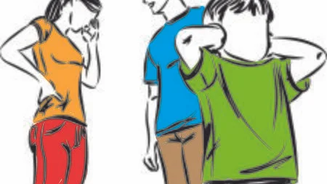
Implication of the case study for a whole family:
Finance – When family has little or no money this can become trigger for abuse between the parents or towards the children.
Alcohol – Been used as escape road from the harsh reality or experiencing domestic abuse makes mum drink alcohol. Chronic traumatic events have also been associated with increased problems with alcohol use. ( Clark and Foy,2000; Simpson, 2003; Stewart, 1996)
Abuse – Father aggression towards mum can be result of financial difficulties or him having childhood trauma. Moreover, it can be just to show dominance.
Children anti-social behaviour – Because they are exposed to abuse at home this makes children prone to been abusive themselves, or this may be their cry for help, not knowing how to deal with the situation at home. Providing timely support is vital. Addressing a child or family’s needs early on can reduce risk factors and increase protective factors in a child’s life. ( Early Intervention Foundation (EIF), 2021).
Father aggression escalates – it is unclear how far dad can go, and the situation can easily spin out of control and serious incident happen.

Slide 8
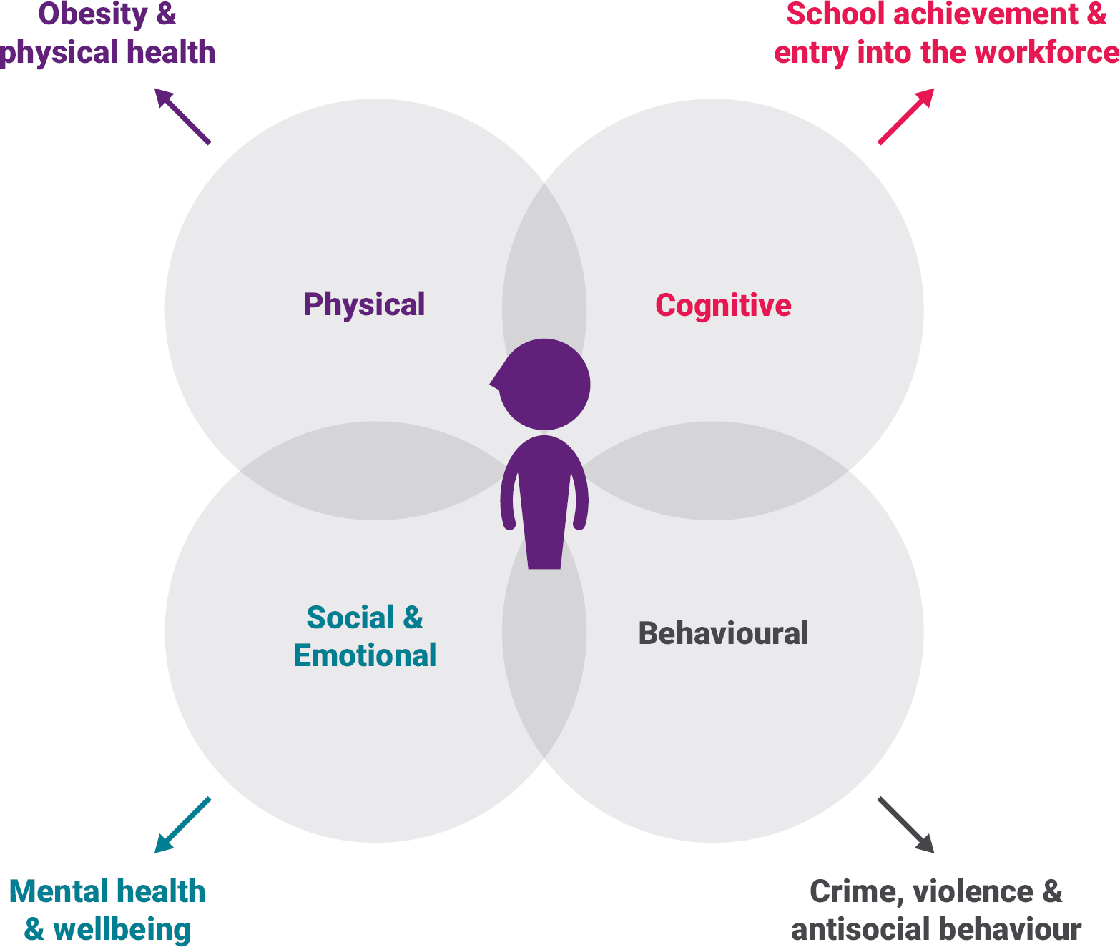
Children:
Children Welfare/ Safeguarding
Antisocial behaviour
School attendance/ Grades
Mental Health problems
Addictions
(Megele, 2017)

Slide 9

Antisocial Behaviour:
This behaviour could lead to:
Involvement in crime and vandalism
Addicted to alcohol and drugs
School Absences/ descending school grades
Fighting and bulling other children
Suicidal tendencies.
Article 19 of the UN states – “ Government must do all they can to ensure that children are protected from all forms of violence, abuse, neglect and bad treatment by their parents or anyone else who looks after them.”
(Bennett, etc., 2009)

Slide 10

Children Analysis:
Psychological - Neglect from both parents contributes to poor behavior.
Emotional distress – Causes them to miss out on their education.
Verbal and Emotional abuse – Links to anti – social behavior because of the constant pressure.
Lack of nurture – Unable to socialise with people within their age range because they don’t know how to communicate.
Aggressive behavior displayed at home – Exposed to negative behavior meaning they pick up traits that are related to bullying.
(Dodge, etc., 2006)
Athene Hamilton

Slide 11

Teams and Services for the children and family overall:
Children Trust – asses children when domestic issues are reported.
Child protection services – provides protection for children who are at risk of, or are experiencing neglect, physical or emotional abuse.
Children in need – fund thousands of charities and projects in every corner of the UK, that support children and young people to feel and be safer.
Care agencies – rehouse children in detrimental situations
School & Colleges – provide solutions and help if learning is affected.
Article 20 is saying – “ if children cannot be looked after, the government must provide special protection and assistance.”
(Cantwell and Holzscheiter, 2007)
Council housing – public housing service that is given to households who are unable to afford pay rent.
Universal credit – money given from the government to help pay or reduce living costs.
Family support worker – Provide emotional and physical support to families.
Family actions – helps families to reach their full potential supporting the needs of families.
Community teams – contribute to the family in need and provide accommodation, healthcare, food etc.
Athene Hamilton

Slide 12
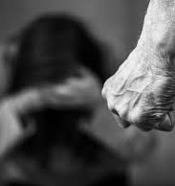
Father:
Mental health problems – Psychologist, helplines, support charities.
Domestic violence – Social services, Police.
(Harris and Woodlock, 2023)
Finance problems/ Unemployment – Job centre, Counselling, Government help (benefits, cost of living, help with housing cost)
Verbal and emotional abuse – Psychotherapy.
(Publication and Lynn, 2022)

Slide 13
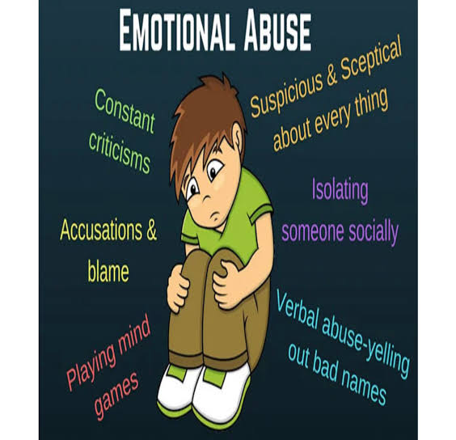
Verbal and Emotional abuse by their father:
Controlling all the steps
Shaming
Blaming them for his problems
Isolate them from outside the world
Bullying
Damaging belongings or home ( throwing objects, punching walls, etc.)
(Evans,2010; Forward and Buck, 2002)

Slide 14

Father analysis:
Father probably has some mental health issues or a childhood trauma. Therefore, he may copy his parents' life or maybe he was shaming and bullying as a child and now he is repeated that situations. He is having:
Aggression
Abuse for the children
Stress/ Depression
Unemployment
Mental Health
(Hale, 2017; Guthrie and Driscoll, 2021; Armor, 2020)
Olga Jarmusevica

Slide 15

Actions and recommendations for adults:
Educate yourself – support for parents can prevent abuse for children. (parents educational classes)
Change area or city – can help avoid contact with people who are bad influences at the moment.
Psychologist – can help realise the main problem and find a solution to resolve it.
Narcologist – can help with alcohol addiction.
Job centre – can help with job search.
Government – can help with temporary benefits or bills repayment.
(Sternberg, 2016; David, 2017)

Slide 16

Actions and recommendations for children:
Verbal encouragement - is the best way them understand what they need to do. Use a privileges to encourage them for their good behaviour
Improve their behaviour – Children must be kind, attending school with out fighting and rudeness.
Explain to children their rights – they have the rights to be safe, and more likely to report and offender, because they will know it is not their fault.
Counselling/ Psychologist – Can help with childhood trauma, with verbal communication, help open up and share emotions.
Rehousing – government or social services should take action to find a safe environment for the children.
Changing school – can help any educational or communication abuse or bullying inside old school between other pupils.
Health services – can help if you have any injuries or health issues.
(Nelsen, 2006)

Slide 17

Conclusion:
In depth analysing and evaluation of the case study leads to concluding that there are various risk factors that can affect persons behaviour. The implications can be prevented by seeking early help and support. Included are suitable recommendations to help the family improve the overall situation, and the suitable services that can provide guidance and support whenever needed. Policies, procedures and laws mentioned above are created in order to protect children and anyone from harm of any kind.

Slide 18

Reference list:
Evans, P. (2010), The Verbally Abusive Relationship: How to recognize it and how to respond, Expanded 3rd Edition, Adams Media.
Publication, G. and Lynn, S. (2022), Healing from Abusive Life for Teens, Independently Publisher.
Forward, S. and Buck, C. (2002), Toxic Parents: Overcoming Their Hurtful Legacy and Reclaiming Your Life, 2nd Revised Edition, Bantam.
Hale, B. (2017), Mental Health Law, 6th Edition, Sweet & Maxwell.
Guthrie, T. and Driscoll, M. (2021), Child Abuse, Child Protections & the Law, 2nd Edition, W. Green.
Harris, B., Woodlock, D. (2023), Technology and Domestic and Family Violence: Victimisation, Perpetration and Responses, 1st Edition, Routledge.
Nelsen, J. (2006), Positive Discipline: The Classic Guide to Helping Children Develop Self – Discipline, Responsibility, Cooperation, and Problem – Solving Skills, Revised Edition, Ballantine Books Inc.
Armor, K. (2020), How Childhood Trauma Manifests itself in Adults, Katrina Armor.
Sternberg, R. and Sternberg. K. (2016), Cognitive Psychology, 7th Edition, Wadsworth Publishing.
David, L. (2017), Alcohol and You – 21 Ways to Control and Stop Drinking: How to Give Up Your Addiction and Quit Alcohol, Independently Published.
Dodge, K. A., Coie, J. D. and Lynam, D. (2006), Handbook of Child Psychology: Aggression and Antisocial Behavior in Youth, John Willey & Sons.
Megele, C. (2017), Safeguarding children and young people online: A Guide for Practitioners, 1st Edition, Policy Press.
Bennett, S., Hart, S. N. and Svevo – Cianci, K. A. (2009), The need for a General Comment for Article 19 of the UN Convention on the Rights of the Child: Toward enlightenment and progress for child protection. Child abuse & neglect, 33(11), pp.783-790.

Slide 19
Reference List:
Cantwell, N. and Holzscheiter, A. (2007), A commentary on the United Nations Convention on the Rights of the Child, Article 20: Children deprived of their family environment. Brill.
Haimovitz, K. and Dweck, C.S. (2017), The origins of children’s growth and fixed mindsets: New research and a new proposal, Child development, 88(6),pp. 1849 – 1859.
McGoldrick, D. (1991), The United Nations convention on the rights of the child. International Journal of Law, Policy and the Family, 5(2), pp. 132-169.
Parton, N. (2006), ‘Every Child Matters’: The shift to prevention whilst strengthening protection in children’s services in England, Children and youth services review, 28(8), pp. 976-992.
Velleman, R., Templeton, and Reuber, D. (2008), Domestic abuse experienced by young people living in families with alcohol problems: Results from a cross-European study. Child Abuse Review: Journal of the British Association for the Study and Prevention of Child Abuse and Neglect, 17(6), pp.387-409.
Kaysen, D., Dillworth, T.M., Simpson. T., etc. (2007), Domestic violence and alcohol use: Trauma-related symptoms and motives for drinking. Addictive behaviors, 32(6), pp. 1272-1283.
Brady, K. T. and Back, S. E. (2012), Childhood trauma , posttraumatic stress disorder, and alcohol dependence. Alcohol research: Current reviews, 34(4), p.408.
Stewart, S.H. (1996), Alcohol abuse in individuals exposed to trauma: a critical review. Psychological bulletin, 120(1), p.83.
Covell, K., Howe, R. B. and Polegano, J. L. (2011), Children’s human rights education as a counter to social disadvantages: A case study from England. Educational Research, 53(2), pp.193-206.
Campbell, J. C. (2002), Health consequences of intimate partner violence. The lancet, 359(9314), pp.1331-1336.
Verdugo, R. R. and Verdugo, N. T. (1989), The impact of surplus schooling on earnings: Some additional findings. Journal of human resources, pp.629-643.
Cutler, D.M. and Lleras-Muney, A. (2006), Education and health: evaluating theories and evidence, National Bureau of Economic Research.
Levendosky, A. A. and Graham-Bermann, S. A. (2001), Parenting in battered woman: The effects of domestic violence on woman and their children. Journal of family violence,16, pp.171-192.
Huang, C. C., Wang, L. R. and Warrener, C. (2010), Effects of domestic violence on behavior problems of preschool-aged children: Do maternal mental health and parenting mediate the effects? Children and Youth Services Review, 32(10), pp.1317-1323.

