Slide 1


Digital skills
Basic digital safety

Slide 2


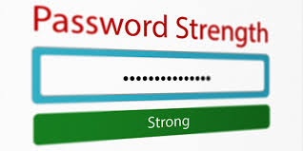

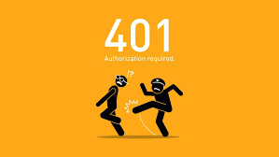
Digital Safety
Protect your computer against virus and use a virus protector such as Norton or McAfee
Use a strong Password
Do not share your bank details to any unknown person
Do not access unauthorised website

