Slide 1

Sustainability Measurement
Assessing progress towards environmental and social goals
Notes:
---

Slide 2
Sustainability Measurement Overview
Notes:
Sustainability Measurement, Introduction, Why Measure Sustainability?, Key Dimensions of Sustainability, Common Sustainability Metrics, Frameworks and Standards, Data Collection Methods, Tools and Technologies, Challenges in Sustainability Measurement, Best Practices, Case Example, Conclusion

Slide 3

Sustainability Measurement
Comprehensive Assessment
  Sustainability measurement evaluates environmental, social, and economic impacts for holistic understanding.
Quantitative and Qualitative Metrics
  Combines measurable data like emissions with insights on stakeholder perceptions and governance.
Supports Decision-Making
  Provides transparency and tracking over time to aid strategic planning and accountability.
Drives Continuous Improvement
  Enables goal setting, progress monitoring, and innovation aligned with societal and planetary needs.
Notes:
Sustainability measurement refers to the systematic process of assessing how activities, organizations, products, or policies perform across environmental, social, and economic dimensions. At its core, it aims to translate the abstract concept of sustainability into concrete, observable, and comparable indicators that can inform decision-making. Rather than focusing solely on financial outcomes, sustainability measurement expands the scope of evaluation to include long-term impacts on natural ecosystems, human well-being, and economic resilience. This approach recognizes that short-term gains can lead to long-term risks if environmental degradation or social inequities are ignored. A comprehensive sustainability measurement framework integrates quantitative metrics, such as greenhouse gas emissions or energy consumption, with qualitative insights, such as stakeholder perceptions or governance practices. It also emphasizes consistency and transparency, ensuring that results can be tracked over time and compared across organizations or sectors. By providing a structured way to understand performance, sustainability measurement supports strategic planning, risk management, and accountability. It enables organizations to set meaningful goals, monitor progress, and communicate outcomes to stakeholders, including investors, regulators, employees, and the public. Ultimately, sustainability measurement is not an end in itself but a foundational tool for driving continuous improvement, fostering innovation, and aligning organizational activities with broader societal and planetary boundaries.

Slide 4

Introduction
Need for Sustainability Measurement
  Sustainability measurement arises from growing concerns around climate change, resource depletion, and social inequality.
Holistic Performance Evaluation
  It provides a structured, holistic approach beyond traditional profit metrics to assess impacts and risks.
Bridging Ambition and Reality
  Sustainability measurement bridges ambitions with operational realities using clear indicators and methodologies.
Dynamic and Evolving Practice
  Measurement evolves with scientific advances, regulations, and stakeholder demands, enhancing precision and actionability.
Notes:
The introduction to sustainability measurement establishes why measuring sustainability has become a critical priority for organizations and governments worldwide. Growing concerns about climate change, resource depletion, social inequality, and economic instability have highlighted the limitations of traditional performance metrics that focus primarily on profit and growth. Sustainability measurement emerged as a response to these challenges, offering a more holistic lens for evaluating success. It provides a structured way to identify impacts, dependencies, and risks that may not be immediately visible in financial statements. By introducing clear indicators and methodologies, sustainability measurement helps bridge the gap between sustainability ambitions and operational reality. It encourages organizations to move beyond vague commitments and instead adopt evidence-based approaches to managing their environmental and social footprints. This introductory perspective also emphasizes the dynamic nature of sustainability measurement, which evolves alongside scientific knowledge, regulatory expectations, and stakeholder demands. As data availability and analytical tools improve, measurement practices are becoming more precise and actionable. Importantly, sustainability measurement supports learning and adaptation by revealing trade-offs, highlighting unintended consequences, and enabling informed prioritization. Through this lens, sustainability is framed not as a constraint, but as an opportunity to enhance long-term value creation, resilience, and trust.

Slide 5

Why Measure Sustainability?
Performance Tracking
  Measuring sustainability enables tracking of impacts and progress toward sustainability goals effectively.
Compliance and Reporting
  Measurement supports adherence to regulations and reporting requirements on environmental and social standards.
Improved Decision-Making
  Reliable sustainability data helps leaders make informed decisions about resource allocation and innovation.
Transparency and Trust
  Sustainability measurement builds transparency, enhancing credibility and stakeholder trust.
Notes:
Measuring sustainability is essential because it transforms values and intentions into actionable insights that guide behavior and decision-making. Without measurement, sustainability efforts remain difficult to manage, compare, or improve. One key reason to measure sustainability is performance tracking, which allows organizations to understand their current impacts and monitor progress toward defined goals. Measurement also supports compliance with increasing regulatory and reporting requirements related to environmental protection, labor standards, and corporate governance. Another important driver is improved decision-making, as reliable data enables leaders to evaluate trade-offs, allocate resources effectively, and identify opportunities for efficiency and innovation. Sustainability measurement also enhances transparency and credibility, helping organizations build trust with stakeholders such as investors, customers, employees, and communities. In the context of ESG reporting, measurement provides the evidence base needed to demonstrate responsible practices and manage reputational risk. Additionally, measuring sustainability helps organizations anticipate and mitigate long-term risks, including climate-related disruptions, supply chain vulnerabilities, and social conflicts. By making impacts visible and comparable, sustainability measurement becomes a powerful lever for accountability, learning, and continuous improvement.

Slide 6

Key Dimensions of Sustainability
Environmental Dimension
  Focuses on impacts on natural systems including emissions, energy, water, waste, and biodiversity.
Social Dimension
  Examines impacts on people including labor, health, diversity, human rights, and community engagement.
Economic Dimension
  Addresses financial performance, innovation, productivity, and sustainable value over time.
Interconnected Sustainability
  Dimensions are interdependent, requiring integrated analysis for balanced sustainability assessment.
Notes:
Sustainability measurement is commonly structured around three interconnected dimensions: environmental, social, and economic. The environmental dimension focuses on how activities affect natural systems, including metrics related to greenhouse gas emissions, energy use, water consumption, waste generation, and biodiversity impacts. Measuring these factors helps identify pressure points on ecosystems and opportunities to reduce environmental harm. The social dimension examines impacts on people and communities, covering areas such as labor conditions, health and safety, diversity and inclusion, human rights, and community engagement. Social metrics aim to capture how organizations contribute to or detract from social well-being and equity. The economic dimension addresses financial performance and long-term viability, including profitability, productivity, innovation capacity, and resilience to external shocks. Importantly, this dimension goes beyond short-term financial results to consider sustainable value creation over time. Effective sustainability measurement recognizes that these dimensions are interdependent. Improvements in one area may create trade-offs or synergies in another, making integrated analysis essential. By measuring all three dimensions together, organizations can gain a balanced understanding of their overall sustainability performance.

Slide 7

Common Sustainability Metrics
Environmental Metrics
  Environmental metrics include carbon footprints, energy use, water withdrawal, waste generation, and recycling rates to measure ecological impact.
Social Metrics
  Social metrics assess employee turnover, workplace safety, training, gender pay equity, and community investment for social responsibility.
Economic Metrics
  Economic metrics measure financial health through revenue stability, R&D investment, and cost savings from efficiency improvements.
Metric Application Principles
  Metrics must align with strategy, be clearly defined, consistently applied, and supported by reliable data for effective sustainability monitoring.
Notes:
Common sustainability metrics provide standardized ways to quantify and compare impacts across organizations and sectors. Environmental metrics often include carbon footprint measurements, expressed as carbon dioxide equivalent emissions, which capture contributions to climate change. Other widely used indicators include energy consumption, water withdrawal and discharge, waste generation, and recycling rates. Social metrics may cover employee turnover, workplace injuries, training hours, gender pay equity, and community investment. These indicators help assess how organizations manage human capital and social responsibility. Economic sustainability metrics typically include measures of long-term financial health, such as revenue stability, investment in research and development, and cost savings from efficiency improvements. The selection of metrics should align with organizational strategy, stakeholder priorities, and material impacts. Importantly, metrics must be clearly defined, consistently applied, and supported by reliable data sources. While no single metric can capture sustainability in its entirety, a well-designed set of indicators provides a practical foundation for monitoring performance, identifying trends, and informing strategic action.

Slide 8

Frameworks and Standards
ESG Frameworks Overview
  ESG frameworks guide sustainability by focusing on environmental, social, and governance factors for investors and markets.
Global Reporting Initiative
  GRI standards emphasize transparency and inclusiveness in sustainability reporting across various impacts.
UN Sustainable Development Goals
  UN SDGs align organizational efforts with global societal objectives for sustainable development.
ISO and SASB Standards
  ISO 14001 and SASB provide environmental management and industry-specific sustainability metrics respectively.
Notes:
Frameworks and standards play a crucial role in sustainability measurement by providing common definitions, methodologies, and reporting structures. ESG frameworks focus on environmental, social, and governance factors that are relevant to investors and financial markets. The Global Reporting Initiative (GRI) offers comprehensive standards for reporting a wide range of sustainability impacts, emphasizing transparency and stakeholder inclusiveness. The United Nations Sustainable Development Goals (UN SDGs) provide a global reference point for aligning organizational activities with broader societal objectives. ISO standards, such as ISO 14001, focus on environmental management systems and continuous improvement. The Sustainability Accounting Standards Board (SASB) develops industry-specific metrics that highlight financially material sustainability issues. Using recognized frameworks enhances comparability, credibility, and alignment with external expectations. However, organizations must carefully select and integrate frameworks to avoid duplication and reporting fatigue. When applied thoughtfully, standards and frameworks provide a robust foundation for consistent and meaningful sustainability measurement.

Slide 9

Data Collection Methods
Direct Measurement Technologies
  Sensors and IoT track energy, emissions, and resources in real time for accurate sustainability data.
Social and Governance Data
  Surveys and audits collect social data like employee engagement and supplier compliance effectively.
Integrated Enterprise Systems
  ERP and sustainability platforms consolidate multiple operational data sources for comprehensive analysis.
Remote Sensing and Satellite Data
  Satellite imagery and remote sensing provide valuable data on land use and biodiversity monitoring.
Notes:
Data collection is a critical component of effective sustainability measurement, as the quality of insights depends on the reliability and relevance of underlying data. Common methods include direct measurement through sensors and Internet of Things technologies, which can track energy use, emissions, and resource flows in real time. Surveys and audits are often used to collect social and governance data, such as employee engagement or supplier compliance. Enterprise information systems, including ERP and sustainability management platforms, integrate data from multiple operational sources. In some cases, satellite imagery and remote sensing provide valuable environmental data, particularly for land use and biodiversity monitoring. Each method has strengths and limitations related to accuracy, cost, and coverage. Combining multiple data sources can improve completeness and robustness. Clear data governance, documentation, and validation processes are essential to ensure consistency over time. By investing in reliable data collection, organizations can strengthen the credibility and usefulness of their sustainability measurements.

Slide 10

Tools and Technologies
Data Analytics Platforms
  Platforms process large sustainability data volumes to identify trends, correlations, and anomalies effectively.
AI and Machine Learning
  AI enhances forecasting, optimizes resource use, and detects inefficiencies in sustainability efforts.
Lifecycle Assessment Tools
  These tools evaluate environmental impacts across products’ full life cycle, from creation to disposal.
Carbon Accounting and Digital Twins
  Software calculates greenhouse emissions, while digital twins simulate scenarios for sustainability decisions.
Notes:
A wide range of tools and technologies support sustainability measurement by enabling data management, analysis, and reporting. Data analytics platforms help process large volumes of sustainability data and identify trends, correlations, and anomalies. Artificial intelligence and machine learning can enhance forecasting, optimize resource use, and detect inefficiencies. Lifecycle assessment tools evaluate environmental impacts across the full life cycle of products and services, from raw material extraction to end-of-life disposal. Carbon accounting software supports the calculation and tracking of greenhouse gas emissions across scopes and value chains. Emerging technologies such as digital twins allow organizations to simulate scenarios and assess the sustainability implications of different decisions. The effective use of these tools requires not only technical capability but also clear objectives and skilled personnel. When aligned with strategy, technology can significantly enhance the accuracy, timeliness, and actionability of sustainability measurement.

Slide 11
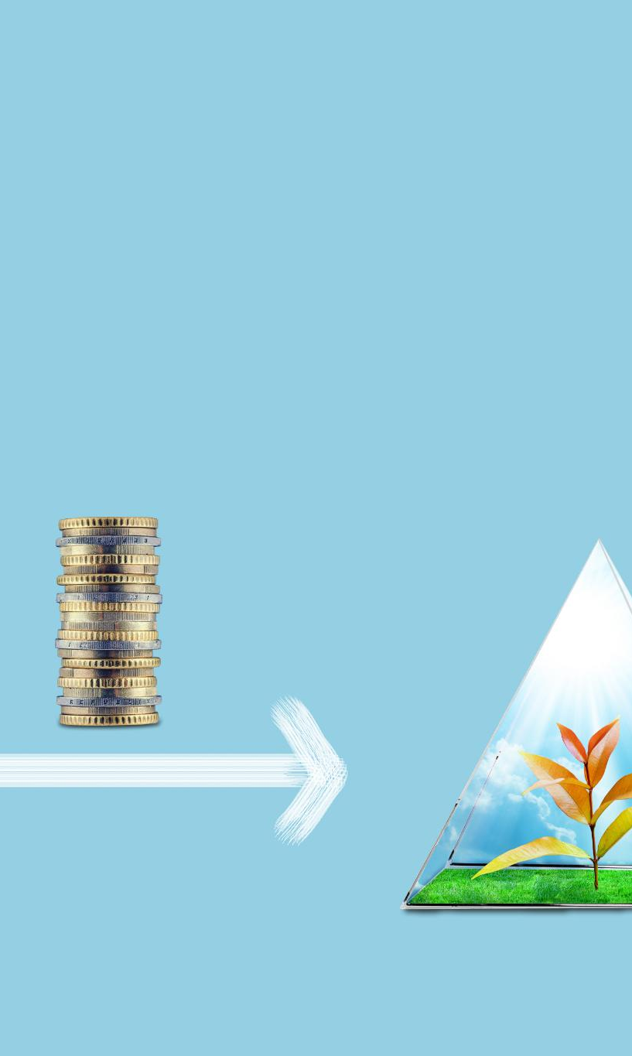
Challenges in Sustainability Measurement
Data Quality and Availability
  Data quality issues and limited availability hinder accurate sustainability measurement in complex supply chains and indirect impacts.
Standardization and Methodologies
  Inconsistent definitions and overlapping frameworks complicate comparison across organizations and reporting periods.
Cost and Complexity
  High cost and complexity of data collection pose challenges, especially for smaller organizations measuring sustainability.
Measuring Intangible Impacts
  Quantifying social well-being and ecosystem health remains difficult, risking narrow focus on easily measurable indicators.
Notes:
Despite its benefits, sustainability measurement faces several persistent challenges. Data quality and availability are common issues, particularly for complex supply chains or indirect impacts. Inconsistent definitions and methodologies can make comparisons difficult across organizations and reporting periods. Standardization remains a challenge, as multiple frameworks and metrics may overlap or conflict. The cost and complexity of data collection and management can also be significant, especially for smaller organizations. Additionally, some sustainability impacts are inherently difficult to quantify, such as social well-being or ecosystem health. There is also a risk of focusing too narrowly on easily measurable indicators while overlooking broader systemic effects. Addressing these challenges requires clear prioritization, stakeholder engagement, and continuous refinement of measurement approaches. Recognizing limitations and uncertainties is an important part of responsible sustainability measurement.

Slide 12

Best Practices
Clear Objectives and KPIs
  Define clear objectives and key performance indicators reflecting material sustainability impacts.
Standardized Frameworks
  Use standardized frameworks and methodologies to enhance comparability and credibility.
Data Accuracy and Governance
  Ensure robust governance, validation, and documentation processes to maintain data accuracy.
Continuous Monitoring and Communication
  Regular monitoring and transparent communication build trust and identify improvement opportunities.
Notes:
Best practices in sustainability measurement emphasize clarity, consistency, and continuous improvement. Organizations should begin by defining clear objectives and identifying key performance indicators that reflect their most material impacts. Using standardized frameworks and methodologies enhances comparability and credibility. Ensuring data accuracy through robust governance, validation, and documentation processes is essential. Integrating sustainability measurement into core business processes, rather than treating it as a separate activity, supports better decision-making. Regular monitoring and review help identify trends, risks, and opportunities for improvement. Transparent communication of methods, assumptions, and results builds trust with stakeholders. Finally, sustainability measurement should be viewed as an evolving practice, adapting to new knowledge, technologies, and expectations over time.

Slide 13
Case Example
Energy Monitoring Implementation
Detailed energy monitoring at the process level helped identify inefficiencies and peak consumption periods in the manufacturing facilities.
Data-Driven Optimization
Data analysis revealed opportunities for equipment upgrades and process improvements that reduced energy use effectively.
Sustainability and Cost Benefits
The initiative reduced energy consumption and emissions by 20%, generating cost savings and improving operational resilience.
Notes:
A practical case example illustrates how sustainability measurement can drive tangible improvements. Consider a manufacturing company that implemented detailed energy monitoring across its production facilities. By measuring energy consumption at the process level, the company identified inefficiencies and peak usage patterns. Data analysis revealed opportunities for equipment upgrades, process optimization, and behavioral changes among employees. As a result, the company reduced its energy use and associated greenhouse gas emissions by 20 percent over two years. Beyond environmental benefits, the initiative delivered cost savings and improved operational resilience. The case demonstrates how targeted measurement, combined with clear goals and accountability, can translate sustainability data into meaningful action and value creation.

Slide 14

Conclusion
Foundation of Sustainability Management
  Sustainability measurement is crucial for managing environmental, social, and economic impacts effectively.
Supports Accountability and Transparency
  Measurement enables organizations to move from intention to action through informed decision-making and accountability.
Challenges and Advances
  Despite challenges in data and standardization, advances in tools and frameworks improve sustainability measurement practices.
Strategic Capability for Success
  Embedding sustainability measurement in decision-making drives resilience, innovation, and long-term sustainable success.
Notes:
In conclusion, sustainability measurement is a foundational element of effective sustainability management and long-term value creation. By systematically assessing environmental, social, and economic impacts, organizations gain the insights needed to navigate complex challenges and opportunities. Measurement supports accountability, transparency, and informed decision-making, enabling organizations to move from intention to action. While challenges related to data, standardization, and complexity remain, ongoing advances in frameworks, tools, and technologies continue to strengthen measurement practices. Ultimately, sustainability measurement is not merely a reporting exercise but a strategic capability that helps organizations align their operations with societal expectations and planetary limits. When embedded into everyday decision-making, it becomes a powerful driver of resilience, innovation, and sustainable success.

