Slide 1

FEMORAL ACETABULAR IMPINGEMENT (FAI)

Slide 2
FAI
Cause of early osteoarthrosis of the hip especially in young and active people
Early pathologic contact between skeletal prominences of the acetabulum and femur that limits physiologic hip range of motion.
Occurs typically during flexion and internal rotation.

Slide 3
FAI
Pincer impingement: acetabular cause of FAI
  Focal or generalized over coverage of the femoral head.
CAM impingement: femoral cause of FAI
  Due to an aspherical portion of the femoral head- neck junction.
Mixed: 86% -Beck et al JBJS Br 2005

Slide 4
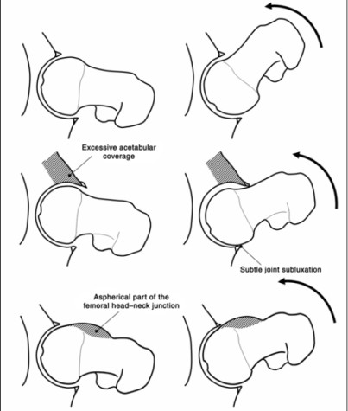

PREDISPOSING FACTORS
Some predisposing factors to FAI
  Perthes disease
  Congenital hip dysplasia
  Slipped capital femoral ephiphysis
  Avascular necrosis
  Mal-united fractures
  Acetabular protrusion
  Elliptical femoral head
  Retroverted acetabulum
  Prominent femoral head- neck junction

Slide 5
PREDISPOSED AETIOLOGY
Abnormal anatomy
  Prominent femoral head neck junction
  Acetabular over coverage
Unusual stresses
  Carpet layers – repeated flexion, adduction, internal rotation

Slide 6
CLINICAL FINDINGS OF FAI
Young: usually in 20-40’s
CAM type: M:F 14:1 (avg age: 32).
Pincer type: M:F 1:3 and usually middle age women (avg age: 40)
Estimated prevalence: 10-15%
Present with groin pain with hip rotation, in sitting position, or during/after sports
Typically aware of limited hip mobility long before sx.

Slide 7
CLINICAL FINDINGS FAI
Diagnosis of FAI syndrome does not depend on a single clinical sign; many have been described and are used in clinical practice.
Hip impingement tests usually reproduce the patient’s typical pain; the most commonly used test, flexion adduction internal rotation (FADIR), is sensitive but not specific.There is often a limited range of hip motion, typically restricted internal rotation in flexion.

Slide 8
TERMINOLOGY FAI
FAI Syndrome
  The primary symptom of FAI syndrome is motion- related or position-related pain in the hip or groin. Pain may also be felt in the back, buttock or thigh. In addition to pain, patients may also describe clicking, catching, locking, stiffness, restricted range of motion or giving way.
Cam morphology
Pincer morphology

Slide 9
IMAGING FAI
An anteroposterior radiograph of the pelvis and a lateral femoral neck view of the symptomatic hip should initially be performed to obtain an overview of the hips, identify cam or pincer morphologies, and identify other causes of hip pain.
Where further assessment of hip morphology and associated cartilage and labral lesions is desired, cross- sectional imaging is appropriate.

Slide 10
MANAGEMENT FAI
FAI syndrome can be treated by conservative care, rehabilitation or surgery.
Conservative care may involve education, watchful waiting, lifestyle and activity modification.
Physiotherapy-led rehabilitation aims to improve hip stability, neuromuscular control, strength, range of motion and movement patterns.
Surgery, either open or arthroscopic, aims to improve the hip morphology and repair damaged tissue.The good management of the variety of patients with FAI syndrome requires the availability of all of these approaches

Slide 11
PROGNOSIS FAI
In patients who are treated for FAI syndrome, symptoms frequently improve, and they return to full activity, including sports.
Without treatment, symptoms of FAI syndrome will probably worsen over time.The long-term outlook for patients with FAI syndrome is unknown. However, it is likely that cam morphology is associated with hip osteoarthritis. It is currently unknown whether treatment for FAI syndrome prevents hip osteoarthritis.

Slide 12
OUTCOMES FAI
Specifically designed and well-validated patient- reported outcome measures should be used to assess treatment for FAI syndrome. The international Hip Outcome Tool (iHOT), Hip and Groin Outcome Score (HAGOS) and Hip Outcome Score (HOS) are recommended.

