Slide 1
TRRS4010
Judaism & Christianity

Slide 2
Dr Angus M Slater
Lecturer in Theology & Religious Studies
Office:
Email:
Office Hours:

Slide 3
Course outline
Week 6:
Sources of Christianity & The Place of Jesus
Week 7:
Paul to the Middle Ages & Reformation to the 19th Century
Week 8:
Modern Theology & Christian Worship
Week 9:
Women in Christian History & Feminist Theology
Week 10:
Contemporary Christianity & Multiple Christianities

Slide 4
General Practice
4hrs a week
2 hrs of lecture
1 hr of seminar
1 hr of set reading / tutorials
All content on Moodle
Released as weeks pass
Readings available as PDF’s / eReadings
Attendance monitoring

Slide 5
Week 6i: sources of Christianity
Gospels, History, creeds, tradition

Slide 6
Christianity
HOW DO WE KNOW WHAT WE KNOW?
Sources – Gospels, Creeds, Historical, Tradition
Historical Jesus
Christ of Faith

Slide 7
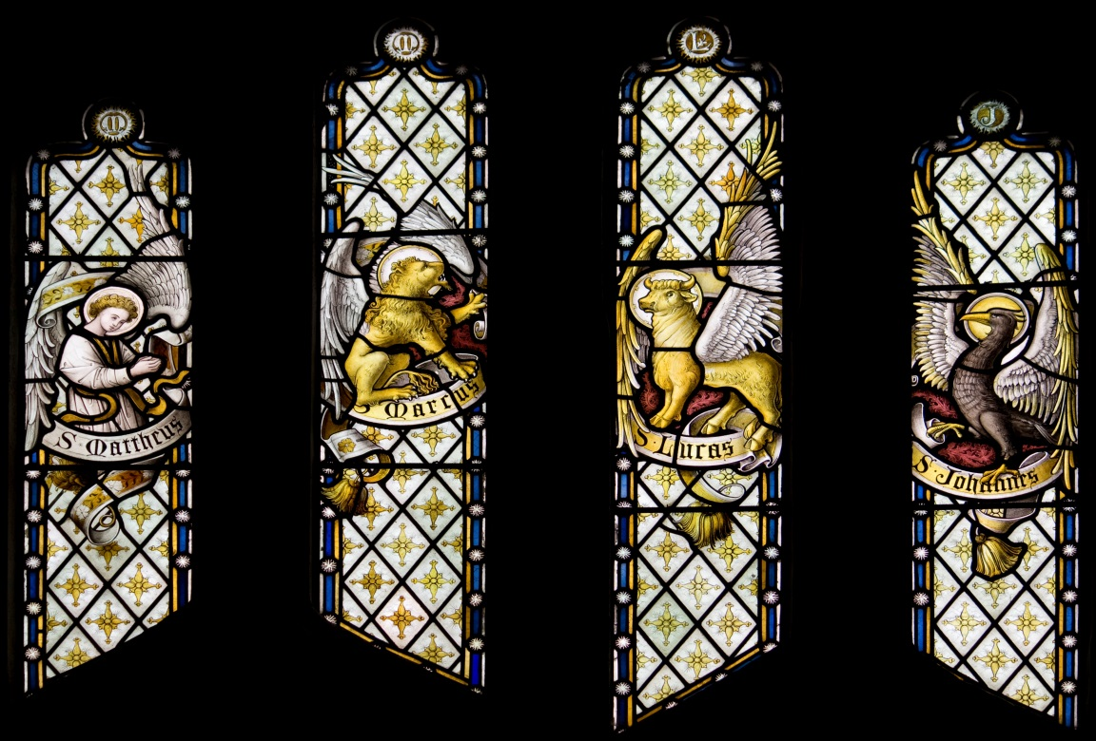
Sources – The new testament
4 Gospels (Matthew, Mark, Luke, John)
Account of actions of Jesus and importance of those actions
Written in varied styles, for different audiences, by different authors, using different sources

Slide 8
Sources – The New Testament
Luke 1: 3-4
John 20: 31
‘I too decided, after investigating everything carefully from the very first, to write an orderly account for you, most excellent Theophilus, so that you may know the truth concerning the things about which you have been instructed’
‘But these are written so that you may come to believe that Jesus is the Messiah, the Son of God, and that through believing you may have life in his name’

Slide 9
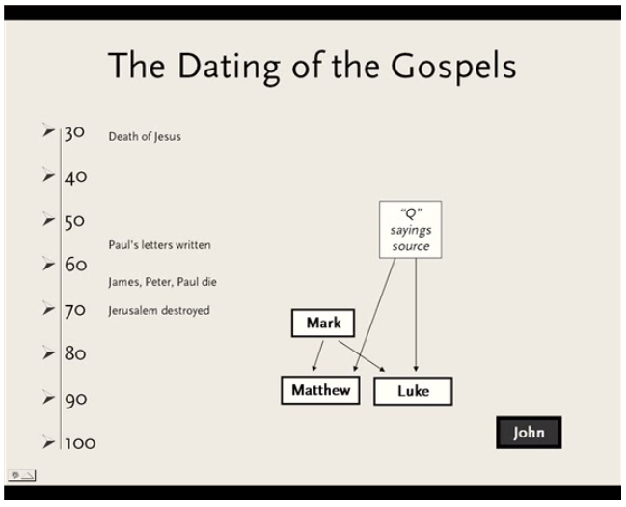
Sources – the new testament

Slide 10
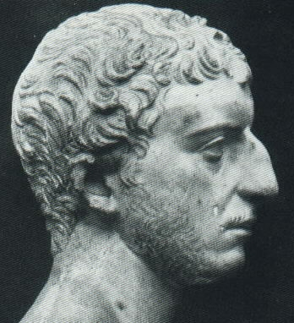
Sources - Josephus
Titus Flavius Josephus, born Yosef ben Matityahu
First-century scholar and historian
Jewish, adopts Roman citizenship
Author of “The Jewish War” and “Jewish Antiquities”

Slide 11
Sources - josephus
FlaviuS Josephus:
Antiquities of the Jews Book 20, Chapter 9, 1
FlaviuS Josephus:
Antiquities of the Jews Book 18, Chapter 5, 2
  Festus was now dead, and Albinus was but upon the road; so he assembled the Sanhedrin of judges, and brought before them the brother of Jesus, who was called Christ, whose name was James, and some others; and when he had formed an accusation against them as breakers of the law, he delivered them to be stoned: but as for those who seemed the most equitable of the citizens, and such as were the most uneasy at the breach of the laws, they disliked what was done;
Now some of the Jews thought that the destruction of Herod's army came from God, and that very justly, as a punishment of what he did against John, that was called the Baptist: for Herod slew him, who was a good man... Herod, who feared lest the great influence John had over the people might put it into his power and inclination to raise a rebellion... Accordingly he was sent a prisoner, out of Herod's suspicious temper, to Macherus, the castle I before mentioned, and was there put to death

Slide 12
Sources - Josephus
FlaviuS Josephus:
Antiquities of the Jews Book 18, Chapter 3, 3
Testimonium Flavianum
About this time there lived Jesus, a wise man, if indeed one ought to call him a man. For he was one who performed surprising deeds and was a teacher of such people as accept the truth gladly. He won over many Jews and many of the Greeks. He was the Christ. And when, upon the accusation of the principal men among us, Pilate had condemned him to a cross, those who had first come to love him did not cease.
He appeared to them spending a third day restored to life, for the prophets of God had foretold these things and a thousand other marvels about him. And the tribe of the Christians, so called after him, has still to this day not disappeared

Slide 13
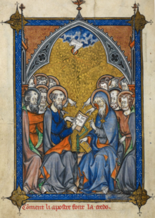
Sources - Creeds
Creeds are statements of faith – series of beliefs and understandings that describe what it is Jesus is and what Christians believe about Jesus
Church history contains a multitude of different creeds that all attempt to define what is, and what is not, “true” Christianity

Slide 14
Sources – Apostles Creed (390AD)
I believe in God, the Father almighty,
creator of heaven and earth.
I believe in Jesus Christ, God's only Son, our Lord,
who was conceived by the Holy Spirit,
born of the Virgin Mary,
suffered under Pontius Pilate,
was crucified, died, and was buried;
he descended to the dead.
On the third day he rose again;
he ascended into heaven,
he is seated at the right hand of the Father,
and he will come to judge the living and the dead.
I believe in the Holy Spirit,
the holy catholic Church,
the communion of saints,
the forgiveness of sins,
the resurrection of the body,
and the life everlasting. Amen

Slide 15
Sources – Chalcedon (451AD)
We, then, following the holy Fathers, all with one consent, teach people to confess one and the same Son, our Lord Jesus Christ, the same perfect in Godhead and also perfect in manhood;
truly God and truly man, of a reasonable [rational] soul and body; consubstantial [co-essential] with the Father according to the Godhead, and consubstantial with us according to the Manhood; in all things like unto us, without sin;
begotten before all ages of the Father according to the Godhead, and in these latter days, for us and for our salvation, born of the Virgin Mary, the Mother of God, according to the Manhood;
one and the same Christ, Son, Lord, only begotten, to be acknowledged in two natures, inconfusedly, unchangeably, indivisibly, inseparably; the distinction of natures being by no means taken away by the union, but rather the property of each nature being preserved, and concurring in one Person and one Subsistence, not parted or divided into two persons, but one and the same Son, and only begotten God, the Word, the Lord Jesus Christ;
as the prophets from the beginning [have declared] concerning Him, and the Lord Jesus Christ Himself has taught us, and the Creed of the holy Fathers has handed down to us.

Slide 16
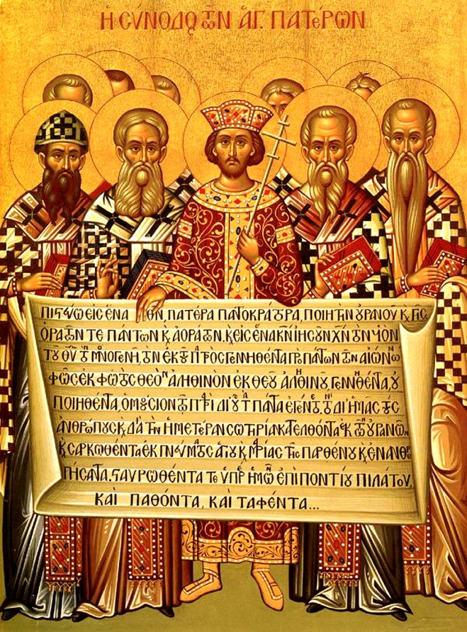
Sources - creeds
Creeds tell us about who Jesus is believed to be.
They relate to ongoing historical questions of faith and are often reactions to schisms in the early church (e.g. Arius)
Creeds give us an outline of why Jesus is an important figure in Christianity and teach aspects of theology – the study of how / what God is

Slide 17
Sources – Later traditions
From these sources, an entire tradition and story has been built up that combines aspects of the gospel tradition, the historical record, religious beliefs, and popular culture
These have created a common narrative of Jesus’s life that includes:
Birth or beginning of ministry
Baptism
Teaching and Miracles
Crucifixion
Resurrection

Slide 18
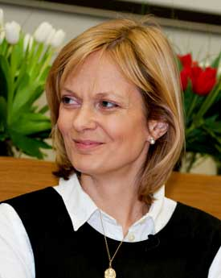
Sources – Later Traditions
Linda Woodhead:
The common narrative thread reflects the gospels’ common purpose:
  to persuade that Jesus was no mere mortal,
  that he was uniquely favoured by God,
  that he has transcended the limitations of normal human life,
  and that those who dedicate their lives to him may share in the eternal life he now enjoys.

Slide 19
Sources
Historical Jesus
Christ of faith
The historical Jesus is an object of historical, not religious, study.
Jesus as a historical figure, his existence, is uncontroversial.
Michael Grant (a classicist) states that:
"In recent years, 'no serious scholar has ventured to postulate the non historicity of Jesus' or at any rate very few, and they have not succeeded in disposing of the much stronger, indeed very abundant, evidence to the contrary.“
Jesus: An Historian's Review of the Gospels, 2004, 200
The Christ of Faith is a term used for the religious study of the importance, significance, and thought of Christ.
It assumes the existence of Jesus and asks about his religious importance for Christianity.
Soren Kierkegaard asked:
“How can something of an historical nature be decisive for an eternal happiness?”
Concluding Unscientific Postscripts, 1846, 86

Slide 20
sources
The Historical Jesus | The Historic Christ
Not relevant for faith | Relevant for faith
Jesus of scholars | Christ of believers
Jesus of critical history | Christ of the Gospels
Uncertain foundation | Certain foundation
Inaccessible to most Christians | Accessible to all Christians
The facticity of Jesus | The significance of Jesus
The Jesus of the past | The Christ of the present

Slide 21
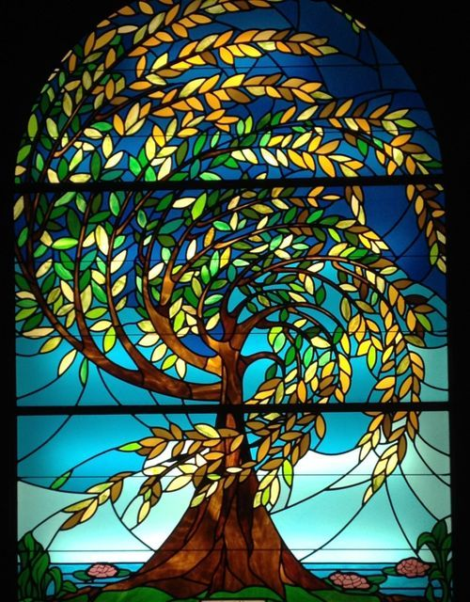
Sources of Christianity
When studying “Christianity” we have a variety of sources to draw on, including:
The Bible, particularly the Gospel accounts of Jesus’ life and actions
Historical accounts from the time, like Josephus’ histories
Creedal statements, like the Apostles or Nicene Creed, which attempt to codify correct beliefs about Jesus
The contemporary tradition, formed of the reception and transmission of the idea of “Christianity” through history and society

Slide 22
Sources of christianity
GOSPELS, HISTORY, CREEDS, TRADITION
We have many different kinds of sources about Jesus and about Christianity
How we choose to approach Jesus and Christianity matters
Just as important as the question “Did Jesus exist?” is the question “What do people believe about Jesus?”

Slide 23
Next Lecture: Jesus
TEACHING AND IMPORTANCE
All these sources of Christianity attempt to tell us something about “Jesus”
Next week we will look at why Jesus is central to Christianity and what we know about his teaching

