Slide 1
Week four session two
Discounted cash flow –
further aspects

Slide 2
Discounted cash flow – further aspects
Objectives
Capital Rationing
Replacement decisions;
Lease v buy decisions.

Slide 3
Discounted cash flow – further aspects
Deal with three specific situations
  Capital rationing
  Replacement decisions
  Lease v buy decisions

Slide 4
Discounted cash flow – further aspects
Capital Rationing
What is Capital Rationing?
Soft capital rationing?
Hard capital rationing?
If an organisation is in a capital rationing situation it will not be able to enter into all projects with positive NPVs
The object of the exercise is to decide how best to invest a limited amount of capital available when there are several investments available.

Slide 5
Discounted cash flow – further aspects
Infinitely divisible projects
The approach is as follows:
  calculate the NPV per $ of initial investment (the profitability index)
  rank the projects in terms of their profitability indexes
  invest as much as possible in the project with the highest profitability index, then go to the project with the next highest, and so on until the capital available is exhausted.
Non-infinitely divisible projects

Slide 6
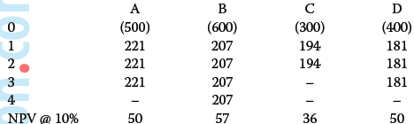
Discounted cash flow – further aspects
Example one
A company has the following 4 projects available:
What should the company’s investment decision be if:
(a) There is no capital rationing
(b) Capital is restricted to $1,600 at time 0 and the projects are infinitely divisible
(c) Capital is restricted to $1,600 at time 0 and the projects are not infinitely divisible.

Slide 7
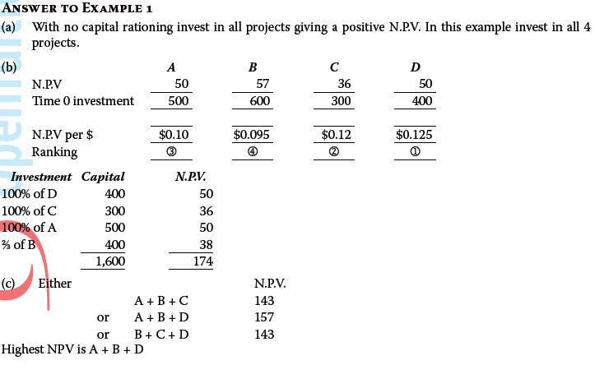
Discounted cash flow – further aspects

Slide 8


Discounted cash flow – further aspects
Replacement
Machines do not last forever
Optimal replacement policy
Equivalent annual costs (EACs)

Slide 9
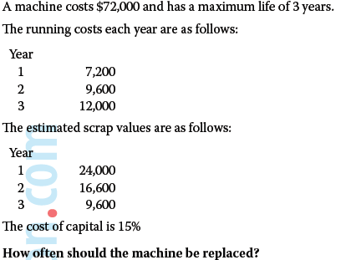
Discounted cash flow – further aspects
Example two

Slide 10
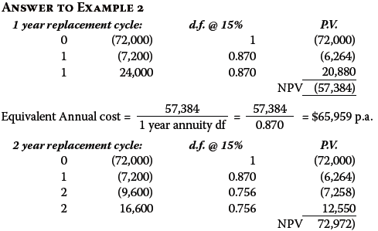
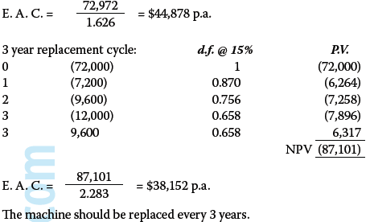
Discounted cash flow – further aspects

Slide 11
Discounted cash flow – further aspects
Lease versus Buy
Buy or financing the machine by way of leasing it rather than buy outright purchase?
Assumptions
  Tax relief on lease payments
  Capital allowances on loans for capital purchase

Slide 12
Discounted cash flow – further aspects
Example three
A company is considering whether to buy a new machine at a cost of $100,000 or alternatively to lease it for $35,000 p.a. (lease payments payable at the start of each year).
Buying it will involve borrowing money at an after tax interest cost of 7% p.a.
If the machine is bought, it will be bought on the last day of current financial year.
The machine will be needed for 4 years, and (if purchased) will have a scrap value after 4 years of $10,000.
Corporation Tax is 30% (payable one year after the end of the financial year)
Capital allowances are 25% (reducing balance).
Should the machine be leased or purchased?

Slide 13
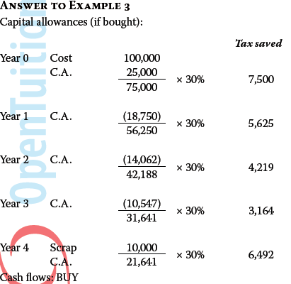
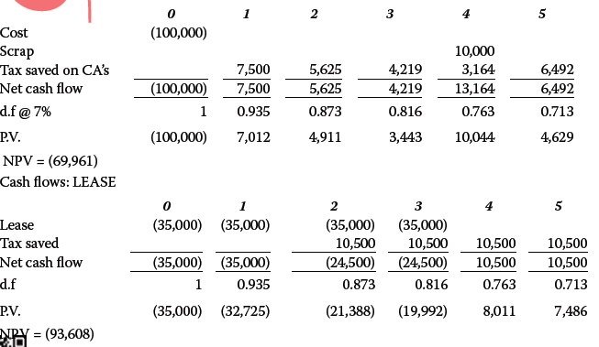
(
)
(
)

Slide 14
Discounted cash flow – further aspects
Summary
Capital Rationing
Replacement decisions;
Lease v buy decisions.

