Slide 1


Module: Population Health and Digital Health Promotion
Module code: LCHS7009
Lecturer: Dr. Raheela Shaikh
Assignment: Component 2 – Individual Poster
Assignment Title: Agoraphobia: Socially Disconnected yet Digitally Free
Student name: Abeer Ishal
Student number: 2128229
Agoraphobia
Picture source: (Stock images no date).
Self-generated picture: (Agoraphobia using Gemini AI, 2026).

Slide 2
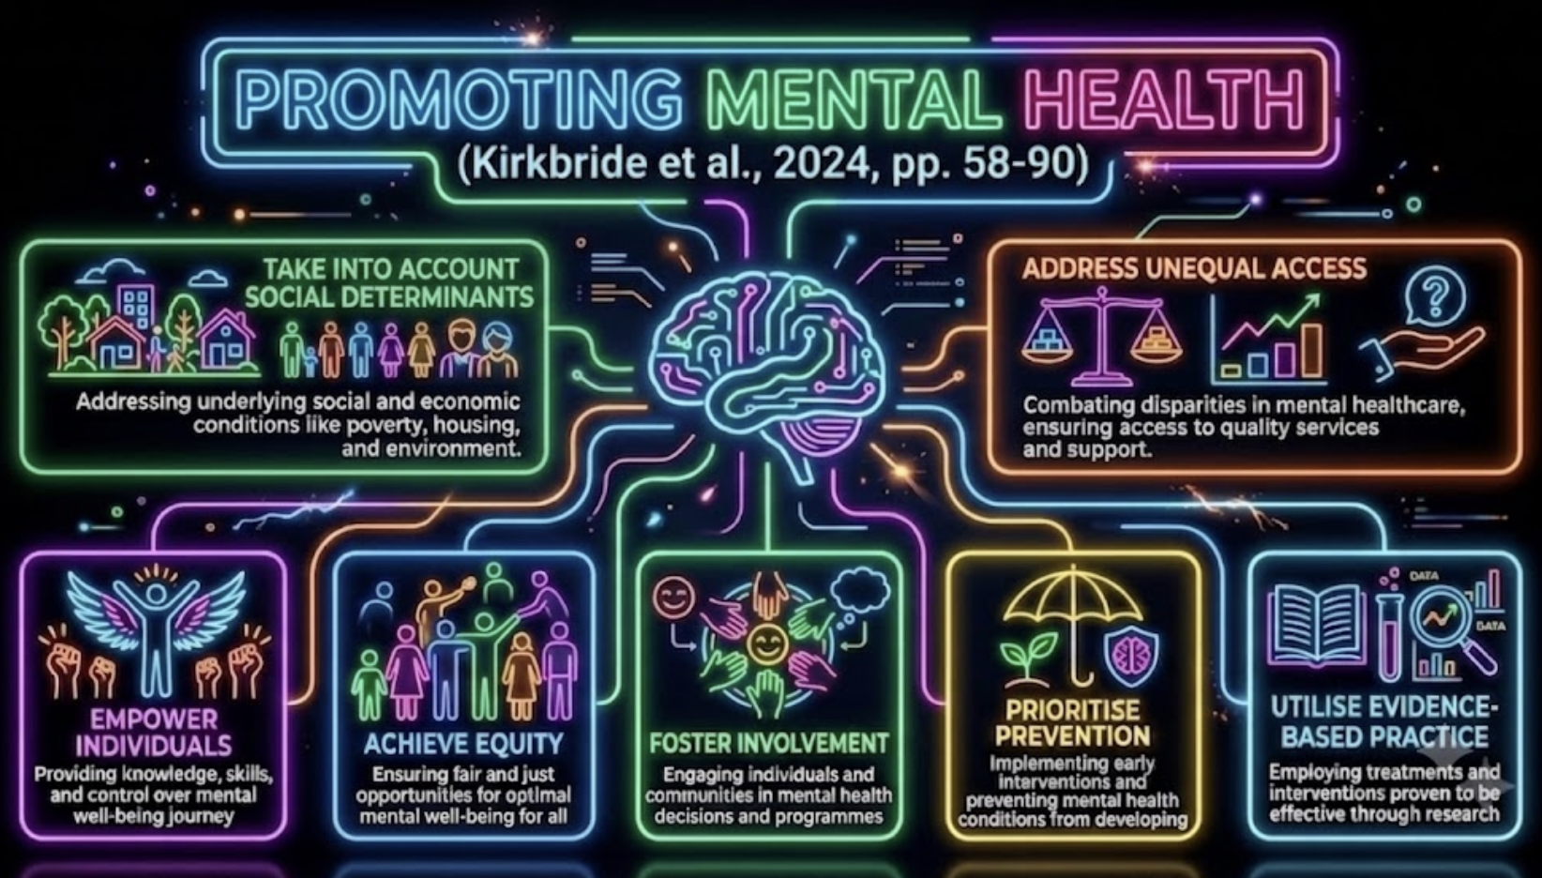


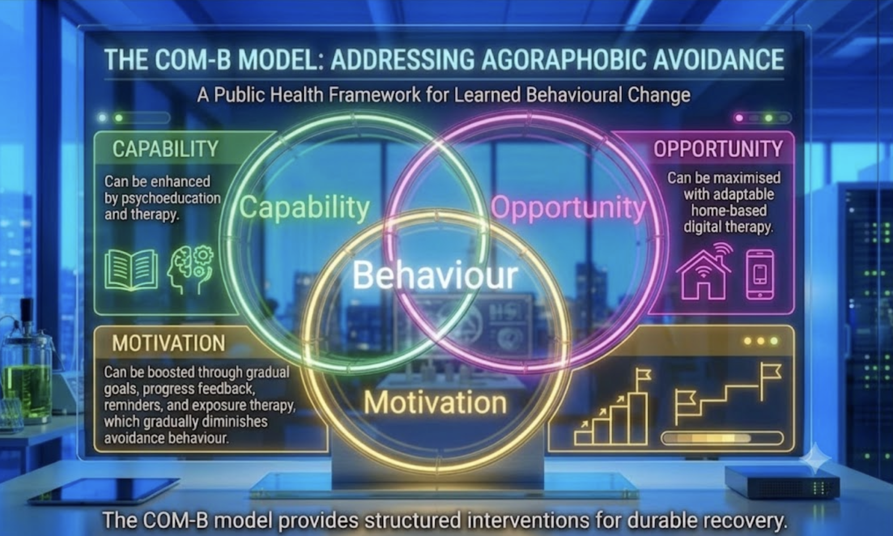

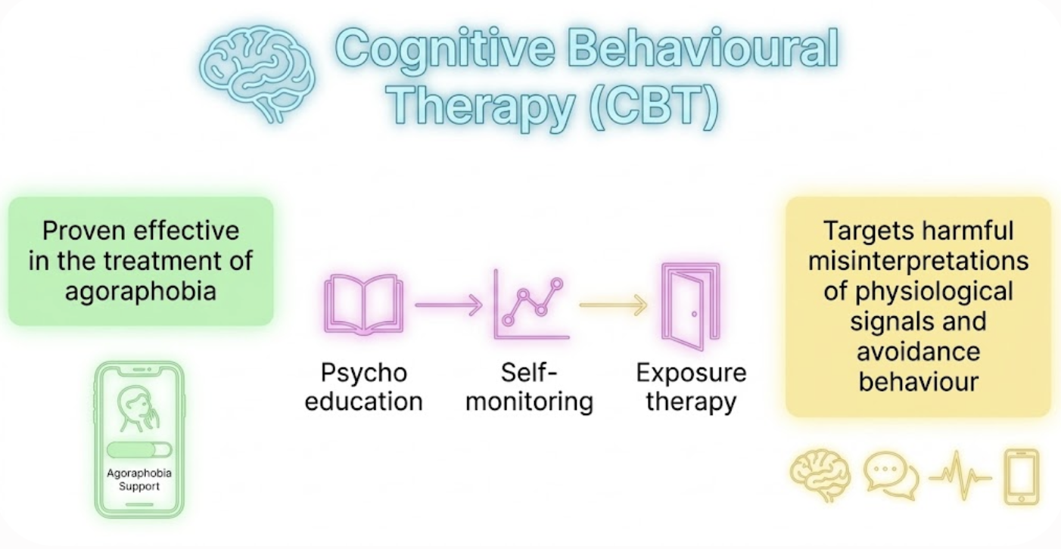
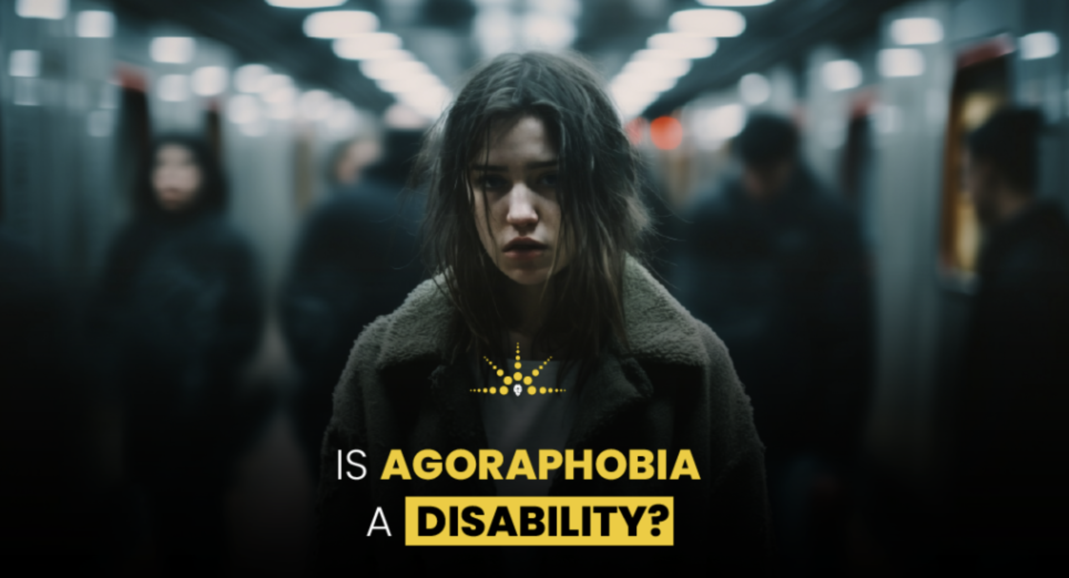
✩ Background: Agoraphobia in UK
⛔️ It reduces life quality.
⛔️ It has close ties to panic disorder.
⛔️ A personality avoidance disorder.
⛔️ It limits outdoor activity.
(Qassem et al., 2021; Lambe et al., 2023; Guth et al., 2025).
⚠️ Symptoms manifest at age 18–35
and are 2× higher in females than males.
(Piras et al., 2021).
▷ Panic disorder affects 2/100 people and about 1/3 will develop agoraphobia.
▷ 20% had ongoing symptoms despite treatment.
(South London and Maudsley NHS, n.d.).
Agoraphobia
(Socially disconnected yet Digitally Free)
1
3
Agoraphobia, (no date).
2
Self-generated picture: (VRT using Gemini Ai, 2026)
✩ Public Health behavioural Change Frameworks
✩ Anticipated outcome
1)App based CBT is beneficial when:
➡️ Exposure therapy is rigorous
➡️ Personalised
➡️ Meticulously adhered to
35% of participants in the exposure app cohort exhibited significant decreases in agoraphobia symptoms after five weeks.
(Guth et al., 2025).
2) The most effective therapy should be:
➡️ Equity-driven
➡️ Inclusive in design
➡️ Digitally flexible
➡️ Multifaceted in approach, rather than merely app-based self-help.
(Robinson et al., 2024; Löchner et al., 2025)
4
Self-generated picture: (CBT Using Gemini AI, 2026).
Self-generated picture: (Promoting Health using Gemini AI, 2026).
7
The Department of Health in the UK awarded multimillion-pound funding to gameChange, the NHS's first virtual reality therapy for agoraphobia (Oxford Health NHS, 2023; NICE, 2023).
(Antonopoulou et al., 2024).
Self-generated picture: (Agoraphobia VRT using Gemini AI, 2026).
✩ Conclusion
Public health need: Agoraphobia is prevalent in the UK, requiring a strategy beyond clinic-based care.
Role of digital tools: App-driven CBT and VRT can widen access to exposure therapy.
Key limitation: Digital App should complement, not replace, professional input.
Core principle: Digital health must do more than digitise; it must proactively enhance fair access.
Conditions for success: Depends on deliberate attention to accessibility, evidence-based guidance and user engagement.
Risk: Technologies risk widening existing mental health disparities.
(Preti et al., 2021; Kirkbride et al., 2024; Guth et al., 2025).
8
5
6
(Pauley et al. 2023; Jung et al., 2025; Spies, Lang and Helbig-Lang, 2025).
Picture 6 Source: (Is agoraphobia a disability, no date).
Self-generated picture: (CBT Using Gemini AI, 2026).

Slide 3
Reference
Agoraphobia (no date) Available at: https://livhospital.b-cdn.net/wp-content/uploads/2025/12/29090335/image-3502.webp (Accessed: 20 June 2026)
Antonopoulou, V., Schenk, P. M., McKinlay, A. R., Chadwick, P., Meyer, C., Gibson, B., Sniehotta, F. F., Lorencatto, F., Vlaev, I., and Chater, A. M. (2024). “Healthcare Professionals’ Responses to Complaints: A Qualitative Interview Study With Patients, Carers and Healthcare Professionals Using the Theoretical Domains Framework and COM‐B Model,” Health expectations: an international journal of public participation in health care and health policy, 27(6), pp. e70118-n/a. Available at: https://doi.org/10.1111/hex.70118. (Accessed: 20 June 2026)
Guth, M., Wiebe, A., Ekhlas-Schumann, M., Rodenjohann, A., Rohlfsen, F., Buchholz, J., Selaskowski, B., Philipsen, A., and Braun, N. (2025). “Mobile App–Guided Exposure Therapy for Panic Disorder With and Without Agoraphobia: Randomized Controlled Trial,” Journal of medical Internet research, 27(12), pp. e76389–e76389. Available at: https://doi.org/10.2196/76389. (Accessed: 17 June 2026)
Is agoraphobia a disability (no date) Available at: https://safestarpsychiatric.com/wp-content/uploads/2024/09/is-Agoraphobia-a-Disability-1024x609.png. (Accessed: 25 June 2026)
Jung, H. W., Jang, K. W., Nam, S., Kim, A., Lee, J., Ahn, M. E., Lee, S.-K., Kim, Y. J., Shin, J.-K., and Roh, D. (2025). “Digital Cognitive Behavioral Therapy for Panic Disorder and Agoraphobia: A Meta-Analytic Review of Clinical Components to Maximize Efficacy,” Journal of clinical medicine, 14(5), p. 1771. Available at: https://doi.org/10.3390/jcm14051771. (Accessed: 11 June 2026).
Kirkbride, J.B., Anglin, D.M., Colman, I., Dykxhoorn, J., Jones, P.B., Patalay, P., Pitman, A., Soneson, E., Steare, T., Wright, T. and Griffiths, S.L. (2024) “The social determinants of mental health and disorder: evidence, prevention and recommendations,” World Psychiatry, 23(1), pp. 58-90. Available at: https://doi.org/10.1002/wps.21160. (Accessed: 17 June 2026)
Lambe, S., Bird, J. C., Loe, B. S., Rosebrock, L., Kabir, T., Petit, A., Mulhall, S., Jenner, L., Aynsworth, C., Murphy, E., Jones, J., Powling, R., Chapman, K., Dudley, R., Morrison, A., Regan, E. O., Yu, L.-M., Clark, D., Waite, F., and Freeman, D. (2023). “The Oxford Agoraphobic Avoidance Scale,” Psychological medicine, 53(4), pp. 1233–1243. Available at: https://doi.org/10.1017/S0033291721002713. (Accessed: 9 June 2026).

Slide 4
Löchner, J., Carlbring, P., Schuller, B., Torous, J., and Sander, L. B. (2025). “Digital interventions in mental health: An overview and future perspectives,” Internet interventions : the application of information technology in mental and behavioural health, 40. Available at: https://doi.org/10.1016/j.invent.2025.100824. (Accessed: 24 June 2026).
Pauley, D., Cuijpers, P., Papola, D., Miguel, C., and Karyotaki, E. (2023). “Two decades of digital interventions for anxiety disorders: a systematic review and meta-analysis of treatment effectiveness,” Psychological medicine, 53(2), pp. 567–579. Available at: https://doi.org/10.1017/S0033291721001999. (Accessed: 15 June 2026)
Preti, A., Piras, M., Cossu, G., Pintus, E., Pintus, M., Kalcev, G., Cabras, F., Moro, M.F., Romano, F., Balestrieri, M. and Caraci, F. (2021). “The Burden of Agoraphobia in Worsening Quality of Life in a Community Survey in Italy,” Psychiatry investigation, 18(4), pp. 277–283. Available at: https://doi.org/10.30773/pi.2020.0342. (Accessed: 10 June 2026).
Qassem, T., Aly-ElGabry, D., Alzarouni, A., Abdel-Aziz, K., and Arnone, D. (2021). “Psychiatric Co-Morbidities in Post-Traumatic Stress Disorder: Detailed Findings from the Adult Psychiatric Morbidity Survey in the English Population,” Psychiatric quarterly, 92(1), pp. 321–330. Available at: https://doi.org/10.1007/s11126-020-09797-4. (Accessed: 20 June 2026).
Robinson, A., Flom, M., Forman-Hoffman, V. L., Histon, T., Levy, M., Darcy, A., Ajayi, T., Mohr, D. C., Wicks, P., Greene, C., and Montgomery, R. M. (2024). “Equity in Digital Mental Health Interventions in the United States: Where to Next?,” Journal of medical Internet research, 26(2), p. e59939. Available at: https://doi.org/10.2196/59939. (Accessed: 22 June 2026).
South London and Maudsley NHS (no date). Agoraphobia . Available at: https://slam.nhs.uk/agoraphobia. (Accessed: 20 June 2026)
Spies, J., Lang, T. and Helbig-Lang, S. (2025) “A Smart Solution? Efficacy of a Self-Management Smartphone App for Panic Disorder and Agoraphobia,” Cognitive therapy and research, 49(1), pp. 98–111. Available at: https://doi.org/10.1007/s10608-024-10513-w. (Accessed: 20 June 2026)
Spies, J., Lang, T. and Helbig-Lang, S. (2025) “A Smart Solution? Efficacy of a Self-Management Smartphone App for Panic Disorder and Agoraphobia,” Cognitive therapy and research, 49(1), pp. 98–111. Available at: https://doi.org/10.1007/s10608-024-10513-w. (Accessed: 20 June 2026)
The National Institute for Health and Care Excellence (2023). Virtual reality technologies for treating agoraphobia or agoraphobic avoidance: early value assessment. [online] Nice.org.uk. Available at: https://www.nice.org.uk/guidance/htg701/chapter/2-The-technologies. (Accessed: 1 June 2026).

