Slide 1
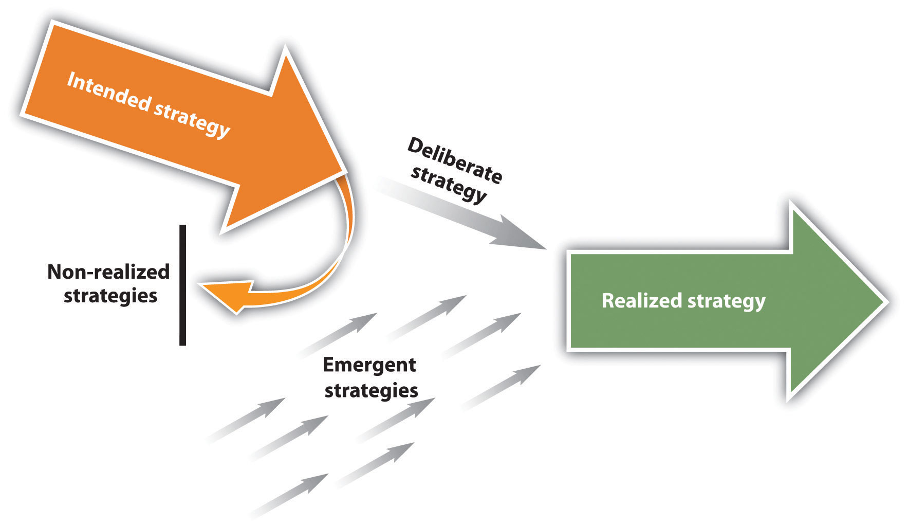
Henry Mintzberg & Strategy
Mintzberg, H., & Waters, J. A. 1985. Of strategies, deliberate and emergent. Strategic Management Journal, 6, 257–272.

Slide 2
Henry Mintzberg & Strategy
Most organizations create intended strategies that they hope to follow to be successful.
Over time, however, changes in an organization’s situation give rise to new opportunities and challenges.
Organizations respond to these changes using emergent strategies.
Realized strategies are a product of both intended and realized strategies.

Slide 3
Exercise
What is the difference between an intended and an emergent strategy?
Can you think of a company that seems to have abandoned its intended strategy? Why do you suspect it was abandoned?
Would you describe your career strategy in college to be more deliberate or emergent? Why?

Slide 4
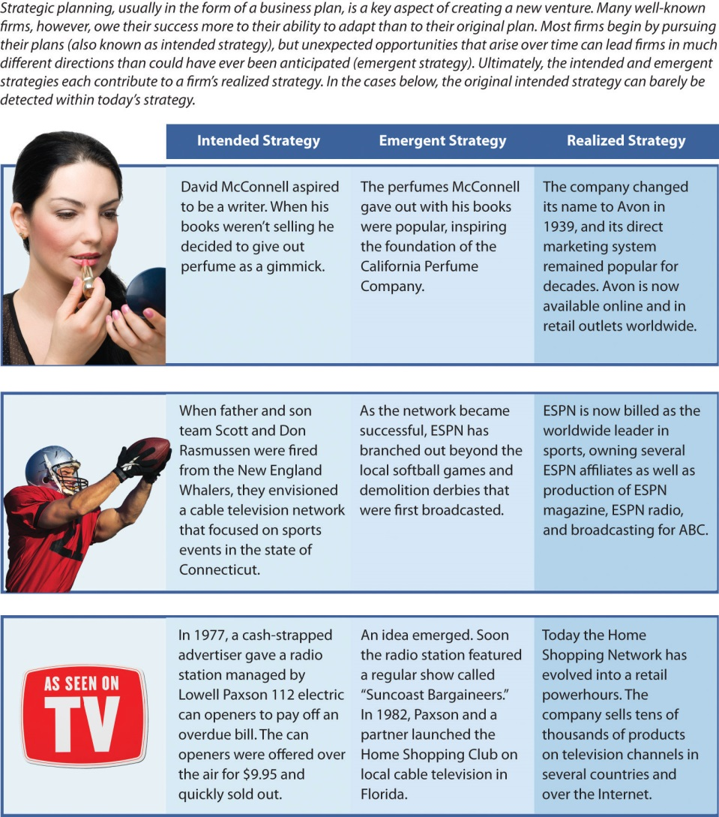
Mintzberg, H., & Waters, J. A. 1985. Of strategies, deliberate and emergent. Strategic Management Journal, 6, 257–272.

