Slide 1
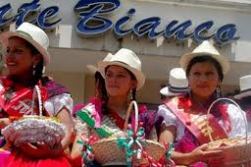
Embodying Country - City Relations:
The Chola Cuencana in Highland Ecuador
Emma-Jayne Abbots

Slide 2
Chola Cuencana, mi chola,
capulllito de amancay,
en ti cantan y en ti ríen
las aguas del Yanuncay.
Eres España que vive
en Cuenca del Ecuador,
con reír de castañuelas
y llanto de rondador.
Con tu donaire y majeza
evocas Andalucía;
pero en todos tus sentires
florece la cuencanía.
Hay en tu cara morena
frescura de amanecer;
y el sol quisiera en tus ojos
cada día atardecer
Chola Cuencana, my chola,
Little branch of amancay,
In you sing and in you laugh
The waters of Yanuncay.
You are Spain living
In Cuenca in Ecuador,
With the laugh of the castanets
And the cry of the panpipes.
With your elegance and grace
You evoke Andalucía;
But in all your senses
Cuenca’s culture flowers
There is in your brown face
The freshness of the dawn;
And the sun longs to set
Each day in your eyes.
Darquea Granda, 1947

Slide 3
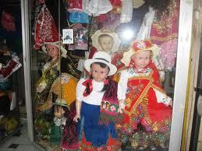
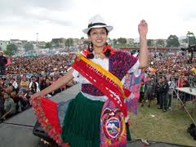
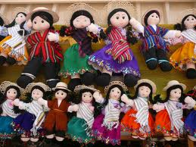
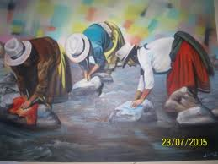

Slide 4
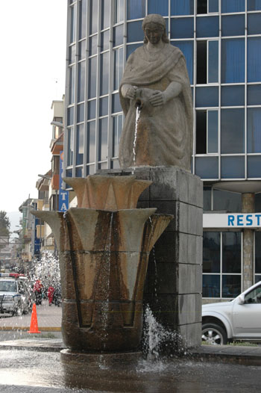
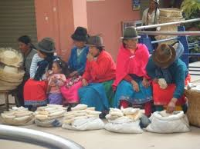
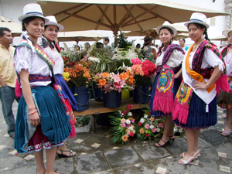
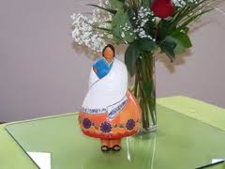

Slide 5
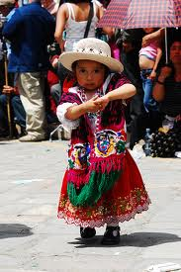
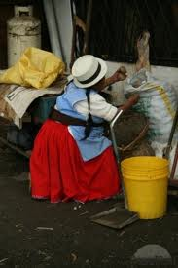
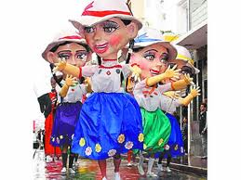
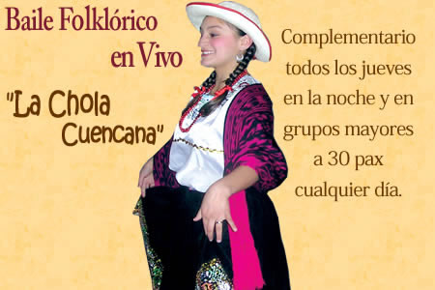

Slide 6
Chola Cuencana, mi chola
http://www.youtube.com/watch?v=H-a3BIbcDZU
http://www.youtube.com/watch?v=9P3vvgNR-iA
http://www.youtube.com/watch?v=xg9mnm9gTJE&feature=related

Slide 7
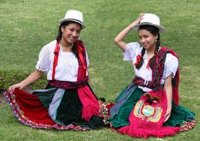
“Popular and elite, and white and indigenous all jostle together in one iconic body, which is always threatening to come apart at the seams.”
Weismantel 2003:

Slide 8
Views of Expatriates
“Isn’t it great? The peasant women with the baskets and the wheelbarrows of fruit – it’s like going back to the old days, you know, when you bought food directly off the people who grew it.”
“eat in a more simplified manner”
“cut out some of the links in the food chain”
“eat clean food that hasn’t been produced on those great big industrial farms”
“produced in the old-fashioned style”

Slide 9
Maria Elena
“[the peasantry] raise their own cows, sheep, chickens and pigs; all the animals just eat the grass and live outside, they don’t add anything”.
“the people in the city, sometimes they don’t know better and they buy their food in supermaxi – and those chickens are full of hormones; all their children are getting ill because of it and they don’t realise –they don’t eat as well as the people in the campo; it’s more natural, food from the campo”.

Slide 10
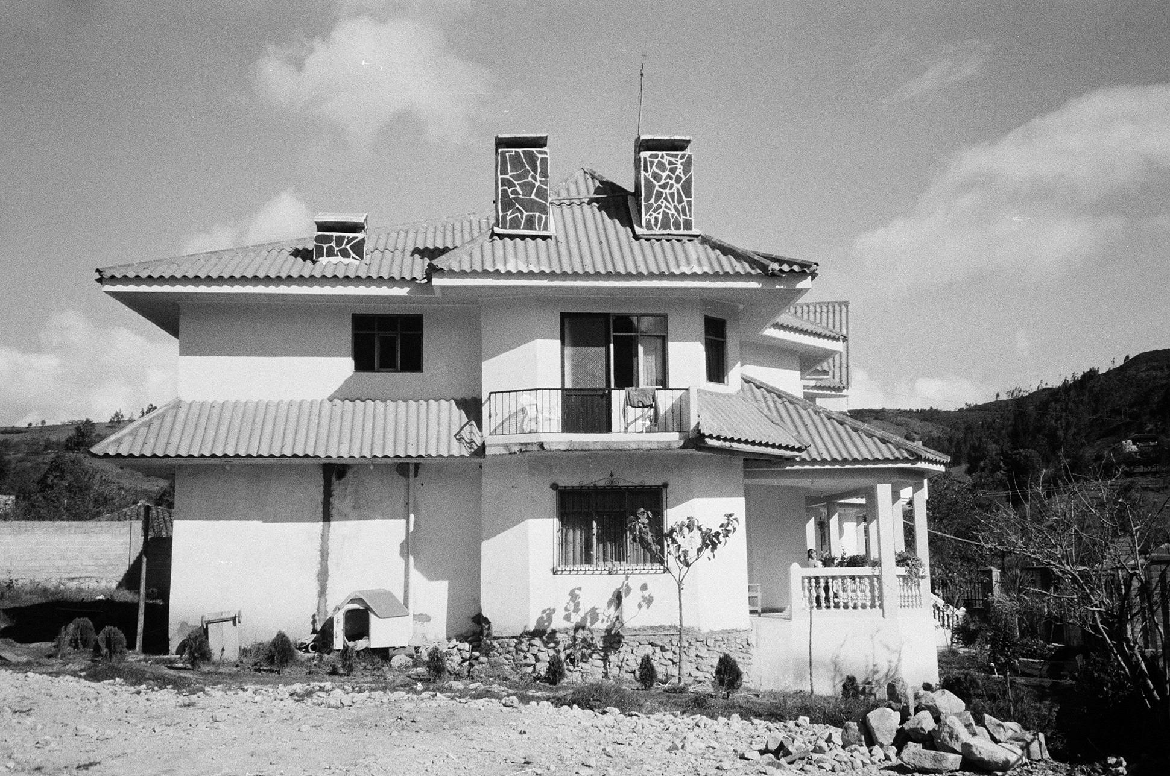
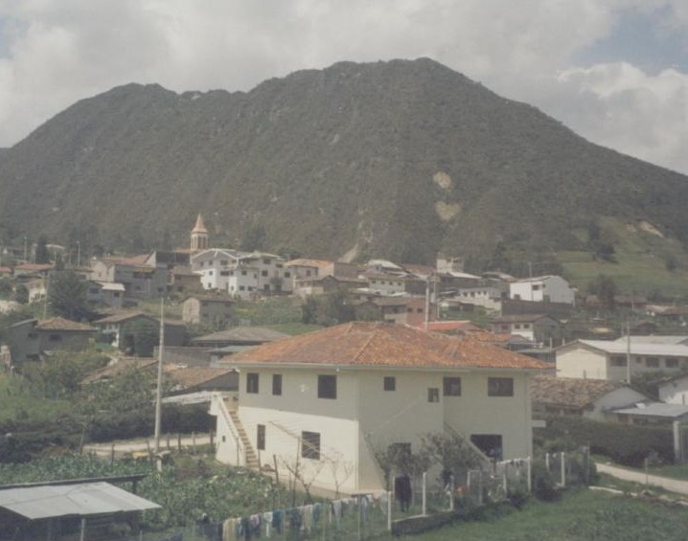

Slide 11
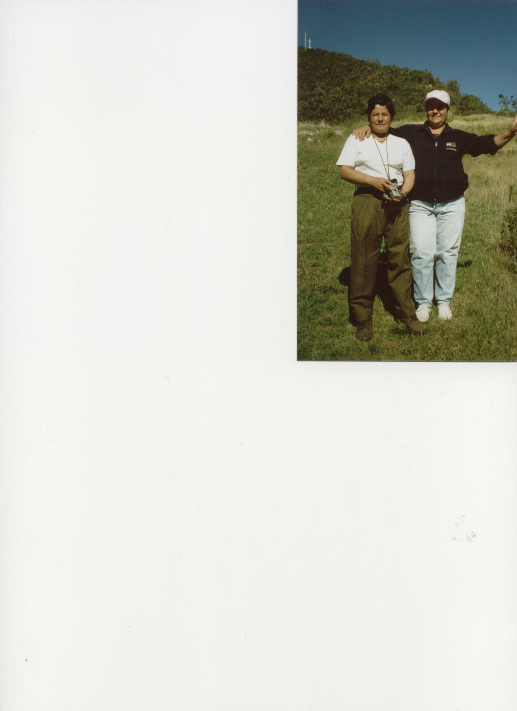
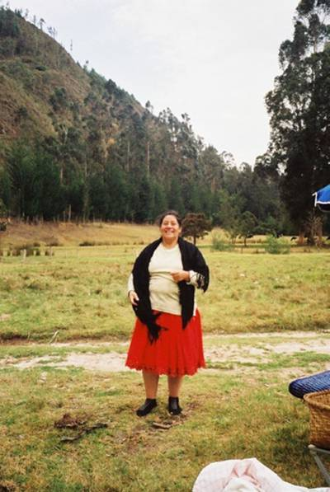

Slide 12


