Slide 1
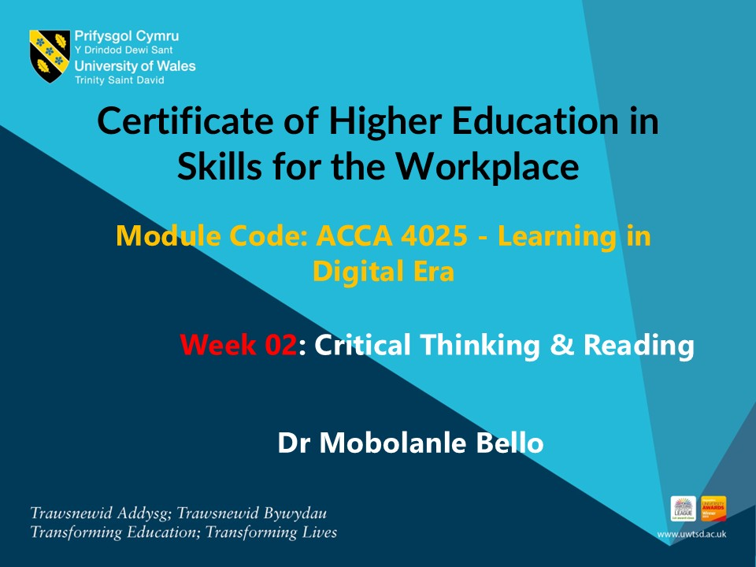

Slide 2
INTRODUCTION TO INFOSKILLS COURSE
In Weeks 2 to 4, you will be introduced to the Infoskills course, which is designed to help you develop essential academic and research skills. You are expected to complete each module within this time.
How It Works :
Each module is assigned as homework.
Upon successful completion, you will earn a digital badge to recognise your progress.
At the beginning of the following week’s class, we will take a few minutes to gather feedback and check completion.
These courses are part of your student engagement activities, and completing them is an important part of your academic journey

Slide 3
Infoskills Courses
The following Infoskills courses will be covered during this period:
Types of Information
Identifying Information – Stages of Information
Academic Integrity & Avoiding Plagiarism
Referencing – The Basics
How to Reference – IEEE
Introduction to Searching

Slide 4
In this session we will…..
Define critical thinking
Explore Scepticism and Objectivity
Introduce the Principle of Charity
Question Bias
Evaluate Evidence
Identify Facts versus Opinions
Critical Reading
Annotating using MS Word

Slide 5
CRITICAL THINKING

Slide 6
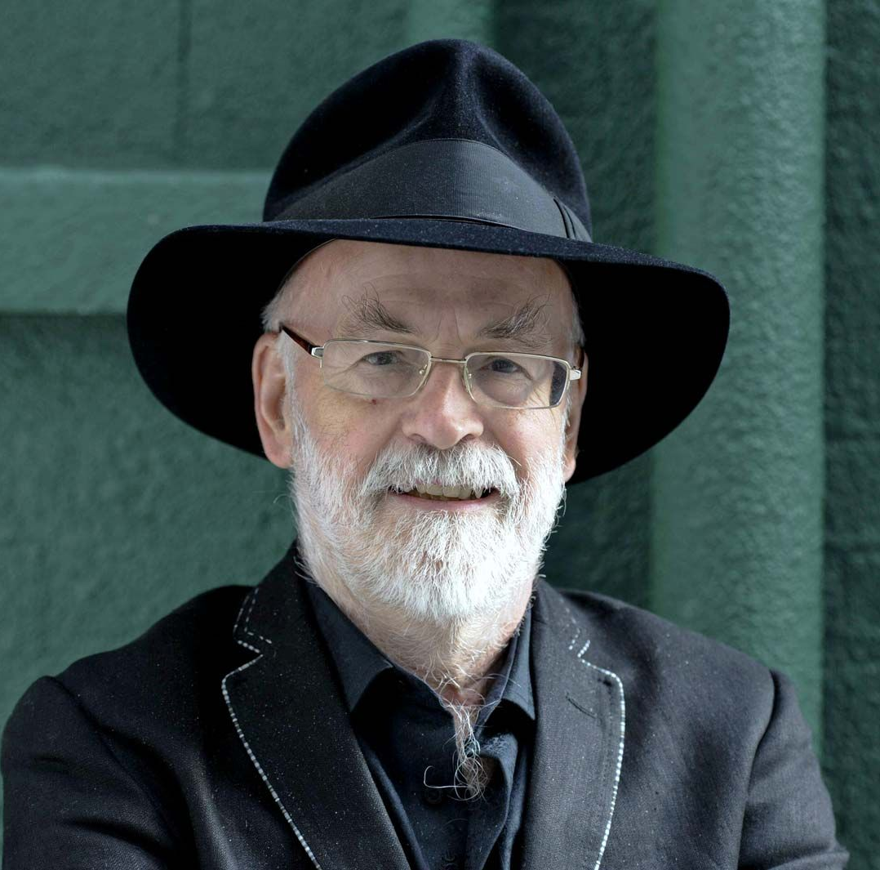
Open Minds
‘The trouble with an open mind of course, is that people will insist on coming along and trying to put things in it.’
(Terry Pratchett)

Slide 7


Slide 8
CRITICAL THINKING
‘Setting out actively to understand what is going on by using reasoning, evaluating evidence, and thinking carefully about the process of thinking itself.’ (Chatfield, 2018)

Slide 9
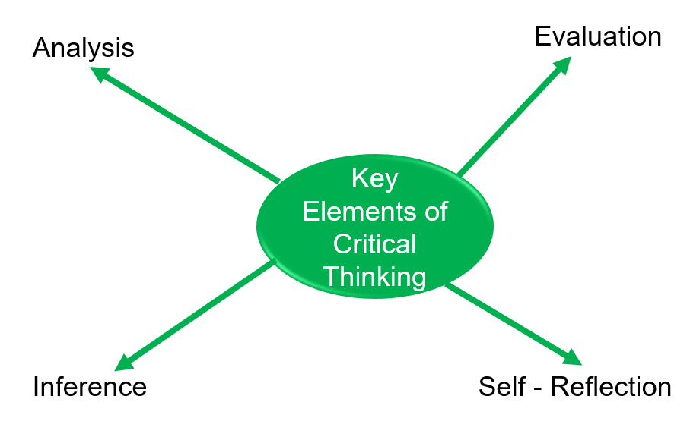
Key Elements of Critical Thinking

Slide 10
Key Elements of Critical Thinking
1) Analysis
Critical thinkers are able to break down complex information into smaller, more manageable parts.
They can identify the main points of an argument, as well as the supporting evidence.
2) Evaluation
Critical thinkers are able to assess the quality of information and arguments.
They can identify biases, fallacies, and other potential problems
3) Inference
Critical thinkers are able to draw conclusions from information and evidence.
They can use logical reasoning to develop arguments and make decisions
4) Self Reflection
Critical thinkers are able to reflect on their own thinking process.
They can identify their own biases and assumptions, and they are open to changing their minds in light of new information

Slide 11
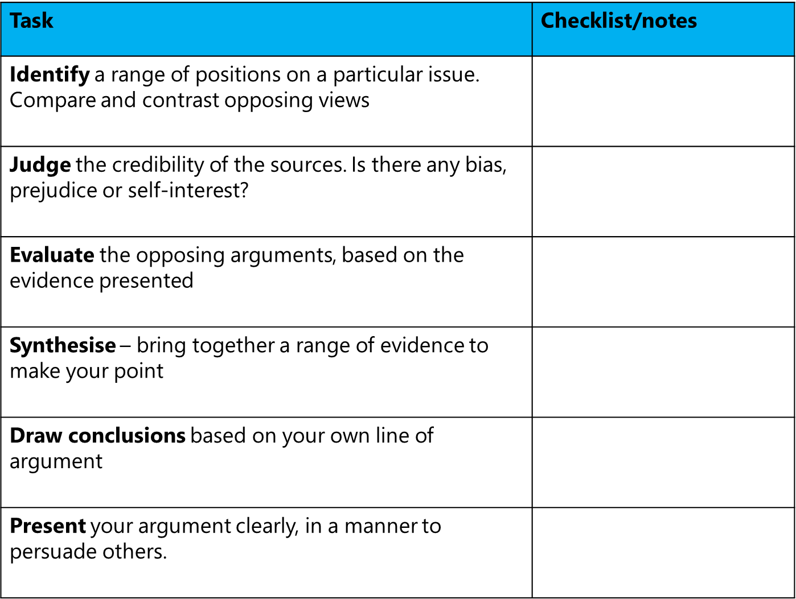
Features of Critical Thinking

Slide 12
Tips for Developing Your Critical Thinking Skills
Be open-minded and willing to consider different perspectives.
Be sceptical of information and arguments. Don't accept something at face value.
Ask questions. Try to understand the reasoning behind claims and arguments.
Look for evidence to support or refute claims.
Be aware of your own biases and assumptions.
Be willing to change your mind in light of new information.
Critical thinking is an essential skill for success in the digital era. It allows us to make informed decisions

Slide 13
Main Components of Critical Thinking
Scepticism
Objectivity

Slide 14
Main Components of Critical Thinking
Scepticism and Objectivity are both crucial components of Critical Thinking
Scepticism and Objectivity help critical thinkers to analyse information more thoroughly and make well-informed decisions.
They ensure that conclusions are drawn from a balanced and evidence-based perspective.

Slide 15
Scepticism and Objectivity
Scepticism
The Greek word ‘skeptics’ means ‘investigation’. A sceptic is an Enquirer.
This involves questioning the validity of claims and seeking evidence before accepting them as true.
Critical thinkers use scepticism to avoid being easily swayed by unsupported arguments or biases.
It encourages a mindset of inquiry and doubt, which is essential for evaluating the reliability of information.

Slide 16
Scepticism and Objectivity
Objectivity
Based on facts and not influenced by personal beliefs or feelings.
This means evaluating information and arguments based on facts and evidence, rather than personal feelings or biases.
Objectivity helps critical thinkers to remain impartial and fair, ensuring that their conclusions are based on logical reasoning and evidence rather than subjective opinions.

Slide 17
Class Activity 1
Ask students in groups or pairs to think about each of the seven claims. Students should identify if the statement/claim can be accepted as scepticism or objectivity.
1) They say it’s probably the best cake in the world. It must be great. I’ll buy some!
2) She wrote the world’s leading psychology textbook: her views on psychology must be taken seriously.
3) She wrote the world’s leading psychology textbook. Her views on the cooking must be taken seriously.
4) French fried are delicious. I’m going to eat them all the time.
5) My friend has hurt is leg and is in pain. I must rush to help him now.
6) The video my friend posted online is hilarious. I’m going to click ‘like’.
7) The video my friend posted online is pathetic. I’m going to personally insult him.

Slide 18
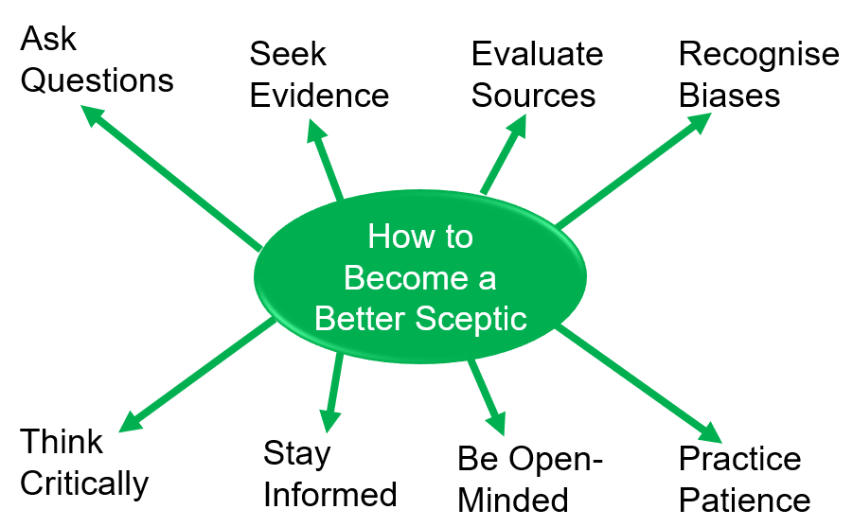
How to Become a Better Sceptic

Slide 19
How to Become a Better Sceptic
Becoming a better sceptic involves developing certain habits and skills. Here are some tips to help you enhance your scepticism:
Ask Questions: Always ask "Why?" and "How?" when presented with information. This helps you understand the reasoning behind claims and identify any gaps or inconsistencies.
Seek Evidence: Look for credible evidence to support or refute claims. Reliable sources and empirical data are key to validating information.
Evaluate Sources: Consider the credibility of the sources providing the information. Are they experts in the field? Do they have a history of accuracy?
Recognize Biases: Be aware of your own biases and those of others. This helps you remain objective and avoid being influenced by personal or ideological biases.
Think Critically: Analyse arguments logically. Look for logical fallacies or weak points in reasoning.
Stay Informed: Keep up-to-date with current knowledge and developments in various fields. This helps you make informed judgments.
Be Open-Minded: While being sceptical, also be open to new ideas and evidence. Scepticism doesn't mean rejecting everything; it means being open to changing your mind when presented with convincing evidence.
Practice Patience: Take your time to thoroughly investigate and understand claims before forming an opinion.

Slide 20
The Principle of Charity
‘The principle of charity is the counter-intuitive idea that you should always try to be as generous as possible when considering ideas that you don’t agree with.’
(Chatfield, 2020)

Slide 21
The Principle of Charity
The Principle of Charity is an important concept in critical thinking.
It involves interpreting others' arguments in the most rational and strongest way possible before evaluating or criticizing them.

Slide 22
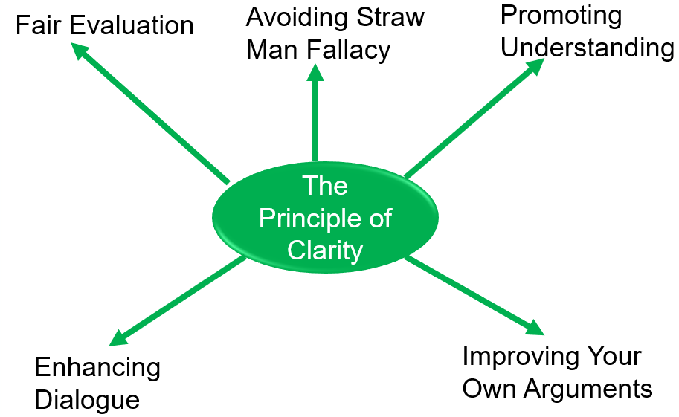
The Principle of Charity

Slide 23
The Principle of Charity
Fair Evaluation: By applying the Principle of Charity, you ensure that you are not misrepresenting or oversimplifying someone else's argument. This leads to a fairer and more accurate evaluation.
Avoiding Straw Man Fallacy: This principle helps you avoid the straw man fallacy, where an argument is misrepresented to make it easier to attack. By interpreting arguments charitably, you engage with the actual points being made.
Promoting Understanding: It encourages you to fully understand the argument from the other person's perspective. This deepens your comprehension and allows for more meaningful discussions.
Enhancing Dialogue: Applying this principle fosters respectful and constructive dialogue. It shows that you are willing to engage with the best version of the opposing view, which can lead to more productive and insightful conversations.
Improving Your Own Arguments: By considering the strongest version of opposing arguments, you can better refine and strengthen your own positions.

Slide 24
Class Activity 2 : Charity in action
Write down an idea you disagree with
___________________________________________
Try to give two strong ideas why so
somebody else might agree with it
___________________________________________
___________________________________________
Now write the strongest two objections you gave to these two reasons
___________________________________________
___________________________________________
Kindly download the worksheet from Moodle – Week 2

Slide 25
15 MINUTES BREAK

Slide 26
COMPONENT 1 ASSESSMENT EXPLANATION

Slide 27
BIAS
Looking at something in a way that is entirely dominated by a particular prejudice or perspective.
Bias plays a significant role in critical thinking because it can distort our judgment and decision-making processes.

Slide 28
Types of Bias
Conscious bias – knowingly and deliberately misrepresenting something
Unconscious bias – unaware of the bias in their preferences

Slide 29
Class Activity 3: Bias?
1. The Prime Minister’s spokesperson insisted that he had acted in good faith and from the best of intentions – unlike his cowardly critics.
Conscious O Unconscious O
2. I prefer the taller, conventionally better-looking candidate based on the photographs of them.
Conscious O Unconscious O

Slide 30
Bias
Just as total objectivity is impossible, none of us can ever be entirely without biases.
The challenge is to become more aware of them and find ways to minimize the distortions caused by the most troubling ones.

Slide 31
Class Activity 4 : Bias
What unconscious biases do you most often see in other people?
__________________________________________________________________________________________.
Might any of these also affect your own judgment?
________________________________________________________________________________________________.
Kindly download the worksheet from Moodle – Week 2

Slide 32

Evaluating Evidence – CRAAP Test
Video:
https://youtu.be/y3PEmtlYeBQ?si=s2Zz7iCi0YbvlEId

Slide 33
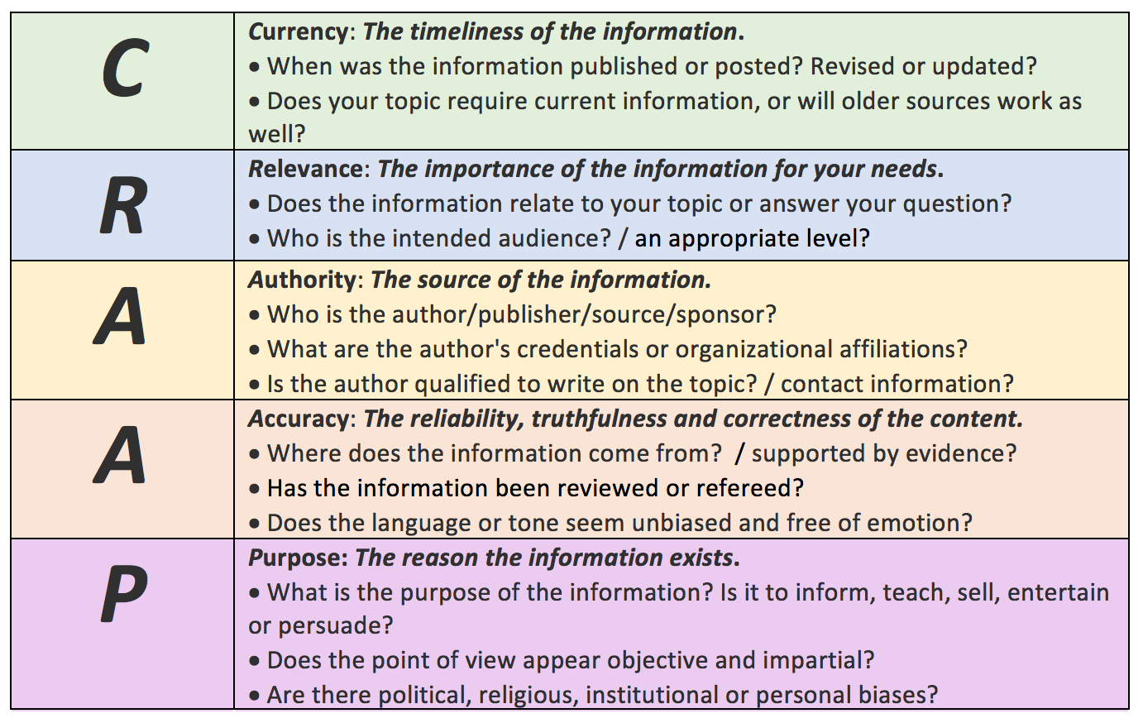
CRAAP TEST

Slide 34
Class Activity 4 : Evaluating Evidence – ‘Climate Change’
Evaluate the sources of evidence using CRAAP Test
https://royalsociety.org/topics-policy/projects/climate-change-evidence-causes/basics-of-climate-change/
https://www.thesun.co.uk/news/15288148/climate-change-risks-economy/
https://www.bbc.co.uk/news/world-us-canada-46351940
https://www.newsweek.com/truth-about-global-warming-154937
https://www.desmog.com/2017/12/11/introducing-desmog-uk-s-climate-disinformation-database/
https://www.thegwpf.org/content/uploads/2022/09/Lindzen-global-warming-narrative.pdf

Slide 35
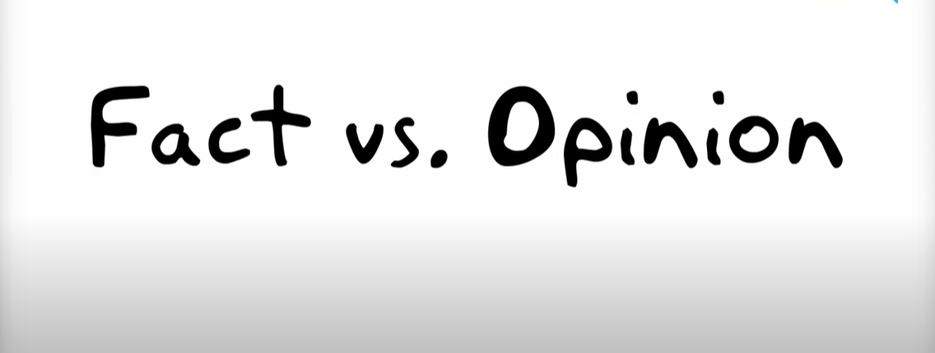
Facts versus Opinions
Video:
https://youtu.be/BTZjqOU_6Vc?si=7c9L3bIssXQSWwPr

Slide 36
Class Activity 5: Facts versus Opinions
Identify if each of the information in the table below is a Fact or Opinion
Singapore is better than Tokyo | The Pacific Ocean is the largest ocean in the world | Madrid is the capital of Spain | Sunflowers are are the most beautiful flowers | Today seems hotter than yesterday
UWTSD has two campuses in Birmingham | Jim Carey is hilarious | The death penalty is wrong | Liverpool FC are the best football team in the UK | LiverpoolFC have won the European Cup 6 times
Water freezes at zero degrees Centigrade | Heart disease is a terrible thing | Your diet is awful. You need to stop eating sweets | Heart disease can result from poor diet | Human beings need Oxygen to survive

Slide 37
15 MINUTES BREAK

Slide 38
CRITICAL READING

Slide 39
CRITICAL READING
Higher Education often requires a lot of reading. Therefore:
Be selective
Choose quality, not quantity
Choose reliable, current sources

Slide 40
Critical Reading Strategies
Predictive – what do you think the text will be about?
Scanning – for keywords
Skimming – introduction and first line of each paragraph for an overview
Intensive Reading – a short section carefully

Slide 41
Class Activity 6 : Skim Read
Skim read the Academic Journal Article below:
Detect main idea in Introduction (author’s Aim?)
Read first sentence of each paragraph
What is the paper about and how is it structured?
https://scholarworks.waldenu.edu/cgi/viewcontent.cgi?article=1260&context=ijamt

Slide 42
Active Reading
Underline and highlight important keywords and phrases
Make annotations to summarise, question, and analyse
Explain the text to someone else
Record yourself reading and listen back later

Slide 43
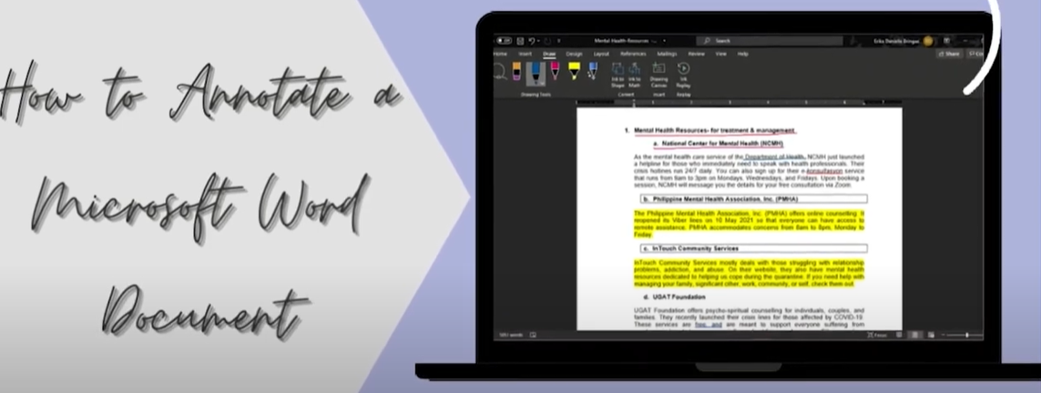
Annotate Using MS Word
Video:
https://youtu.be/4a1m1caIhJ4?si=HXlPSmQ7Qe_TOh4A

Slide 44
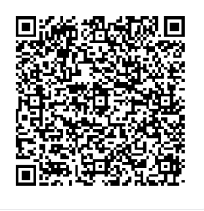
Homework : Identifying Information - Stages of Information
Kindly click on the link below to start the course or use the QR Code
moodle.uwtsd.ac.uk/mod/scorm/player.php?a=6864&currentorg=articulate_rise&scoid=14763&sesskey=fiSHR9WZNM&display=popup&mode=normal
This should be completed before the next class
Once completed, please send a screenshot of your badge to your lecturer via email.

Slide 45
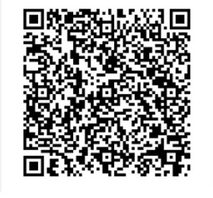
Homework : Types of Information
Kindly click on the link below to start the course or use the QR Code
moodle.uwtsd.ac.uk/mod/scorm/player.php?a=6863&currentorg=articulate_rise&scoid=14761&sesskey=fiSHR9WZNM&display=popup&mode=normal
This should be completed before the next class
Once completed, please send a screenshot of your badge to your lecturer via email.

Slide 46
Questions and Answers

