Slide 1
Electromagnetic
Radiation
(ACDC5009)
Lecture - 10

Slide 2
Content
Antenna
Types of Antenna
  Wire Antenna
  Halfwave Dipole Antennas
  Full wave dipole antennas
  Short dipole antennas
  Long wire antenna
  V antenna
  Inverted V antenna
  Rhombic Antenna
  Loop antenna
  Helical antenna
  Aperture antenna
  Horn Antenna
  Slot Antenna
  Micro strip antenna
  Lens Antenna
  Parabolic Antenna

Slide 3
Learning Outcome
The student upon completion of the lecture will be able to:
Describe the various types of antenna

Slide 4
Wire Antennas
Wire antennas are the basic types of antennas. These are well known and widely used antennas.
The wire or the transmission line has some power, which travels from one end to the other end. If both the ends of transmission line are connected to circuits, then the information will be transmitted or received using this wire between these two circuits.
If one end of this wire is not connected, then the power in it tries to escape. This leads to wireless communication.
If one end of the wire is bent, then the energy tries to escape from the transmission line, more effectively than before. This purposeful escape is known as Radiation

Slide 5
Wire Antennas
For the radiation to take place effectively, the impedance of the open end of the transmission line should match with the impedance of the free-space.
Consider a transmission line of a quarter-wave length size. The far end of it is kept open and bent to provide high impedance. This acts as a half-wave dipole antenna.
Already, it has low impedance at one end of the transmission line. The open end, which has high impedance, matches with the impedance of free space to provide better radiation.

Slide 6
Dipole Antenna
The radiation of energy when done through a bent wire, the end of such transmission line is termed as dipole or dipole antenna.
The reactance of the input impedance is a function of the radius and length of the dipole. The smaller the radius, the larger the amplitude.
It is proportional to the wavelength. Hence, the length and radius of the dipole should also be taken into consideration.
The current for a dipole is maximum at the center and minimum at its ends. The voltage is minimum at its center and maximum at its ends.
The types of wire antennas include Half-wave dipole, Half-wave folded dipole, Full-wave dipole, Short dipole, and Infinitesimal dipole.

Slide 7
Dipole Antenna
The dipole antenna is cut and bent for effective radiation. The length of the total wire, which is being used as a dipole, equals half of the wavelength (i.e., l = λ/2). Such an antenna is called as half-wave dipole antenna.
This is the most widely used antenna because of its advantages. It is also known as Hertz antenna.
Frequency range
The range of frequency in which half-wave dipole operates is around 3KHz to 300GHz. This is mostly used in radio receivers.

Slide 8
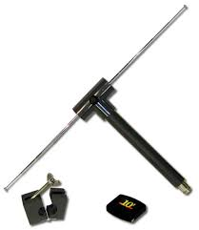
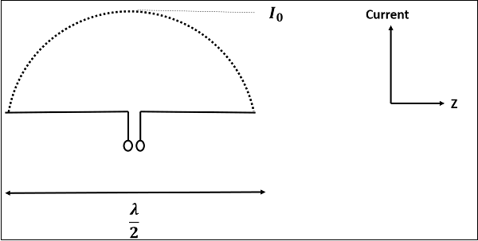
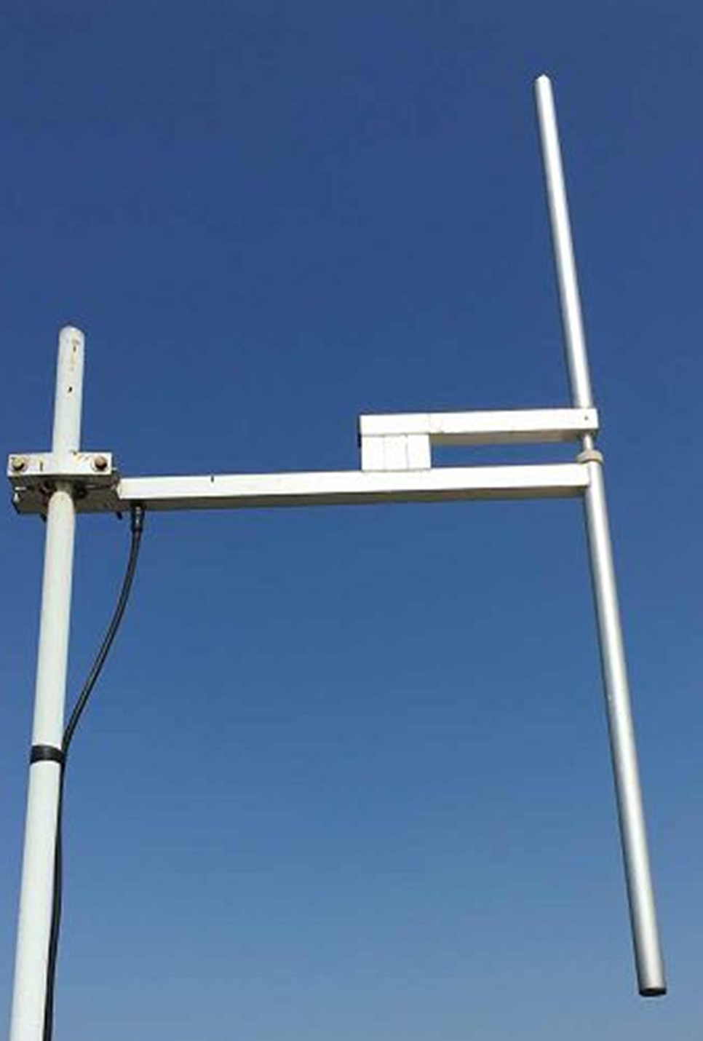
Dipole Antenna
The figure shows the current distribution in half wave dipole.
The directivity of half wave dipole is 2.15dBi, which is reasonably good.
An antenna works effectively at its resonant frequency, which occurs at its resonant length.

Slide 9
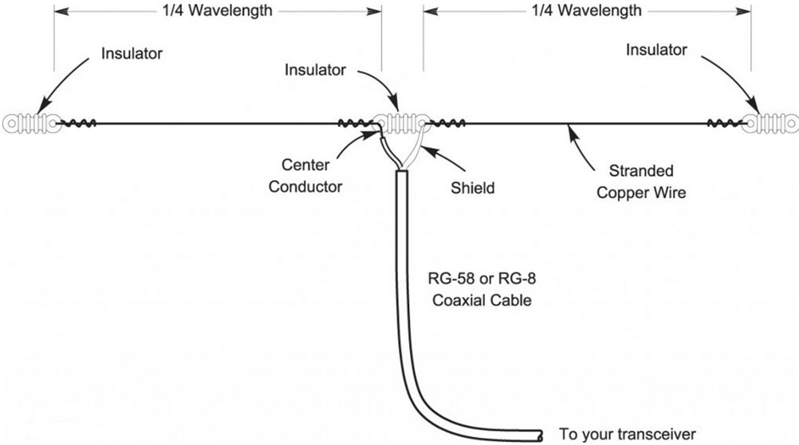
Dipole Antenna

Slide 10
Dipole Antenna
Applications
Used in radio receivers.
Used in television receivers.
When employed with others, used for wide variety of applications.

Slide 11
Folded Dipole Antenna
A folded dipole is an antenna, with two conductors connected on both sides, and folded to form a cylindrical closed shape, to which feed is given at the center.
The length of the dipole is half of the wavelength. Hence, it is called as half wave folded dipole antenna.
This antenna is commonly used with the array type antennas to increase the feed resistance. The most commonly used one is with Yagi-Uda antenna.
Frequency range
The range of frequency in which half wave folded dipole operates is around 3KHz to 300GHz. This is mostly used in television receivers.

Slide 12
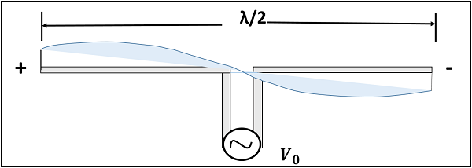
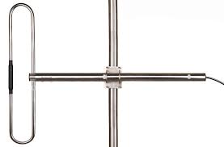
Folded Dipole Antennas
This antenna uses an extra conducting element (a wire or a rod) when compared with previous dipole antenna. This is continued by placing few conducting elements in parallel, with insulation in-between, in array type of antennas.

Slide 13
Folded Dipole Antennas
If the diameter of the main conductor and the folded dipole are same, then there will be four folded (two times of squared one) increase in the feed impedance of the antenna.
This increase in feed impedance is the main reason for the popular usage of this folded dipole antenna. Due of the twin-lead, the impedance will be around 300Ω.
Half-wave folded dipole antennas are used where optimum power transfer is needed and where large impedances are needed.

Slide 14
Folded Dipole Antennas
Applications
Mainly used as a feeder element in Yagi antenna, Parabolic antenna, turnstile antenna, log periodic antenna, phased and reflector arrays, etc.
Generally used in radio receivers.
Used in TV receiver antennas.

Slide 15
Full wave dipole Antenna
If the length of the dipole, i.e. the total wire, equals the full wavelength λ, then it is called as full wave dipole.
If a full wavelength dipole is used either for transmission or for reception.
Both the positive and negative peaks of the wave induce positive and negative voltages respectively. However, as the induced voltages cancel out each other, there is no question of radiation.
The full-wave dipoles length is λ.
It is seen that two half-wave dipoles are joined to make a full-wave dipole.

Slide 16
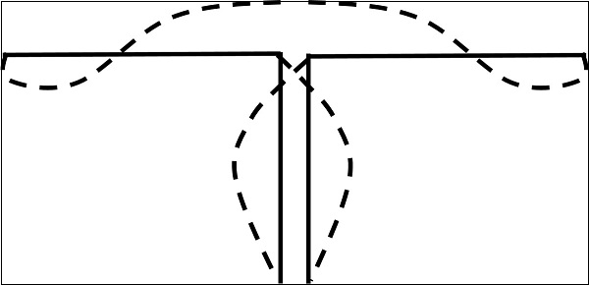
Full wave dipole Antennas

Slide 17
Full wave dipole Antennas
Disadvantages
Heat dissipation
Wastage of power
No radiation pattern
No directivity and no gain
Due to these drawbacks, the full-wave dipole is seldom used.

Slide 18
Short dipole Antenna
A short dipole is a simple wire antenna. One end of it is open-circuited and the other end is fed with AC source.
This dipole got its name because of its length.
The Short dipole is the dipole antenna having the length of its wire shorter than the wavelength.
Frequency range
The range of frequency in which short dipole operates is around 3KHz to 30MHz. This is mostly used in low frequency receivers.

Slide 19
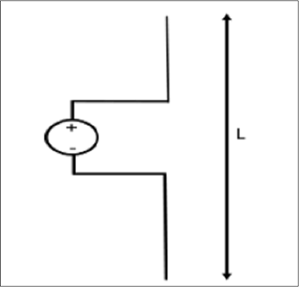
Short dipole Antenna
The actual size of the antenna does not matter. The wire that leads to the antenna must be less than one-tenth of the wavelength. That is
L<λ/10
Where
  L is the length of the wire of the short dipole.
  λ is the wavelength.

Slide 20
Infinitesimal dipole Antenna
Another type of short dipole is infinitesimal dipole, whose length is far less than its wave length.
A dipole whose length is far less than wavelength is infitesimal dipole.
This antenna is actually impractical. Here, the length of the dipole is less than even fiftieth part of the wavelength.
The length of the dipole, Δl << λ. Where, λ is the wavelength. Δl=λ/50.
As the length of these dipoles is very small, the current flow in the wire will be dI.

Slide 21
Short dipole Antenna
Applications
Used in narrow band applications.
Used as an antenna for tuner circuits.

Slide 22
Long Wire Antenna
The long wire antennas are formed by using a number of dipoles. The length of the wire in these type of antennas is n times λ/2.
L=n λ/2
Where,
  L is the length of the antenna,
  n is the number of elements,
  λ is the wavelength
As ‘n’ increases, the directional properties also increase.
Types of Long-wire Antennas
  Resonant Antennas
  Non-resonant Antennas.

Slide 23
Long Wire Antenna
Resonant Antennas
Resonant Antennas are those for which a sharp peak in the radiated power is intercepted by the antenna at certain frequency, to form a standing wave.
The resonant antennas are periodic in nature.
They are also called as bi-directional travelling wave antennas, as the radiated wave moves in two directions, which means both incident and reflected waves occur here.
In these antennas, the length of the antenna and frequency are proportional to each other.

Slide 24
Long Wire Antenna
Non-resonant Antennas
Non-resonant Antennas are those for which resonant frequency does not occur. The wave moves in forward direction and hence do not form a standing wave.
These non-resonant antennas are non-periodic in nature.
They are also called as Unidirectional travelling wave antennas, as the radiated wave moves in forward direction only, which means that only incident wave is present.
As the frequency increases, the length of the antenna decreases and vice versa. Hence, the frequency and length are inversely proportional to each other.
These long-wire antennas are the basic elements for the construction of V-shaped antennas or the Rhombic antennas.

Slide 25
V- Antenna Antennas
A better version of long-wire antennas is the V-Antenna.
This antenna is formed by arranging the long wire in a V-shaped pattern. The end wires are called as legs.
This antenna is a bi-directional resonant antenna.
Two long wires are connected in the shape of V to make a V-antenna.
The two long wires are excited with 180˚ out of phase. As the length of these wires increases, the gain and directivity also increases.
Transmission line impedance z and the length of the wire λ/2, making an angle Φ_{m} with the axis, which is called as apex angle.
The gain achieved by V-antenna is higher than normal single long wire antenna. The gain in this V-formation is nearly twice compared to the single long wire antenna, which has a length equal to the legs of V-antenna.
Frequency Range
The frequency range of operation of V-antenna is around 3 to 30 MHz.
This antenna works in high frequency range.

Slide 26
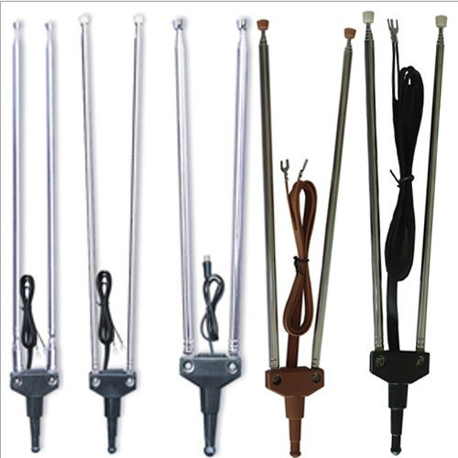
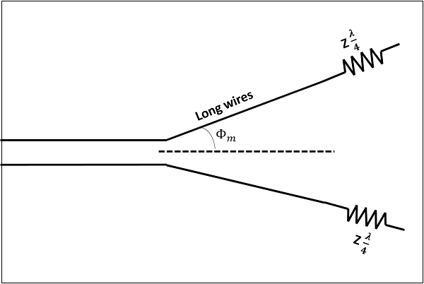
V- Antenna Antennas

Slide 27
V- Antenna Antennas
Applications
Used in radio communications

Slide 28
Inverted Vee Antenna
A travelling wave antenna produces no standing wave.
These are inverted Vee antenna
The maximum radiation for an inverted V-antenna is at its center.
It is similar to a halfwave dipole antenna.
The antenna is placed in the shape of an inverted V, with its two transmission lines or legs bent towards the ground making 120° or 90° angle between them.
The angle made by one of the legs with the axis of the antenna, is known as the tilt angle and is denoted by θ.
Frequency Range
The frequency range of operation of an inverted vee antenna (or V-antenna) is around 3 to 30 MHz. This antenna works in high frequency range.

Slide 29
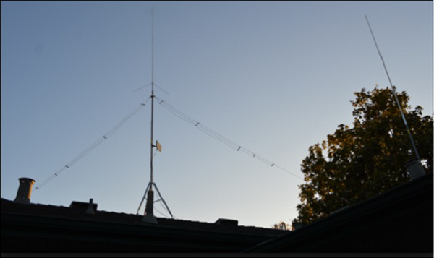
Wire Antennas

Slide 30
Wire Antennas
Applications
Used in tuned circuit applications
Used in radio communications
Used in commercial applications

Slide 31
Rhombic Antenna
The Rhombic Antenna is an equilateral parallelogram shaped antenna. Generally, it has two opposite acute angles.
It is arranged in the form of a rhombus or diamond shape and suspended horizontally above the surface of the earth.
Rhombic antenna can be regarded as two V-shaped antennas connected end-to-end to form obtuse angles.
Figure 1 shows the construction of rhombic antenna for point-to-point communication in olden days. Figure 2 shows the rhombic UHF antenna for TV reception, used these days.
Frequency Range
The frequency range of operation of a Rhombic antenna is around 3MHz to 300MHz. This antenna works in HF and VHF ranges.

Slide 32
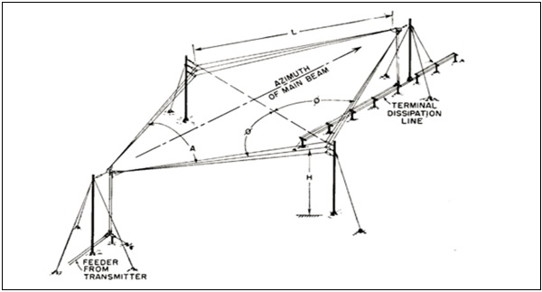
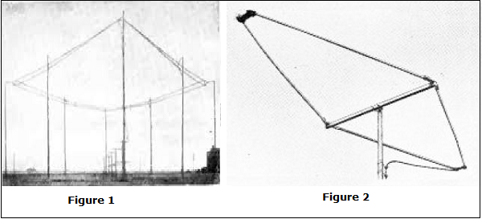
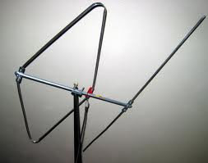
Rhombic Antenna

Slide 33
Rhombic Antenna
Applications
Used in HF communications
Used in Long distance sky wave propagations
Used in point-to-point communications

Slide 34
Loop Antenna
An RF current carrying coil is given a single turn into a loop, can be used as an antenna called as loop antenna.
The currents through this loop antenna will be in phase. The magnetic field will be perpendicular to the whole loop carrying the current.
A loop antenna is a coil carrying radio frequency current. It may be in any shape such as circular, rectangular, triangular, square or hexagonal according to the designer’s convenience.
Frequency Range
The frequency range of operation of loop antenna is around 300MHz to 3GHz. This antenna works in UHF range.
Loop antennas are of two types.
  Large loop antennas
  Small loop antennas

Slide 35
Loop Antenna
Large Loop Antennas
Large loop antennas are also called as resonant antennas. They have high radiation efficiency.
These antennas have length nearly equal to the intended wavelength.
L=λ
Where,
  L is the length of the antenna
  λ is the wavelength
The main parameter of this antenna is its perimeter length, which is about a wavelength and should be an enclosed loop.

Slide 36
Loop Antenna
Small loop antennas
Small loop antennas are also called as magnetic loop antennas. These are less resonant. These are mostly used as receivers.
These antennas are of the size of one-tenth of the wavelength.
L=λ/10
Where,
  L is the length of the antenna
  λ is the wavelength
It has low radiation efficiency due to high losses.
Its construction is simple with small size and weight.
Due to its high reactance, its impedance is difficult to match with the transmitter.
If loop antenna have to act as transmitting antenna, then this impedance mis-match would definitely be a problem. Hence, these loop antennas are better operated as receiver antennas.

Slide 37
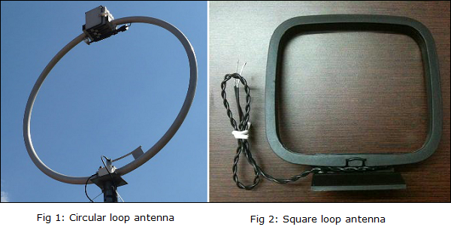
Loop Antennas
Small loop antennas are mainly of two types −
  Circular loop antennas
  Square loop antennas
These two types of loop antennas are mostly widely used. Other types (rectangular, delta, elliptical etc.) are also made according to the designer specifications.

Slide 38
Loop Antennas
Applications
Used in RFID devices
Used in MF, HF and Short wave receivers
Used in Aircraft receivers for direction finding
Used in UHF transmitters

Slide 39
Helical Antennas
Helical antenna is an example of wire antenna and itself forms the shape of a helix.
This is a broadband VHF and UHF antenna.
In this antenna the conducting wire is wound in helical shape and connected to the ground plate with a feeder line.
It is the simplest antenna, which provides circularly polarized waves.
It is used in extra-terrestrial communications in which satellite relays etc., are involved.
These antennas require wider outdoor space
It consists of a helix of thick copper wire or tubing wound in the shape of a screw thread used as an antenna in conjunction with a flat metal plate called a ground plate.
One end of the helix is connected to the center conductor of the cable and the outer conductor is connected to the ground plate.

Slide 40
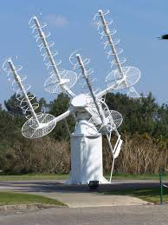
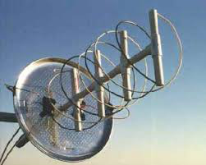
Helical Antennas
The radiation of helical antenna depends on the diameter of helix, the turn spacing and the pitch angle.
Pitch angle is the angle between a line tangent to the helix wire and plane normal to the helix axis.
α=tan−1(SπD)
where,
  D is the diameter of helix.
  S is the turn spacing (centre to centre).
  α is the pitch angle.
Frequency Range
The frequency range of operation of helical antenna is around 30MHz to 3GHz. This antenna works in VHF and UHF ranges.

Slide 41
Helical Antenna
Applications
A single helical antenna or its array is used to transmit and receive VHF signals
Frequently used for satellite and space probe communications
Used for telemetry links with ballastic missiles and satellites at Earth stations
Used to establish communications between the moon and the Earth
radio astronomy

Slide 42
Aperture Antennas
An Antenna with an aperture at the end can be termed as an Aperture antenna.
Waveguide is an example of aperture antenna.
The edge of a transmission line when terminated with an opening, radiates energy. This opening which is an aperture, makes it an Aperture antenna.
The main types of aperture antennas are −
  Wave guide antenna
  Horn antenna
  Slot antenna

Slide 43
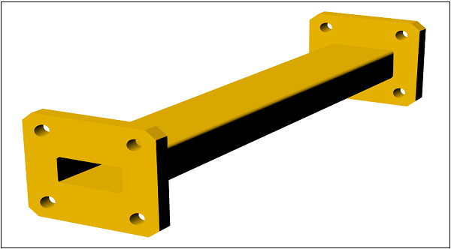
Waveguide Antennas
Waveguide Antenna
A Waveguide is capable of radiating energy when excited at one end and opened at the other end. The radiation in wave guide is greater than a two-wire transmission line.
Frequency Range
The operational frequency range of a wave guide is around 300MHz to 300GHz. This antenna works in UHF and EHF frequency ranges.

Slide 44
Waveguide Antennas
Applications
Micro wave applications
Surface search radar applications

Slide 45
Horn Antennas
To improve the radiation efficiency and directivity of the beam, the wave guide should be provided with an extended aperture to make the abrupt discontinuity of the wave into a gradual transformation.
So that all the energy in the forward direction gets radiated. This can be termed as Flaring. This can be done using a horn antenna.
The energy of the beam when slowly transform into radiation, the losses are reduced and the focussing of the beam improves.
A Horn antenna may be considered as a flared out wave guide, by which the directivity is improved and the diffraction is reduced.
.

Slide 46
Horn Antennas
There are several horn configurations out of which, three configurations are most commonly used
Sectoral horn
This type of horn antenna, flares out in only one direction. Flaring in the direction of Electric vector produces the sectorial E-plane horn. Similarly, flaring in the direction of Magnetic vector, produces the sectorial H-plane horn.
Pyramidal horn
This type of horn antenna has flaring on both sides. If flaring is done on both the E & H walls of a rectangular waveguide, then pyramidal horn antenna is produced. This antenna has the shape of a truncated pyramid.
Conical horn
When the walls of a circular wave guide are flared, it is known as a conical horn. This is a logical termination of a circular wave guide.

Slide 47
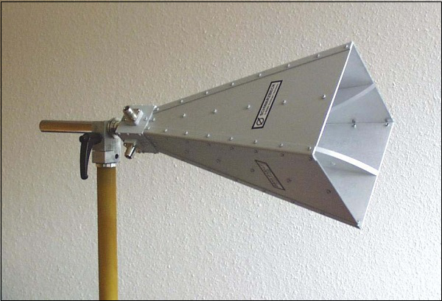
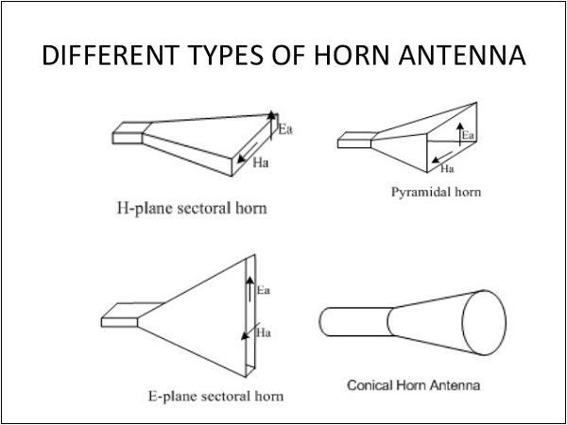
Horn Antennas
Frequency Range
The operational frequency range of a horn antenna is around 300MHz to 30GHz. This antenna works in UHF and SHF frequency ranges.

Slide 48
Horn Antenna
Applications
Used for astronomical studies
Used in microwave applications

Slide 49
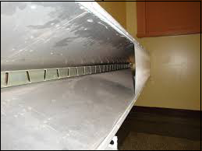
Slot Antennas
Slot Antenna is an example of Aperture antenna.
A rectangular slot is made on the conducting sheet. These slot antennas can be formed by simply making a cut on the surface, where they are mounted on.
When an infinite conducting sheet is made a rectangular cut and the fields are excited in the aperture (which is called as a slot), it is termed as Slot antenna.
Frequency Range
The frequency range used for the application of Slot antenna is 300 MHz to 30GHz. It works in UHF and SHF frequency ranges.

Slide 50
Wire Antennas
Case 1 − Consider a light source and a conducting plane (field) with an aperture before a screen. The light does not pass through the opaque area, but passes through the aperture.
Case 2 − Consider the light source and a conducting plane of the size of the aperture in the previous case, being held against the screen. The light does not pass through the plane but through the remaining portion.
Case 3 − Combine these two conducting planes of both the cases and put before the light source. The screen is not placed to observe the resultant combination. The effect of screen gets nullified.
This principle of optics is applied to electromagnetic waves for the wave to get radiated. It is true that when a HF field exists across a narrow slot in a conducting plane, the energy is radiated.

Slide 51
Slot Antenna
Applications
Usually for radar navigational purposes
Used as an array fed by a wave guide

Slide 52
Microstrip Antennas
Micro strip antennas are low-profile antennas.
A metal patch mounted at a ground level with a di-electric material in-between constitutes a Micro strip or Patch Antenna.
These are very low size antennas having low radiation.
Micro strip antenna consists of a very thin metallic strip placed on a ground plane with a di-electric material in-between.
The radiating element and feed lines are placed by the process of photo-etching on the di-electric material.
Usually, the patch or micro-strip is choosen to be square, circular or rectangular in shape for the ease of analysis and fabrication.
The following image shows a micro-strip or patch antenna.
The length of the metal patch is λ/2. When the antenna is excited, the waves generated within the di-electric undergo reflections and the energyis radiated from the edges of the metal patch,which is very low.

Slide 53
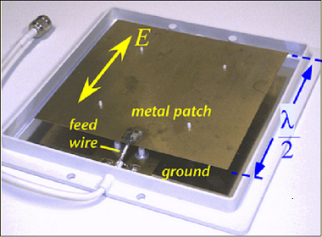
Microstrip Antennas
Frequency Range
The patch antennas are popular for low profile applications at frequencies above 100MHz.

Slide 54
Microstrip Antennas
Applications
Used in Space craft applications
Used in Air craft applications
Used in Low profile antenna applications

Slide 55
Lens Antennas
The lens antennas use the curved surface for both transmission and reception.
Lens antennas are made up of glass, where the converging and diverging properties of lens are followed. The lens antennas are used for higher frequency applications.
If a light source is assumed to be present at a focal point of a lens, which is at a focal distance from the lens, then the rays get through the lens as collimated or parallel rays on the plane wavefront.
The rays that pass through the centre of the lens are less refracted than the rays that pass through the edges of the lens. All of the rays are sent in parallel to the plane wave front. This phenomenon of lens is called as divergence.
The same procedure gets reversed if a light beam is sent from right side to left of the same lens. Then the beam gets refracted and meets at a point called focal point, at a focal distance from the lens. This phenomenon is called convergence.
Frequency Range
The frequency range of usage of lens antenna starts at 1000 MHz but its use is greater at 3000 MHz and above.

Slide 56
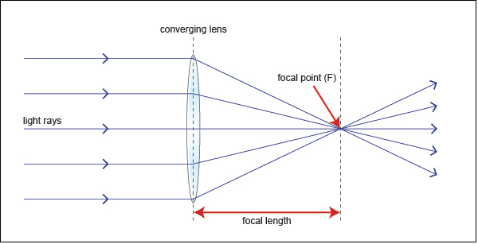
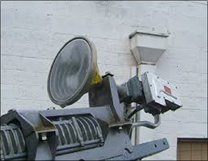
Lens Antennas

Slide 57
Lens Antennas
The ray diagram represents the focal point and focal length from the source to the lens.
The parallel rays obtained are also called as collimated rays.
In the above figure, the source at the focal point, at a focal distance from the lens, gets collimated in the plane wave front. This phenomenon can be reversed which means the light if sent from the left side, gets converged at the right side of the lens.
It is because of this reciprocity, the lens can be used as an antenna, as the same phenomenon helps in utilizing the same antenna for both transmission and reception.

Slide 58
Lens Antenna
Applications
Used as wide band antenna
Especially used for Microwave frequency applications

Slide 59
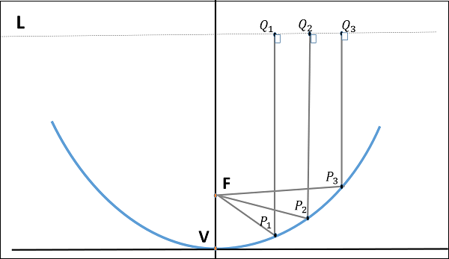
Parabolic Reflector Antennas
Parabolic Reflectors are Microwave antennas.
The following figure shows the geometry of parabolic reflector. The point F is the focus (feed is given) and V is the vertex.
The line joining F and V is the axis of symmetry.
PQ are the reflected rays where L represents the line directrix on which the reflected points lie (to say that they are being collinear).
Frequency Range
The frequency range used for the application of Parabolic reflector antennas is above 1MHz. These antennas are widely used for radio and wireless applications.

Slide 60
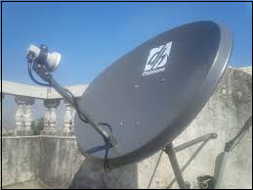
Parabolic Reflector Antennas
The reflected wave forms a collimated wave front, out of the parabolic shape.
The law of reflection states that the angle of incidence and the angle of reflection are equal. This law when used along with a parabola, helps the beam focus.
The shape of the parabola when used for the purpose of reflection of waves, exhibits some properties of the parabola, which are helpful for building an antenna, using the waves reflected.

Slide 61
Parabolic Reflector Antennas
Properties of Parabola
All the waves originating from focus, reflects back to the parabolic axis. Hence, all the waves reaching the aperture are in phase.
As the waves are in phase, the beam of radiation along the parabolic axis will be strong and concentrated.
Following these points, the parabolic reflectors help in producing high directivity with narrower beam width.
If a Parabolic Reflector antenna is used for transmitting a signal, the signal from the feed, comes out of a dipole or a horn antenna, to focus the wave on to the parabola. It means that, the waves come out of the focal point and strike the Paraboloidal reflector. This wave now gets reflected as collimated wave front, as discussed previously, to get transmitted.
The same antenna is used as a receiver. When the electromagnetic wave hits the shape of the parabola, the wave gets reflected onto the feed point. The dipole or the horn antenna, which acts as the receiver antenna at its feed, receives this signal, to convert it into electric signal and forwards it to the receiver circuitry.

Slide 62
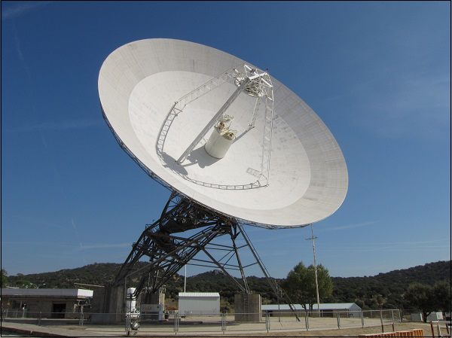
Parabolic Reflector Antennas
Cassegrain Antenna
When the antenna acts as a transmitting antenna, the energy from the feed radiates through a horn antenna onto the hyperboloid concave reflector, which again reflects back on to the parabolic reflector. The signal gets reflected into the space from there. Hence, wastage of power is controlled and the directivity gets improved.
When the same antenna is used for reception, the electromagnetic waves strike the reflector, gets reflected on to the concave hyperboloid and from there, it reaches to the feed. A wave guide horn antenna presents there to receive this signal and sends to the receiver circuitry for amplification.
Take a look at the following image. It shows a paraboloid reflector with cassegrain feed.

Slide 63
Parabolic Reflector Antennas
Applications
The cassegrain feed parabolic reflector is mainly used in satellite communications.
Also used in wireless telecommunication systems.

Slide 64
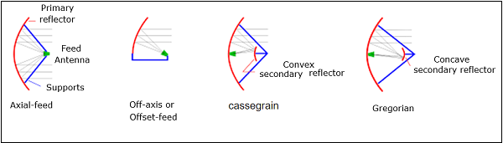
Parabolic Reflector Antennas
Gregorian Feed
This is another type of feed used. A pair of certain configurations are there, where the feed beamwidth is progressively increased while antenna dimensions are held fixed. Such a type of feed is known as Gregorian feed. Here, the convex shaped hyperboloid of casssegrain is replaced with a concave shaped paraboloid reflector, which is of course, smaller in size

Slide 65

Thank You
Module Descriptor

