Slide 1
Shahnaz Tabassum
2021914
BMHP4019_BIRM
Psychology Health and Social Care
I am presenting to you my views on why a child’s experience between the ages of 0-5 years can affect the rest of their lives.

Slide 2
introduction
Welcome parents to this parenting course and I hope you find it interesting!
Bringing up a child correctly does not start when they are more conscious or more mature but it is vital to get them prepped and pushed at younger ages, more specifically between the ages of 0-5 because the affection, love, attention and lessons they learn even from ages as young as these can shape them up to be the adults they will be in the future, so it is vital that children are not neglected at these younger ages.
In this presentation I will talk you through some Psychology Models and Theories which relate to the 0-5 year olds and also evidence the importance of them in real life scenarios and how you could support your child’s development to help shape them to be the best individuals they can be!

Slide 3
Pagiet’s cognitive theory.
Pagiet compiled a theory that states that we have to conquer 4 stages of cognitive development.
The 4 stages are the:
SENSORI-MOTOR STAGE.
PRE-OPERATIONAL STAGE
CONCRETE OPERATIONAL STAGE
FORMAL OPERATIONAL STAGE
- The key stages in this instance concerning the age bracket of 0-5 years are both stages 1 and 2.
Stage 1:
- occurs between ages birth – 2.
- the 5 senses are developed : SEE, HEAR, SMELL, TOUCH AND TASTE.
- it begins with simple reflexes and then we start to develop our first habits. This enhances the importance of child development being important even from ages as young as 0-2 because habits can be formed.
- We have an awareness of the external environment and objects.
- There is also increased mobility which has been proven to increase COGNITIVE DEVELOPMENT.

Slide 4
PAGIET’S THEORY CONTINUED.
Stage 2:
- occurs at ages 2-7.
- Children learn to speak and understand that words, images and gestures are symbols for something else.
Children also like to play pretend.
By the age of 4 children begin to ask many questions and become intuitive.

Slide 5
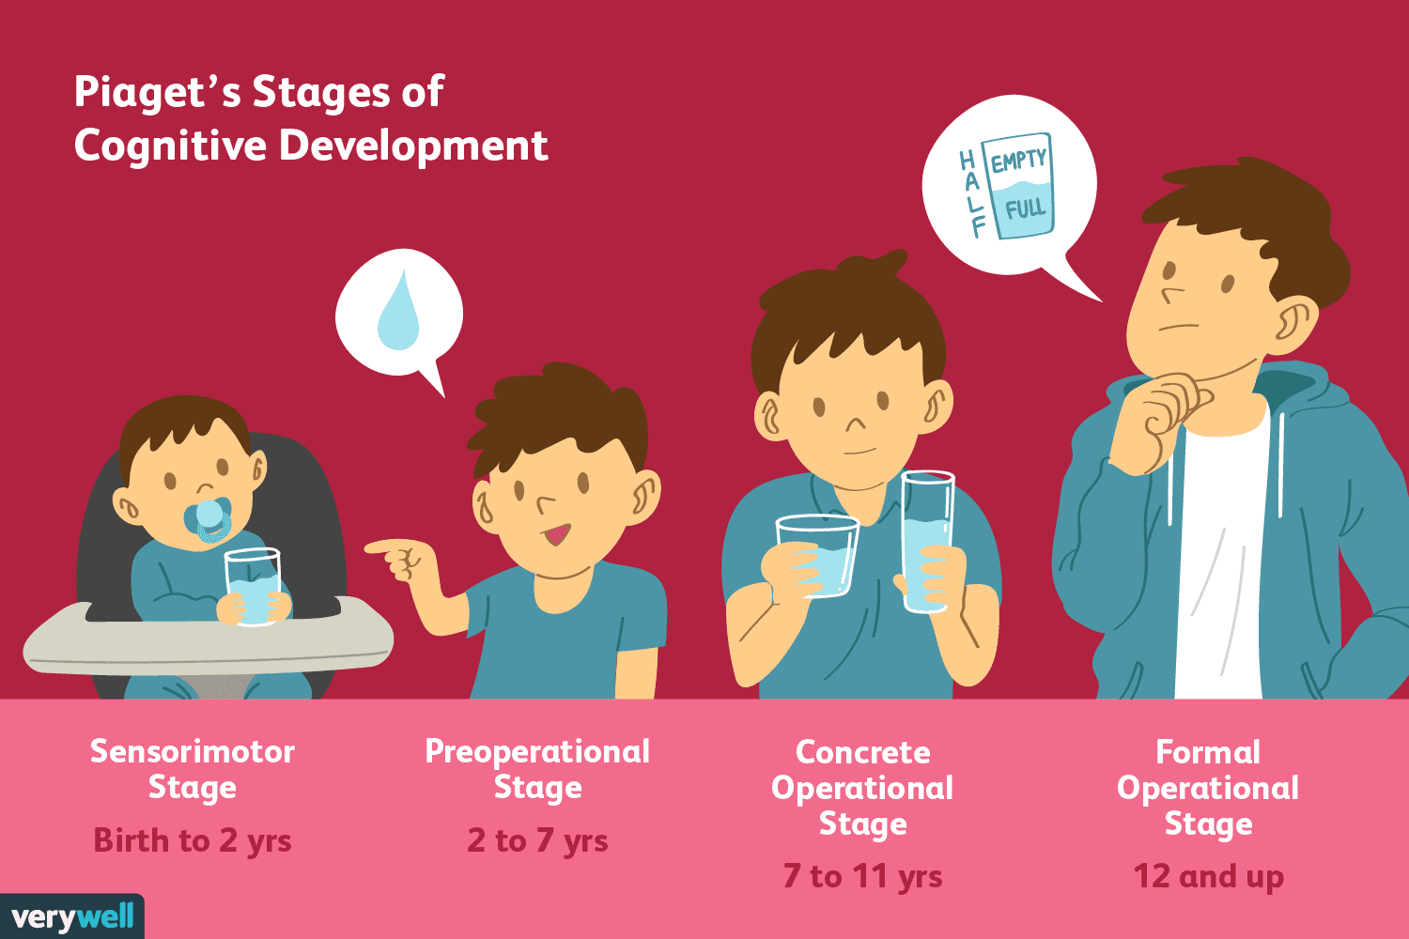
Practical application regarding pagiet’s theory.
One practical application you could use to help maximise a child’s development is provide them with functional SENSORY TOYs because during the first stage of Pagiet’s theory it is stated that between the ages of 0-2 their senses are developed.
If you work on a child’s ability to touch and grip at a younger age as they get older they will have a better ability to grip because they have more development in this field.
Another practical application we could use because we know that habits are formed between the ages of 0-2 is: we could prevent bad habits from being formed and allow good habits to be maintained.
E.g., If a child throws tantrums whenever they do not get something they want we can undo this bad habit by not allowing them to throw tantrums hence not allowing it to become a habit.

Slide 6
SIGMUND FREUD’S PSYCHODYNAMIC THEORY:
This theory states that events in our childhood have a great influence on our adult lives, shaping our personality.
Events that occur in our childhood can remain in the UNCONSCIOUS and cause problems as adults.
The first 3 stages of development:
1. Oral
2. Anal
3. Phallic
ORAL STAGE (0-1 years):
A baby takes pleasure from sucking.
Biting and teeth emerge and then chewing gives pleasure.
ANAL STAGE (1-3 years):
Explusion substage – potty training begins and parental conditions come into use.
Retention Stage – Parents are viewed as authority figures.
PHALLIC STAGE (3-6 years):
Children begin to discover the differences between males and females.
Both boys and girls experience conflicting emotions towards the opposite sex parents.
Future personality development is dependent on how matters are resolved in this stage regarding these feelings.

Slide 7
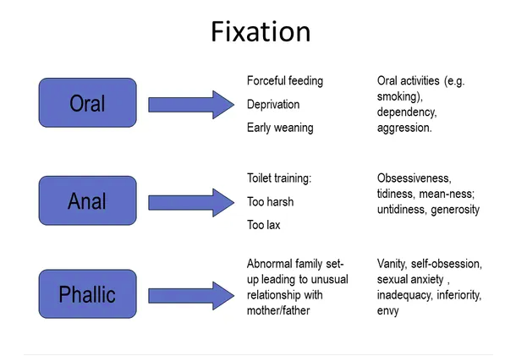
Practical application regarding freud’s psychodynamic theory:
One practical application that could help a child’s development using our knowledge from Freud’s psychodynamic theory is:
Potty training children in their anal stages of 1-3 years is vital to ensure their toilet habits are appropriate and they are able to maintain sanitary in their lifetime. If this is not maintained in younger ages then it may be harder to maintain as you get older.

