Slide 1




Case study: Stockport
Module name: Children, Young People and Families
Module code: (BMHP5004_LON)
Assessment: Assessment Component 1 - Group Presentation
Lecturer name: Jolly Nwankwo
Group name:
Students’ names and IDs:
Sophia Sarpong: 2030974
Safa Ahmed: 2124319
Elizabeth Molineros 2020078
Yoanna Uzunova: 2124312
Awla Semakala: 1912740

Slide 2

•Presentation of the case study
•Factors of vulnerability children, young people and families can face
•The impact of these factors on the children and young people
•The process of intervention by relevant health and social care agencies within the case study
•Actions of social services with the family
•Results and outcomes
•Recommendations

Slide 3

Presentation of the case study
Alcoholic mother that came from an abusive childhood
The father of her children passed away because of drug overdose
Her home was a meeting place for drinkers
Children not attending to school
Not working

Slide 4




Specific reasons why the children, young people and/or family were in a position of vulnerability
Traumatic childhood for the mom
Loss of the children's father
Alcoholic mother
Sources:
Center of Child counselling
Vocal Media
AmenClinics

Slide 5


Factors of vulnerability faced by the family
Abusive childhood
Her house is a meeting place for drinkers
She experienced domestic abuse
Disruptive behaviour of the children
Sources:
The Guardian
Clearview Treatments

Slide 6

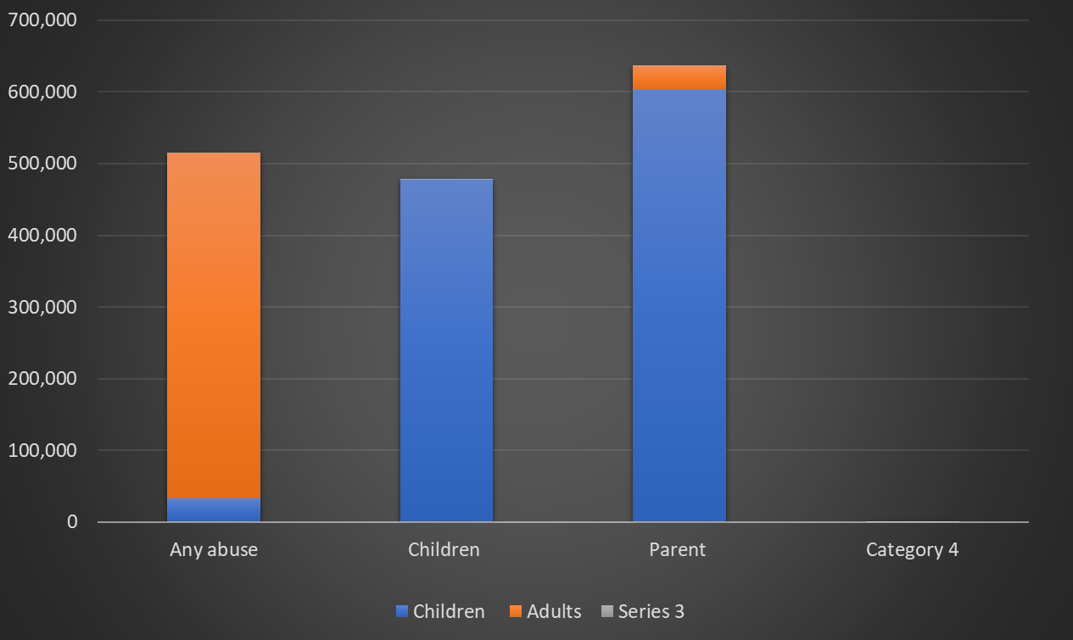

Data of the level of the factor/s of vulnerability in UK

Slide 7
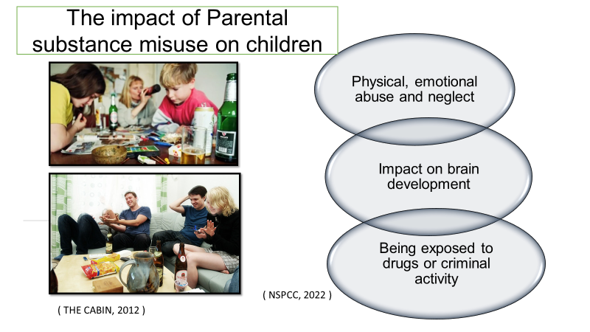

Slide 8
Initiation of Assessment and Agency’s Decisions
Identification of the Problem: The mother acknowledged the detrimental impact of her alcoholism and chaotic home environment on her life and her children’s wellbeing, prompting the need for intervention (MHCLG, 2014).
Agency’s Involvement: The mother’s situation was assessed by a worker of “Troubled Families Job Centre Plus,” a health and social care agency providing targeted services for families in dire circumstances.
Action Plan: The agency undertook a comprehensive assessment and promptly arranged a detoxification programme to address the mother’s alcohol addiction. The intervention was planned following an ecological approach, considering multiple interacting systems around the family (Bronfenbrenner, 1979).
Continuous Support: The family worker maintained regular contact with the mother, supporting her through the recovery journey and gaining her trust to discuss her parenting issues, a critical element in establishing an effective working relationship (Healy, 2014).
Notes:
The initial stages of the intervention begin with identifying the problem where the mother acknowledged the negative impact of her alcoholism and tumultuous home environment on herself and her children’s wellbeing. This acknowledgement is the crucial first step in seeking help and support.
Then, the crucial role of the Troubled Families Job Centre Plus in addressing the issues faced by the family has been discussed. This health and social care agency is known for its tailored services for families dealing with complex problems.
The agency’s decision to carry out an exhaustive assessment can be understood within the framework of Bronfenbrenner’s ecological theory, which posits that various interconnected systems influence an individual’s development. In this case, the mother’s alcohol addiction, childhood experiences, and the environment she provided for her children contribute to a complex network of influencing factors.
The detoxification programme was arranged promptly for the mother, signalling the agency’s understanding of the situation’s urgency and potential impacts on the children. Research suggests that children of alcohol-dependent parents are at an increased risk of psychological and behavioural problems, thereby underlining the importance of prompt intervention.
The family worker’s continuous support and persistent contact were vital. Healy underscores the importance of maintaining regular contact and building trust to create an effective working relationship, which was evidently the case here as the mother began opening up about her parenting challenges.

Slide 9
Timeline of Events and Actions
Initial Phase: The assessment was carried out, identifying the mother’s alcohol dependency. The detox programme was promptly arranged to combat the immediate issue (MHCLG, 2014).
Trust-Building Phase: The family worker maintained consistent contact with the mother, fostering trust and openness to discuss sensitive issues such as her parenting skills (Healy, 2014).
School Involvement: The agency communicated with the school, providing necessary information about the family’s situation to promote a better understanding and support for the children’s needs.
Establishment of Routine: The mother was guided to set routines and boundaries for the children, significantly improving the children’s school attendance – a prime example of structure being an essential element in children’s development.
Counselling and Job Support: The agency facilitated counselling for the mother to understand her addiction triggers and arranged for her to meet a Troubled Families Job Centre Plus specialist for direct employment support (MHCLG, 2014).
Notes:
The timeline begins with the detox programme addressing the mother’s alcohol addiction. The family worker kept in touch with the mother to discuss her parenting abilities during the trust-building period. It supports Healy’s claim that social work interventions require trust-building for effective communication and engagement. The school’s involvement is part of the agency’s overall family support. The organisation informed the school of the family situation because family circumstances can affect children’s academic performance.
While establishing the routine phase, the mother was encouraged to create routines and boundaries for her children, significantly improving school attendance. Brooks-Gunn and Markman argue that the provision of structure is crucial for children’s development and academic performance, confirming the appropriateness of this intervention step.
Lastly, the agency facilitated counselling for the mother, allowing her to explore the underlying reasons for her addiction. Simultaneously, they introduced her to a Troubled Families Job Centre Plus specialist for direct employment support. This dual approach addressed both the psychological underpinnings of her addiction and her practical need for employment, reinforcing the effectiveness of a holistic intervention strategy.

Slide 10
Actions of social services with the family
Child-centred approach (Section 11 of the Children’s Act 2004, GOV. UK).
Children’s and adults social care services must work together, co-operatively (The Care Act and Whole-Family Approaches, 2014, GOV. UK)
Support for the mother.

Slide 11
Results and outcomes
Meeting with the social worker.
Inclusion in a detoxification program.
Establish routines and boundaries for children.
Looking for a job.

Slide 12
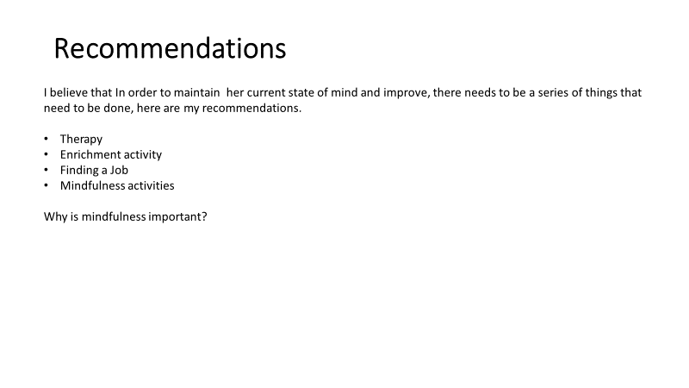

Slide 13
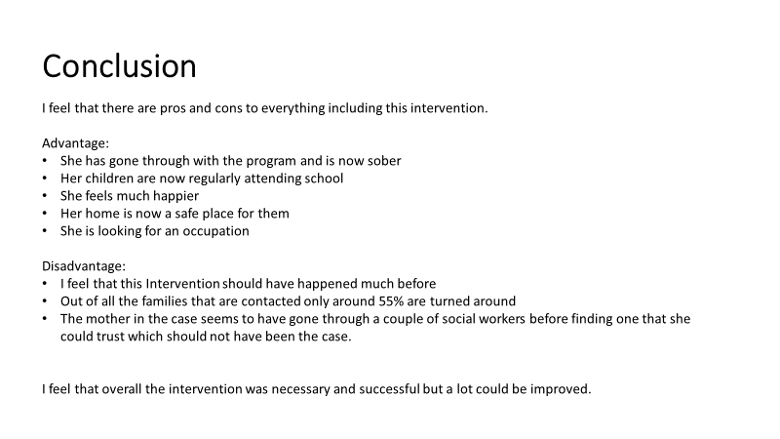

Slide 14
References
GOV. UK (2014), The Care Act and Whole-Family Approaches. pdf [Online], Available at: https://www.local.gov.uk/sites/default/files/documents/care-act-and-whole-family-6e1.pdf, (Accessed: 22. July. 2023)
GOV. UK (2018), Safeguarding and promoting the welfare of children affected by parental alcohol and drug use: a guide for local authorities [Online], Available at: https://www.gov.uk/government/publications/safeguarding-children-affected-by-parental-alcohol-and-drug-use/safeguarding-and-promoting-the-welfare-of-children-affected-by-parental-alcohol-and-drug-use-a-guide-for-local-authorities, (Accessed: 22. July. 2023)
GOV. UK (2021), Parents with alcohol and drug problems: adult treatment and children and family services [Online], Available at: https://www.gov.uk/government/publications/parents-with-alcohol-and-drug-problems-support-resources/parents-with-alcohol-and-drug-problems-guidance-for-adult-treatment-and-children-and-family-services, (Accessed: 22. July. 2023)
NHS 75 (2022), Children and Young People Services [Online], Available at: https://www.whittington.nhs.uk/default.asp?c=3963, (Accessed: 22. July. 2023)
The Youth Endowment Fund (2022), Children, violence and vulnerability 2022.pdf [Online], Available at: https://youthendowmentfund.org.uk/wp-content/uploads/2022/10/YEF-Children-violence-and-vulnerability-2022.pdf, (Accessed: 24. July. 2023)
Urban Family (2018), How to Handle Parenting in a Culturally Diverse Context [Online], Available at: http://urbanfamily.thatsmags.com/shanghai/post/2273/how-to-handle-parenting-in-a-culturally-diverse-context.html, (Accessed: 22. July. 2023).
NSPCC (2022) Parental substance misuse Servise[Online] Available at:https://learning.nspcc.org.uk/children-and-families-at-risk/parental-substance-misuse, ( Accessed: 15. July 2023)
Office for National Statistcs (2021)Child abuse in England and Wales Servise [Online] Available at: https://www.ons.gov.uk/peoplepopulationandcommunity/crimeandjustice/bulletins/childabuseinenglandandwales/january2020, ( Accessed: 21. July.2023).
Khanna, S. and Greeson, J.M. (2013a). A narrative review of yoga and mindfulness as complementary therapies for addiction. Servise [Online] Available at: https://www.sciencedirect.com/science/article/pii/S0965229913000265#sec0055, ( Accessed: 10. July. 2023).
UWTSD (2023), Troubled families: Stockport, Case study [ Moodle], Available at: BMHP5004-Children, Young People and Families

Slide 15
Bronfenbrenner, U. (1979). Ecology of Human Development: Experiments by Nature and Design. Boston, MA: Harvard University Press.
Healy, K. (2014). Social Work Theories in Context: Creating Frameworks for Practice. 2nd ed. New York, NY: Palgrave Macmillan.
MHCLG (2014). Case Study – Troubled Families: Stockport. [online] Ministry of Housing, Communities & Local Government. Available at: https://www.gov.uk/government/case-studies/troubled-families-stockport [Accessed 28 Jul. 2023].

