Slide 1

Assignment Title: Planning and Delivering an International Meeting/Event
Module Title: International Meetings Management BMIH6007
Lecturer’s Name: Kathryn Roberts
Student Name: Md Belal Hussain
Student ID: 2225724

Slide 2
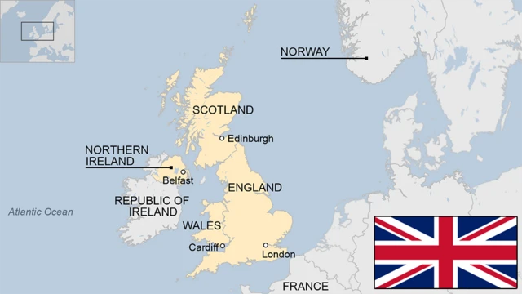
Introduction
Croeso Cymru: Global Business Meets Welsh Welcome is a three-day gathering of corporations designed to bring together corporate leaders, investors, and Welsh entrepreneurs in one venue. The overall goal is to promote the socialization of Welsh hospitality while encouraging business innovation and the establishment of international partnerships (Yen et al. 2025).
The venue proposed is situated in the capital city of Wales, Cardiff, which is known to have a progressive infrastructure and strong culture (Reynolds et al. 2022). This choice is consistent with the Year of Legends campaign by Visit Wales, and therefore, it becomes easily demonstrative in proving Wales as a cultural and economic destination (Bisani, Daye, and Mortimer, 2024).
The event is a perfect example of the combination of tourism and business, which is expected to draw international crowds, encourage economic growth, and support the Welsh brand internationally (Jones, Ap Gwilym, and Roberts, 2025).
To support the future success and sustainability of this new MICE proposal, a detailed feasibility study is conducted, including strategic, operational, financial, and market-based analysis (Wee, Kamarulzaman, and Anas, 2022).

Slide 3

Content and Context of the Event
The event manifests the unique identity and the hospitality spirit of Wales by focusing on the production of corporate networking and cultural immersion. It offers an organized space on which to work together, negotiate trade, and appreciate other cultures (Anas et al. 2020).
Some of the programmatic elements are business conferences, keynote speeches, product showcases, and cultural demonstrations like Welsh food tastings, live harp concerts, and traditional tale-telling (Kim et al. 2024).
It is expected that the event will host over 2,000 representatives of various parts of the world, thus creating potential openings to visit Welsh fields such as tourism, technology, sustainability, and innovation (Montañés-Del-Río, and Medina-Garrido, 2020).
The idea advances a sense of place, where the participants experience the values of Welsh conviviality and solidarity as they interact in the substantive business discourses, and is hence used to validate the argument that culture and business may exist together in promoting economic growth and international goodwill.

Slide 4
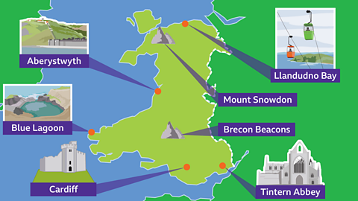
Justification
The city of Cardiff has been chosen due to its ease of access, modern infrastructure, and the fact that it is a friendly and vibrant urban centre. The city is equipped with world-class facilities like ICC Wales and the Principality Stadium, making it appropriate to host large-scale events (Yoon, and Wang, 2023).
The event is positioned in strategic terms to meet the objectives of tourism in Wales since it will translate the Year of Legends campaign into a business-hospitality nexus, presenting Wales as a tourist destination and an international investment and innovation centre.
The event also helps in economic recovery after the pandemic through tourism and accommodation usage, and local spending in the hospitality tourism industry, retail, and transport (Pocinho, Garcês, and De Jesus, 2022).
Croeso Cymru is proposed as a long-term brand that can be repeated every year, sustainable tourism, international partnership, and increased international awareness of Wales (Almeida, and Almeida, 2024).

Slide 5

Market Factors- Target Market and Demand
The key target market will include foreign investors, trade representatives, business leaders, governmental officials, and Welsh SMEs, and these individuals seek networking prospects, collaboration building, and market visibility.
The worldwide MICE industry is characterized by a high growth rate, and the figure is estimated at above £800 billion; Wales has a chance to benefit well from the expansion.
Wales is yet to realize its full potential as a MICE destination, and therefore, the event is timely and strategically relevant, and these conferences that combine professional networking and cultural immersion are in high demand (Kim, Chhabra, and Timothy, 2022).
Other competing conferences in London, Dublin, and Edinburgh are more business-based; in Cardiff, the cultural richness and low cost will give the business a clear competitive advantage, and a population that is interested in authenticity and meaningful connections will come (Disimulacion, 2024).

Slide 6

Market Factors- Marketing and Promotion Strategy
To advertise the event on an international level, the international platforms will be used, and the target audience will be business professionals who can be approached with the help of professional networks, including LinkedIn, X (previously Twitter), and Instagram, to focus on the Welsh culture (Hur, Lee, and Kim, 2022).
Partnerships with Visit Wales, Welsh diplomatic missions, and trade missions will improve credibility and increase international outreach, which will guarantee national branding needs (Palaniswamy, 2021).
The event portal and mobile application will provide multilingual support, simplified online registration, virtual networking, and real-time updates on the events and, in this way, make the event more accessible to both physical and hybrid attendees (Singh, and Deri, 2024).
Some of the PR activities will include press releases, influencers, and features in business and tourism magazines to create anticipation, focusing on the welcoming nature of Wales, scenic beauty, and professionalism in dealing with world-class events (de Almeida, and Boavida-Portugal, 2025).

Slide 7
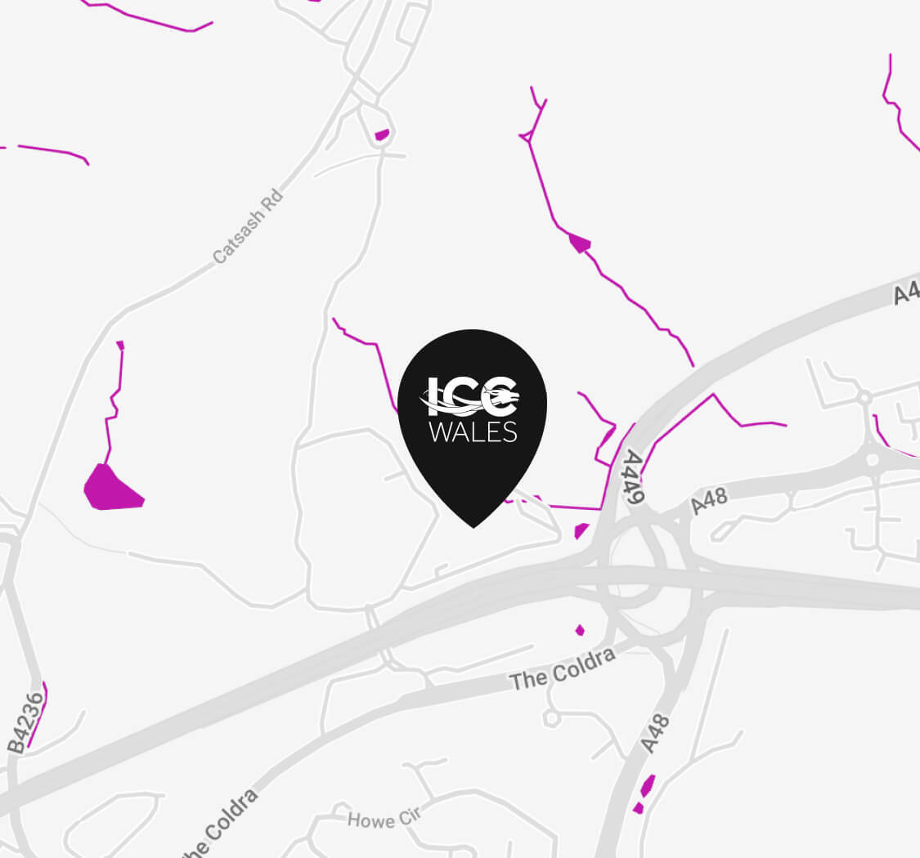
Operational Feasibility- Venue and Logistics
ICC Wales is the chosen venue offering more than 26,000 square meters of conference space, advanced technological facilities, and eco-friendly design to host the event with the potential of 2,000 delegates and breakout options to conduct workshops and meetings (Mair, and Smith, 2021).
The better transport accessibility of Cardiff through the Cardiff Airport, railways, and the close accessibility to motorways will be the guarantee of easy accessibility for both local and foreign players.
Logistics will include airport transfer, hotel accommodation, bilingual signage, and on-site support desks, something that will create an atmosphere conducive to hospitality and care for the attendees.
There will be strict compliance with the accessibility and safety rules, including accessibility with wheelchairs, well-marked emergency exits, and security guards who have learned how to handle crowds, which will provide them with a smooth, professional, and inclusive experience.

Slide 8

Operational Factors- Staffing, Sustainability, and Resources
The event will involve hiring a team of professionals that will include the event planners, audiovisual technology, hospitality personnel, interpreters, and cultural performers to make sure that there will be impeccable execution.
The training modules will be made available to the staff to enhance professionalism, cultural sensitivity, and environmental responsibility throughout the event.
Sustainability will also take center stage, which will be reflected in the adoption of digital name badges and reduced use of paper, and a joint effort of hands with local Welsh suppliers to curtail carbon emissions.
The catering will also entail the contemporary Welsh cuisine, sourced locally, such as vegetarian, vegan, halal, and gluten-free food, thereby exemplifying the Welsh hospitality in terms of diversity and inclusiveness (Martin-Rojo, and Gaspar-González, 2025).
Operational excellence, in the long term, will also be realised through the introduction of high-speed Wi-Fi, new stage lighting, and event-management software solutions, which will contribute to making all the elements of the events more efficient (Minor, McLoughlin, and Richards, 2021).

Slide 9
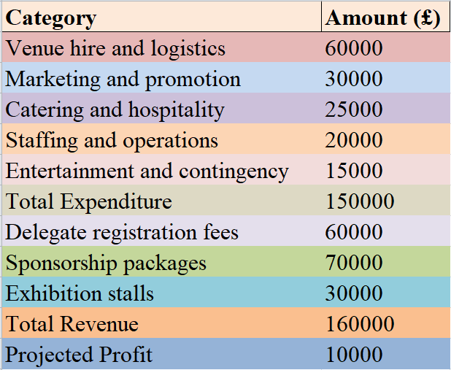
Overview of Budget
The overall event expenditure will amount to 150000 pounds, which will include the venue rental, logistics, manpower, marketing, and hospitality. It is expected that the event will generate a small profit but will provide high quality (Yoon, and Wang, 2023).
Suggested Expenditure: venue hire and logistics (£60,000), marketing and promotion (£30,000), catering and hospitality (£25,000), staffing and operations (£20,000), entertainment and contingency (£15,000).
Estimated Revenue: delegate registration (£60,000), sponsorship packages (£70,000), and exhibition stalls (£30,000). The gain that would be realized in this setup is £10,000.
The financial strategy places more emphasis on value creation and cost efficiency. The contracts will all be flexible to include unexpected changes. The estimated numbers prove the event to be financially feasible and capable of supporting itself without any external debt.

Slide 10

Strategy related to Funding and Sponsoring
Various sponsors will be sought to spread the risks in financing and strengthen brand association (Disimulacion, 2024). Principality Building Society, Admiral Group, PwC Wales, Transport for Wales, and Hilton Hotels have been confirmed to have interest.
Sponsorship packages will be classified as Gold (£25,000), Silver (£15,000), and Bronze (£5,000) packages, offering packages of different scales to businesses of different sizes. All packages include branding options, media coverage, and VIPs.
Visit Wales and Welsh Government tourism funds will support the government in enhancing credibility, and costs will be reduced. Trade, tourism, or sustainability grants will also be sought.
The financial strategy is reasonable and long-term, as it seeks to strike a balance between the state and the corporate sectors. Such a partnership model will make sure that the event advertises Wales in a joint manner and avoids financial risks, as well as enhancing relations among sponsors.

Slide 11

Conclusion
The viability testing has proved that Croeso Cymru is a very feasible and strategic event. Cardiff has a perfect infrastructure, a trained hospitality workforce, and a rich culture, which makes it a perfect host city.
The event helps to achieve the goals of Visit Wales to improve tourism, promote the Welsh culture, and encourage foreign business investment. It provides a long-term solution to increase the international presence of Wales.
Having strong marketing, effective funding, and professional operations, it is predicted that in the future years, "Croeso Cymru" will be profitable, effective, and replicable.
With a grand mix of tradition and innovation, the event will make a permanent mark on the world about Wales being a country that opens its arms to the world to embrace business growth, cultural pride, and the true spirit of the "Year of Legends."

Slide 12
References
Almeida, G.G.F. and Almeida, P., 2024. Researching destination branding in pandemic crises: A research agenda. European Journal of Tourism, Hospitality and Recreation, 14(1), pp.165-178. Available at: https://sciendo-parsed.s3.eu-central-1.amazonaws.com/66b7b4cf244b564e1ba07cf7/10.2478_ejthr-2024-0012.pdf?X-Amz-Algorithm=AWS4-HMAC-SHA256&X-Amz-Content-Sha256=UNSIGNED-PAYLOAD&X-Amz-Credential=ASIA6AP2G7AKAFIRFFN2%2F20251031%2Feu-central-1%2Fs3%2Faws4_request&X-Amz-Date=20251031T084557Z&X-Amz-Expires=3600&X-Amz-Security-Token=IQoJb3JpZ2luX2VjEEgaDGV1LWNlbnRyYWwtMSJIMEYCIQC45pruGvd8aJSS50lBL6aTVXn2i0wI898uuwRUPaeyywIhALNDqKM3L6Z%2Ft4oLYH8sRldJXDW%2BizDrG6K4l7RB2q48Kr0FCBEQAhoMOTYzMTM0Mjg5OTQwIgxfufrb3D%2FE3TggCBUqmgXyyHssOzYUw27icPKzP58fE%2BjBgZ3gKzshaCvcqR%2BpTgoeZ3uDYY6S74rIaQvUkVNdxmbOnj2euY2dqQrTsTiYkF6Gca7nq8nZ3CEzFkMWZXHWxFuNlSmCqAjvKFKsctgzEKEDG8MFSZ0vyPgk4uW%2BrlJdjwTBw%2BiFx8i5FdWYUDadq6w80qy4SV75wx0St4vYsMODd0M8dSAkoEKxnMS4bNxVpV8dtzZNw0dhfz4E86YJ4l39HBKOQ58j4KSM%2B%2BA2BAJnmyTl9p1oo2VsfseX9kniWsmT3rJUrFQ1C6OwtX1wxXX21tZ1wTtmJiQD8m%2F9tVR1%2FisUcAv%2FgoGT0MA1NTGOkVskC6TQu%2FHpjjrb2nqAe%2Bk9mrTV5S7cn9%2F9mfndDnmZ5aJ5bN%2BlYv3X0UWASyK5thOQ0OLwhz8to1NJ4anIwcSuIwtjHyguBgf8uqWqJX1NKjzTrK%2F5mwYT8rIhlkxs0EIF%2FYdHfAdw%2F%2B5TRNscmn80ZqnmNX50SAaKXK%2BV8y8jcMYJ%2BhMRSBuSUdQ4UfEQaVV%2FVIy1HwLDwpY%2B%2B6ACgdg7M9MOQKOU0w6mlQAsa%2BDd5ckIqX1%2BELo9Zz7zjCzcpHyTz1RS99bm4dZeJFzfQaJ9A84vBTciEfjqBu4uCuLusI3JULYeLUTTPoTnjv1UFBo6%2F%2FZ9FEXrGd1w1gQUJFBaAu%2FymLW%2FAIfSOmDFvGVbeFjqxdACiE9m8rQBdGXzAxyIKxd8%2FSh%2FXwj%2FPBfU%2B6UWp5umcemBQywAB2HlfgSV8Ro2Mv3i98Eubgygf5E1aOOkEQYkXnb9pJAHSf%2BZ6FG0aO4aLBaO7YxCpjw8r%2B%2BKMzSuo%2BJTML8zSN7Wi6LTS%2FQuhHUkBn%2FNdmq%2F9ibMKUSJZeBlOOIwk9eRyAY6sAEcet2l%2FP%2FILeKB1NIW1HYugOIEQI%2B2pbut4fI%2FrEjHUgwj5pr7DT3MRACTb1ENLSIqAkwLf1eDgf2WPE9%2Bprht8bJaezVz128yJQUJ1Bk%2B54q%2Bs1FL25T6kaCPQOqegOXq1kJ3WrhRa0eqV8TeCEgZrjvYGm030fKC60wP380q2dCviemNYwGgxXysq5fQk6MHn97zjdIb3w2n8jbS3rpgvSK32%2Fhy074vvu7%2FX1xHcw%3D%3D&X-Amz-Signature=43d72f4df41175132be4b9f0899cd2b96a76658691feee6246812068edc0fe74&X-Amz-SignedHeaders=host&x-amz-checksum-mode=ENABLED&x-id=GetObject (Accessed: 31 October 2025)
Anas, M.S., Maddiah, N.A., Noor Eizamly, N.U.E., Sulaiman, N.A. and Wee, H., 2020. Key success factors toward MICE industry: A systematic literature review. Journal of Tourism, Hospitality & Culinary Arts (JTHCA), 12(1), pp.1-34. Available at: https://ir.uitm.edu.my/id/eprint/29153/1/AJ_MUHAMMAD%20SAUFI%20ANAS%20JTHCA%20B%2019.pdf (Accessed: 31 October 2025)
Bisani, S., Daye, M. and Mortimer, K., 2024. Legitimacy and inclusivity in place branding. Annals of Tourism Research, 109, p.103840. Available at: https://www.sciencedirect.com/science/article/pii/S0160738324001178 (Accessed: 31 October 2025)
de Almeida, D.S. and Boavida-Portugal, I., 2025. Digital twins in tourism: a systematic literature review. arXiv preprint arXiv:2502.00002. Available at: https://arxiv.org/pdf/2502.00002 (Accessed: 31 October 2025)
Disimulacion, M.A.F., 2024. Innovating the MICE Industry through Creative Tourism: Opportunities and Future Directions. International Journal of Sustainable Competitiveness on Tourism, 3(01), pp.54-62. Available at: https://journal.poltekpar-nhi.ac.id/index.php/ijscot/article/view/1485 (Accessed: 31 October 2025)
Hur, D., Lee, S. and Kim, H., 2022. Are we ready for MICE 5.0? An investigation of technology use in the MICE industry using social media big data. Tourism Management Perspectives, 43, p.100991. Available at: https://www.sciencedirect.com/science/article/abs/pii/S2211973622000563 (Accessed: 31 October 2025)
Jones, E., Ap Gwilym, R. and Roberts, O., 2025. Developing a new set of targets for the Welsh Economy. Available at: https://pure.bangor.ac.uk/ws/portalfiles/portal/81640833/Developing_a_new_set_of_targets_for_the_Welsh_economy.pdf (Accessed: 31 October 2025)
Kim, E.G., Chhabra, D. and Timothy, D.J., 2022. Towards a creative MICE tourism destination branding model: integrating heritage tourism in New Orleans, USA. Sustainability, 14(24), p.16411. Available at: https://www.mdpi.com/2071-1050/14/24/16411 (Accessed: 31 October 2025)
Kim, S., Williady, A., Wang, J. and Kim, H.S., 2024. A mixed-method approach to grounded theory regarding the MICE industry at Busan Exhibition & Convention Center. Tourism and Hospitality, 5(4), pp.1012-1027. Available at: https://www.mdpi.com/2673-5768/5/4/57 (Accessed: 31 October 2025)
Mair, J. and Smith, A., 2021. Events and sustainability: Why making events more sustainable is not enough. Journal of sustainable tourism, 29(11-12), pp.1739-1755. Available at: https://www.tandfonline.com/doi/pdf/10.1080/09669582.2021.1942480 (Accessed: 31 October 2025)
Martin-Rojo, I. and Gaspar-González, A.I., 2025. The impact of social changes on MICE tourism management in the age of digitalization: a bibliometric review. Review of Managerial Science, 19(7), pp.2211-2234. Available at: https://link.springer.com/content/pdf/10.1007/s11846-024-00751-3.pdf (Accessed: 31 October 2025)
Minor, K., McLoughlin, E. and Richards, V., 2021. Enhancing the visitor experience in the time of COVID 19: The use of AI robotics in Pembrokeshire Coastal Pathway. In Information and Communication Technologies in Tourism 2021: Proceedings of the ENTER 2021 eTourism Conference, January 19–22, 2021 (pp. 570-577). Cham: Springer International Publishing. Available at: https://link.springer.com/content/pdf/10.1007/978-3-030-65785-7_55.pdf (Accessed: 31 October 2025)
Montañés-Del-Río, M.Á. and Medina-Garrido, J.A., 2020. Determinants of the propensity for innovation among entrepreneurs in the tourism industry. Sustainability, 12(12), p.5003. Available at: https://www.mdpi.com/2071-1050/12/12/5003 (Accessed: 31 October 2025)
Palaniswamy, N., 2021. Social Media Marketing (SMM) A Strategic Tool for Developing Business for Tourism Companies. arXiv preprint arXiv:2107.03895. Available at: https://arxiv.org/pdf/2107.03895 (Accessed: 31 October 2025)
Pocinho, M., Garcês, S. and De Jesus, S.N., 2022. Wellbeing and resilience in tourism: A systematic literature review during COVID-19. Frontiers in Psychology, 12, p.748947. Available at: https://www.frontiersin.org/journals/psychology/articles/10.3389/fpsyg.2021.748947/full (Accessed: 31 October 2025)
Reynolds, L., Koenig-Lewis, N., Doering, H. and Peattie, K., 2022. Competing for legitimacy in the place branding process:(re) negotiating the stakes. Tourism Management, 91, p.104532. Available at: https://www.sciencedirect.com/science/article/pii/S0261517722000450 (Accessed: 31 October 2025)
Singh, A. and Deri, M.N., 2024. Exploring the use of virtual and hybrid events for mice sector: Trends and opportunities. In New Technologies in Virtual and Hybrid Events (pp. 47-70). IGI Global. Available at: https://www.igi-global.com/chapter/exploring-the-use-of-virtual-and-hybrid-events-for-mice-sector/353848 (Accessed: 31 October 2025)
Wee, H., Kamarulzaman, N.D. and Anas, M.S., 2022. MICE industry survival: A systematic literature review. The International Journal of Academic Research in Business & Social Sciences, 12(11). Available at: https://d1wqtxts1xzle7.cloudfront.net/100470247/mice-industry-survival-a-systematic-literature-review-libre.pdf?1680220912=&response-content-disposition=inline%3B+filename%3DMICE_Industry_Survival_A_Systematic_Lite.pdf&Expires=1761901303&Signature=LUO6RiTyGrMFsuz1f5CrqwN2Y1lI44ZbV9WRxa-pyCv7IG1FU066rcjvQjEbNjtC4GlLf5GapttiLOc3057f4Xd0m6wUG~PTo1cOHzj-JBzD5ymofR6-yy57YUSOb7yI7-1ja8LVCcSjoRgmQ5RAxE1IVbNCMxk5trEJ4sTNnWLSE7sf5G3l4kFDxDY75yXA~VnhYKRJCeiR8xJTwDgaaxHfxhYKJle3s0vEqSMFrMUpKMhS7ctiV3Q5bTSUsPLfx4ZozZcvAP2aNwvdbbgWde~7FYe~GGalUy~34hAYnBt3~pxVTuDqrz-ugD3-TO10aw7za4Mkz5sUey9b0N3WrA__&Key-Pair-Id=APKAJLOHF5GGSLRBV4ZA (Accessed: 31 October 2025)
Yen, D., Jang, J., Wei, L., Morgan, N. and Pritchard, A., 2025. Leveraging folklore and fantasy to promote small destinations: the case of Visit Wales. Journal of policy research in tourism, leisure and events, 17(3), pp.736-750. Available at: https://www.tandfonline.com/doi/pdf/10.1080/19407963.2023.2263860 (Accessed: 31 October 2025)
Yoon, T.H. and Wang, S., 2023. How important is stakeholder collaboration in the mice industry: Antecedents and outcomes of supply chain integration. Sustainability, 15(20), p.14966. Available at: https://www.mdpi.com/2071-1050/15/20/14966 (Accessed: 31 October 2025)

Slide 13


