Slide 1
SJSS5001
The Internet of Things
Dr C Lohmann-Hancock
Joanne Davies

Slide 2
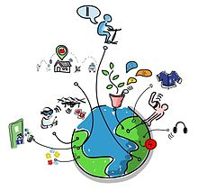

Slide 3
What is the Internet of Things?
Discuss…

Slide 4
Internet of Things
No one definition but those who are concerned with IoT include:
  World community of users. In fact, there are many different groups including governments, academicians, researchers, practitioners, innovators, developers and corporate people
Most agree…
  The idea that the first version of the Internet was about data created by people
  The next version is about data created by things
  (Kosmatos,Tselikas and Boucouvalas, 2011)

Slide 5
Not Just DATA:
Analysis and Understanding
Objects can both sense the environment and communicate
  tools for understanding complexity and responding to it swiftly
Humans? Who are they?
  Physical information systems are now beginning to be deployed
  With some working without human intervention

Slide 6
IoT:
Data Data Everywhere!
The “Internet of Things” refers to
  coding and networking of everyday objects and things to render them individually machine-readable and traceable on the Internet

Slide 7
IoT Definitions
  The rapidly growing network of connected objects that are able to collect and exchange data using embedded sensors. Thermostats, cars, lights, refrigerators, and more appliances can all be connected to the IoT. (Meola, 2019)
  An open and comprehensive network of intelligent objects that have the capacity to auto-organize, share information, data and resources, reacting and acting in face of situations and changes in the environment” (Kosmatos,Tselikas and Boucouvalas, 2011)

Slide 8
Overview: The Internet of Things (IoT)
A paradigm shift in IT arena
Internet:
Global system of interconnected computer networks that use the standard Internet protocol suite (TCP/IP) to serve billions of users worldwide
A network of networks that consists of millions of private, public, academic, business, and government networks, of local to global scope
Linked by a broad array of electronic, wireless and optical networking technologies
(Nunberg, 2012)

Slide 9
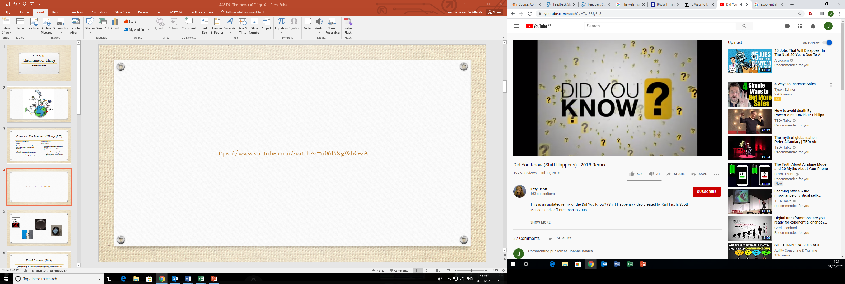
Shift Happens
https://www.youtube.com/watch?v=u06BXgWbGvA

Slide 10
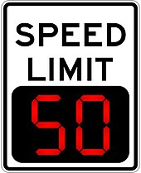
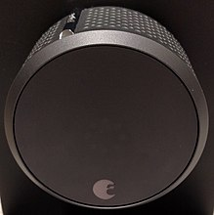
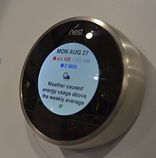
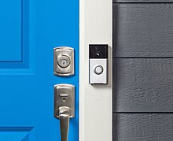

Slide 11
What’s Included in the IoT
What’s included:
  Electronic devices we encounter and use daily
  Technologically advanced products such as equipment and gadgets
  “Things” that we do not do normally think of as electronic at all
    food, clothing; and furniture; materials, parts and equipment, merchandise and specialized items;
    landmarks, monuments and works of art and all the miscellany of commerce, culture and sophistication (Kosmatos,Tselikas and Boucouvalas, 2011)

Slide 12
IoT:
Data Data Everywhere!
The Internet of Things refers to
  Coding and networking of everyday objects and things to render them individually machine-readable and traceable on the Internet

Slide 13
‘Connected’
“Being connected”
  Often considered in regards to electronic devices such as
    servers, computers, tablets, telephones and smart phones
  The Internet of Things
    sensors and actuators embedded in physical objects—from roadways to pacemakers—are linked through wired and wireless networks, often using the same Internet IP that connects the Internet
    These networks allow for a huge volumes of data that flow to computers for analysis

Slide 14
Internet of Things Devices
There will be more than 64 billion IoT devices installed around the world by 2026 a rise from 10 billion in 2018 (Meola, 2019)
What are IoT Devices?
Discuss…

Slide 15
Internet of Everything?
What’s In?
Things can be both living things like
  person, animals—cow, calf, dog, pigeons, rabbit etc., plants—mango tree, jasmine, banyan and so on
and non-living things like
  chair, fridge, tube light, curtain, plate etc. any home appliances or industry apparatus
So at this point
  things are real objects in this physical or material world

Slide 16
Common IoT Devices
Group Task
How many devices can you think of?
How many do you have in your home

Slide 17
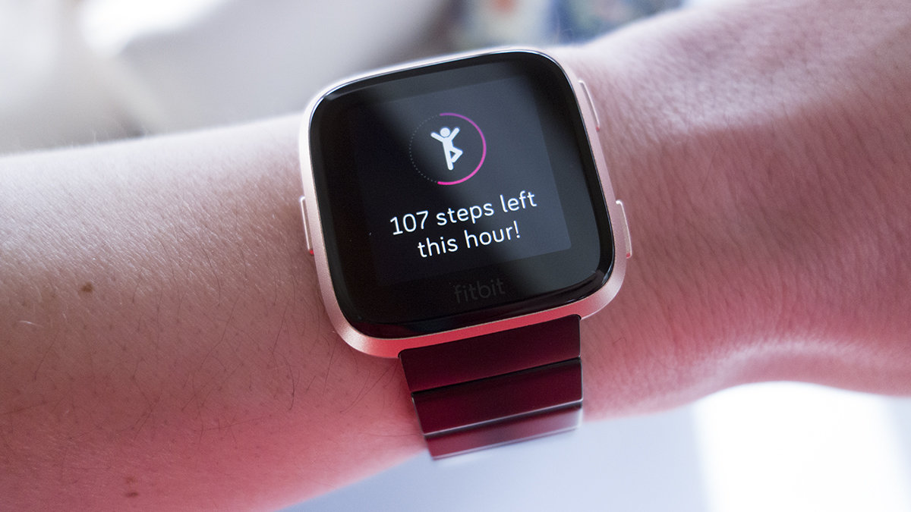
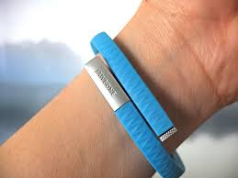
Smart Wearables
Smart Wearables
Fitbits/ trackers etc.
Smart Glasses https://www.youtube.com/watch?v=mjCt3QAhX7Q

Slide 18
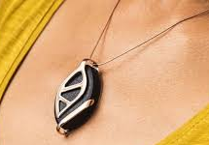
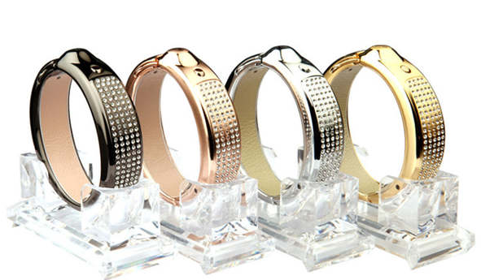
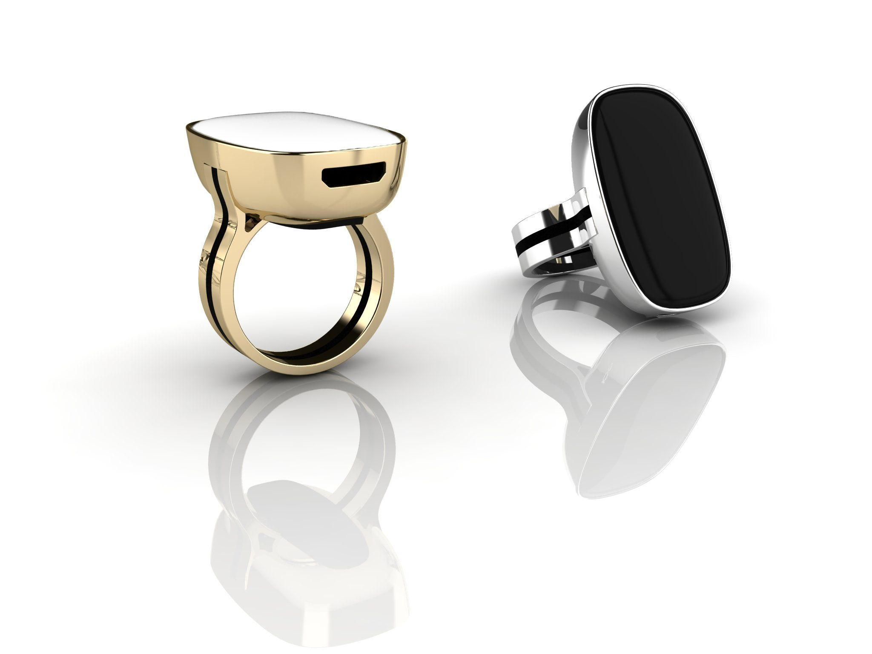
Smart Jewellery
https://www.youtube.com/watch?v=MYIGBL8ON4g

Slide 19
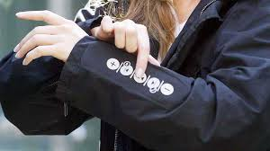
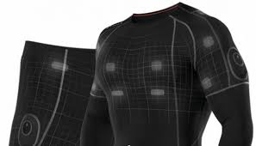
Smart Clothing
Smart clothing
-electronic devices worn near or directly on the body
Monitors the wearers condition
More natural to wear?
Academic and Clinical Research
Track biometric signals (eg. heart rate, temperature, activity)
(Fernández-Caramés and Fraga-Lamas, 2018)

Slide 20
Driverless Cars
EE has opened its 5G network to car makers, self-driving technology companies, start-ups and public sector organisations.
Experts say the cars, which will be connected to each other and to traffic management systems, will help to improve road safety and traffic flow.
a 5G-enabled road management system could reduce the time motorists spend in traffic by 10% – saving the UK economy £880m a year and reducing CO2 emissions by 370,000 metric tonnes per year.
Ambulance service trails are due to start in September 2020 (Madden, 2020)
https://www.youtube.com/watch?v=gU6q19ausio

Slide 21
Science and Medicine
Advances in detection and treatment of Parkinsons Disease
Operating by remote control using robots
Better communication means sharing of new ideas and innovations is easier
Or does it?...

Slide 22
Advances in Healthcare
Smart Medicines
Monitoring of patients receiving treatment at home
Advances in treatment of diabetes (Continuous Glucose Monitors and Insulin Pens)
Connected Inhalers (monitors and adapts dosage) (NHS, 2018)

Slide 23
Effects on Health and Social Care
Technology Integrated Health Management (TIHM)
Elderly Care https://www.youtube.com/watch?v=BCK-v0cWE3k
Dementia Care (monitors and other IoT devices)
Staff monitoring devices (Maruthappu, 2018)
Data Analysis Solutions for Healthcare- IoT UK (with NHS and DoH)
https://iotuk.org.uk/wp-content/uploads/2017/11/IoT-in-Health-and-Social-Care.pdf

Slide 24
Health and Social Care
Is the use of the IoT a good thing in Health and Social Care?
Discuss…

Slide 25
IoT in Agriculture
Smart Farming
Aids Pest Management
Enables food to be grown cleanly and sustainably
Uses sensors to monitor crops (light, humidity, temperature etc.)
Automated irrigation and feeding
Drones used to monitor crop health and mapping (Ravindra, 2020)

Slide 26
IoT in Agriculture
Smart Farming
Livestock- monitors health and well-being of animals
Identifies sick animals and leads to prevention of spread of disease
Locates animals
A new initiative in Wales involved using IoT tech at nearly 20 farms. One cattle farmer believes the technology will reduce the time required to find lost animals.
Plus, it will even show which spots the cows prefer to graze! (Mathews, 2019)

Slide 27
Smart Cities
Since the 1930’s city living has been in decline in favour of commuting
Produced a negative stereotype of inner city living
Recently there has been a move back to city living and London is more populated than ever
People who live in cities are often healthier and wealthier than others
By 2050 it is predicted that 75% of the world population will live in cities

Slide 28
Smart Cities
https://www.youtube.com/watch?v=Br5aJa6MkBc
Transforming cities with technology
https://www.youtube.com/watch?v=hRY-ZUlJXY0

Slide 29
Smart Cities
But we should always remember: smart cities are not about making our cities ‘fit for the future’ - they’re about making the future fit, for the future of our citizens
(Gov.Uk, 2018)

Slide 30
Globalisation and the IoT
Highlights a vision of a global infrastructure of networked physical objects, enabling anytime, anyplace connectivity for anything and not only for any one
(Kosmatos, Tselikas and Boucouvalas, 2011)
A global network which allows communication between
  human-to-human
  human-to-things
  and things-to-things
  by providing unique identity to each and every object (Aggarwal & Las Das, 2012)
  just about anything can be connected and communicates in an intelligent fashion

Slide 31
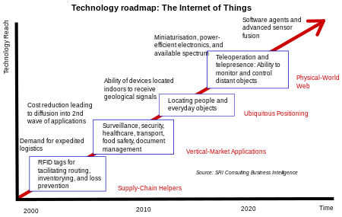

Slide 32
Legislation: IoT
One of the key drivers of the IoT is data.
The success of the idea of connecting devices to make them more efficient is dependent upon access to and storage & processing of data
  For this purpose, companies working on the IoT collect data from multiple sources and store it in their cloud network for further processing
  Privacy and security dangers and single point vulnerability of multiple systems
  Issues of consumer choice and ownership of data and how it is used
  Regulations and governance regarding these issues of privacy, security, and data ownership continue to develop (GDPR) (Weber & Weber, 2010; Hassan, 2018; Hassan, Khan and Madani, 2017)
  Remember IoT regulation depends on the country

Slide 33
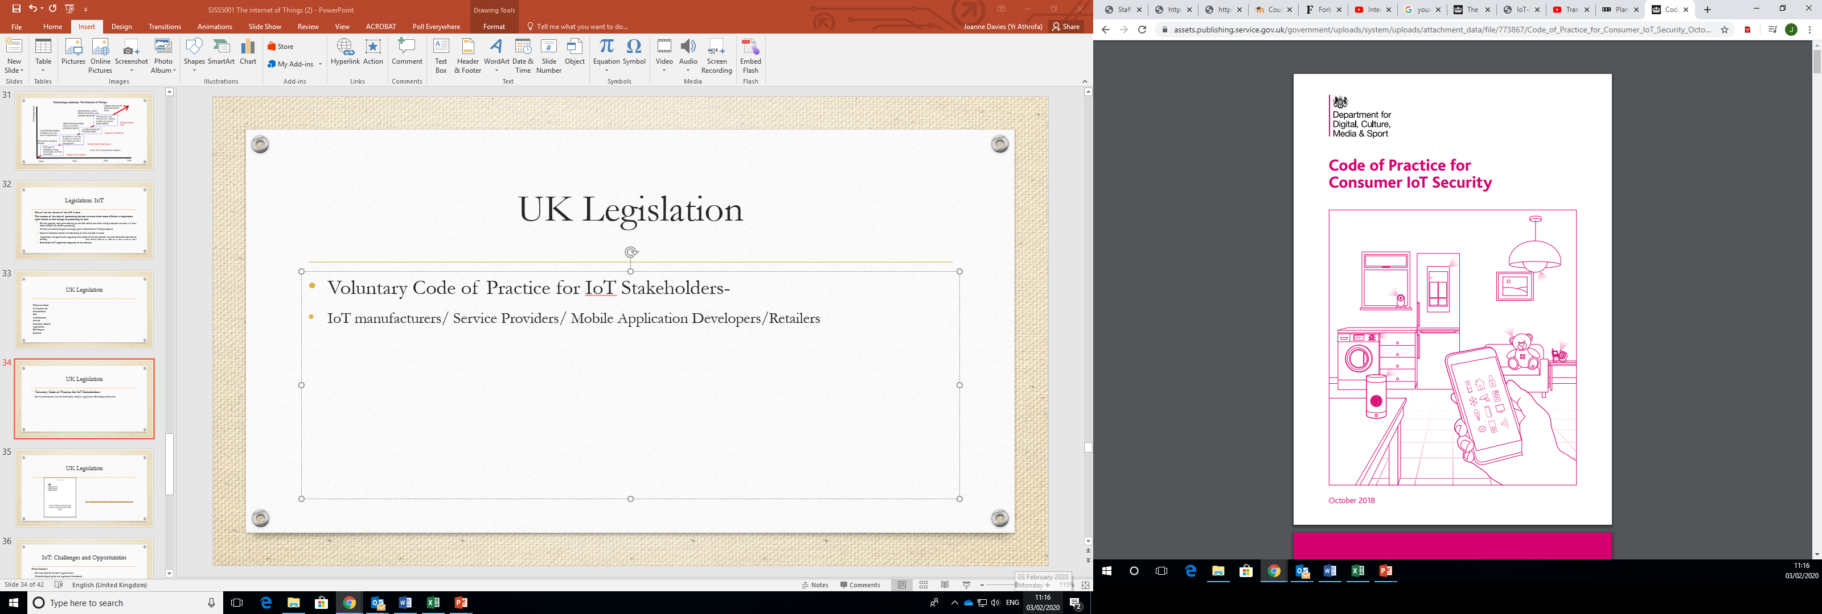
UK Legislation
Voluntary Code of Practice for IoT Stakeholders-
IoT manufacturers/ Service Providers/ Mobile Application Developers/Retailers
https://assets.publishing.service.gov.uk/government/uploads/system/uploads/attachment_data/file/773867/Code_of_Practice_for_Consumer_IoT_Security_October_2018.pdf

Slide 34
UK Legislation
No default passwords
Implement a vulnerability disclosure policy
Keep software updated
Securely store credentials and security-sensitive data
Communicate securely
Minimise exposed attack surfaces
Ensure software integrity
Ensure that personal data is protected
Make systems resilient to outages
Monitor system telemetry data

Slide 35
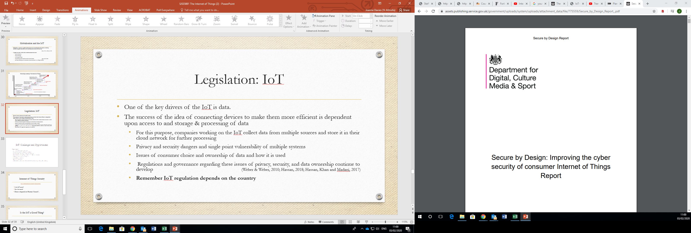
UK Legislation
https://www.gov.uk/government/publications/secure-by-design-report

Slide 36
IoT: Challenges and Opportunities
These include –
Still early days for the IoT in government
Underdeveloped policy and regulatory frameworks
Unclear business models, despite strong value proposition
Clear institutional and capacity gap in government AND the private sector
Inconsistent data valuation and management
Infrastructure a major barrier
Government as an enabler
Most successful pilots share common characteristics (public-private partnership, local, leadership)

Slide 37
Internet of Things Security
https://www.youtube.com/watch?v=pGtnC1jKpMg
Is the IoT secure?
Can it be secure?
Does it depend on Human Nature?...

Slide 38
David Cameron (2014)
“I see the Internet of Things as a huge transformative development, a way of boosting productivity, of keeping us healthier, making transport more efficient, reducing energy needs, tackling climate change. We are on the brink of a new industrial revolution and I want us... to lead it.”
(The Guardian, 2014)

Slide 39
Boris Johnson…
(Addressing the UN General Assembly in 2019)
"You may keep secrets from your friends, from your parents, your children, your doctor – even your personal trainer – but it takes real effort to conceal your thoughts from Google."
"A future Alexa will pretend to take orders. But this Alexa will be watching you, clucking her tongue and stamping her foot."
"In the future, voice connectivity will be in every room and almost every object: your mattress will monitor your nightmares; your fridge will beep for more cheese, your front door will sweep wide the moment you approach, like some silent butler."
"Are we doomed to a cold and heartless future in which computer says yes — or computer says no with the grim finality of an emperor in the arena?“ (Asher Hamilton, 2019)

Slide 40
Is the IoT a Good Thing?
What do you Think?

Slide 41
References
Asher Hamilton, I. (2019) Boris Johnson gave a deeply bizarre speech about 'limbless chickens,' 'pink-eyed terminators,' and evil Alexa. Available at: https://www.businessinsider.com/boris-johnson-gives-bizarre-speech-about-technology-to-the-un-2019-9?r=US&IR=T (Accessed: 23 January 2020).
Fernández-Caramés, T.M. and Fraga-Lamas, P. (2018) Towards The Internet-of-Smart-Clothing: A Review on IoT Wearables and Garments for Creating Intelligent Connected E-Textiles Available at: file:///C:/Users/j.davies1/Downloads/electronics-07-00405%20(1).pdf (Accessed: 26 January 2020).
Gov.Uk, (2018) The UK's Leadership in Smart Cities. Available at: https://www.gov.uk/government/speeches/the-uks-leadership-in-smart-cities (Accessed: 1 February 2020).
Kosmatos, E.A., Tselikas, N.D. and Boucouvalas, A.C. (2011) ‘Integrating RFIDs and Smart Ob-jects into a Unified Internet of Things Architecture. Advances in Internet of Things.’ Scientific Research 1(1), pp.5-12. Available at: https://www.scirp.org/journal/paperinformation.aspx?paperid=4696 (Accessed: 18 January 2020).
Madden, E. (2020) From driverless cars to smart ambulances: what 5G really means and why it matters Available at: https://www.theguardian.com/taking-care-of-business/2019/dec/11/from-driverless-cars-to-smart-ambulances-what-5g-really-means-and-why-it-matters (Accessed: 1 February 2020).
Maruthappu, B. (2018) How can we revolutionise social care in 2019? Available at: https://www.forbes.com/sites/benmaruthappu/2018/12/20/how-can-we-revolutionise-social-care-in-2019/#2ca052404a22 (Accessed: 29 January 2020).
Mathews, K. (2019) 5 IoT Use Cases That Will Shape the Future of Agriculture Available at: https://ubidots.com/blog/agriculture-smart-farming/ (Accessed: 28 January 2020)

Slide 42
References
Meola, A. (2019) Business Advisor: A look at examples of IoT devices and their business applications in 2020. Available at: https://www.businessinsider.com/internet-of-things-devices-examples?r=US&IR=T (Accessed: 16 January 2020).
NHS, (2018) Technology Integrated Health Management (TIHM) Available at: https://www.england.nhs.uk/ourwork/innovation/test-beds/tihm/ (Accessed: 26 January 2020).
Nunberg, G. (2012) The Advent of the Internet: 12th April, Courses. Available at: https://www.scirp.org/(S(i43dyn45teexjx455qlt3d2q))/reference/ReferencesPapers.aspx?ReferenceID=1482944 (Accessed: 18 January 2020).
Ravindra, S. (2020) IoT Applications in Agriculture: The demand for growing population can be successfully met with IoT. Available at: https://www.iotforall.com/iot-applications-in-agriculture/ (Accessed: 28 January 2020).
The Guardian, (2014) Internet of Things: Funding to Double, David Cameron Announces. Available at: https://www.theguardian.com/technology/2014/mar/10/internet-of-things-to-get-more-funding
Weber, R.H.; Weber, R. (2010). ’Internet of Things: Legal Perspectives’. Springer Science & Business Media. pp. 59–64. ISBN 9783642117107.
Hassan, Q.F. (2018). Internet of Things A to Z: Technologies and Applications. London: John Wiley & Sons.
Hassan, Q.F.; Khan, A. ur R.; Madani, S.A. (2017). ’Internet of Things: Challenges, Advances, and Applications’. CRC Press. pp. 41–2. ISBN 9781498778534.

