Slide 1
The Great Confinement

Slide 2
Nervous or mad?
From the late 17th century onwards there was a growing interest and absorption in the intricacies of the brain and the nervous system.
The more educated public started to associate madness with the body, there was a need to rationalise the distressing behaviours that mad people demonstrated.
For those wealthy and elite individuals who were susceptible to bouts of melancholy and depression, or other medical or physical problems using the language of “the nerves” was appealing

Slide 3
King George III
Was insistent that he was not mad or ill, he frequently stated “I am nervous…I am not ill, but I am nervous; if you would know what is the matter with me, I am nervous”
He wasn’t…he was mad.
In his extreme bouts of madness George displayed delusional and violent behaviours, he foamed at the mouth, he was restless, couldn’t sleep and his language and behaviour was at times obscene.
He often appeared to get better, but then would fall back into a state of madness. This pattern would repeat itself.
For the last 10 years of his life King George was out of his mind, he was blind, rambling, manic and irrational.

Slide 4
Discussion Point
George III’s illness and it’s Impact on Psychiatry (1968)
George III’s illness and it’s impact on Psychiatry – reassessment (2010)

Slide 5
Question
How relevant and important is the debate about what King George III was actually suffering from?

Slide 6
The rise of the asylum
The confinement of the mad/insane became the solution to the problem of the Bedlam mad.
With the development of the asylum came the specialists in asylum medicine – the mad doctors.
Growing role of state funding

Slide 7
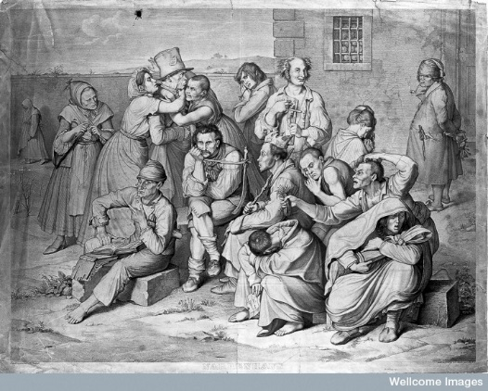
Rise of the Asylums
There developed a need to confine the mad and the dangerous, to remove them from society.
A decision was made to create a network of asylums that could be used to detain any mad person,
And so began the great confinement.
This became a very visible response to mental health issues that would continue right up until the 1980s/1990s.

Slide 8
National network of voluntary lunatic Hospitals
From 1751 we have the founding of a vast range of asylums:
Luke’s Hospital in London
Others in Manchester, York, Liverpool and Exeter
County Asylum Act (Wynn’s Act)
County asylums opened in 1812 in Nottingham and Bedford
Expansion of private madhouses.

Slide 9
Bethlem
Over-worked and undermanaged staff, including the keepers and attendants had fallen into the habit of keeping the challenging inmates in strait-waistcoats or chained to the wall.
The building was crumbling and in a state of disrepair.
The place was dank, vermin-infested and the plaster was rotting.
In 1810 the government finally granted modest funding for the building of a new hospital, on a new site.

Slide 10
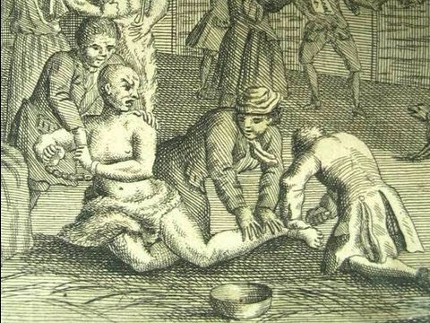
Bethlem cont…
Edward Wakefield on visiting Bethlem noticed:
Poorly clothed patients, shivering with cold
Chained to the wall, in one case a patient was chained to the wall by an iron ring riveted around his neck.
Brutality and neglect
With the staff blaming each other for the conditions.
Even in the new building in St George’s Fields, Southwark the conditions remained the same.

Slide 11
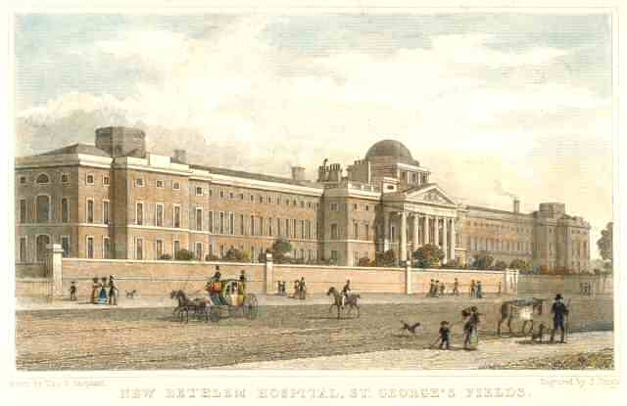
Conditions in Bethlem, Southwark.
Inmates became desperate to curry favour with the keepers
The keepers would often set the inmates on each other for their own amusement
Viscous beatings
Anyone who tried to appeal for justice would have their outside visits refused.

Slide 12
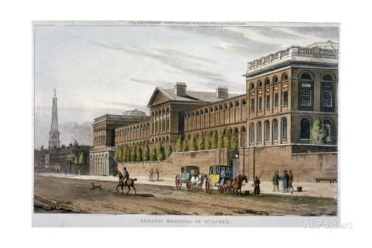
St Luke’s Hospital
The public visibility of madness prompted medical interest in the question of what it really was: what caused madness and what could cure it?
St Luke’s Hospital was set up as a rival to Bedlam. It did not allow visitors public visitations
Blood-letting, purging and blistering were put aside in favour of new therapeutic plans.
More chemical treatments were utilised, including: mercury for venereal diseases, and opium for pain,
Luke’s Hospital, London

Slide 13
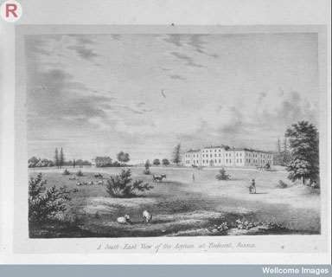
Conditions inside the madhouses
The quality of the private madhouses ranged from squalid to a network of houses with pleasant gardens and living conditions.
The squalid houses were often overcrowded and were often designed to get in as many people as possible to get as much profit from them
Ticehurst

Slide 14
Enlightened and Progressive Private Madhouses
Even before the development of the York retreat in the 1790s, there is evidence that the private madhouses would often treat their patients with kindness and consideration, with only limited use of restraints.

Slide 15
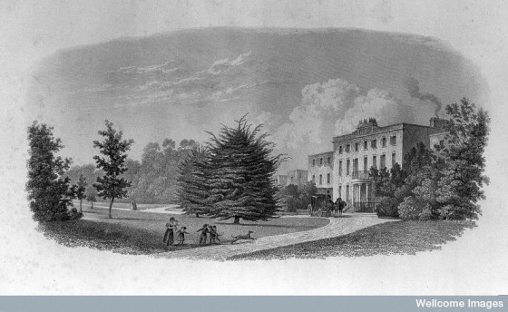
Edward Long Fox
Brislington House: His longterm project where he could practice his ideas of treating mental disorders.
Purpose built
It met the needs of those with differing mental health needs but also catered for the needs of the upper class and elite.
Furnished and equipped on a lavish scale.
Brislington House

Slide 16
Who was admitted to the state institutions?
Had to demonstrate that they were mad.
There would be some fees
Some would be sent by parishes
There would be a form of certification

Slide 17
Family and Lunacy
The place in the family of the mad individuals
No. Cases |  | Middlesex | Other Counties
 | Husbands | 4 | 5
 | Wives | 2 | 3
 | Sons | 1 | 4
 | Daughters | 2 | 0
 | Widows | 2 | 4
 | Servants/Apprentices | 2 | 2
 | Not Specified | 21 | 33
 | Total | 34 | 51

Slide 18
Questions
Was Bethlem Hospital a dumping ground for the unwanted, undesirable and troublesome in the early modern period?
'The 18th century was a disaster for the insane'. Do you agree?

Slide 19
Dorothea Dix
Own readings and articles.

Slide 20
Next Week!
Tuke and Pinel
Read articles posted online prior to the lecture.

