Slide 1
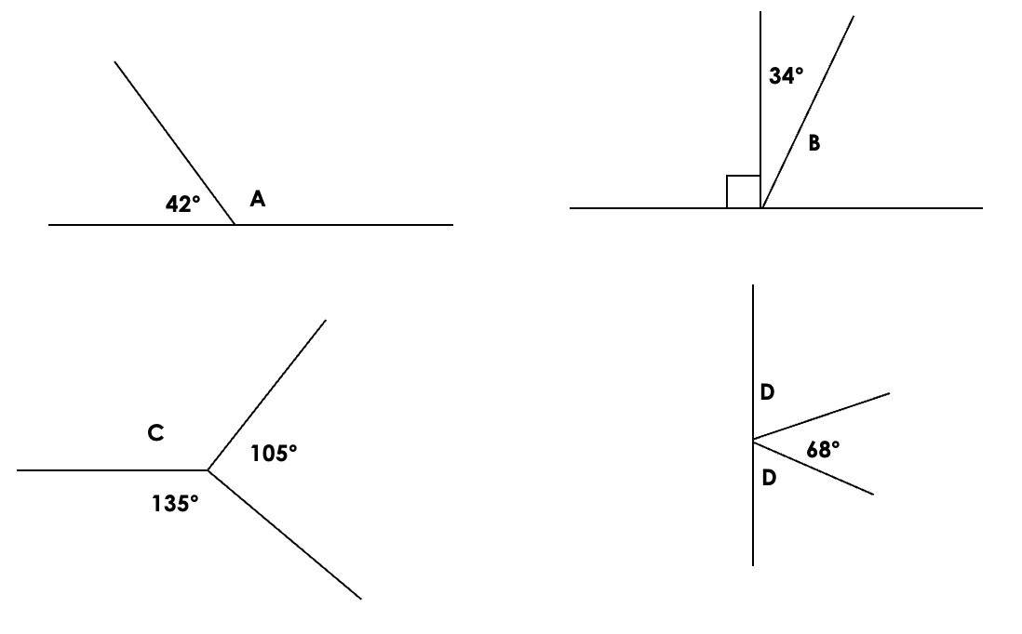
Gwaith Dosbarth Dydd Gwener 11^{eg} Hydref
Angles in Triangles and Quadrilaterals
Starter:
Can you identify the angles below? What do you know about them?
1. 2. 3.
Work out the missing angles:
Notes:
Write on the wipe board, date, title and – ONGLAU is the gair y wers (welsh word of the session)
Angles on a straight line add up to 180º
Right angles – equal 90º
Angles around a point = 360º.
Acute angle = less than 90º
Obtuse angle = greater than 90º but less than 180º
Reflex = greater than 180º, less than 360º.
A) 180 – 42 = 138 a = 138º
B) 180 – 90 – 34 = 56 b = 56º
C) 360 – 105 – 135 = 120 c = 120º
D) 180 – 68 = 112. 112 ÷ 2 = 56. d = 56º

Slide 2


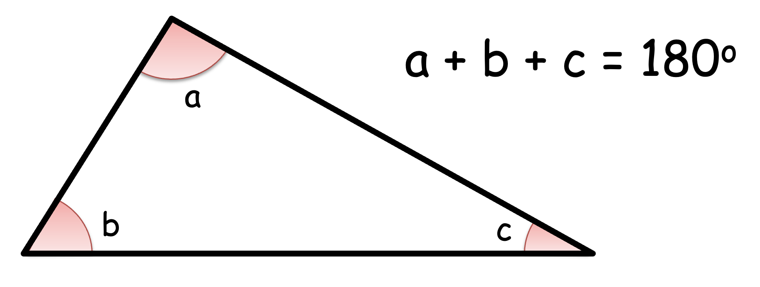
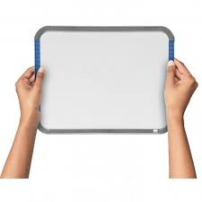
Angles in Triangles
Angles in a triangle add up to 180º.
On your mini whiteboards, name at least one type of triangle.
Notes:
If they don’t know their triangles, draw one.

Slide 3
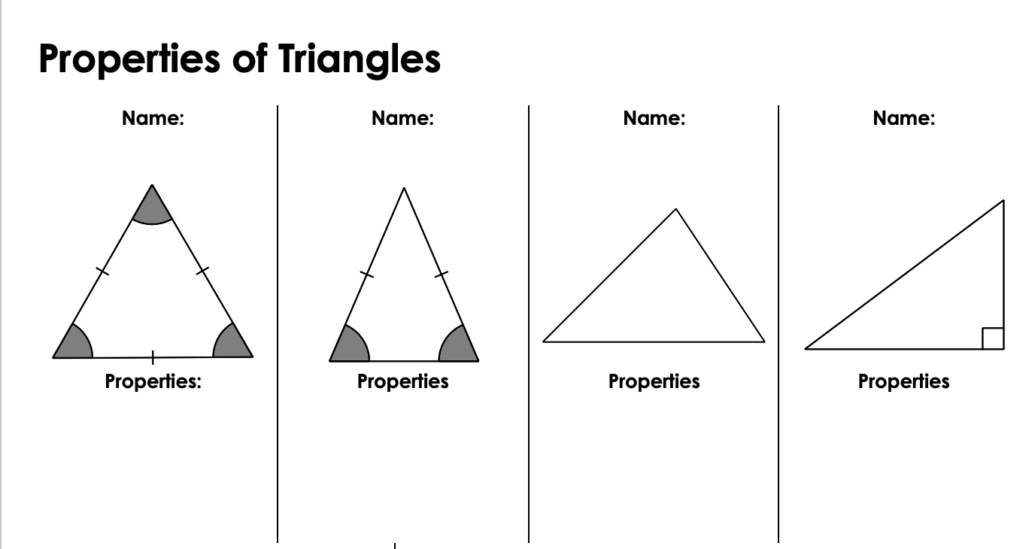
Angles in Triangles
Equilateral triangle
Isosceles
triangle
Scalene
triangle
Right-angled
triangle
3 equal sides
3 equal angles
2 equal sides
2 equal angles
0 equal sides
0 equal angles
One 90º angle.
Notes:
Point out here the following:
The line on each of the three sides of an equilateral triangle to show all three sides are equal.
The line on two sides of an isosceles triangle to show that the two sides are equal.
A right angle is shown by a square.

Slide 4
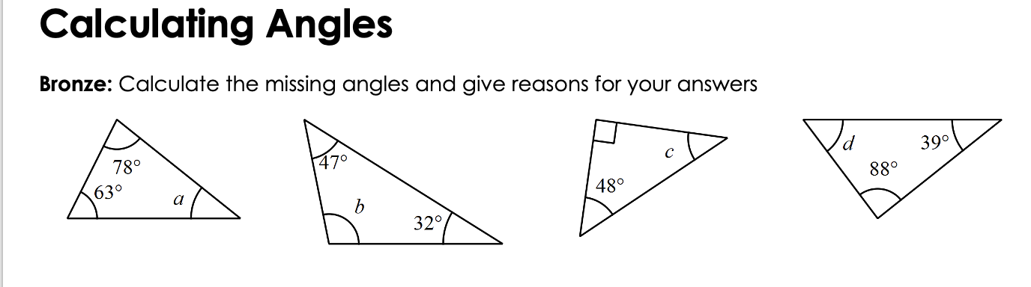
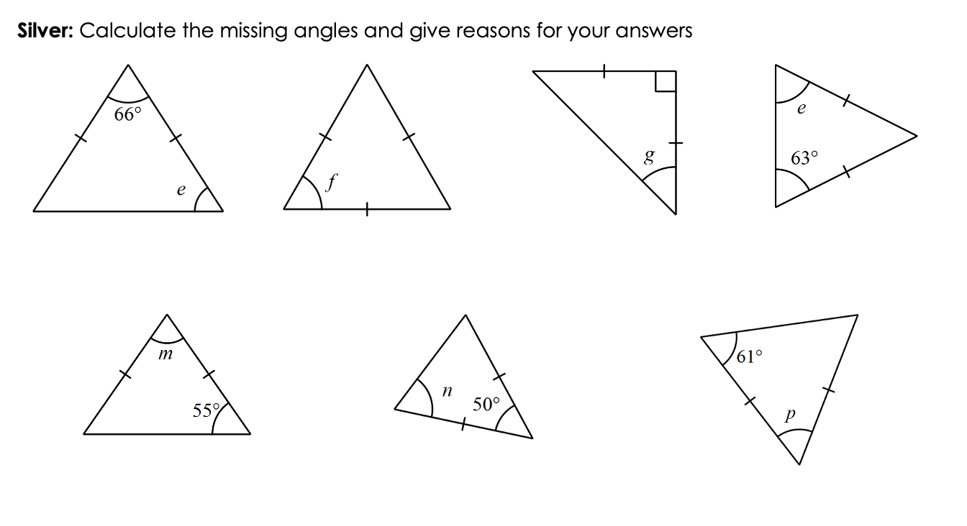


Angles in Triangles
Examples:
Notes:
Blank space underneath to use interactive whiteboard to model how to work it out.
How can we use what we wrote down in our starter to help us?
What type of angle is a? Acute. So what does that mean? It should be less than 90º.
What type of angle is b? Obtuse. So what does that mean? It should be greater than 90º but less than 180º.

Slide 5
Angles in Triangles
Complete the rest of the worksheet (Bronze and Silver)
Notes:
Use interactive whiteboard timer
Blank space on the right hand side to use interactive whiteboard to model how to work it out.

Slide 6
Angles in Triangles
Answers
Notes:
Blank space on the right hand side to use interactive whiteboard to model how to work it out.

Slide 7
Angles in Triangles
Notes:
What type of triangle is this? Equilateral triangle
What do we know about this type of triangle? What are its properties?
3 equal sides and 3 equal angles
How does this help us?
a = the same angle.
This is an equilateral triangle.
a + a + a = 180º
Can we collect like terms here?
3a = 180º
Divide both sides by 3
a = 180/3
a = 60º
If they get this quite easily, extend the line from angle 55º on the board to make a straight line and ask them the value of the new angle on the straight line.
Blank space on the right hand side to use interactive whiteboard to model how to work it out.

Slide 8
Angles in Quadrilaterals
What are quadrilaterals?
2D shapes
4 sides
Notes:
2D shape
4 sides
Square, rectangle, trapezium, kite, rhombus, parallelogram etc.

Slide 9
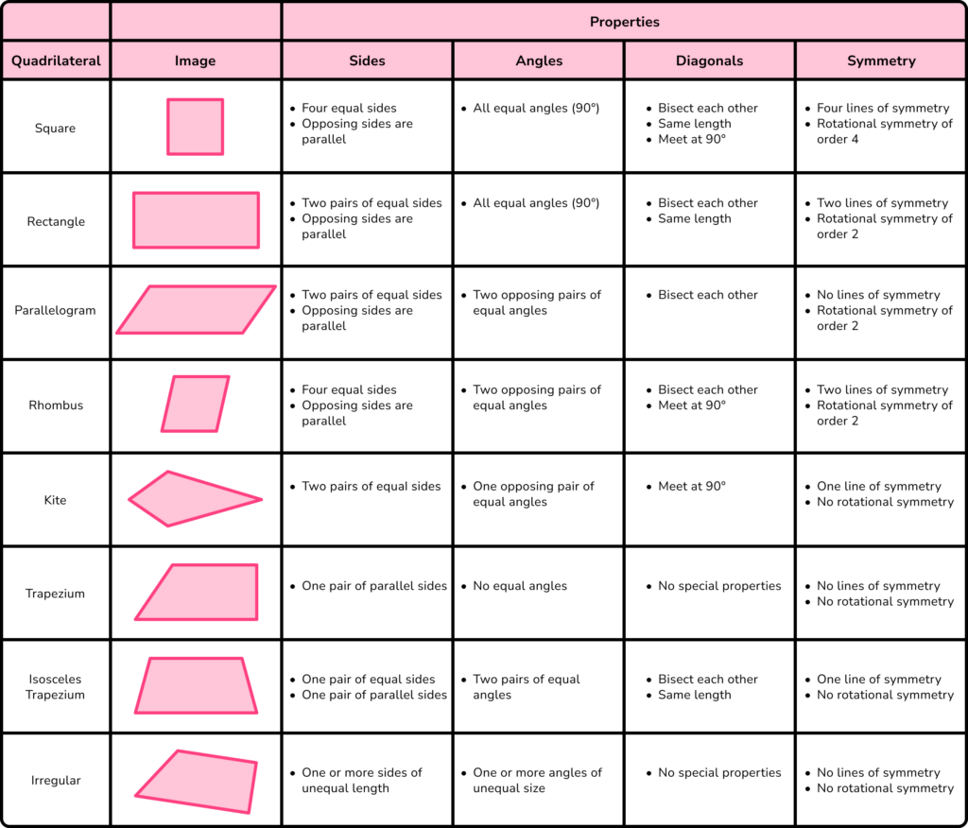
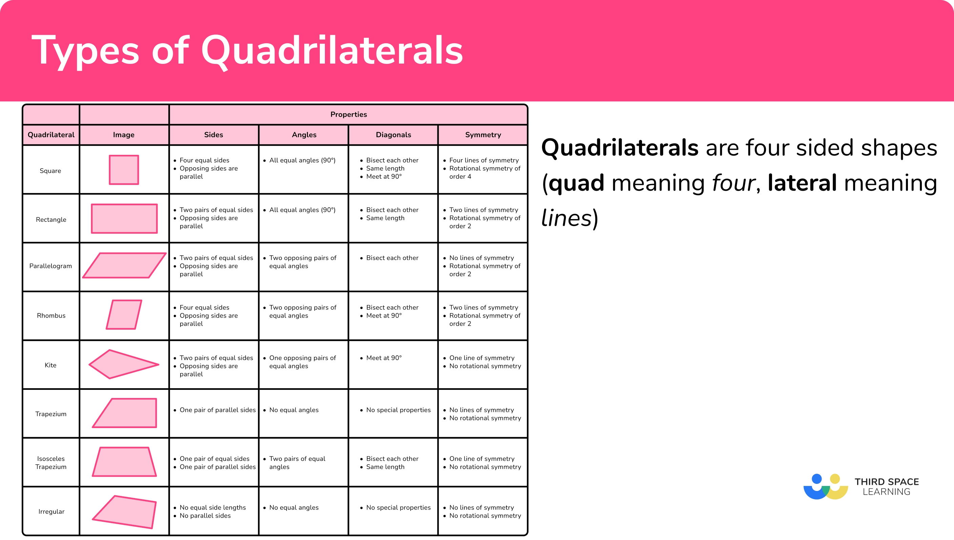
Angles in Quadrilaterals
Angles in a quadrilateral add up to 360º.
Notes:
We can see that the interior angles of quadrilaterals equal 360º as they contain two triangles (180º x 2 = 360º).
Link to literacy here:
Reading – the names of the shapes off of the board and seeing their spelling.
Writing – writing these names into their books.
Listening – to the teacher read out each name.

Slide 10
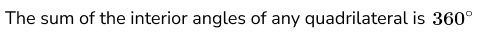
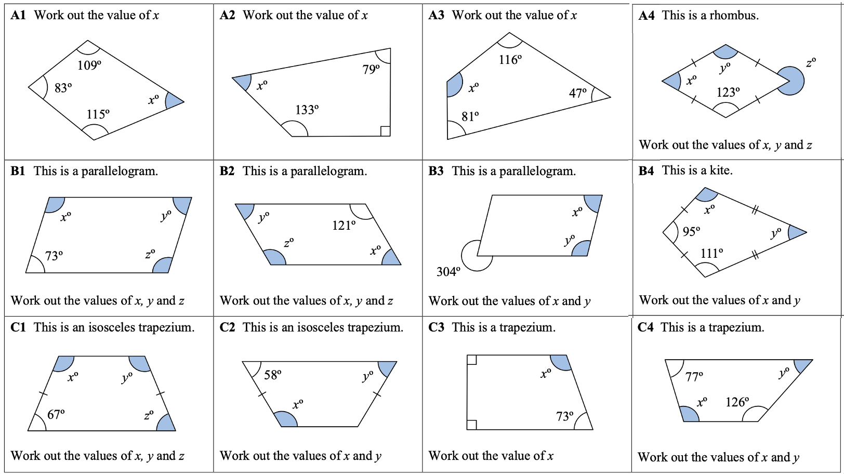
Angles in Quadrilaterals
Notes:
If running out of time, work down the sheet rather than across to do a range of question types (i.e., A1, B1, C1, A2, B2, C2, etc.).

Slide 11
Angles in Quadrilaterals
Notes:
Answers – modelled underneath in the blank space.

Slide 12
Angles in Quadrilaterals
Notes:
Answers – modelled underneath in the blank space.

Slide 13


Plenary
3 Stars and a Wish
3 Stars
(3 positives from this lesson, anything that you’ve learned, anything you enjoyed, etc.)
1 Wish
(What do you wish to improve on? Is there anything you wish to know more about?)
Notes:
Plenary – 3 stars and a wish.

Slide 14
Recap – Finish the sentences
Angles in a triangle add up to …
The four types of triangles are …
Angles in a quadrilateral add up to …
Three examples of quadrilaterals are …
Notes:
If we have time – if not, use as starter for next lesson.

