Slide 1





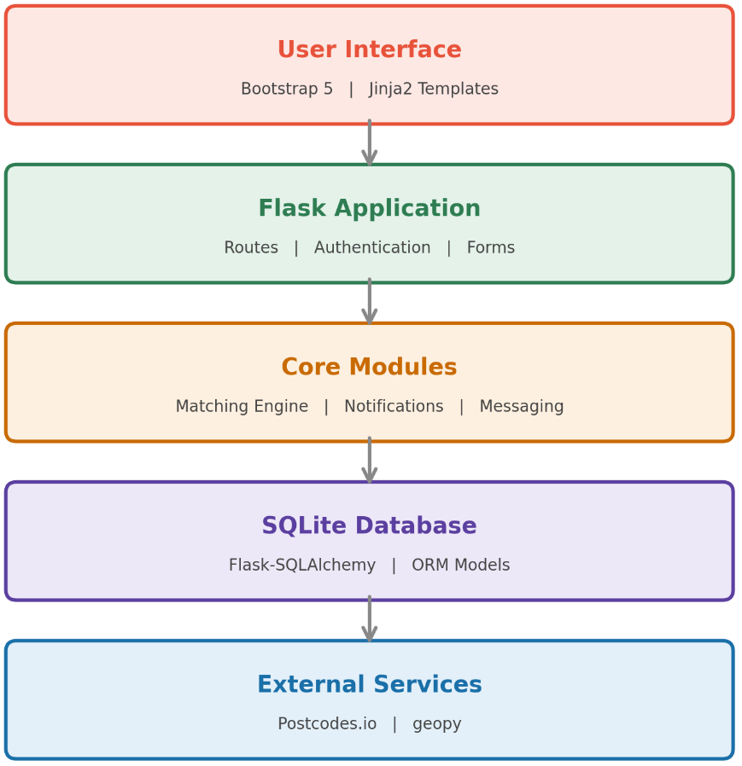

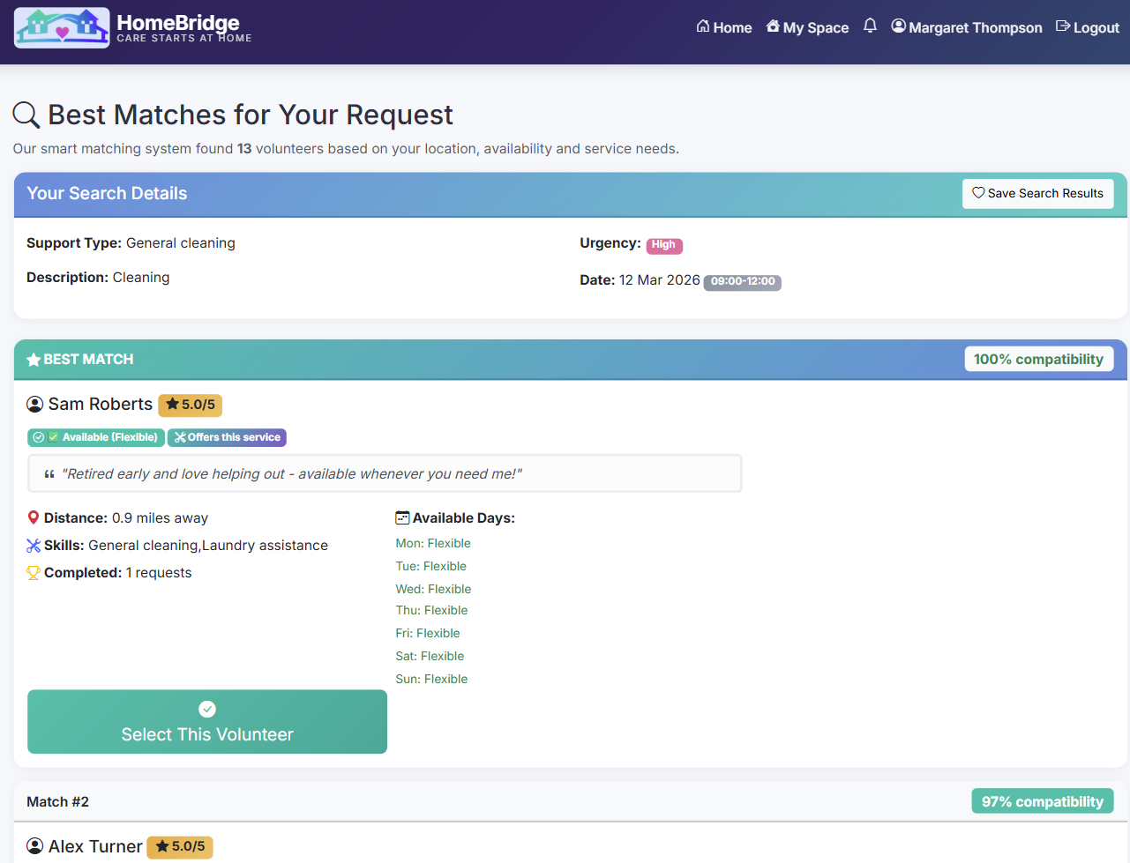





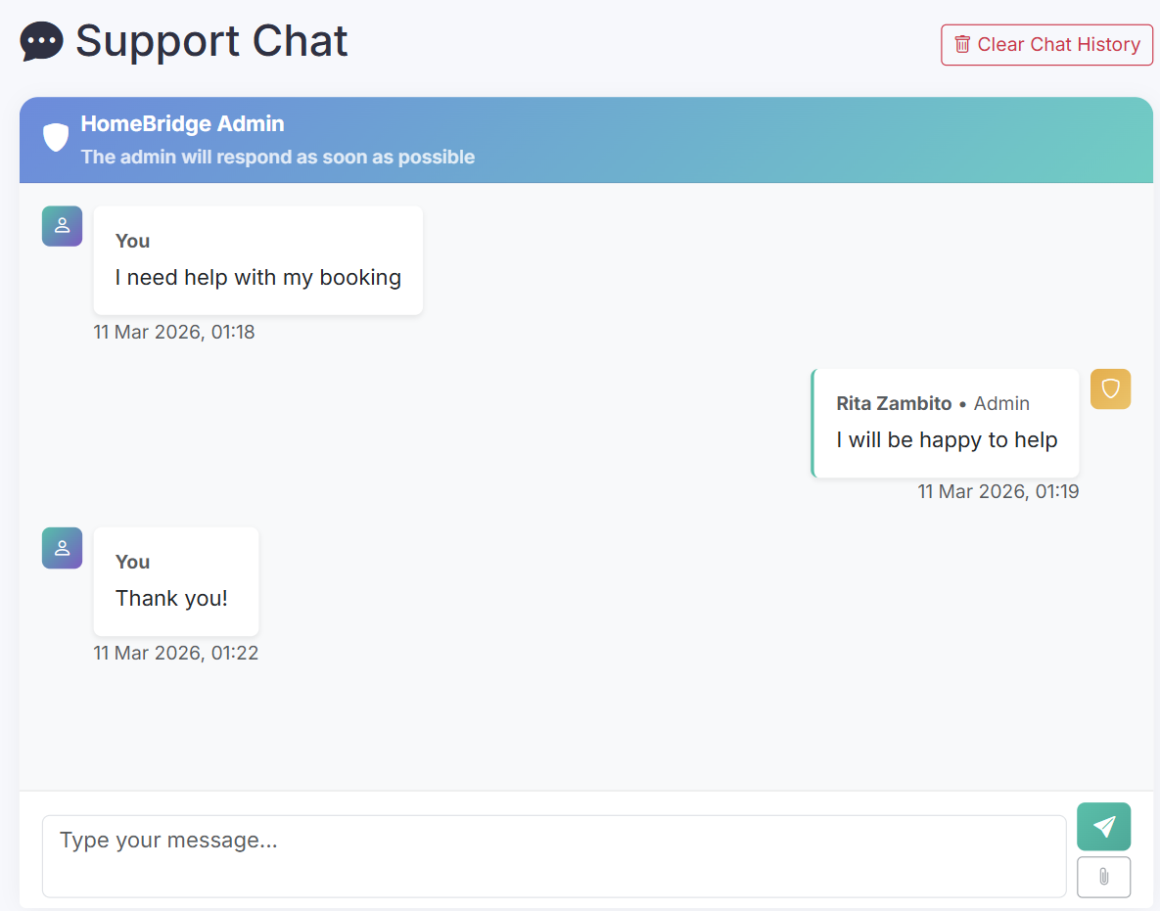
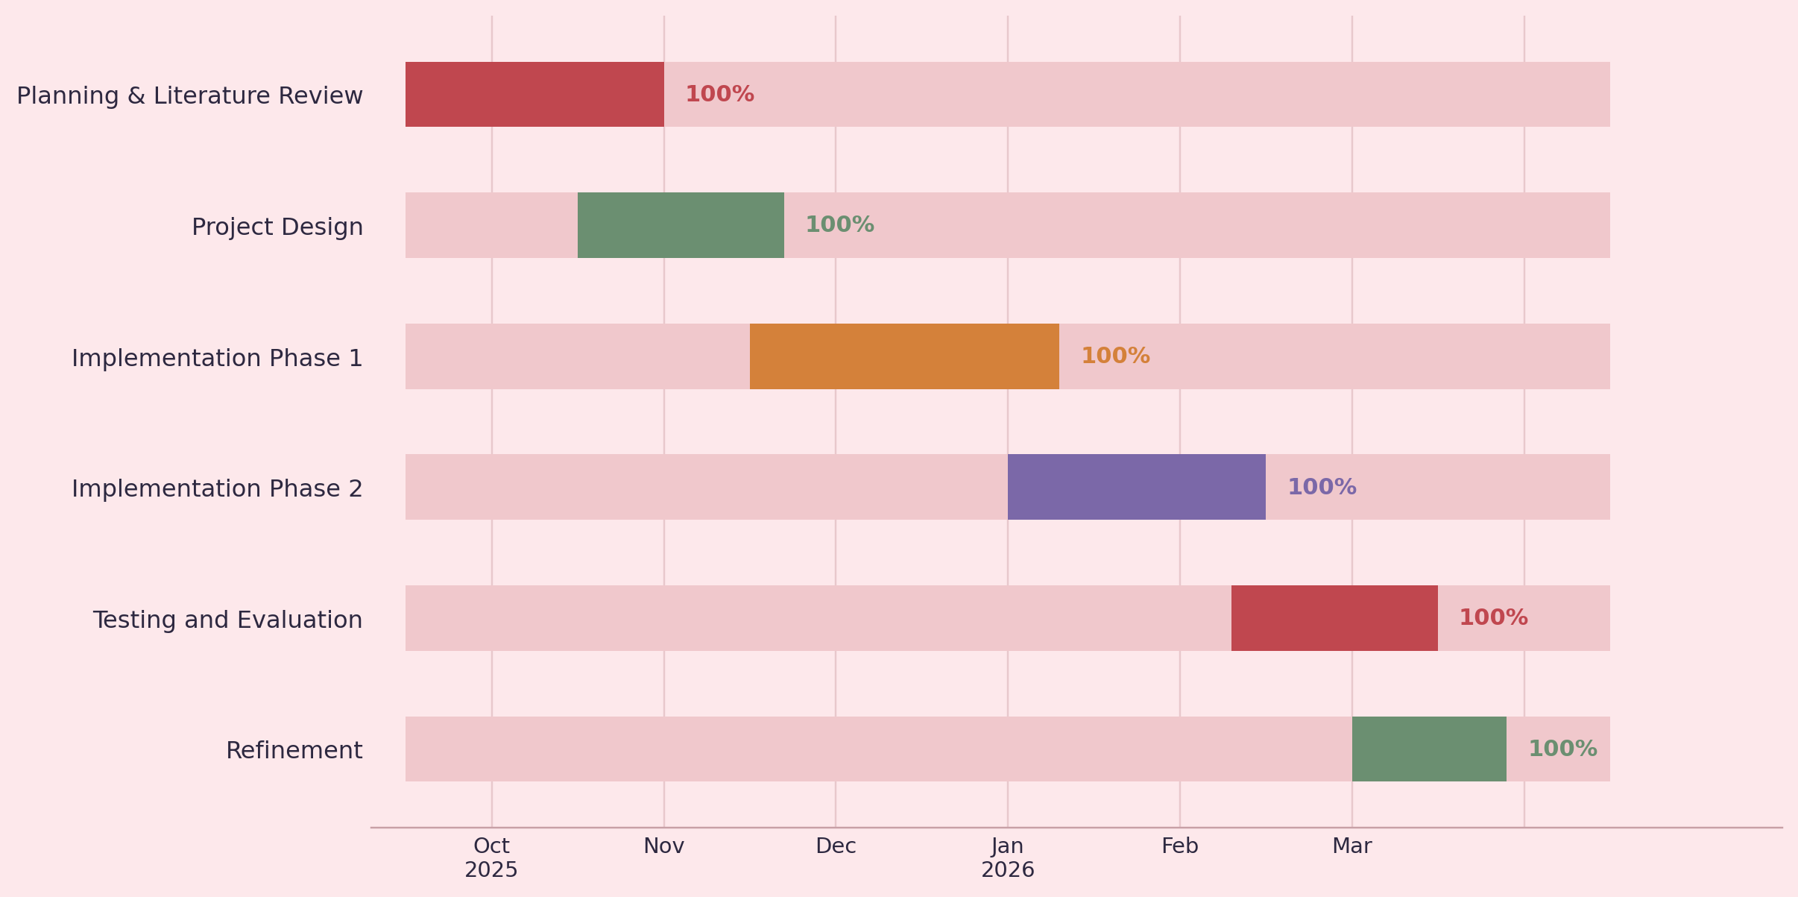
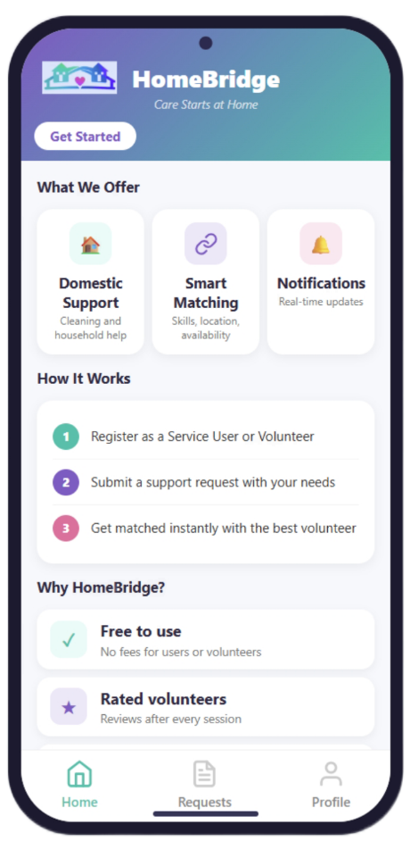
HomeBridge
Rita Zambito - 2245801
BSc (Hons) Applied Computing
UWTSD
Introduction
Aims and Objectives
Methodology and Tools
Vulnerable individuals in the UK, including older adults, people with disabilities, and those affected by hoarding disorder, often lack access to practical domestic support.
Existing services such as Age UK, Royal Voluntary Service, Grant A Smile CIC, and Community Bees rely on fragmented manual referral channels with no centralised digital solution.
HomeBridge was developed to fill this gap through automated, location-based volunteer matching.
HomeBridge aims to design and develop a smart web-based platform that automates volunteer matching for domestic support in the UK.
O1: Investigate the social, functional, and technical requirements of the platform.
O2: Build a responsive web application supporting user registration, service requests, and volunteer management.
O3: Implement a weighted matching algorithm based on proximity, availability, skill match, and volunteer rating.
O4: Evaluate the system through functional testing and accessibility compliance.
Agile iterative methodology, each cycle focused on a specific module, enabling early defect detection.
The system follows a five-layer architecture, and was developed using Python and Flask as the core framework, Bootstrap 5 for the responsive interface, and SQLite with Flask-SQLAlchemy for data management. Geopy and Postcodes.io handle geolocation and postcode lookups across the UK.
Matching Algorithm and Key Features
Development Lifecycle and Testing
Conclusion and Future Work
Weighted 100-point scoring: Geographical Proximity 40pts, Availability Alignment 40pts, Skill Match 15pts, Volunteer Rating 5pts.
Key features: 48-hour cancellation protection for vulnerable users, contextual notifications with auto-expiry, admin support chat linked to booking requests, coordinate caching for fast matching results, and three user roles (Service User, Volunteer, Administrator).
Development ran from September 2025 to March 2026 across six phases, all 100% complete: Planning and Literature Review, Project Design, Implementation Phase 1, Implementation Phase 2, Testing and Evaluation, Refinement. Testing covered 50 simulated users across 5 UK cities. Validated functional correctness, edge cases, responsive design, and accessibility compliance.
HomeBridge demonstrates that a centralised web platform can automate volunteer matching for vulnerable individuals. The system represents a meaningful contributions to community-focused software design.
Future work includes real user testing with vulnerable populations, email and SMS notifications, integration with NHS and social care systems to enable automated referrals, and a native mobile application.
References
[1] J. Chen et al., "Housing and health in vulnerable social groups," Reviews on Environmental Health, vol. 37, no. 1, pp. 1–14, 2022.
[2] E. Emerson et al., "Poverty and people with disabilities," Disability and Health Journal, vol. 14, no. 3, 2021.
[3] V. Manshadi, S. Rios, and R. Saban, "Redesigning volunteer matching platforms," Management Science, vol. 70, no. 5, pp. 2937–2958, 2023.
[4] W3C, Web Content Accessibility Guidelines (WCAG) 2.2, W3C Recommendation, Oct. 2023. [Online]. Available: https://www.w3.org/TR/WCAG22/ [Accessed: 10 Mar. 2026].
[5] Pallets Projects, Flask Documentation, 2024. [Online]. Available: https://flask.palletsprojects.com [Accessed: 10 Mar. 2026].

