Slide 1
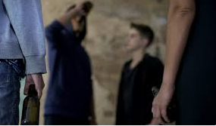
Young people
Youth gangs and vulnerability
Week 7
2024

Slide 2
Aim of lesson
Age of criminality responsibility
Gang culture
Youth offending rates
Dealing with young offenders
Interventions
Consider key UK Programmes helping families
Discuss initial actions when responding to a public protection incident
Examine the approach to dealing with youth offending

Slide 3
Age of Criminal Responsibility
England and Wales is 10 years old.
Children under 10 cannot be charged but can be given a:
Local Child Curfew
Child Safety Order
Parents can also be held responsible
Notes:
https://www.gov.uk/if-my-child-gets-in-trouble-with-police

Slide 4
Scotland
Criminal responsibility is 8 years old. All children over 8 can be arrested & charged for a crime.
The age of criminal prosecution is 12 years old.
Children aged between 8 and 11 cases are dealt in a Children's Hearing.
Children aged 12 to 16 can be taken to court but only for serious crimes

Slide 5

Age of Criminal Responsibility
Is 10 too young?
  Discuss
  In our Law several offences which are targeted at the inability of children to make good decisions.
  s5 of the Sexual Offences Act 2003 states that a child under 13 cannot consent to sex even if they agree to it.
  No matter what a child wants or think they want, they are, by definition, too immature to understand the consequences of or consent to certain behaviour.
Notes:
https://www.kingsleynapley.co.uk/insights/blogs/criminal-law-blog/youth-justice-time-to-change-the-age-of-criminal-responsibility

Slide 6
Criminal Responsibility Across the World
The United Nations - Rights of the Child, stated that a minimum age of criminal responsibility low 12 is not acceptable.
Holland – 12
France - no threshold for a minor to be criminally liable. The judge assesses whether the minor has acted with discernment and can therefore be held responsible in law
New Zealand – 10 Singapore - 7
Norway – 15 Portugal - 16
Italy – 14 Spain – 16
Iran – Girls 9 The Islamic Penalties Act (2013) Religious puberty Boys 15
USA each state differs the youngest being Oklahoma 7 years old. Many American states do not have a minimum

Slide 7
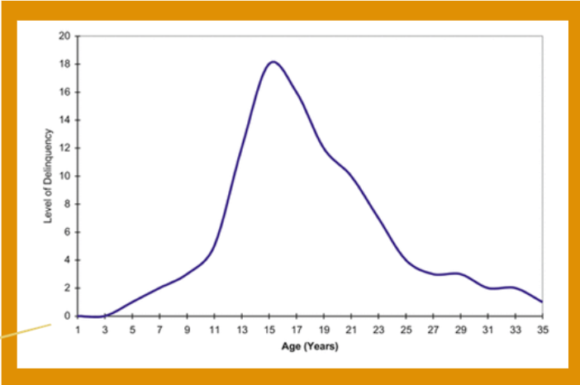
On set offending age

Slide 8
The Children and Young Persons Act of 1963 and 1969
The 1963 reformed the treatment of young offenders in juvenile courts
It also emphasised the importance of care and protection, raising the age of criminal responsibility from eight to ten
The 1969 act reduced the powers of juvenile courts to make orders, coming down in favour of care orders and supervision by probation officers and social workers
Legislation was child-centred and focused on the ‘needs’ rather than the ‘deeds’ of children.
Act emphasized importance of the welfare principle to govern state’s intervention in lives of young people.
Multi-agency approach.
Diversion from - INTERVENTION

Slide 9
1991 Criminal Justice Act
Youth Courts: the Act replaced juvenile courts with youth courts and included 17-year-olds for the first time
Custody age: raised the minimum age at which the youth court could impose custody from 14 to 15 years old
Curfew Orders: were introduced for individuals over 16 years old.
Notes:
Youth justice timeline - Beyond Youth Custody

Slide 10
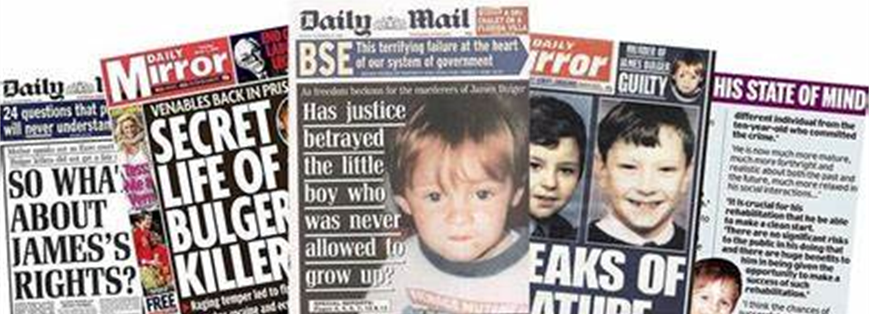
Mid 1990's
1993 Murder of James Bulger
Increasing amount of complaints about delinquency and weaknesses in youth justice system
1997 White Paper – No More Excuses
Notes:
The decision to try Venables and Thompson as adults was influenced by several factors:
Severity of the Crime: The brutal nature of the crime played a significant role. The public and legal system viewed the crime as exceptionally heinous, which contributed to the decision to try the boys in an adult court¹.
Public Outcry and Media Attention: There was immense public and media pressure for justice. The case received widespread attention, and there was a strong demand for a severe response².
Legal Framework: At the time, the legal system in the UK allowed for children as young as ten to be tried in adult courts for serious crimes. This was in line with the age of criminal responsibility in England and Wales, which is ten years old².
Deterrence and Accountability: There was a belief that trying the boys as adults would serve as a deterrent to others and ensure that they were held fully accountable for their action

Slide 11
Jack Straw & Alun Michael - two of the principal architects of youth justice reform - argued that:
“Insufficient attention is given to changing behaviour, to teaching the difference between right and wrong … Too little is done to change youngsters’ behaviour early in their offending career … We believe that the time has come for fundamental changes to be made … We have to start again … by prioritising early intervention to nip offending in the bud’
(Straw and Michael, 1996).
1996 Tony Blair:
"Tough on crime, tough on the causes of crime"
"Want to make the streets safe again"
Youth Crime peaked 1995/1996

Slide 12
‘No More Excuses’ - 1997
Clear strategy to prevent offending – youth justice must help prevent youth offending.
Taking Responsibility – no more excuses; children above ACR are mature enough to be accountable.
Earlier, more effective intervention – stopping children at risk and preventing early criminal behaviour from escalating.
Faster, more efficient procedures – preventing delays.
Partnership – multi-agency teams to co-operate at a local level.
Further reform – reform of youth court.
Notes:
The ’No More Excuses’ white paper that was published November 1997 sought to draw a line under the past and sets out a new approach to tackling youth crime.
Clear Strategy to Prevent Offending: ‘’As well as putting the public at risk, allowing young people to drift into a life of crime undermines their welfare and denies them the opportunity to develop into fully contributing members of society’’. Thus, the government believed that the purpose of youth justice must be to help prevent offending of young people.
Taking Responsibility: ‘’we must stop making excuses for youth crime’’ therefore children above the age of criminal responsibility are mature enough to be accountable for their actions and the law should recognise this.
Earlier, More Effective Intervention: new focus on nipping crime in the bud – stopping children at risk from getting involved in crime and preventing early criminal behaviour from escalating into persistent or more serious offending.
Faster, More Efficient Procedure: ‘’Delays in the youth justice system can frustrate and anger victims and give the impression that they can offend with impunity’’ – Delays will be cut by introducing a streamlined procedure and better case managements by setting mandatory time limits.
Partnership: sets out how they see clear national leadership is necessary to improve the performance of the youth justice system and sets out plans for the Youth Justice Board and Youth Offending Teams.
Further Reforms: sets out proposals for further reforms of the youth court – to provide a faster, more open system with a less adversarial approach.

Slide 13
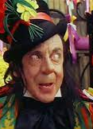
Youth Justice
‘Catching Them Early’ title of the YJB's conference in March 1999.
Guilt was no longer the founding engagement of YJT/YOT/YOPT
Intervention triggered without an offence being committed
Children with certain characters or a way of life was judged to be failing or posing risk.
Perceived risk is not crime, yet terms such as ‘potential offender’, ‘pre-delinquent’ and ‘crime-prone’ are increasingly mobilised to legitimise formal intervention

Slide 14
Dealing with Young Offenders
In dealing with any offence committed by a young person the police have a range of options:
No further action
Community Resolution -RJ’s, used to deal with low-level crime where the young offender admits their guilt and victim states No Formal Action. RJ’s apologise/affected. Sometimes additional support from YOTS involved too. No criminal record for young person.
Youth Caution
Youth Conditional Caution
Charge
Notes:
https://www.sentencingcouncil.org.uk/sentencing-and-the-council/types-of-sentence/types-of-sentences-for-young-people/

Slide 15
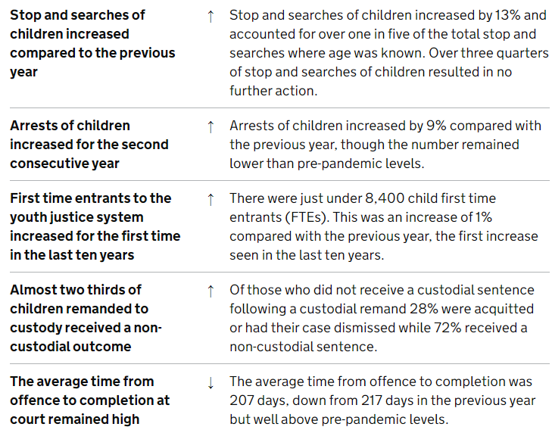

Slide 16
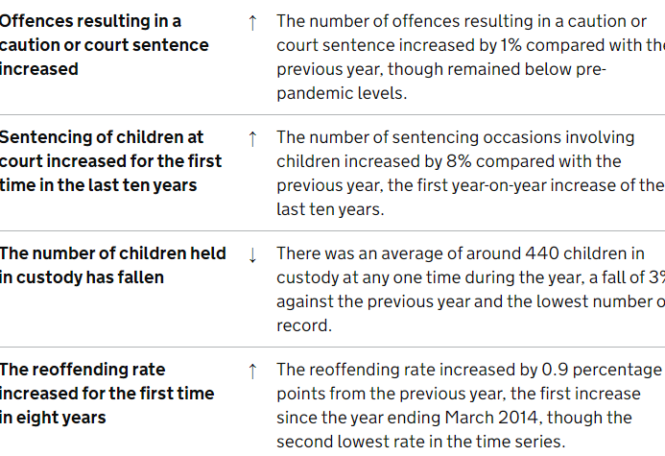
Notes:
Youth Justice Statistics: 2022 to 2023 (accessible version) - GOV.UK

Slide 17
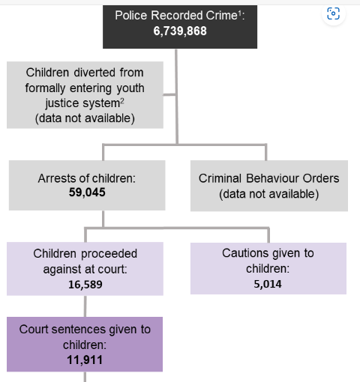
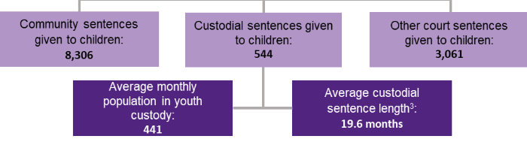
Notes:
Youth Justice Statistics: 2022 to 2023 (accessible version) - GOV.UK

Slide 18

What Works?
Discussion
  What are the influences that encourage youth offending?
  What helps in preventing young people from offending?

Slide 19
Why children commit crime
There is generally no simple reason why children offend
ID certain circumstances can cause to commit crime such as:
not doing well in school / truanting from school
difficult family relationships
lack of boundaries and parental supervision
having friends who commit crime
drug and alcohol misuse
mental health issues, such as attention deficient and hyperactivity disorder (ADHD)

Slide 20
Role of Parents
Relationships and primary care settings shape us as children, young people and to parents
See parents acting in a way - reflection in children
Absent parents
Unemployment & benefits
Young pregnancies/ Poor child-rearing methods.
Children are much less likely to get into trouble if their parents:
have a good relationship with them and can talk openly with them
can agree sensible clear rules and encourage them to stick to them as much as possible
know where they are and what they are up to
Notes:
https://www.nidirect.gov.uk/articles/preventing-involvement-crime
Parents are usually the most important people in their children’s lives. Their views and behaviours can have a good or bad influence on their children’s behaviour including offending behaviour.

Slide 21
Roles of School
Inadequate transition to school
An unhealthy school climate
Schools' contribution to academic failure
Anti-social peer relationships formed at school
Negative relationships between students and school personnel
School policy abuse or victims
Parents interest in school life and encourages children to go to school
Notes:
https://www.msd.govt.nz/about-msd-and-our-work/publications-resources/journals-and-magazines/social-policy-journal/spj37/37-the-relationship-between-school-and-youth-offending.html

Slide 22
Community
Austerity
  Cuts in services
Attitudes
  From those living in the community
Antisocial Behaviour
  Peer pressure
Poverty
Services – access to leisure facilities / youth clubs
Parents encourage engagement in groups.

Slide 23
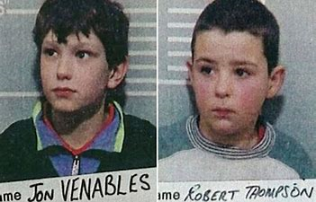
Venables & Thompson
Notes:
12th February 1993
Both had similarities in backgrounds:
Parents had separated
Poor school attendance, learning and behaviour issues at school.
Shoplifting quite often
History of violence
Picture of a empty, broken young life?

Slide 24
Thompson and Venables
Thompson was child 5 out of 7 children.
Difficult child
Dad walked out of home 5yrs. before murders.
Mum often found in pubs rather than looking after the children in her chaotic home.
Social Services were involved but not enough to be taken away.
Serious violent incidents happened at home – (battering, torture, biting)
Mum took one son to Police station after he had threatened his older brother with a knife.
Child begged to be taken into care but on return to house tried to kill himself.
Poor education
Lack of engagement in community
Venables parents separated but both looked after the children.
Siblings had learning difficulties
Evidence of hyperactivity
Parents said he was weak – didn’t like to be liked or loved
Feared Thompson older brothers
Feared Mother
Poor education
Lack of engagement in community

Slide 25
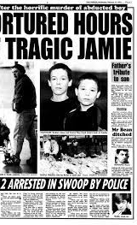
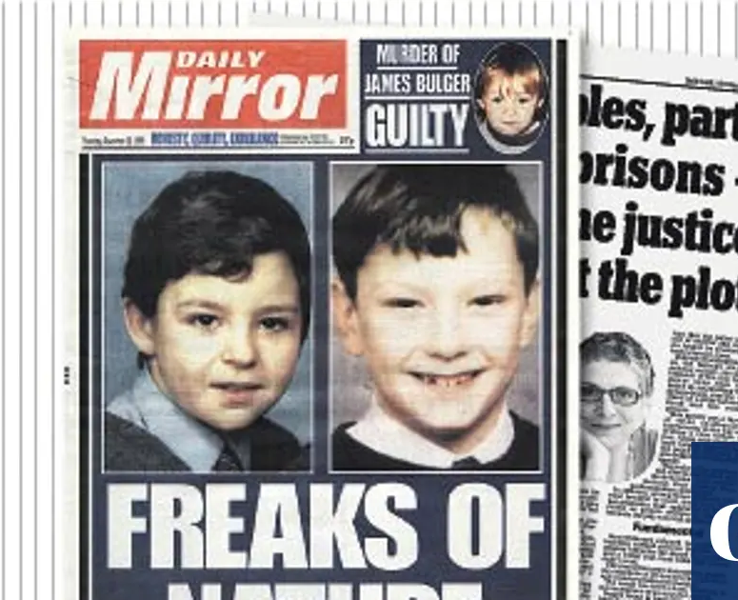
Media Image
Determine to prove that they were evil.
Neighbours told of pigeons being killed.
Charity collection boxes being stolen
Assaulted children in the classroom
Bad parenting from broken homes with trashy TV
Thompson mum was portrayed as an alcoholic
Venables mum as ‘loose woman’ with many male friends
All contribute to the vacuum to offend

Slide 26

Mothers also guilty
Parents of Thompson and Venables could were also on trial - that the blame for this terrible murder was placed at the door of their shambolic households.
After the trial, Mr Justice Morland laid the moral responsibility squarely with the parents. He said a public debate about the parenting and family background of Thompson and Venables was required.
A public decision on guilt – mugshots, CCTV images, family background was all unearthed.

Slide 27
Thompson and Venables
Thompson remained stonily silent.
Venables collapsed after his arrest and wept for days.
Both boys were said to have suffered from post- traumatic stress disorder.
Psychologist have not discovered why they killed that day
Detective Roberts that day “I stared evil in the face. A match made in hell. They went out that day to kill and if had not been caught would have killed again. Pure evil”.
Notes:
https://www.independent.co.uk/news/bulger-ruling-after-six-years-psychiatrists-have-little-more-insight-into-the-killers-motives-1132868.html
https://inews.co.uk/news/uk/james-bulger-killers-jon-venables-robert-thompson-murder-now-494467

Slide 28
The Trondheim case
15 October 1994, in Trondheim, Norway five-year-old Silje Redergard was beaten to death by two little boys.
Echoes the Bulger killing
Parents were neighbours/children has played together before
Trigger where the boys turned onto the girl punching, kicking and beating her with stones.
They stripped her and ran away, leaving her to die in the snow.
The difference was the way Norway dealt with the killing
Notes:
15 October 1994
Siljie & two six-year-old boys, were playing on a football field
Their parents were neighbours but didn’t know each other but children had played together before.
Something happened that trigged a reaction
The boys turned onto the girl punching, kicking and beating her with stones.
They stripped her and ran away, leaving her to die in the snow.

Slide 29
The Trondheim case
Norway, the age of criminal responsibility is 15
Mum and Stepdad were blamed as the killers
There was a lynch mob atmosphere but once they knew it was kids who killed the mob mood died down.
Very little in the Norwegian newspapers
The names of the boys never given although they are known in the area.
New schools the new parents were consulted about the new pupils.
Whole care package in place for boys

Slide 30
Trondheim Adults
18 can turn care down but can run up to aged 23
Although all the support given one of the boys is homeless, has been in trouble, not coping, using drugs – ‘Living a nightmare’
We've forgiven them for being children but we'll never forgive them for what they did.
Notes:
https://www.theguardian.com/theguardian/2010/mar/20/norway-town-forgave-child-killers

Slide 31
Youth Crime 2010 – Troubled Families
Total number of proven offences committed by youth in 2010/11: 176,5117
Total cost to the country of police and justice for young offenders in 2007-8: approximately £4 billion annually
On 4 August 2011, a police officer shot dead 29-year-old Mark Duggan
Riots – started 8 August: outbreaks in London areas
Similar riots were reported in Birmingham, Bristol, Gillingham and Nottingham
Areas effected by widespread looting, arson and violence
Est. £200 Million in damages
Govt. - Riots Communities and Victims Panel, which blamed the breakdown of families and lack of character in the young, rather than structural issues.
Met. Police asked for the community to work out, with the police, ways to reduce the impact of stop and search
Notes:
many areas of London were affected by widespread looting, arson and violence.
outbreaks in Battersea, Brixton, Bromley, Camden, Croydon, Ealing, East Ham, Hackney, Harrow, Lewisham, Peckham, Stratford, Tower Hamlets, Waltham Forest, Wandsworth, Woolwich, and Wood Green

Slide 32

History Troubled Families Initiative
The Troubled Families programme was launched by the former PM Cameron in 2011.
In response to the 2011 riots and change the repeating generational patterns of poor parenting, abuse, violence, drug use, anti-social behaviour and crime in the most troubled families in the UK
“...these families are the source of a large proportion of the problems in society. Drug addiction. Alcohol abuse. Crime. A culture of disruption and irresponsibility that cascades down the generations... a small number of these families cost an extraordinary amount of money.” Cameron, 2011
Notes:
Riots after the death of Mark Duggan.
Happened in Hackney, Brixton, Tottenham
David Cameron Oldbury speech (New Statesman, 15.12.11)
Daily Telegraph (20.07.12) Louise Casey

Slide 33
Troubled Families Initiative
Troubled Families programme of targeted intervention for families with multiple problems, including crime, anti-social behaviour, truancy, unemployment, mental health problems and domestic abuse.
Local authorities identify ‘troubled families’ in their area and usually assign a key worker to act as a single point of contact.
Only happening in England.
£448 million was allocated to the first phase 2012 to 2015. Local authorities worked with around 120,000 families, and ‘turned around’ 99%.
£920 million allocated to second phase from 2015 to 2020, to help an additional 400,000 families. Report on successes out 2022.
Notes:
£3733.00 per family

Slide 34
Louise Casey Head of TF Service stated that:
“We are not running some cuddly social workers programme...we should be talking about things like shame and guilt...we have lost the ability to be judgmental because we worry about being seen as nasty to poor people”.
Eric Pickles, (2012) then Communities Minister stated:
'We have sometimes run away from categorising, stigmatising, laying blame. We need a less understanding approach'.
Notes:
Daily Mail (10.06.12) Pickles

Slide 35
Troubled Family Risk Factors
Involvement in crime/ASB
No parent in the family is working
Poor parenting
Family lives in poor-quality
or overcrowded housing
Child Behavioural Problems
Truancy, exclusion or low
educational attainment
No parent has any qualifications
Limited support network
Family in debt
Child is a carer
Child Substance abuse problems
Mother has mental health problems
Drugs or alcohol misuse
Adult with learning difficulties
Communications problems
At least one parent has a long-standing
limiting illness, disability or infirmity
NEET
Marriage, relationship
or family breakdown
Family has low income
(below 60% of the median)
Teenage Parent(s)
Domestic violence
Family cannot afford a number
of food and clothing items
Child protection issues
Risk factors attributed to families with 5 or more disadvantages (from) Families At Risk: Background on families with multiple disadvantages, Social Exclusion Taskforce Research Report, 2007
Additional risk factors from families supported through family intervention (NatCen, Mar 2010).

Slide 36
Criticism of Troubled Families
Most of the people targeted were not involved in crime or anti-social behaviour; most were not alcohol or drug dependent.
Most were poor, unemployed and with very high levels of mental / physical illnesses and disabilities in adults and children
Characteristics shared by most of the families were unemployment, poverty illness, disabilities = high welfare cost to the state.
Now called – Supporting Families Programme
Notes:
9% of those in the program were lone parent families. Underage pregnancy was statistically insignificant, with the under-18 conception rate at 2%. 90% of adults had not been convicted of a criminal offence and 93% of adults had no record of anti-social behaviour. Among children, 88% of children had no record of anti-social behaviour. 3% of adults were recorded as treated for alcohol dependency and a further 3% of adults for drug dependency. The families were reported to suffer from high levels of health problems and disabilities. 46% had an adult or adults suffering a mental health problem; 33% of children had mental health problems. 32% of adults and 20% of children had a long-standing physical illness or disability; 39% had a child or children with SEN statements; 46% had a child with school problems; 15% had a child with a temporary exclusion. The families were also poor and in social housing: 74% of households were workless; 83% received out of work benefits; 27% were in rent arrears; 21% were at risk of eviction.

Slide 37
Statistics
9% lone parent families
90% of adults had not been convicted of a criminal offence and 93% of adults had no record of anti-social behaviour, 88% of children had no record of anti-social behaviour.
3% of adults were recorded as alcoholic & 3% of adults for drug dependency.
46% adults & 33% children had mental health problem;
32% adults & 20% of children long-standing physical illness or disability;
39% had a child or children with SEN statements; 46% had a child with school problems; 15% had a child with a temporary exclusion.
Poverty - 74% of households were workless; 83% received out of work benefits; 27% were in rent arrears; 21% were at risk of eviction.

Slide 38
Troubled Families Kid’s as Victims
"The behaviour of older children must be understood in the context of trauma.“
Want to spend more time away from their neglectful home
More vulnerable to risks such as going missing, offending behaviour, taking drugs/drinking or exploitation.
However, parents and professionals often see only the issues in front of their eyes without taking the context of neglect into account.
Reports say: "Children are not the problem"

Slide 39
The CAPRICORN framework
England
Collaborative approaches to preventing offending and re-offending by children
A framework to help local authorities prevent young people offending and re-offending by looking at primary causes of offending.
Involves family, relationships and community involvement to change and prevent.
Notes:
https://www.gov.uk/government/publications/preventing-offending-and-re-offending-by-children/collaborative-approaches-to-preventing-offending-and-re-offending-by-children-capricorn-summary
https://assets.publishing.service.gov.uk/government/uploads/system/uploads/attachment_data/file/828228/CAPRICORN_resource.pdf
https://www.gov.uk/government/publications/preventing-offending-and-re-offending-by-children

Slide 40
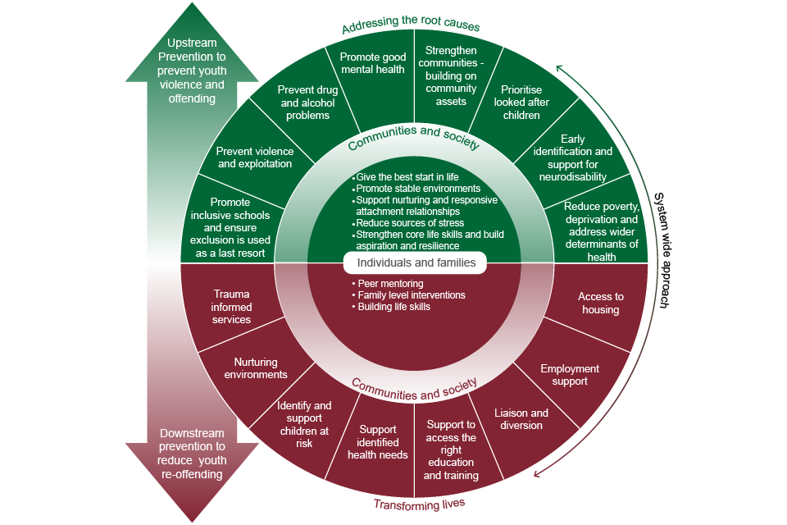
Notes:
https://www.gov.uk/government/publications/preventing-offending-and-re-offending-by-children
https://assets.publishing.service.gov.uk/government/uploads/system/uploads/attachment_data/file/828228/CAPRICORN_resource.pdf

Slide 41
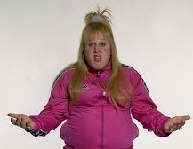
Reoccurring Themes on What Works
Early intervention
Building resilience
Stability, continuity and transitions
Effective parenting and supporting families
Tackling educational performance
Tackling worklessness
Tackling poor health
Tackling poverty
Involving communities and building social capital
Building capabilities, resilience and skills development

Slide 42
Aims to move families closer to independence from public services
Supports early intervention
Multi-agency working with sharing information
Single Family Assessment Framework
Families/workers are able to access services required quickly with some priority
Sustainable services
Sustainable families
Troubled children / teenagers can seem 'resilient' and appear to be making 'lifestyle choices' when they are in fact finding unsafe ways of coping - gangs, misusing drugs and alcohol, crime.
‘These children are incredibly vulnerable’.
Family Support Model - Key Principles
Notes:
Some older children have been neglected by their parents over many years.
Troubled children / teenagers can seem 'resilient' and appear to be making 'lifestyle choices' when they are in fact finding unsafe ways of coping, like getting involved in gangs or misusing drugs and alcohol.
‘These children are incredibly vulnerable’.

Slide 43
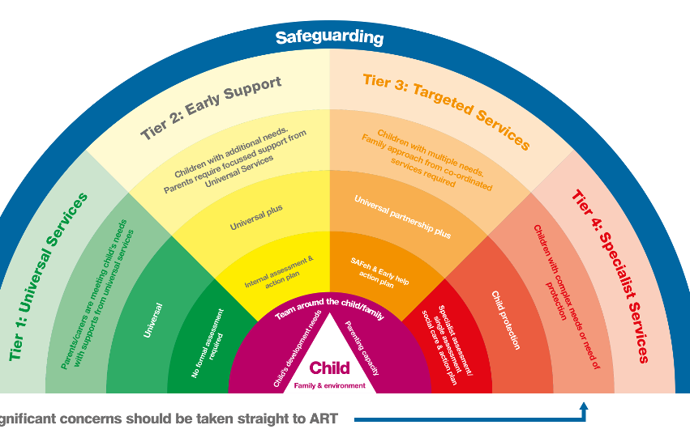
Notes:
Continuum need of support

Slide 44

Getting Support
Support to be offered to the whole family
Support to help them to keep their children safe and give them the care they need.
Early Intervention.
Families who don’t care and will not take up support.
Why? – environment, history, happy as they are, no desire to change, would mean changes in life.
Notes:
Environment – where they live/come from maybe a hard area, no one works all receiving benefits.
History – with Social services, police, YOT hate the fact they get involved in issues, will not conform to society’s rules
Happy being known as a certain person/family. Happy to take drugs and not work etc.
Don’t want to change as it means a change of life style or maybe to hard to change i.e. drink/drug problems
Have to go to work and no benefits. Why do that?

Slide 45
Wales
Families First Teams / Team Around the Family
For all families who need help
Principles of Families First?
Family-focussed – services should look at the needs of your whole family rather than the needs of individual family members.
Bespoke – services tailored to meet family’s specific needs.
Empowering – families to take control of their lives.
Integrated – agencies must work together
Pro-active – needs are identified as early as possible
Sustainable – support given should enable families to continue to make progress

Slide 46
Operation Encompass
Gwent Police
Operation Encompass is a police and education early information safeguarding partnership enabling schools to offer immediate support to children experiencing domestic abuse.
A system which ensures the police contact a school before the next school day when one of their pupils has been exposed to domestic abuse.
School is aware of issues such as food, uniform, homework, mental health.
Time out rooms available as well as food and uniform
Emotional support also available if needed
Keeping children in school – safe environment
Notes:
https://www.gov.uk/government/news/funding-boost-to-help-pupils-affected-by-domestic-abuse
https://www.operationencompass.org/
https://www.operationencompass.org/why-was-operation-encompass-created

Slide 47

Centre for Crime & Justice Studies
Child criminalisation and the mistake of early intervention publication.
Early intervention was the hallmark of the ‘new youth justice’ after the election of Labour Government 1997
Notes:
https://www.crimeandjustice.org.uk/publications/cjm/article/child-criminalisation-and-mistake-early-intervention

Slide 48
Research
Lesley MeAra and Susan MeVie (2007) research ‘Edinburgh Study of Youth Transitions and Crime’:
Findings indicate that the key to reducing offending lie in minimal intervention and maximum diversion
Doing less rather than more in individual cases
Repeated and more intensive forms of contact with agencies of youth justice may be damaging to young people in the longer term
Barry Goldson (2000) asserts that history has taught us that diversion is more effective than intervention
Notes:
https://www.crimeandjustice.org.uk/publications/cjm/article/child-criminalisation-and-mistake-early-intervention

Slide 49
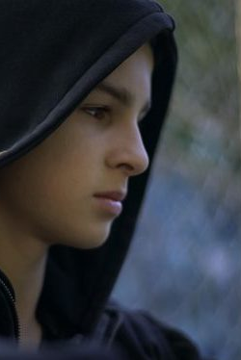
Young Persons view
when I’ve been arrested, it’s like, you’re a kid in care, you’re never going to get out of this way of life. You’re in care, kids in care are always on drugs, kids in care always make themselves unsafe, kids in care always self-harm. So they sort of put a title on kids in care like they’re something bad.

Slide 50
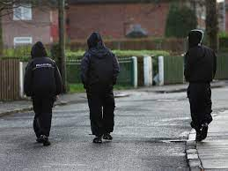
Gangs
Gangs mean different things in different contexts.
It is not illegal for a young person to be in a gang
Different types of gangs
Not all 'gangs' are dangerous or criminal
However – gang membership is linked to illegal activities

Slide 51
Gang meaning -
The word ‘gang’ means different things
Government paper ‘Safeguarding children and young people who may be affected by gang activity’ distinguishes between the following:
Peer group
A relatively small and transient social grouping which may or may not describe themselves as a gang depending on the context.
Street gang
“Groups of young people who see themselves (and are seen by others) as a discernible group for whom crime and violence is integral to the group's identity.”
Organised criminal gangs
“A group of individuals for whom involvement in crime is for personal gain (financial or otherwise). For most crime is their 'occupation.”
Notes:
DCSF-00064-2010.pdf.pdf

Slide 52
Gangs
Gang membership and associated youth violence can have a devastating impact on children, young people and their families.
Being part of a peer group is seen as a normal part of childhood development.
Peer groups are less defined and organised than gangs, and membership of peer groups is fairly fluid, i.e., members can come and go as they please.
It’s also relatively normal for groups of children to get together in public places – their development
For some, this may mean getting involve low-level criminality, however, this does not necessarily make them a gang
Gangs have clear structures and tasks.

Slide 53
Definition of a gang
A gang is a relatively durable, predominantly street-based group of young people who see themselves (and are seen by others) as a discernible group and engage in a range of criminal activity and violence. They may also identify with or lay claim over territory, have some form of identifying structure feature, and/or are in conflict with other, similar gangs.
Serious Youth Violence - House of Commons Library

Slide 54
Children in Need
In 2023, 11,110 children assessed by children’s social care were deemed to be at risk due to gang involvement
Could be more – many gangs are unknow to authorities
Children in need are a legally defined group of children under Children Act 1989:
Those who are - needing help and protection as a result of risks to their development or health. Including:
Children on child protection plans, children looked after by local authorities, care leavers and disabled children. Children in need also include young people aged 18 or over who continue to receive care, accommodation or support from children's services, and unborn children.
Notes:
Children Act 1989 (opens in a new tab)),

Slide 55
What is Serious and Organised Crime?
SOC are individuals who plan, co-ordinate and commit serious offences, whether individually, in groups or as part of transnational networks
distinction between Organised Crime Groups (OCG) and Urban Street Gangs
connections between gangs and organised crime: urban gang members may engage in street drug dealing on behalf of organised criminals and some gangs aspire to and may become organised crime groups
Urban Street Gangs (USGs)
OCGs have traditionally been the wholesalers of drugs and USGs the street retailers. However, USGs are now becoming increasingly involved in the wholesale of drugs.
For example, in Merseyside, young people are forming gangs and are frequently becoming involved in crime that is focused on a business‑based model driven by profits
Notes:
A Practitioner Toolkit – Working with young people to prevent involvement in Serious and Organised Crime

Slide 56
Every Child Matters
legal framework, which requires relevant agencies to take responsibility for safeguarding and promoting the welfare of every child to enable them to:
be healthy
stay safe
enjoy and achieve
make a positive contribution
achieve economic well-being.

Slide 57
County Lines
NPCC definition of a county line is the term used to describe gangs and organised criminal networks involved in exporting illegal drugs into one or more area within the UK using a dedicated mobile phone
January 2019 the NCA estimated that there were at least 1,000 county lines operating
Appropriate 300 lines within Greater London
Gangs create a network between urban hubs and county locations to supply illegal drugs
New markets are established by gangs
Sometimes they are the main line / some overtake other lines / some may operate several lines in towns

Slide 58
Terms associating with County Lines
Cuckooing
Trap House
Cuckoos take over other bird’s nests – Gang will take over a vulnerable persons home using acts of violence and intimidation.
Gang will use the house as their trap house
Vulnerable person – drug dependency, mental health, health problems, financial issues
Building in the county location which is used as a base from which drugs are sold
Occupants include drug users
Homes that are cuckooed but also short let homes or cheap hotel accommodation

Slide 59
Terms associating with County Lines
Trapping
Going Country / Out there / OT
Either selling or moving drugs via a county line from urban area hub to the county location hub
An individual becoming involved in county line
Act of travelling to another area
City or town reference to deliver or pick up drugs

Slide 60
Terms associating with County Lines
Deal line
Taxing
The mobile phone number operated by the county line group and used to communicate with drug users
Communication with potentially hundreds of individuals
Take orders for drugs
Use of violence to exercise control over a county line member
Injuring, marking or worse

Slide 61
Offences associated with county Lines
Illegal drug supply – illegal distribution and dealing with potentially dangerous drugs
  Section 4 of Misuse of Drugs Act 1971
Firearms, offensive weapons and bladed objects
  Firearms Act 1968, The Prevention of Crime Act 1953, Criminal Justice Act 1988
Violence – used to intimidate to recruit or use homes
  Offences Against the Person Act 1861
Abuse / exploitation – move drugs/money/weapons/relationships/controlled/sexual abuse/perform sex acts
  Sexual Offences Act 2003, Modern Slavery Act 2015

Slide 62
Law Response
Complex nature – young people, geographical, offender/child/victim
Multi-agency approach – LA, Regional Organised Crime
Detect and disrupt activities – Police to agree
NCA and NPCC – National County Lines Coordination Centre NCLCC
Maps out threats of CL
Provide support to disrupt lines
Intensification week IW
Safeguarding issues – multi-agency response
Safeguarding referral with a pathway process
S47 Children Act 1989 a child is suffering or is likely to suffer significant harm

Slide 63
Characteristics of county lines
Where they bases?
Informal structure
Operation mileage
Locations
Transport
Runners
Branded mobile
Promotion how?
Plugged
Clean skins
Types of recruitment

Slide 64
Answers
Where they bases? County line based in urban location
Informal structure – runners, youngers, baby mamas, girls, elders, olders
Operation mileage - Span many miles 50 to 100 miles
Location – where economic problems exist and affluent towns/university
Use of public transport but stop short before final destination/rent cars
Runners – yp, young women
Branded Mobile – the brand of drugs available so uses associate with
Promotion – S/media, business cards, free cigarette lighters / WhatsApp.
Plugged- plugged with drugs usually placed in the rectum and/or vagina
Clean skins - very young people, no criminal record who are runners
Types of recruitment – financial, coercion, violence, debt, intimidation

Slide 65
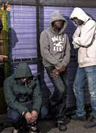
Young People & Gangs
An identity at a time when they are looking for one?
But it’s is not the identity they want or need.
To be a “gangster” reinforces all that is most dangerous and inadequate about their own behaviour.
Attractive to young people who want respect but fear they are unworthy of it.
Glamorises and normalises behaviour that is much worse.
Cuts young people further off from the society around them.
Notes:
https://youth.gov/feature-article/gang-prevention-overview-research-and-programs
https://assets.publishing.service.gov.uk/government/uploads/system/uploads/attachment_data/file/97861/gang-violence-summary.pdf

Slide 66
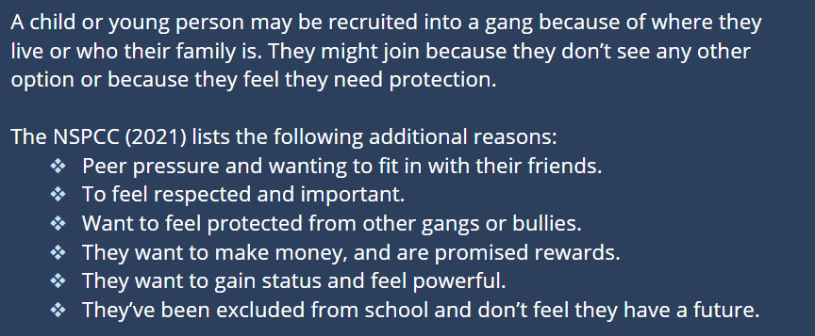

Slide 67
Gang’s
House of Lords (2022) state Unknown figure of gangs.
Childrens Commissioner estimates that there are 46,000 children involved in gangs in England & 4,000 just in London.
Thousands of girls and young women are associated with these gangs
Official statistics do show that women are statistically far less likely to be involved in gang crime than men
However, the gap is narrowing.
Home Office figures from 2013 reveal that over 160,000 teenage girls or women were arrested. Almost one in three of those arrests were for violent attacks.
https://www.centreforsocialjustice.org.uk/library/girls-and-gangs
Notes:
read:https://www.telegraph.co.uk/women/womens-life/10857716/Britains-gangster-girls-The-dark-side-of-female-empowerment-The-rise-of-women-and-females-running-gangs.html
https://lordslibrary.parliament.uk/violent-crime-burglaries-and-gang-activity/

Slide 68
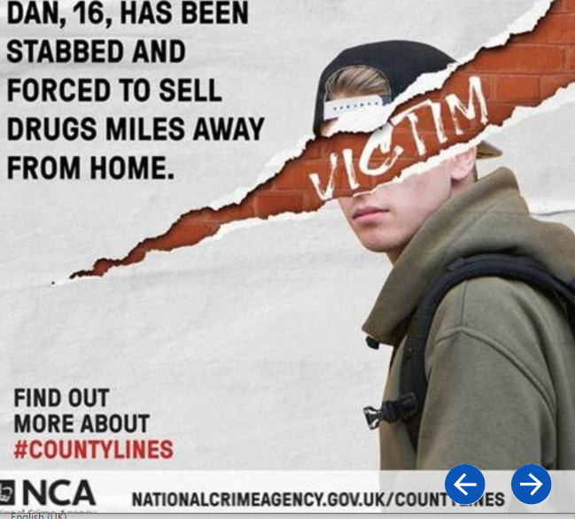

Slide 69

ISIS Poster Girls
Bethnal Green Trio - Amira Abase, Shamima Begum, and Kadiza Sultana left UK 2015 during school half term to Marry Islamic State Fighters
  Shamima has had to face her children dying, living in poor conditions, isolated, want to return to the UK, facing a ‘Non-citizenship’
  Amira & Kadiza reported dead
Notes:
https://www.theguardian.com/world/2019/feb/14/shamima-begum-friends-kadiza-sultana-amira-abase-joined-isis-syria

Slide 70
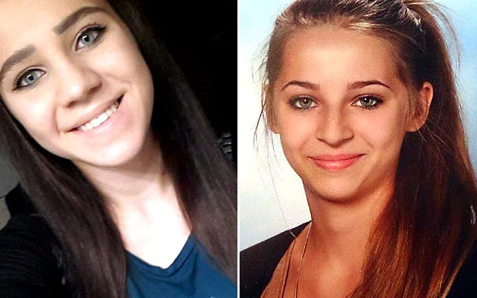
ISIS Poster Girls
Samra Kesinovic 17 yrs. & Sabina Selimovic 15 yrs. disappeared from her home in Vienna to join IsIs in 2014.
  Left a note left for their parents read: “Don't look for us. We will serve Allah and we will die for him.”
  Sabina was killed, Samra used as a sex slave and wanted to go home. Was hammered to death trying to escape.
Brained washed into joining ISIS

Slide 71

Pull Factors
What is attracting females to become linked to Terrorist groups?
  ‘jihadi sisters’ – reached out to by others – poster girls
  Attractive?
  Brained Washed or manipulated
  idea that by joining such groups and contributing to them
  Making groups grow and flourish was the job of everybody
  In reality, when it comes to joining violent extremist causes, women are susceptible to the very same processes as men.

Slide 72

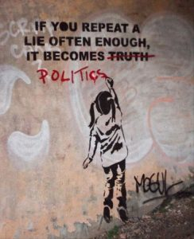

Slide 73
reference
https://assets.publishing.service.gov.uk/government/uploads/system/uploads/attachment_data/file/6151/2183663.pdf
https://www.law.ox.ac.uk/sites/files/oxlaw/crime_and_the_family_mt16.pdf
https://www.theguardian.com/society/2016/oct/17/governments-448m-troubled-families-scheme-has-had-little-impact-thinktank
https://www.familylives.org.uk/advice/teenagers/behaviour/what-is-a-parenting-order/
https://www.bbc.co.uk/news/education-44725966
https://www.gov.uk/government/news/funding-boost-to-help-pupils-affected-by-domestic-abuse
https://www.crimeandjustice.org.uk/publications/cjm/article/child-criminalisation-and-mistake-early-intervention

Slide 74
https://www.nidirect.gov.uk/articles/preventing-involvement-crime
https://assets.publishing.service.gov.uk/government/uploads/system/uploads/attachment_data/file/251064/6288.pdf
https://gov.wales/sites/default/files/publications/2019-05/youth-justice-blueprint_0.pdf
https://journals.sagepub.com/doi/abs/10.1177/0306396812446564
https://www.crimeandjustice.org.uk/sites/crimeandjustice.org.uk/files/09627250608553388.pdf
https://www.gov.uk/government/news/next-phase-of-165-million-programme-for-vulnerable-families-launched

Slide 75
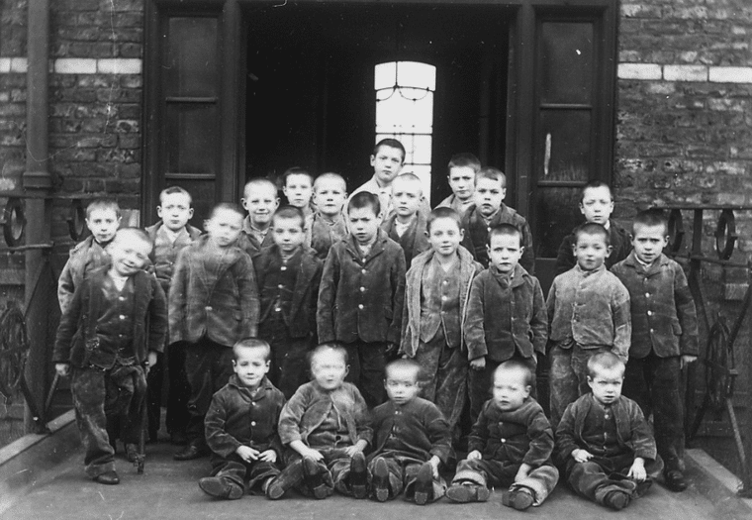
Workhouses 1834 Poor Law Act
Most children who ended up here were:
Orphans
Deserted Children
Bastards
Children of idiots or of cripples or of felons
If an abled man was sent to working House his whole family would
1839 out of 97,510 workhouse population 42,767 were children*
* girls under 16 years old and boy under 13 years old

