Slide 1

Session 7

Slide 2

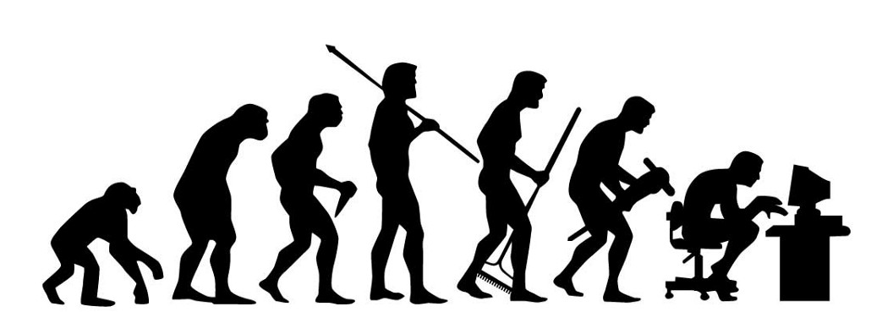
Agenda
Forces Driving Organisational Change - Overview
Planned Change
Unplanned Change
Responding to Change
Reflection

Slide 3
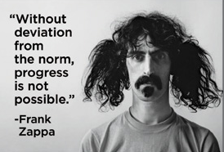
Notes:
Change is about progress….but change involves moving from one position or state to another – this is deviation from what has become the ‘norm’ for most people.

Slide 4
Forces Driving Organisational Change – Some Examples
Discussion
Force for Change | Examples
Workforce Diversity | Sex, Race/Ethnicity, Cultural Differences, LGBTQ, Age/Generation
The Economy | Recession, Government Policy, Rising Health Care Costs
Technology | Mobile Devices, Social Media, Internet Security, Robotics
Globalization | Multinational Corporations, Political Instability, Fair Trade, Sustainability, Outsourcing, Emerging Markets
Competition | Global Competition, Mergers and Acquisitions, Customer Standards, Time to Market
Scandura, T. A., (2018) p.289
Notes:
Scandura, T. A., (2018) Essentials of Organization Behavior, 2nd Ed., Thousand Oaks, CA: Sage

Slide 5
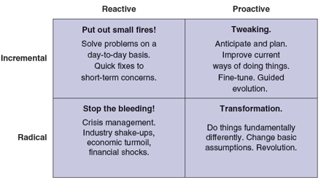
Planned Change
Scandura, T. A., (2018) p.91
Notes:
Discuss the four categories and explore which of these the students have experienced themselves, in their working careers so far. Tutor to share examples from own experiences, as well as appropriate case-studies.

Slide 6
Organisational Subsystems Involved in Planned Change
Formal organization: Provides the coordination and control necessary for organised activity.
Social factors: Include individual differences, team interactions, and organisational culture.
Technology: How raw materials and inputs transform into outputs, such as work flow and job design.
Physical setting: Characteristics of the physical space and how it is arranged.
Scandura, T. A., (2018) p.91
Notes:
Scandura, T. A., (2018) Essentials of Organization Behavior, 2nd Ed., Thousand Oaks, CA: Sage

Slide 7

Unplanned Change
Spontaneous, rather than intentional
Often Chaotic
Can bring unexpected results
Notes:
Unplanned internal change can be regarded as a change which takes place within an organization not in a planned manner or as a strategic intervention, but are introduced in an unplanned manner in response to either a change in the demographic composition of an organization or due to performance gaps

Slide 8
Unplanned Change
Source of change influenced by external factors outside of organisation’s control
Economic/market fluctuations, political changes, competition, and even weather changes can lead to internal problems – sudden resignations, machine & technological failures
Organisations improvise and devise solutions – often within very short timeframes
Brings more upheaval to the structure of an organisation…may take longer to deal with the effects

Slide 9

Unplanned Change
What could an organisation’s leadership and management do to manage the potential impact of unplanned change?
      Discussion
Notes:
Facilitator led discussion. Key themes could include: -
Treating unplanned change instances in the same disciplined manner as planned change – only shorten timescales and ensure monitoring of impact, to allow for remedial action – where appropriate
Organisations should be led through more ‘planned’ change, as a treatment to acclimatise the workforce to change….so that they are more able (and willing0 to cope with unplanned change constructively.
Focus on creating a culture of continuous improvement – to include an effective problem solving approach. Thus ‘unplanned change’ becomes just another problem to solve and the workforce are unconsciously competent to deal with it.
A ‘learning organisation’ culture is likely to be more able to deal with unplanned change effectively……so, work to establish such a culture.
Leadership could also use any successful unplanned change to stress that there is no need to fear change, as long as organisations seize the opportunity to maximise the benefits and minimise the negative impacts

Slide 10
Phillip Hodson’s Transitional Curve
Negation
Denial
Withdrawal
‘Business as usual’
Focus on past
Activity without accomplishment
Resolution
Commitment
Excitement
Co-operation
Co-ordination
Goal clarity
Objectives-setting
Action planning
New ways of working
Negation
Resolution
Past
Future
Self-Justification
Resistance
Rationalise Denial
Anger, blame
Anxiety
Depression
Air of resignation
Apathy
Exploration
Recognition
Over-preparation
Confusion
Chaos
Energy / ideas without cohesion
Self-Justification
Exploration
‘Days of Change’ Model
Notes:
Phillip Hodson’s website page for ‘Days Of Change’ is located at https://www.philliphodson.co.uk/554/
The video from which these extracts are taken, is called ‘Days Of Change’.

Slide 11
Responding to Change: A Parable
Who Moved My Cheese?
Johnson, S. (1998) Who moved my cheese? 4th edn. USA; Penguin Putnam, Inc.
The cheese is a metaphor for what we want to have in life (a job, power status, relationships). The maze is a metaphor for where you spend your time looking for what you want (within the organisation, outside it, in the community, at home etc).

Slide 12

Who Moved My Cheese
Notes:
https://www.youtube.com/watch?v=Txy6DwbwZ9g

Slide 13
The Handwriting On The Wall
Change Happens – They keep moving the cheese
Anticipate Change – Get ready for the cheese to move
Monitor Change – Smell the cheese often so you know when it is getting old
Adapt To Change Quickly – The quicker you let go of the old cheese, the sooner you can enjoy new cheese
Change – Move with the cheese
Enjoy Change! – Savour the adventure and enjoy the taste of new cheese!
Be Ready To Quickly Change & Enjoy It, Again – They keep moving the cheese

Slide 14
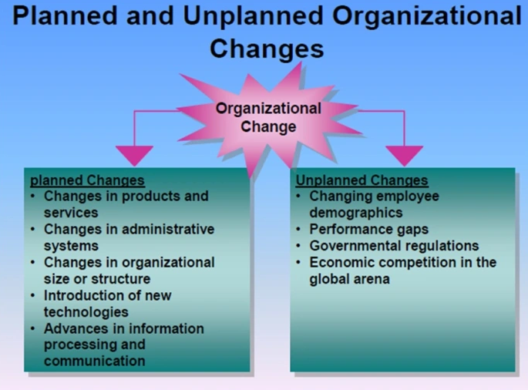


Summary
Organisational change is challenging…especially when it is the unplanned variety…

