Slide 1
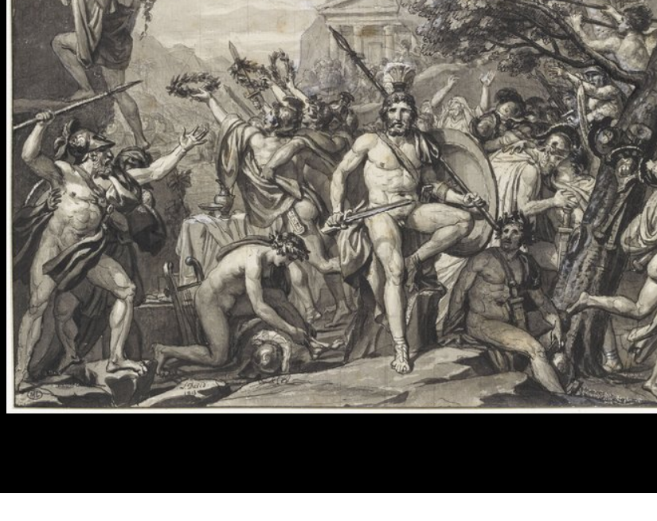
Perioikoi: The ‘Forgotten’ Soldiers of Sparta?
Module: (HPAH5044) Armies and Navies: Studies in Ancient Warfare
Thomas Clarke - 1900472
Jacques Louis-David, ‘Léonidas aux Thermopyles’, 1813, Louvre – INV 26080

Slide 2
Introduction
I argue that the perioikoi were not ‘forgotten’ but misrepresented in Spartan society, with their full contribution only being considered recently (a lack of information and evidence has severely hindered this). The ‘Spartan Mirage’ (Ollier 1933, 1943) reshaped preconceptions of Lacedaemon society, and the constituent parts within. Historical Revisionism has driven an understanding of the relationship of Sparta to its surrounding regions, with recent attention placed on the ‘smaller elements’ that play a part in the larger picture of society. For example, the role of agrarianism (Hanson 1995), and community ‘dependency’ (Hall 2000). I aim to show a transformation within scholarly thinking, and the revised approaches to the perioikoi.

Slide 3
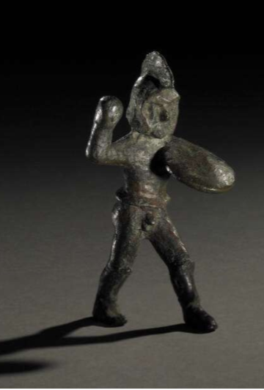
The Spartan Ideal: The ‘Citizen-Soldier’
How was this ideal embodied?
A free (wealthy) citizen who devoted themselves to military and political life
Homoios = A Spartan citizen with full political rights
Tyrtaios reinforces hoplite idealisation (fr. 11 21-38)
Not adopted in reality: Classical Era - ‘poor’ citizens and non-citizens, slaves, incorporated into military service, in substantial numbers (Hunt 1998, van Wees 2004) = A reframed ‘Spartan citizen-soldier’
Cost of panoply exclusivity – approximately 75-100 drachmae, 3 months wages (van Wees 2004: 52, Hanson 1995: 294-301, Jarva 1995: 148-154). Thus, an overlap occurs between practicality and status – something seldom awarded or available
6th Century Laconian Bronze Warrior Figure – British Museum, BM 1016.6

Slide 4
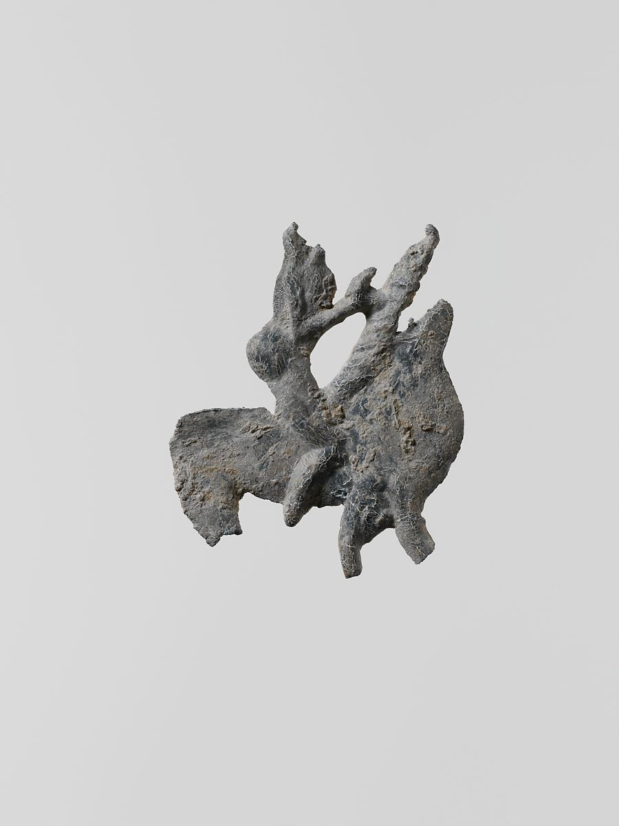
Who were the Perioikoi?
A community of free (but not citizen) peoples, whose ‘masters’ granted limited form of “municipal independence” (Ducat 2017)
Occupied poleis – not wholly subordinate “… with some degree of internal administrative complexity” (Shipley 2006: 58). Indication of distinction from Sparta
Shipley (1997) and Hall (2000) view the communities as city-states, ‘dependant’ upon Sparta – in line with Gschnitzer (1958). To an extent they were dependant – but I feel it is only necessitated by Spartan hegemony
Perioikoi = “unable to hold office in Sparta or participate in the Spartan assembly” (Hawkins 2011). Their precarious nature as residents is evident
Estimated perioikic communities - Messenia and Laconia - 33, e.g Thyrea, Gythium (Shipley 2006: 58-59).
“Suiting the deed to the word, he distributed the rest of the Laconian land among the "perioeci," or free provincials, in thirty thousand lots” (Plu. Lyc. 8.3)
6th/5th Century Laconian Lead Horseman, Met Museum, MMA 24.195.100

Slide 5
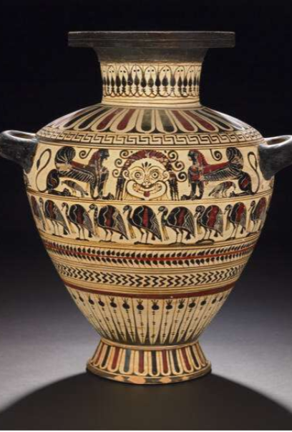
Perioikic Status
Scholarly dispute:
“The Spartans were an inner group within the Lakedaimonians, who took decisions in the name of all Lakedaimonians” (Hampl 1937: 33). The Spartan Mirage is perhaps evident in its failing to recognise the individual institutions within a perioikic polis. It distinguishes but assumes.
Important to think of perioikoi as part of a larger image “…. not as subjects but as fellow members…of the Lakedaimonian ethnic body and polity” (Shipley 1996: 213)
“le territoire périèque fait partie intégrante du territoire lacédémonien” (Lévy, 2003: 142). Rightly, their presence cannot be dismissed – they comprised a significant part of Lacedaemon
In line with Ridley, viewing the Lycurgan Constitution as unquestioned, further distances perioikoi and reinforces tripartite society within Sparta - perpetuating Spartan disinclination (Plu. Lyc. 24, Ridley 1974: 292)
A key example of status: Gythium – perioikic port – the “arsenal of Sparta” (Ridley 1974: 289). Many perioikic poleis were coastal which served as a basis for establishing trades (see the Vix krater) further afield through commercial and likely martial traffic
6th Century Laconian Black-Figured Hydria, British Museum, BM 0518.14

Slide 6
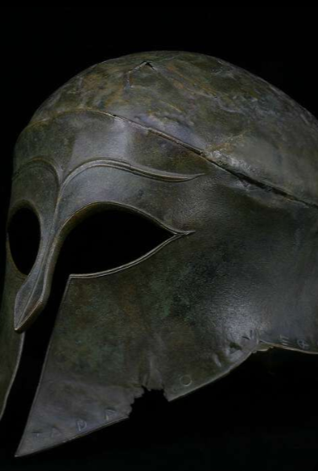
Roles in Martial Conflict
Evidence that shows perioikoi were given significant roles:
Diplomacy (or secrecy!) = Phrynis “one of the perioeci” sent to Chios (Thuc. 8.6.4)
Hdt. 9.11.3 on Plataea – “5000 picked Lacedaemonian troops drawn from the outlying towns”
Navy – “captains and marines were citizens and perioikoi, but the rest of the crew were ‘either helots or hired men’.” (van Wees 2004: 212-3)
Deiniadas - warship commander (Xen. An. 5.1.15)
C. 5th Century Corinthian Helmet, British Museum, BM 0407.32

Slide 7
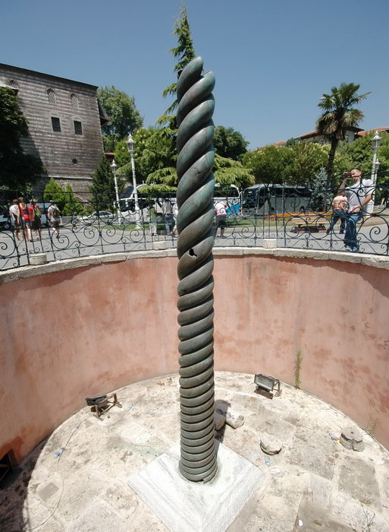
Perioikoi ‘On The Battlefield’ (1)
Reliance on Spartan non-citizens: “a serious breach in the principle of the citizen militia” (Cartledge 1979: 40). The Spartan Ideal was not sustainable, but in accordance with van Wees (2004), was not inaugurated by manpower crisis
Large contribution – Plataea (479 BC): “10,000 Lacedaemonians, of which 5,000 were Spartans” (Hdt. 9.28). Perioikic contribution continuous and considerable
Delphic Serpent Column – 10,000 ‘Lacedaemonians’ not Spartans (Hall 2000: 75). Significant as this recognizes ‘the wider Lacedaemon’ in the public sphere
Kratistoi “strongest/best” at phalanx front (Xen. Lac. 11.8) – Evidence of Spartan monopolisation?
Xerxes + Demaratus: indicative of exaggerated Spartan nomos? “the other men in Lacedaemon are not their equals – but good soldiers none the less” (Hdt. 7.234.2). It is not that they were not recognised but Sparta wished to demonstrate their own capabilities in comparison
Consistent loyalty throughout Spartan history, perioikic communities present during Augustus’ rule
Few instances of disaffection – Only Thouria and Aithaia joined ‘helot revolt’ in 464 BC (Shipley 1996: 202)
Delphic Serpent Column at Hippodrome Constantinople (Istanbul)

Slide 8
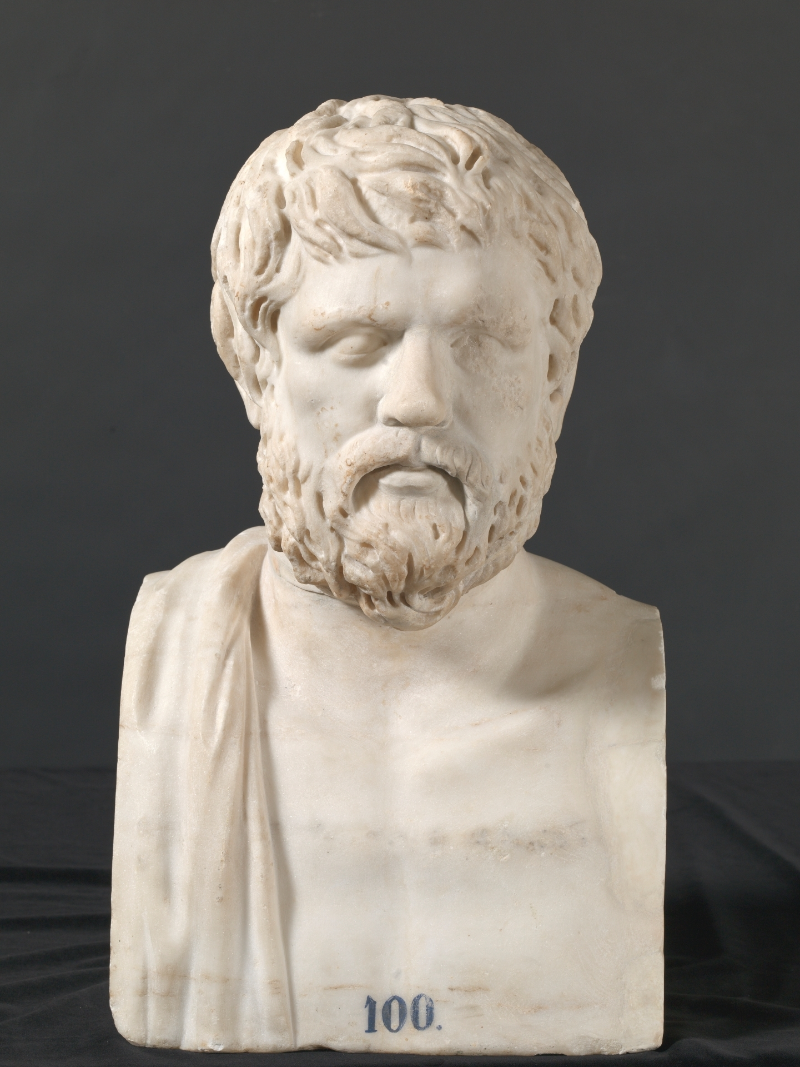
Perioikoi ‘On The Battlefield’ (2)
“Whereas Spartans and Perioikoi had fought in separate contingents in the early 5th century, later ….. began to incorporate Perioikoi into the same units in which the remaining homoioi themselves were brigaded” (Hawkins 2011: 403). But they were still distinguished; a separate yet ‘synchonised’ entity
Xen. Hel. 6.4.15 distinguishes Lacedaemons from Spartans in recounting casualty totals
Grievances of aristocratic perioikos – still largely excluded from spheres, unlike the neodamodeis, who had noticeable status change, the perioikoi remained static
“Auxiliary role” – involvement restricted by agricultural calendar (Hawkins 2011). Not exclusive to the perioikoi, helots were also bound to land
Large contribution of perioikoi at Pylos/Sphacteria (425 BC): “Altogether 440 hoplites had crossed over, and of these 292 were taken alive to Athens, the rest having being killed. About 120 of the prisoners were of the Spartan officer class” (Thuc. 4.38)
Debate exists whether Sparta’s action was driven by desire to protect 120 Spartiate elite (Lungquist 2019). Personally, Sparta needed all the men it could get, and potential appeasement for nearby Messenia, where perioikoi were a demographic
2nd Century Marble Bust of Xenophon, Museo Del Prado, E000100

Slide 9
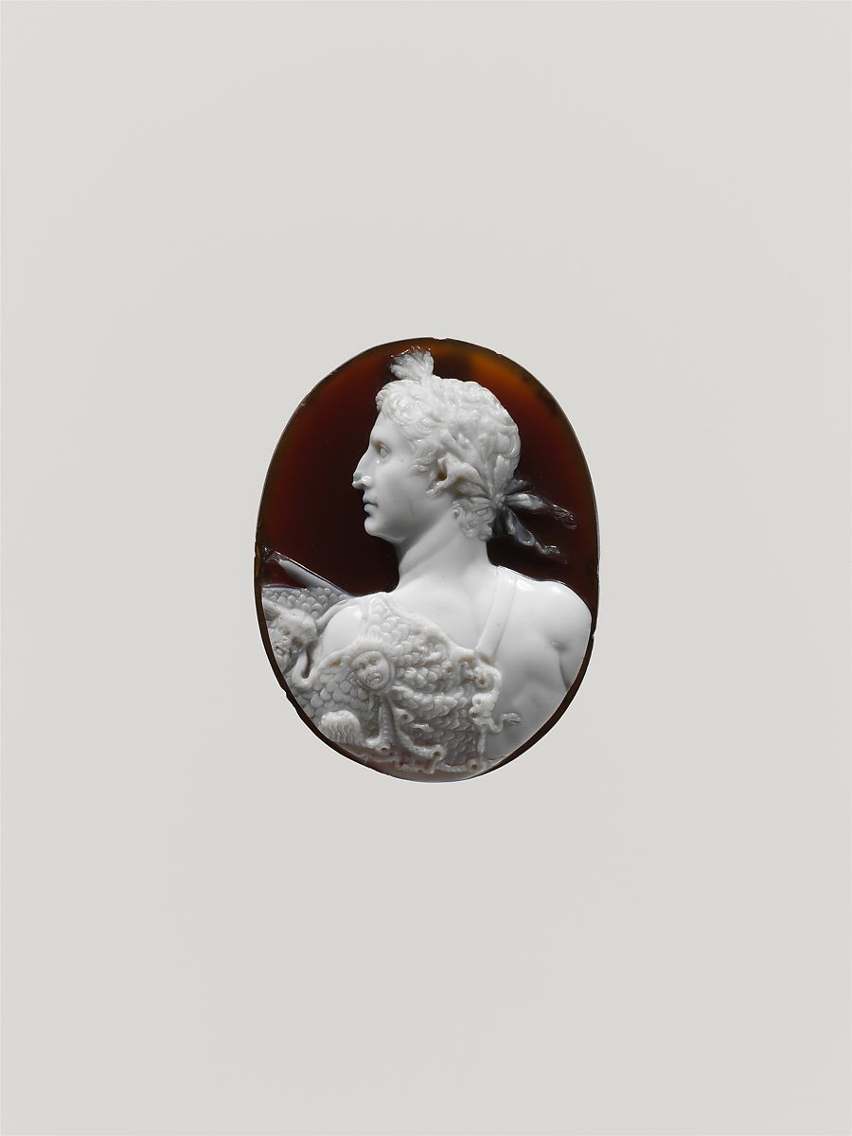
In the Late Hellenistic Period
Sparta decline in later centuries = perioikic communities passed in and out of their control (Kennell 1999)
195 BC many ‘perioikoic’ cities unified, formed Achaean League
Under Augustus (21 BC) formed Eleutherolakones ‘League of Free Laconians’ (Alcock 1993: 16)
c. 41-51 AD Sardonyx Cameo of Emperor Augustus, Met Museum, MMA 42.11.30

Slide 10
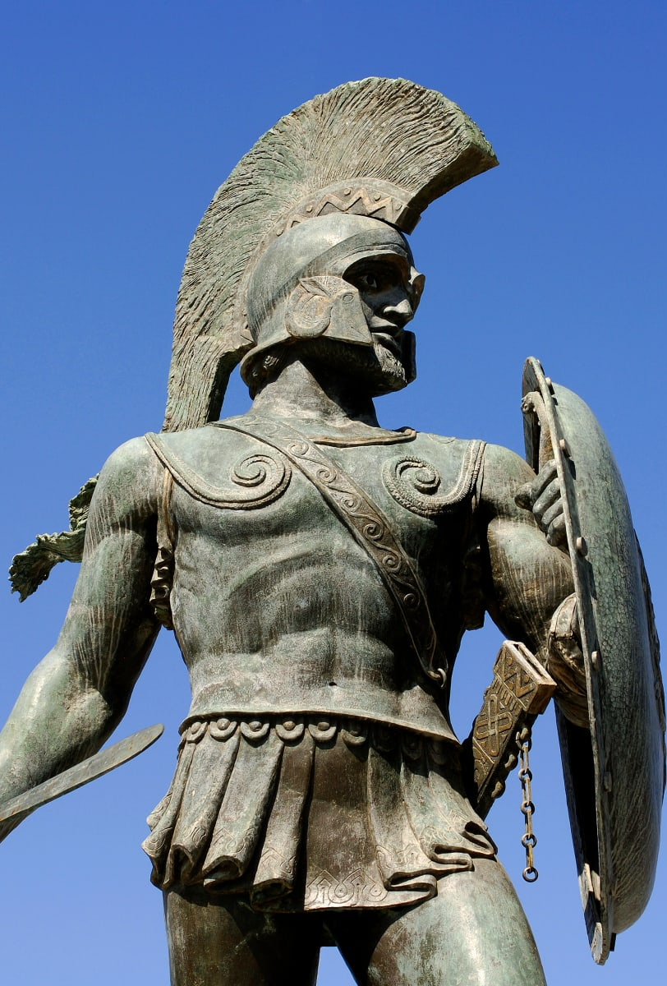
Limitations in Our Studies of Perioikoi
Records rarely predates 5th century = non-Spartan accounts facilitates ‘Spartan Mirage’+ ‘Spartocentric’ perceptions (Shipley 1992)
Approaches to terminology – (Xen. An. 4.8.25) mercenary Dracontius: Spartiate yet exiled as a boy – not considered homoios?
Inscriptions – esp. martial – extremely limited (Lazenby 1985: 13-16)
Conflict/bias within literature: Cinadon attempt to mobilise Perioikic support 399 BC failed – exaggerated personal hatred of Sparta “Gladly eat them raw” (Xen. Hel. 3.3.6, Van Wees 2004: 84)
Elaborated: “they themselves were afraid of the hardships or the dangers or the length of time involved …. to take the brunt of the danger from all the rest.” (Isc. 12.180)
Archaeological evidence scarce and sporadic – infrequent work; largest conducted recently = BSA Laconia Survey (1983-9)
Bronze Statue of Leonidas at Battle of Thermopylae site

Slide 11
Conclusion
To conclude, it is clear the perioikoi were significant within the Spartan military, in number and in role (evidenced in the Serpent Column). Yet, they often faced exclusion or distinction from Spartiatai. They gave more than they were given back, were a ‘means to an end’ towards the ‘ultimate’ Spartan goal. They were constricted yet mandated to balance martial service and agricultural production. Perioikic commitment to the Spartiatai lasted for the duration of Sparta’s history, providing the arms of the Spartan army.
The largely martial writing of classical scholars has presented challenges for the ‘modern’ scholar, and it has forcibly framed our research towards ancient Greece, and Sparta particularly. This resulted in a ‘Spartocentric’ ideology which mis-attributes what was a more kaleidoscopic society, and a social structure found within the perioikoi themselves. The perioikoi are not ‘forgotten’ but are representative of a dormant ideology that has only been dismantled in recent years.

Slide 12
Bibliography (1)
Alcock, S.E (1993) ‘Graecia Capta: The Landscapes of Roman Greece’ Cambridge; Cambridge University Press
Cartledge, P. (1979) ‘Sparta and Lakonia: A Regional History, 1300-362 BC’ London; Routledge & Kegan Paul
Ducat, J. (2017) ‘The Perioikoi’ in (ed.) Powell, A., ‘A Companion to Sparta’ New Jersey; Wiley-Blackwell, pp. 596-615
Gschnitzer, F. (1958) ‘Abhängige Orte im griechischen Altertum‘ Zetemata, Heft 17, Munich: pg. XIII, + 195
Hall, J.F (2000) "Sparta, Lakedaimon and the Nature of Perioikic Dependency." In Further Studies in the Ancient Greek Polis, ed. by P. Flensted-Jensen. Stuttgart: Franz Steiner Press, pp. 73-89
Hampl (1937) ‘Die Lakedaimonischen Periöeken’ Hermes 72, Stuttgart: Franz Steiner Verlag, pp. 1-49
Hanson, V.D (1995) ‘The Other Greeks: The Family Farm and the Agrarian Roots of Western Civilisation’ Berkeley: University of California Press
Hawkins, C. (2011) ‘Spartans and Perioikoi: The Organisation and Ideology of the Lakedaimonian Army in the Fourth Century B.C.E’ Greek, Roman and Byzantine Studies, Vol. 51, Durham; Duke University Press, pp. 401-434
Herodotus. ‘The Histories’ A. De Sélincourt. (trans.). 2003, London: Penguin Books
Hunt, P. (1998) ‘Slaves, Warfare and Ideologies in the Greek Historians’ Cambridge: Cambridge University Press

Slide 13
Bibliography (2)
Isocrates. ‘Panathenaicus’ G. Norlin. (trans.). 1980, London: William Heinemann Ltd.
Jarva, E. (1995) ‘Archaiologia on Archaic Greek Body Armour’ Rovaniemi: Pohjois-Suomen Historiallinen Yhdistys: Societas Historica Finlandiae Septentrionalis, Studia Archaeologica Septentrionalia 3
Kennell, N.M (2009) ‘From Perioikoi to Poleis: The Laconian Cities in the Late Hellenistic period’ in (ed.) Hodkinson, S. and Powell, A. ‘Sparta: New Perspectives’, Swansea; Classical Press of Wales, pp. 189-211
Lazenby, J. (1985) ‘The Spartan Army (Stackpole Military Series)’ Mechanicsburg; Stackpole Books
Lévy, E. (2000) ‘Sparte: Histoire Politique et sociale jusqu’ à la conquête romaine’ Paris; Éditions du Seuil
Lungquist, S. (2019) ‘The Failure of the Spartan System at Pylos’ War History Online: https://www.warhistoryonline.com/instant-articles/failure-of-the-spartan-system.html (Date Accessed: 2/6/21)
Nielsen, T.H (2002) ‘Arkadia and Its Poleis in the Archaic and Classical Periods’ Göttingen; Vandenhoeck & Ruprecht
Ollier, F. (1933) ‘Le Mirage spartiate : Étude sur l'idéalisation de Sparte dans l'antiquité grecque de l'origine jusqu'aux Cyniques’ Paris: Paris de Boccard
Ollier, F. (1943) ‘Le mirage spartiate : étude sur l'idéalisation de Sparte dans l'antiquité grecque du début de l'école cynique jusqu'à la fin de la cité. 2e partie’ Paris: Paris de Boccard
Ridley, R.T ‘The Economic Activities of the Perioikoi’ Mnemoysne, Vol. 27, No. 3, Leiden; Brill, pp. 281-292

Slide 14
Bibliography (3)
Shipley (1992) ‘Perioikos: the discovery of classical Lakonia ‘ in (ed.) Sanders, J.M. ‘Philolakon: Lakonian Studies in Honour of Hector Catling’, London; The British School At Athens, pp. 211-26
Shipley, G. (1996) ‘”The Other Lakadaimonians”: The Dependant Perioikic Poleis of Laconia and Messenia’ in (ed.) Mogens Herman Hansen ‘The Polis as an Urban Centre and as a Political Community: Acts of the Copenhagen Polis Centre Vol. 4 – Symposium August 29-31, 1996’, Copenhagen; Kgl. Danske Videnskabernes Selskab, pp. 189-231
Shipley, G. (2006) ‘Sparta and its Perioikic neighbours: a century of reassessment’ Hermathena – In Honour of George Huxley, Vol. 181, Dublin; Trinity College Dublin, pp. 51-82
Thucydides ‘History of the Peloponnesian War’. R. Warner (trans.). 1972, London: Penguin Books
Tyrtaios ‘fragment 11. 21-38’ P. de Souza, (trans.). 2003, Oxford: Osprey Publishing
van Wees, H. (2004) ‘Greek Warfare: Myths and Realities’ New York; Bloomsbury Press
Xenophon. ‘Hellenica’ . R. Warner (trans.). 1972, London: Penguin Books

Slide 15
Picture References
Slide 1: ‘Léonidas aux Thermopyles’ (INV 26080) https://collections.louvre.fr/en/ark:/53355/cl020211738 - (Date Accessed: 30/5/2021)
Slide 2: Laconian Bronze Warrior Figure (BM 1016.6) https://www.britishmuseum.org/collection/object/G_1929-1016-6 - (Date Accessed: 30/5/2021)
Slide 3: Laconian Lead Horseman (MMA 24.195.100) - https://www.metmuseum.org/art/collection/search/251666 - (Date Accessed: 30/5/2021)
Slide 4: Laconian Black-Figured Hydria (BM 0518.14) https://www.britishmuseum.org/collection/object/G_1849-0518-14 - (Date Accessed: 30/5/2021)
Slide 5: Corinthian Helmet (BM 0407.32) https://www.britishmuseum.org/collection/object/G_1824-0407-32 - (Date Accessed: 30/5/2021)
Slide 6: Delphic Serpent Column https://www.livius.org/pictures/turkey/istanbul/constantinople-hippodrome/constantinople-hippodrome-serpent-column/ - (Date Accessed: 30/5/2021)
Slide 7: Xenophon Marble Bust (E000100) https://www.museodelprado.es/en/the-collection/art-work/portrait-of-the-writer-xenophon/90ffdd20-ed7b-4428-8de2-2a00c04fbf42 - (Date Accessed: 31/5/2021)
Slide 8: Sardonyx Cameo Augustus (MMA 42.11.30) https://www.metmuseum.org/art/collection/search/254473 - (Date Accessed: 31/5/2021)
Slide 9: Bronze Statue of Leonidas https://www.history.com/topics/ancient-history/sparta - (Date Accessed: 31/5/2021)

