Slide 1
Team work
In a company that provides Consultation services to customers

Slide 2

Benefits of team working in a Company that offers consultation Services to Customers:
Builds trust, coordination and collaboration
Develops conflict resolution skills
Fosters learning and creativity
Promotes beneficial risk taking
Encourages sense of leadership
Improves team working ability
Heightens employee morale and motivation
Notes:
Team work in a company that offers consultation services to customers has a wide range of benefits on individual performance that again leads to organizational productivity. With staffs working in a team of a consultation services firm, they develop coordination, trust on the team members and communication among the team members enabling the team achieve the collected objectives efficiently through strong coordination and collaboration. Individuals when working in a team of a company that provides consultation services improves a number of skills and ability from other team members through working in a group and improves their creativity as well. While working in a together, a team may experience a number of conflicts within their team. Team members within the consultation company develops their conflict resolution skills through team working. The sense of leadership also is developed through team work as every team members realises their significance in the team. They strive to identify the ways of improving team performance, which improves their leadership skill.

Slide 3
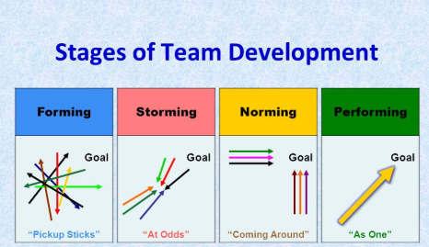
Stages of team development:
There are five stages of team development, forming, storming, norming, performing and adjourning as proposed by the psychologist Bruce Tuckman.
Stage 1: Forming
Stage 2: Storming
Stage 3: Norming
Stage 4: Performing
Stage 5: Adjourning
Notes:
Forming is the first stage of team development, which is more or less the job orientation where the team has been introduced. Most of the team members are excited to start a new project and they tend to be very polite and pleasant.
In the second stage of team development, storming, the initial feelings of excitement and getting to know other members diminish. In this particular stage, personality may clash, when members disagree to others point of view. Majority of the teams in the particular consultation firm go through different conflicts that are managed efficiently by competent leaders. In the third stage, norming, individual staffs start appreciating other members’ skills. At this stage, group start settling and they work in coordination. Members in the consultation company are confident, familiar with the tasks they have been performing and motivated at their tasks in the fourth stage, performing. The team at this stage perform without supervision. The fifth stage of adjourning is when the project closes and the team is dissolved.

Slide 4
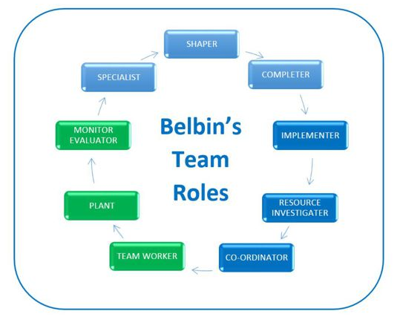
Team roles in a company that offers consultation Services to customers :
Action oriented roles:
Shaper:
Completer Finisher
Implementer:
People oriented roles:
Co-ordinator
Resource investigator
Team worker
Thought oriented:
Plant
Specialist
Monitor evaluator

Slide 5
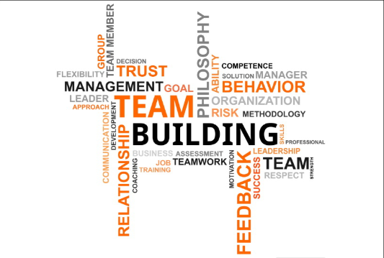
Successful team development :
The must have clearly defined objectives to accomplish
Build team values and objectives
Clear sense of direction
Clear and transparent communication while conveying message to the team members
Experienced team leader efficient in managing conflicts and issues
Encourage trust and coordination among team members within the team
Encourage team members for sharing information, opinions and decisions
Delegating problem solving and decision-making tasks to the team members
Promote listening and brainstorming
Evaluate and monitor team performance
Notes:
For successful team development in the selected consultation giving company, key components are as follows:
The company must have clearly defined objectives to accomplish
Build team values and objectives
Clear sense of direction
Clear and transparent communication while conveying message to the team members
Experienced team leader efficient in managing conflicts and issues
Encourage trust and coordination among team members within the team
Encourage team members for sharing information, opinions and decisions
Delegating problem solving and decision-making tasks to the team members
Promote listening and brainstorming
Evaluate and monitor team performance

Slide 6
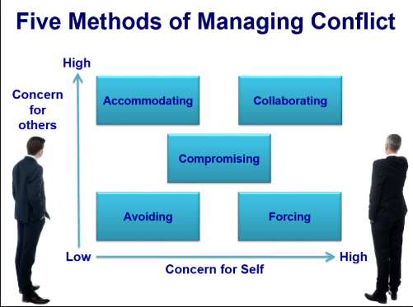
Managing conflict in the Company that Offers consultation services to customers:
Avoidance
Accommodation
Compromise
Confrontation
Collaboration
Notes:
Different conflicts management strategies that company that provides consultation services to its customers are as follows:
Avoidance: Ignoring or denying the issues that there is a problem
Accommodations: Some team members give up their positions so agree to others decisions
Compromise: Managing individual goals of every team members and link among the team members
Confrontation: Aggressive way of action or striving to win
Collaboration: Team works together for solutions that satisfy every team members

Slide 7
References
Belbin, R., 2012. Team roles at work.. 2nd ed. UK: Routledge..
Berlin, J., Carlström, E. & Sandberg, 2012. Models of teamwork: ideal or not? A critical study of theoretical team models. Team Performance Management: An International Journal, pp. 328-340.
Cannon-Bowers, Janis A. & Bowers., C., 2011. Team development and functioning. London: SAGE.
Colbert, A., Barrick, M. & and Bradley, B., 2014. Personality and leadership composition in top management teams: Implications for organizational effectiveness. Personnel Psychology, pp. 351-387.
Drew, S. & Coulson‐Thomas, C., 2013. Transformation through teamwork: the path to the new organization?. Team Performance Management: An International Journal.
Harvard Management Communication Letter, 2012. Handling Conflict in Teams A Roundup of Recent Research. Scotland.: Reprint number C0004F.

