Slide 1
Study skills:
Poster presentations

Slide 2
Provide an overview of why posters are an effective method of communication
Provide tips and advice on how to start to construct a poster
Practical examples of how to go about developing an effect poster
AIMS AND OBJECTIVES

Slide 3
Oral and Poster Presentations
The main difference between the written words (contained within your poster) and giving an oral presentation is the ‘ORAL’ part!
The facts remain the same – you just ‘tell’ them differently

Slide 4
Poster presentations
The purpose of a poster is to act as a medium to advertise your work
Enable a succinct summary of work/ideas, and allow you to get your main points across to as many people as possible
Also act as a conversation started (at conferences, for example)

Slide 5
Poster presentations
A poster should speak for itself; an audience should be able to work out your key messages without you stood there presenting them
With a Hosted Poster, you have the visual aid of your poster plus provide a succinct (very brief) summary of the key messages
  And therefore allow the audience to read your poster in greater detail, if they want to, later on

Slide 6
Poster presentations
Remember to consider:
  Audience
    Some knowledge of what you are going to be talking about
  Subject
    You choose (covered in module so far) – related to your own academic or professional skills development
  Length of Time
    Check how long you will present and how long is set aside for questions
  Mode of Delivery
    Poster AND oral summary (hosted) or poster alone

Slide 7
Poster presentations
An effective poster will:
Have a catchy title
Use the right language (audience)
Use images purposefully
Have enough ‘white space’
Present information in a logical way

Slide 8
Poster presentations
Things to think about:
People tend to read posters from left to right, and top to bottom – so consider your layout!

Slide 9


Slide 10
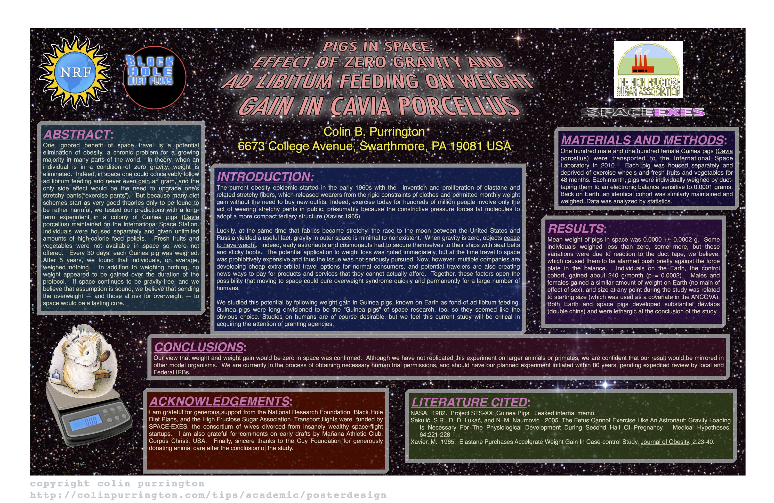

Slide 11
Poster presentations
Things to think about:
People tend to read posters from left to right, and top to bottom – so consider your layout!
Avoid too much jargon

Slide 12
Jargon
“Special words or expressions used by a profession or group that are difficult for others to understand.”
Acronyms
  Can be used to shorten difficult terms IF you’ve introduced the term in full, first
2. Unusual terms
  Many psychological terms are unusual! Only use them if you are confident your audience will understand what they mean

Slide 13
Poster presentations
Things to think about:
People tend to read posters from left to right, and top to bottom – so consider your layout!
Avoid too much jargon
Colour and font schemes
  Remember: Simple is often best

Slide 14
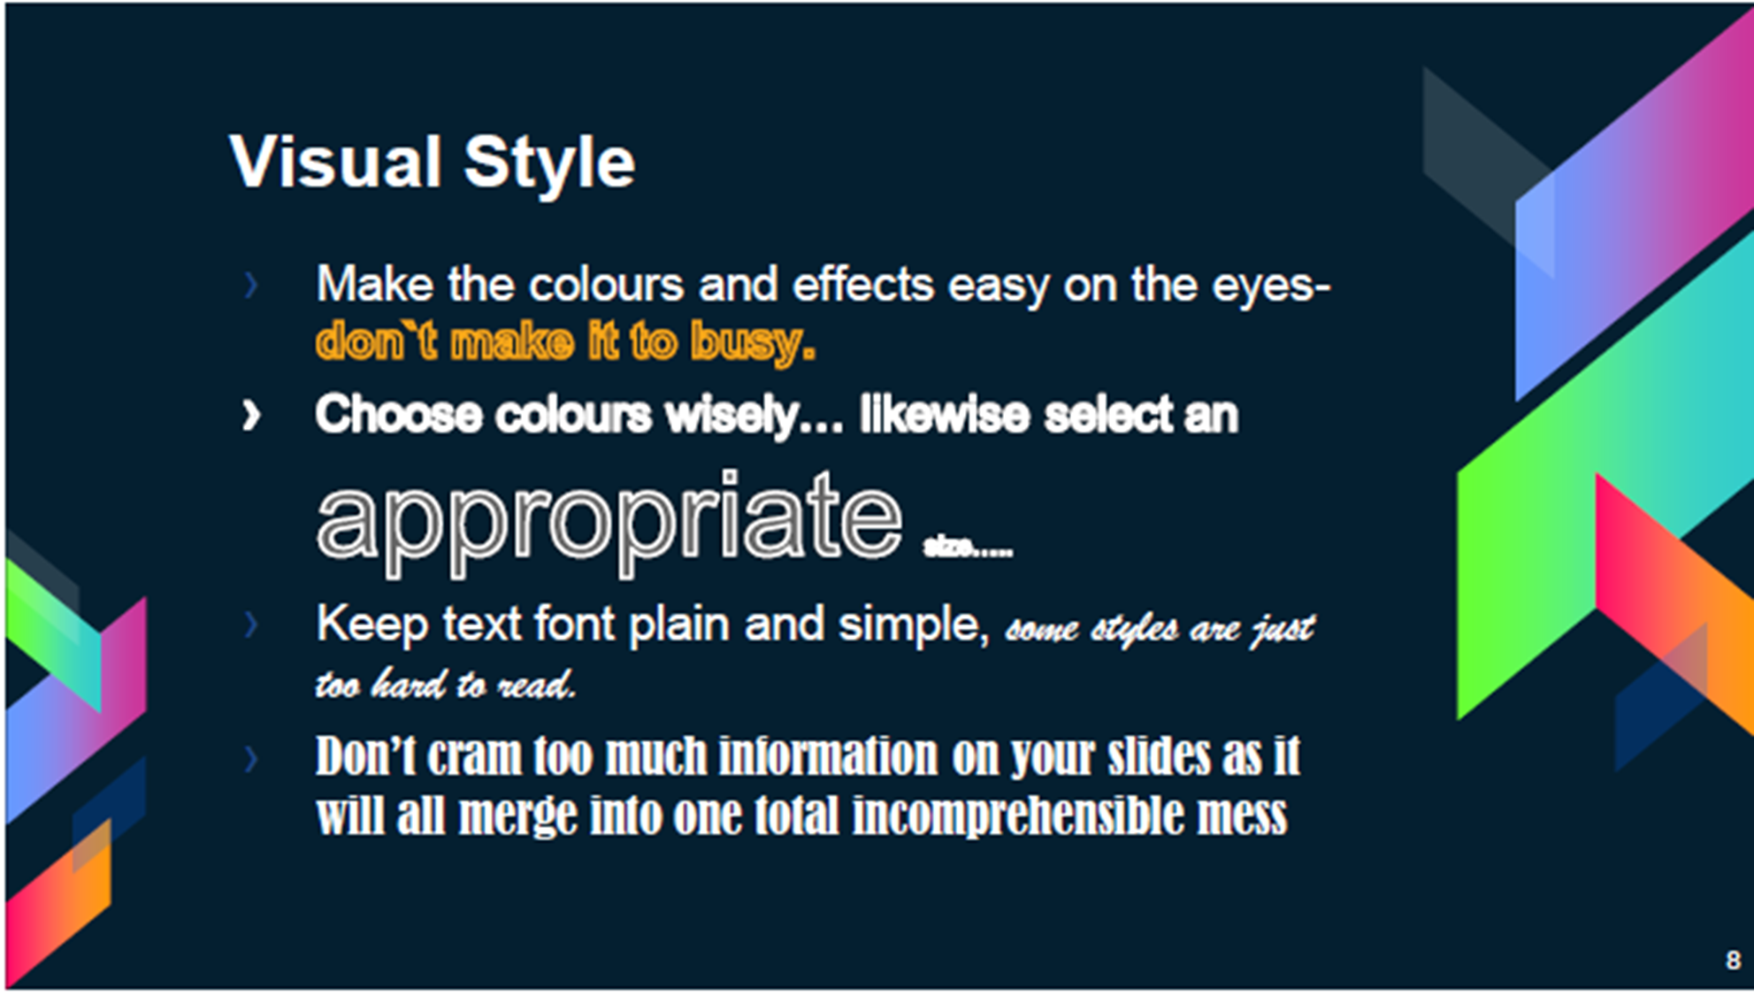

Slide 15
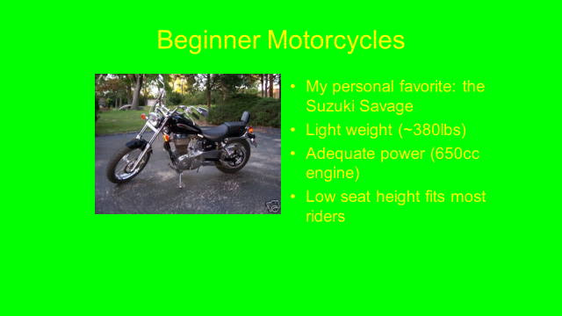

Slide 16
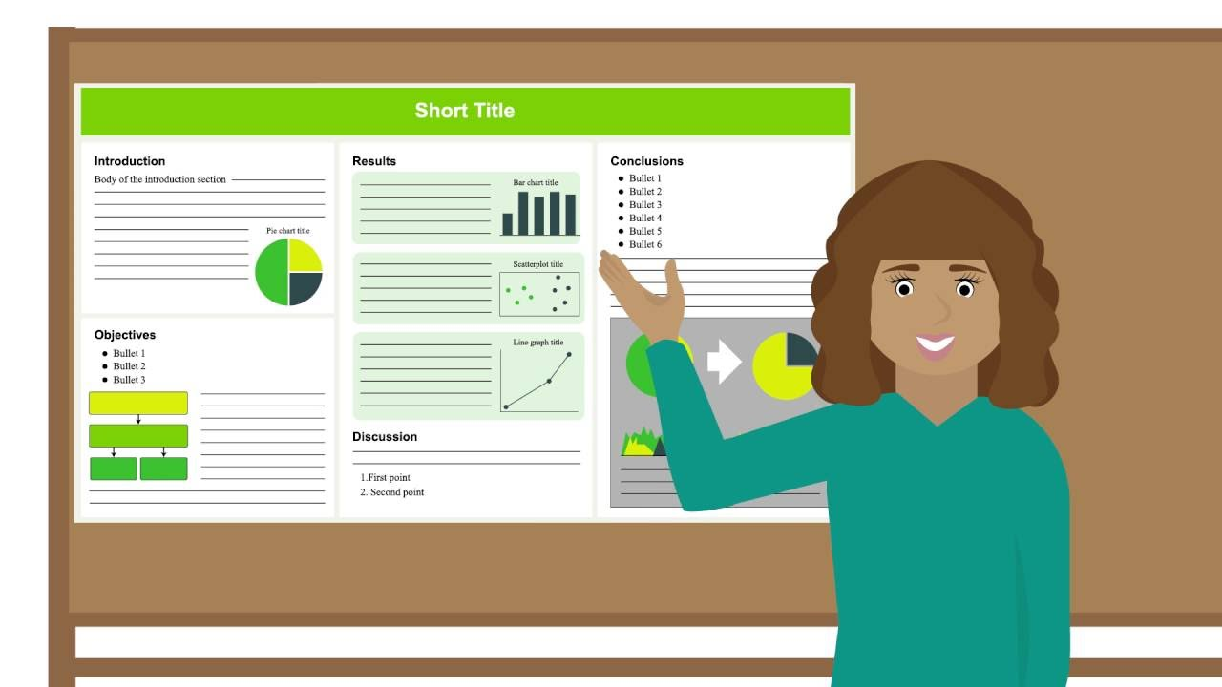

Slide 17
Poster presentations
Things to think about:
People tend to read posters from left to right, and top to bottom – so consider your layout!
Avoid too much jargon
Colour and font schemes
  Remember: Simple is often best
Balance text and images (and space!)

Slide 18

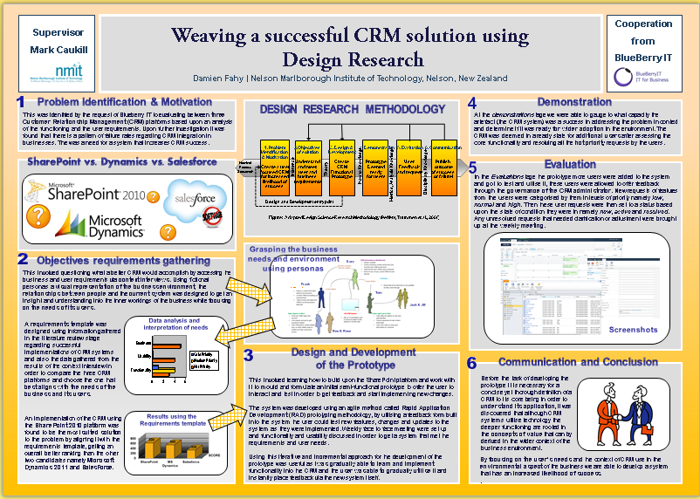

Slide 19
Oral presentations: Guidelines
The main difference between the written words (contained within your poster) and giving an oral presentation is the ‘ORAL’ part!
The facts remain the same – you just ‘tell’ them differently

Slide 20
Oral presentations: Guidelines
Identify the purpose
Understand the audience
Organise the introduction
Organise the body
Organise the conclusion
Beins and Beins (2012)

Slide 21
Oral presentations: Guidelines
1. Identify the main points
  Don’t overload the audience
2. Provide evidence to support points
3. Practice!
  Poor timing affects grades.
4. If including results of studies, keep it simple

Slide 22
Any questions?

