Slide 1
Module: Developing Emotional Intelligence Skills for the Workplace
Student name: Maria Francisca Dumitru
Student ID: 2121820

Slide 2
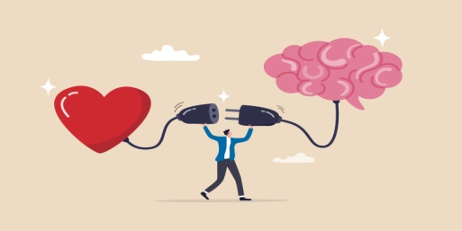
INTRODUCTION
Emotional Intelligence refers to the capacity to appraise, comprehend, control and influence one’s own emotions as well as those of other people. It embraces key competencies such as self-awareness, self-regulation, empathy and social skills of communication for effective communication and building relations with other people (Wong & Law, 2020).
The importance of EI, however, does not stop there, for it has major implications on personal and professional successes. At the workplace, high EI assists people in handling stress, solving problems of conflicts, and building positive relations which finally turns into better team work and cooperation.

Slide 3
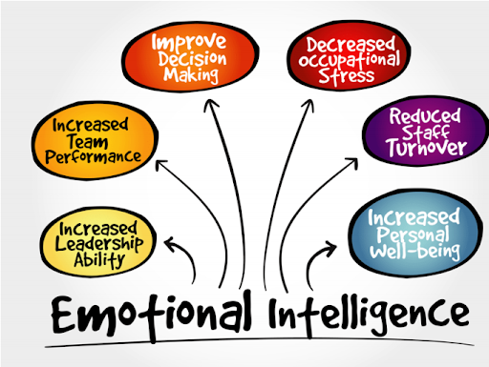
THE POTENTIAL BENEFITS OF EI
I personally find EI to be more beneficial in communication, work relationships, and problem-solving. Higher EI enables me to express my thoughts more clearly and empathetically while speaking, taking into consideration other people’s emotions and responding to them with due regard. This saves communication from a lot of possible misunderstandings and opens the way for frank and open discussion (Martinez, 2022).
In work-related aspects, being able to listen with attention and show empathy enhances trust and bonding with other employees, which makes a cooperative and supportive environment (Gupta & Sharma, 2021).
Regarding problem-solving, EI keeps one’s emotions under control even in stressful situations, thus allowing him to take some sensible and reasonable decisions peacefully. It also allows taking into account multiple perspectives in finding a better solution that meets the needs of all parties involved (Wong & Law, 2020).

Slide 4
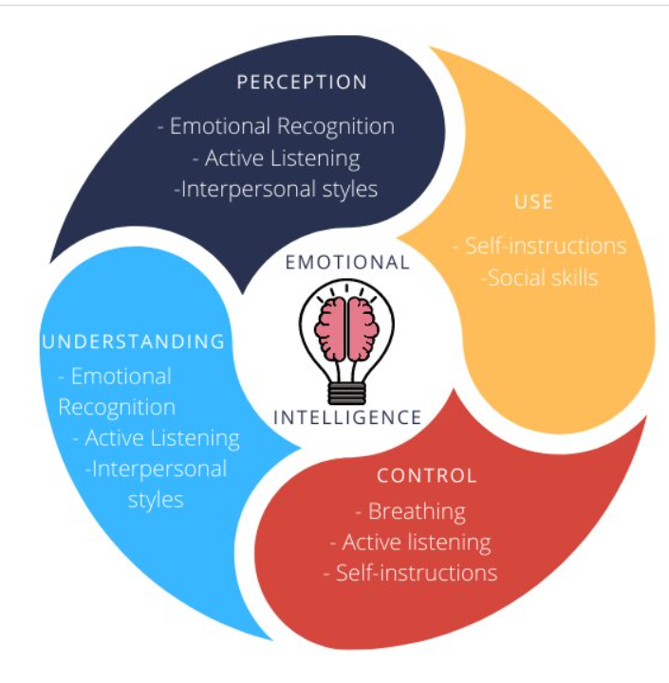
THE TYPES OF EI SKILLS
Emotional intelligence includes a number of key skills related to effective relationships with others and personal success. Empathy is one of these core EI skills—for instance, knowing what other people are feeling and responding emotionally to social situations. It helps build closer connections and allows a person to respond sensitively to others’ needs (Goleman, 2020).
Another vital skill is being a good listener, which means engaging in active conversation, focusing on the words and emotions of the speaker, and then responding thoughtfully. This will allow one to communicate well and establish trust.
The last basic EI skill is the ease of flexibility: it allows one to process emotions and adapt to changing situations with due resiliency. These EI skills further improve cooperation, leadership, and flexibility in both personal and professional affairs.

Slide 5
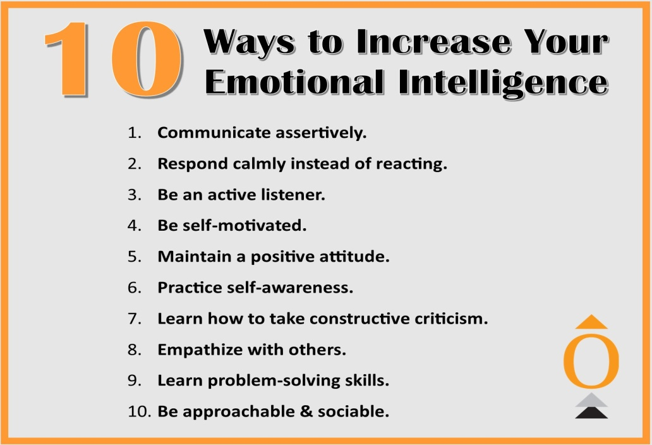
HOW TO IMPROVE AND CAPITALISE ON MY EI
Improving my Emotional Intelligence (EI) skills can be done by paying attention to some key areas. First, I can enhance self-awareness by being sensitive to my feelings and labeling the precipitants that act on my behavior.
This can be achieved by practicing mindfulness or keeping a journal. Second, empathy development is essential; this can be done by working at appreciating the viewpoint of others by active listening and using open-ended questions.
Third, self-regulation should be enhanced by providing control of emotional responses in areas requiring an approach for the maintenance of a calm and thoughtful decision-making process. Fourth, other social skills such as conflict resolution and teamwork further enhance communication and collaboration. The continued improvement of one’s feelings over time with regular hints from colleagues and unending practice the whole set of emotional management techniques allows most gains for my EI (Roberts & Pruitt, 2023).

Slide 6
REFERENCES
Goleman, D., (2020). Emotional Intelligence: Why It Can Matter More Than IQ. 10th Anniversary ed. New York: Bantam Books.
Gupta, A. & Sharma, R., (2021). Emotional Intelligence and Its Impact on Workplace Performance: A Review of Current Literature. Journal of Business Research, 128, pp.281-293.
Martinez, I., (2022). The Role of Emotional Intelligence in Leadership: A Systematic Review. Leadership & Organization Development Journal, 43(3), pp.372-386.
Roberts, R.D. & Pruitt, J., (2023). Developing Emotional Intelligence in Teams: Strategies for Enhanced Collaboration. International Journal of Human Resource Management, 34(1), pp.88-102.
Wong, C.S. & Law, K.S., (2020). The Effects of Emotional Intelligence on Job Performance: A Review of the Literature. Journal of Applied Psychology, 105(8), pp.883-900.

