Slide 1
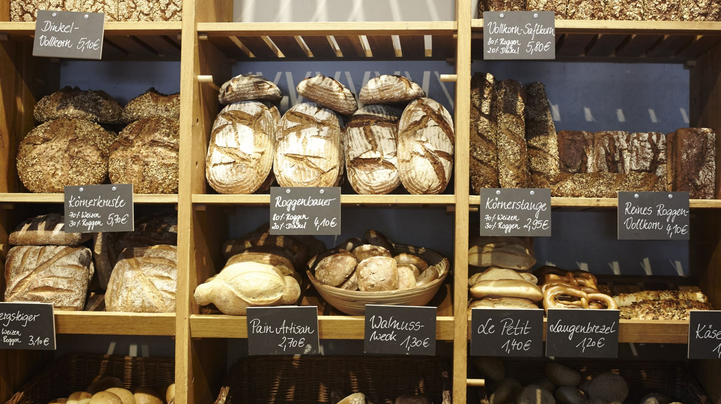
Basils Bakery: Problem Solving & Decision Making
Student Name: Abdul Rasool
Student Number:2238467
Module: LCLM4004
Lecturer: Bodhan Kovalov
Date: 7^{Th October}

Slide 2
Task 1: Introduction
Small independent bakery in Coventry retail park opened 2015
Sell cakes, pastries, bread organic high quality ingredients
Pre 2020 steady growth core customers local shoppers, retail parks& warehouse staff
Problem is sales down -25% since 2019 not recovered post Covid
Retail parker quieter, shops closing, jobs lost, fewer daily visitors
Hybrid working makes the office staff no longer on site daily
Rising costs and unmet customers demands make business at risk
Speakers Notes:
Basils bakery is a valued independent business in Coventry. After years of growth sales fell sharply in 2020 and remain 25% below pre pandemic levels. The retail park is declining, customers have changed how the work and shops, costs are rising, and new service request cant be met. I will analyse the root causes and external factors to recommend a way foward

Slide 3

Task 2 Issues Identified
Nature & Scope Lack Of Sales Growth
Falling footfall: Retail park decline, shop closure, job losses
Changed work patterns Hybrid/Remote working fewer daily lunchtimes visit
Pre Order failures: Cant always answer phone, lost sales and long wait times
Rising Costs: Rent, energy, insurance, rates all up organic supplies = unpredictable pricing
Internal limitations: Sole reliance on basil on site, no digital systems no staff capacity
SPEAKERS NOTES
These Issues are both external like hybrid working and inflation and internal such as no delivery or phone coverage. Together they shrink revenue and raise costs squeezing survival margins

Slide 4
Slide 4 Task 3 – PESTEL Analysis
PILLAR | FACTORS IMPACTING BASILS BAKERY
POLITICAL | Limited government small business support no local council retail revival schemers (Brooks, 2011)
Economic | Cost of living crisis reduced disposable income higher energy/food/rent/costs sales down by 25% down since 2019 (Kotler, 2023)
Social | Hybrid/Remote working fewer daily customers: shift toward delivery and online ordering demand for ethical, organic options (CIDD, 2024)
Technological | No delivery platform, no online pre ordering, phone accessibility issues weak digital preference (Chaffey, 2023)
Environmental | Organic supply vulnerability – crop failures = price swings, energy inefficient premises, sustainability marketing options (Brooks, 2011)
Legal | Minimum wage rises, food safety organic certifications costs, commercial rent reviews business rate changes
Critiques of PESTEL
Pros: Simpler framework, Spots threats, opportunities, highlights factors outside control (CIPD, 2024)
Cons: Overlap Energy = Economic + Environmental) no priority weighting, static snapshot (Brooks,2011)
Key Takeaway: Tech & Social shifts are most actionable, economic pressure most urgent
Economic factors hit hardest – sales down while costs rise. Social shifts mean fewer people visit daily. Technological gaps stop Basil offering delivery or pre orders customers want. Environmental sourcing adds cost volatile. Political and Legal pressures compound everything. PESTEL shows what's outside his control but technology and digital presence are areas he can fix

Slide 5
Task 4: Fishbone/Cause & Effect Diagram
Problem: Declining Sales & Threatened Survival
People: Remote work local job losses, reduced daily footfall, changing customer habits
Process: No delivery, unreliable phone no pre order platform basil on site only
Place Retail park decline, vacant units, failing visitors numbers and reduced convinence
Pricing Organic premium, rising rent, energy rates, unpredictable supply costs
Product: Organic only limits margins no new lines menu inflexibility
Critique Of fishbone:
Pros: Visual clarity, organises brainstorming, reveals roots vs surface causes (Sproull,2018)
Cons: No measurement of impact, can over simplify complex links, needs skilled facilitation
Top 3 Causes 1) Remote Working 2) No delivery/pre order system 3)Rising Cotst
Speakers Notes: The Fishbone Organises everything driving this decline. Place the retail park is dying People customers don’t come everyday. Process No delivery Or easy ordering. Pricing Cost outplace revenue. Product Organic quality costs more. The biggest Levers to pull are digital ordering – those directly address what customers are asking for.

Slide 6
Task 5: Key Findings
Summary
Sales remain 25% below pre 2020 levels not recovering naturally
Hybrid Working + Retail park decline = permanent loss of daily trade
Delivery & Pre orders = customers asking to spend – Basil cant serve them
Organic Commitment – Higher quality but higher cost + risks
Top priority: Introduce low costs digital ordering + patterned delivery to retain loyal customers
Without charge – continued decline without change – loyal base can grow via channels
In short the customers haven’t vanished their habits have. They want to buy from Basil, just differently. Digital and delivery fixes are within reach. Acting now can turn loyal support into sustainable revenue

Slide 7
References
Brooks, I. (2011) Business Environment. Pearson
CIPD (2024) PESTLE Analysis Factsheet
Chaffey, D. (2023) Digital Business. Routledge
Kotler, P. (2023) Principles of marketing. Pearson
Sproull, R. (2018) Problem solving tools. Kogan Page

