Slide 1
Exchange: A Study of the Kula Ring and the Iroquois Culture
By Thomas Clarke
(1900472)

Slide 2
Introduction
In response to the chosen theme of exchange I will assess trade across the Trobriand islands in and within the Iroquois culture
I think that one of the most interesting factors will be the level of which both are based (localized trade), and from that I hope to draw as to whether it, despite being on a smaller scale, the level of significance for the peoples concerned
Since it is a localised trade I will try and highlight their place in an everchanging world

Slide 3
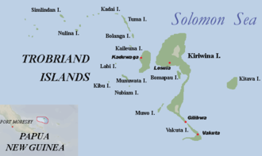
Kula Ring 1
Exchange was critical, it created a close cross-island network. Circuitous nature of the ring lent itself well to islanders. Gifts would be ranked both in terms of materials used and success in cross-island expeditions.
The exchanges affected social status, with the gifts not being kept but passed on, social norms therefore clearly played a part, showing the complexity to this ritual. Certainly a level of exclusivity that operated within this framework.
It is ironic that it was inclusive in inviting whole tribal communities to participate, but it also (exclusively) consequently sub-divided people further.

Slide 4
Kula Ring 2
The idea of locality does play part in its function, arguably the system could not function without the work of these groups. Personally, the Kula Ring is clear visual political/social ambition and was a political spotlight within their island communities.
The Kula exchange systems could be seen to reinforce status/authority distinctions since the hereditary chiefs own the most important shell valuables and are responsible for the ocean voyages.
Key to this assessment is the study of individual anthropological scenarios that could be applied to this. One such is the idea of gift giving behavior. Both Neisser (1973) and Shurmer (1971) hinted that trade, could lead to an extension of the individual
John F.Sherry links gift-giving to identity. This is a key point but does neglect the intrinsic idea of the ‘ring’, a unification of many through a few objects. I think it is a more generalised outlook on the concept of gift-giving/reciprocity.

Slide 5
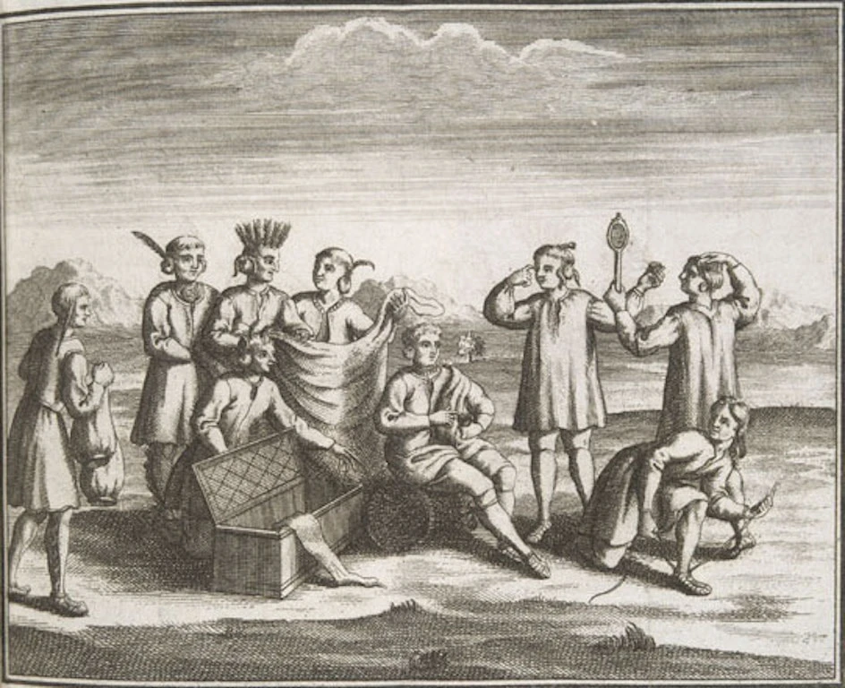
Iroquois
Iroquois used to gift-give more often than any other exchange, reciprocity is a central component that appears in the Kula (there is no real ‘trade’, more a series of transactions), hence the name ‘ring’
With the Iroquois there was expected reciprocation, this is not so much with the Kula, as they operate through an already ‘certain’ ring of trade. Close quarters living surely must have accentuated the ‘relatedness’ that members of the Iroquois felt, and lent itself well to the style of trade adopted by them. The Kula presumably lived in communities in contrast to this yet acted as a collective group
The kind of exchange used by the Iroquois is completely polarised to the Kula ring, which was centred on bringing tribes/islands together. External trade offered one of the few opportunities for individual enterprise in Iroquois society. The Kula have adapted themselves to the prevalence of tourism.
Both cultures have adopted a monopoly in trade. For the Kula it was a means of establishing a ‘reputation’. With the Iroquois it was more a survival aspect, especially during European occupation. Also, it was a way of establishing themselves over other regional tribes, something the Kula never faced.

Slide 6
Conclusions
The ring is reflective of a system that operates around obligation to those in power and also an attempt to ‘leapfrog’ within the structure
The Iroquois system is a key example of a uterine society
Both have traded for survival, but the Iroquois was perhaps more advanced due to outside influence. Despite this, the Kula have had no real threat and ‘outsider’ activity has turned into investment opportunity. Iroquois always faced threat, so could we say that the Kula were too isolated?
Expectation vs. Certainty
For the Kula, they were a very isolated group, and there has been no real outsider contact with this group. The main observations from this culture stemmed from Malinowski’s work with Participant Observation. This appears unapparent in the Iroquois culture who faced a more ‘brutal’ way of contact.
The Kula Ring system is ultimately slanted if gifts are proffered along the lines of value and age, so not totally reciprocal

Slide 7
Bibliography
Image 1: https://en.wikipedia.org/wiki/Kula_ring
Image 2: https://theculturetrip.com/north-america/canada/quebec/articles/a-history-of-the-iroquois-in-montreal/
[1]. B. Malinowski, ‘Argonauts of the Western Pacific’ (1922) pg. 2- Routledge Press
This is a very useful first-hand account of a part of the world rarely explored. Malinowski brought Paarticipant Observation to the Triobriands and shifterd perspectives on the daily lives of tribal communities. I feel that this is an important source as it heralds the start of a new line of thinking and prepares us for closer look at the roles of exchange. His lengthy involvement (2 years) with this community seeks to serve the validity of this book, however we do know that he privately held different views on the Kula, so this does cast doubts on his observations. Additionally as he inaugurated this theory, he may not have known speicifically what he was looking for, so primarily gave a recorded account. I feel that this is a wide step from the previous Armchair Anthropologists which removes from an initial narrow perspective and starts to shed lights on ordinary lives from a more personal perspective. This is a widely renowned book also.
[2]. F.H. Damon,"The Kula and Generalised Exchange: Considering some Unconsidered Aspects of the Elementary Structures of Kinship"(1980), pg. 278 - Royal Anthropological Institute of Great Britain and Northern Ireland This aource was especially of use to me as it distanced me from preconceived ideas of trade, and the relevance of external factors to its operation, it moves us away from the notoons of life as propounded by Malinowksi and instead focuses on an internal perspective as not seen priorto this. The internal machinations I feel had not been exlplored that much beforehand, and is perhaps more reflective of this system operating at this time.
[3]. John F. Sherry “Gift Giving in Anthropological Perspective” (1983), pg. 159 - Journal of American Research, Oxford University Press The anthology in which this article fits is defined as: “The Journal of Consumer Research is a bimonthly peer-reviewed academic journal covering research on all aspects of consumer behavior, including psychology, marketing, sociology, economics, anthropology, and communications.” They have spread a wide variety of topics across this publication which I feel ultimately affects the validity of this source. In order to fit in the journal there is inevitably a word limit placed upon so it is constrained by the journal itself. Thie idea of gift-giving is a general theme that finds itself globally. Gift –giving naturally presents itself with variations in different places so any analysis of the term can only be done in a generalised theme so it is conducive to an comparative approach.
[4]. John F. Sherry “Gift Giving in Anthropological Perspective” (1983), pg. 159 - Journal of American Research, Oxford University Press
[5]. https://www.merriam-webster.com/dictionary/wampum This is a word definition from what I believe to be a reputable source. It is frequently referenced
[6]. Stites, Sara Henry (1905). ‘Economics of the Iroquois.’(1905) pg. 79-80 The New Era Printing Company.
The only reason I chsose this book, is its relevance within the title itself. I had no knowledge of the topic itself and wanted to read around the subject. This book is a really helpful insight into a topic I was unaware of and proved to be a really good introduction to a new topic for me. My only regret with this book is not spending enough tine looking at it. The greatest factor to me is that the author was female and therefore perhaps had a greater insight and place within a uterine society itself. This may have improved the availability of evidence immensely.
[7]. R. Morrison and C. Wilson Native Peoples:The Canadian Experience (2004) pg.231- Oxford University Press This book is valuable to a person specifically assessing Canadian tribal experiences, but I had assumed the Iroquois to be American so I feel that I could have neglected further analysis simply through reading the wrong book. I especially liked how this book brought together several experts on each individual tribe as it became apparent that they did not all share the same customs. I liked the analysis of the Iroquois which I thought was varied, but conversely was its downfall. I feel that that it was too broad in its scope and had no one real focal point as such. I looked at trade and although it mentioned trade in aspects of the book, I felt that it more revolved around me attempting to fit in quotes that perhaps were not directly relevant (i.e on dietary habits and living arrangements ). Despite this, I did feel that as it went along the lines of experiences (plural) it did give me a look on antirationality amongst tribes in this area, which was the whole focus of my assessment.
[8].B. Malinowksi “Coral Gardens and Their Magic: A Study of the Methods of Tilling the Soil and of Agricultural Rites in the Trobriand Islands” (1935) pg. 205 -Routledge Press Tis is a very useful first-hand account of a part of the world rarely explored. Malinowski brought Participant Observation to the Trobriands and shifted perspectives on the daily lives of tribal communities. I feel that this is an important source as it heralds the start of a new line of thinking and prepares us for closer look at the roles of exchange. His lengthy involvement (2 years) with this community seeks to serve the validity of this book, however we do know tbat he privately held different views on the Kula, so we can never really know his tr ue thoughts. Additionally as he inaugurated this theory, he may not have known specifically what he was looking for, so primarily gave a recorded account. I feel that this is a wide step from the previous Armchair Anthropologists which removes from an initial narrow perspective and starts to shed lights on ordinary lives from a more personal perspective. This is a widely renowned book also. This is a further insight into the Kula lifestyle, albeit on a slightly smaller scale. Nevertheless it is still an informative account of not just the agricultural methods of the Kula, but also the social and familial structure of the Kula, which is think is a topic that he was able to unpick more the more he spent time there. Consequently this set me up perfectly for comparison with the structure of the Iroquois. I feel that this books’ strength is in the analysis of social formation, which is potentially much nehlected topic about the Kula, as we tend to associate it with a collective community.
[9]. . Morriosn and C. Wilson Native Peoples:The Canadian Experience (2004) pg.231- Oxford University Press
[10]. Stites, Sara ‘Economics of the Iroquois.’ (1905) pg.81- The New Era Printing Company.
[11]. https://www.bbc.co.uk/programmes/articles/3Q4RS42nDKWr8Wkz5VYBlSf/kula-ring-blog Although this is an article from the BBC, it may present itself to be relatively niche in its value. This is due to the fact that it was to accompany a television programme, so may neglect certain factors to keep with the continiuity of the show. Therefore I felt I could not rely on it wholy, but I instead used to it to look at this ring in a modern context. This is almost a successor to Malinowski which I found amusing, and showed to me a comparative insight to this operation . Obviously it sets itself at the present, so this is where its key strengths lie, in my opinion.The BBC is perhaps one of the most referenced sources on a global scale so clearly it has some standing within the wider community. Some may say that its unbias leads to a linear perspective, but I feel that it is a useful tool in ‘planting the seed’ upon which I can read around the subject and build.
[12]. Stites, Sara ‘Economics of the Iroquois.’ (1905) pg.80- The New Era Printing Company

