Slide 1


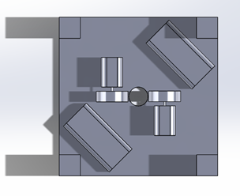
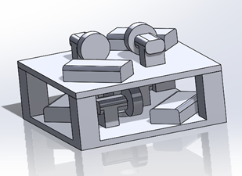
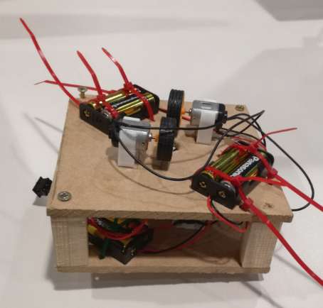
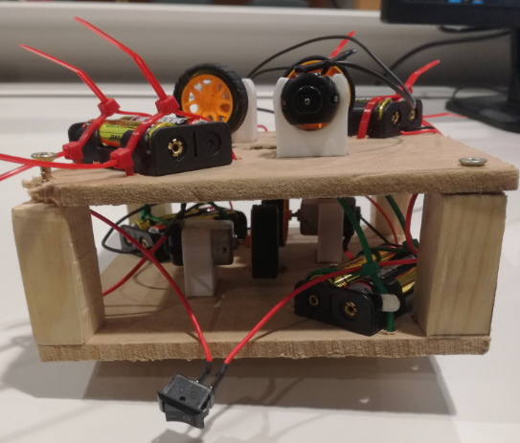

External Pipe Crawler – Group Project
Michael Heys, Callum Evans, George Dalton – Brown, Alexander Spurgin
Richard Morgan
School of Engineering
BEng (Hons) Automotive/Motorsport Engineering
Solidworks Drawing – top view of 3D final model
Introduction
For this task we were split up into groups and told to design and build a pipe crawler in accordance within the IMechE pipe crawler challenge specifications. The pipe crawler had to be self-contained, fit within a certain size, and go up and down the pipe with the only interference from team members being turning it on. The pipe crawler had to lift a steel chain over a height of 2m. We were also told that we had to work to a minimalistic, budget of £25 that was fully reimbursable by the university.
Features
There are still three features that we need to include on this design:The on/off switch needs to be relocated so that it is mounted on the very top of the design and so will turn off the motors when the pipe crawler reaches the top, at which point the pipe crawler will begin to fall back down the pipe.The pipe crawler still needs some form of impact resistance on the bottom of the base to protect it when it falls back down the pipe.The pipe electronic circuit needs to be altered in such a way that it produces more torque by configuring the battery/motor combination.
How and Why
Our design utilises four electric motors to propel the pipe crawler up the pipe whilst lifting a chain that is getting heavier the higher it gets. We made our pipe crawler out of MDF over two layers. On the first layer, there are two motors with wheels that make contact with the pipe (on opposite sides), and on the second layer the motors were arranged in the same fashion, however they are offset by 90 degrees. This means that there are four driving points of contact on the pipe. The battery packs used 2 AA batteries each and were connected in a parallel circuit. These were mounted in a cross pattern, on the first layer there are two battery packs, in opposite corners; and the second layer there are two battery packs in opposite corners but offset by 90 degrees.
Team Information
Michael Heys – Mechanical Drive and Propulsion – BEng Motorsport Engineering - For this project I came up with the original idea for the orientation of the motors.
Callum Evans – Power Generation and Storage – BEng Motorcycle Engineering - For this project I assisted in building the pipe crawler and ordered most of the motors.
George Dalton – Brown – Team Leadership and Systems Integration – BEng Motorsport Engineering -For this project I compiled the reports and organised meetings.
Alexander Spurgin – Control, Robustness and Reliability and Payload BEng Automotive Engineering -For this project I integrated the wiring into the design and came up with the concept of using two layers.
School of Engineering

