Slide 1
Care Documentation
at Riverdale Nursing Home
How Microsoft Word helps staff write better, safer care records
Module name: Digital Skills and Research Methods
Student name: Patricia Tandazo
Student ID: 2545058
Lecturer’s Name: Kwame Assa-Agyei

Slide 2

Introduction
CARE RECORD
What is Care Documentation?
Care documentation is recording everything that happens to a resident, such as what medication they take, how they are feeling, and whether there have been any changes in their condition.
If these records are unclear, incomplete or stored in different places, staff on the next shift may not have the information they need — and that puts residents at risk.
This presentation recommends Microsoft Word as the best tool for care documentation at Riverdale.
The problem
Why Word?
How it helps
Pros & Cons

Slide 3




The Problem: How Riverdale Records Care Today
What staff have to document
1-Medication given — what, when and by whom
2-Daily care — washing, meals, mobility
3-Changes in a resident's health or behaviour
4-Any accidents or incidents on shift
5-Each resident's individual care plan
Handwritten note
(lost in drawer)
✖
Paper form
Different paper formats make information confusing and waste staff time.
The problem today:
Records are written by hand and kept in different places, making them hard to find when needed
Printed sheet
(not updated)
If information is not updated, staff may make serious mistakes.
Notebook
(missing pages)
Missing pages mean missing information—staff may not know what health problem the resident has or had.

Slide 4
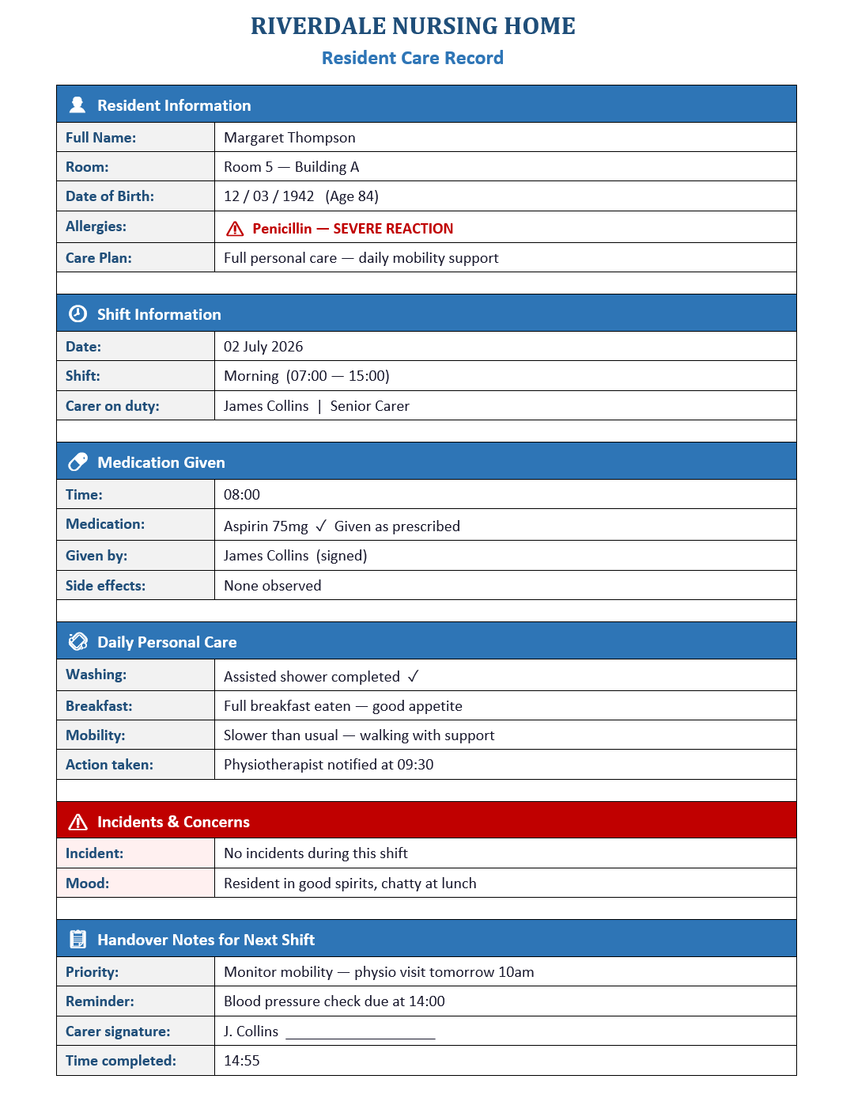
The Solution: Microsoft Word
Riverdale Care Record — Room 5
Why Microsoft Word?
Word lets staff write structured, professional documents that are easy to read, update and share. Everyone knows how to use it — and it is already part of Microsoft 365.
Professional Templates
Easy to Edit
Use the same format every time — no confusion.
Update a record quickly without rewriting everything.
Searchable
Saved to OneDrive
Find a resident's record in seconds.
Accessible from any computer in the building.

Slide 5
How Word Improves Efficiency at Riverdale
BEFORE Word
AFTER Word
1-Handwritten notes — hard to read
2-Records kept in different folders
3-Time wasted searching for information
4-Inconsistent formats across staff
5-Risk of errors due to missing details
6-Night shift doesn't know what happened
1-Clear, typed records everyone can read
2-All documents in one shared folder
3-Find any record instantly
4-Same template used by all staff
5-Accurate records protect residents & staff
6-Night shift is fully up to date
→
(NMC, 2018; Microsoft, 2023; CQC, 2023)

Slide 6
Advantages & Limitations of Microsoft Word
Word is a strong choice for care documentation — but it is important to be honest about its limits too.
✓
Advantages
!
Limitations
1-Easy to use — most staff already know Word
2-Templates keep all records consistent
3-Documents can be shared across both buildings
4-Records are clear, typed and easy to read
5-Already included in Microsoft 365 — no extra cost
1-Not designed for real-time updates — one person edits at a time
2-Staff need to remember to save and store files correctly
3-Without OneDrive, documents can still get lost on local computers
4-Not purpose-built for healthcare — a specialist system would do more
(Al-Fraihat et al., 2020; CQC, 2023)

Slide 7
References
Harvard Referencing
Care Quality Commission (CQC) (2023) How CQC regulates: documentation and record keeping in care homes. Available at: https://www.cqc.org.uk [Accessed: 25 June 2026].
Microsoft (2023) Microsoft Word features and accessibility. Available at: https://www.microsoft.com/en-gb/microsoft-365/word [Accessed: 25 June 2026].
NHS England (2022) Good record keeping: a guide for health and social care staff. Available at: https://www.england.nhs.uk [Accessed: 25 June 2026].
Nursing and Midwifery Council (NMC) (2018) The Code: Professional standards of practice and behaviour for nurses and midwives. London: NMC.

