Slide 1

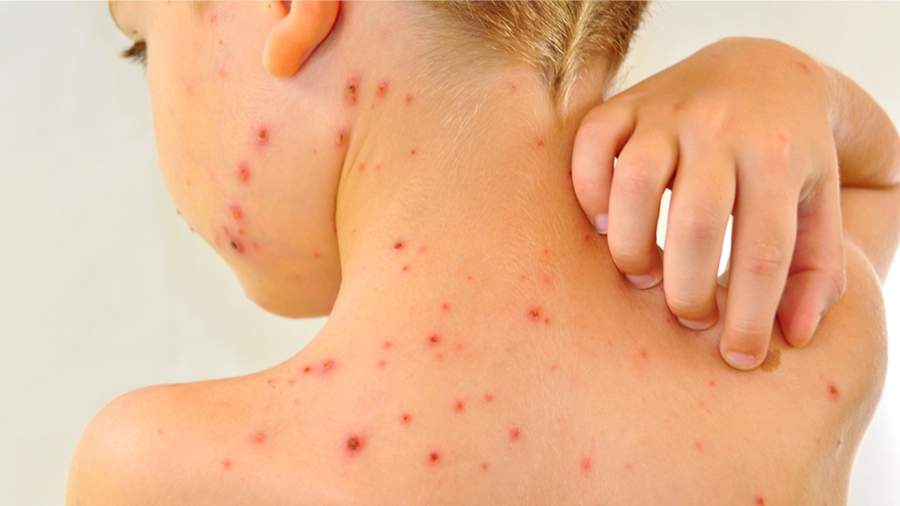
Group 5
Module Code: LCHS4001
Module: Public Health
Lecturer: Arif Ahmed
Chicken pox

Slide 2
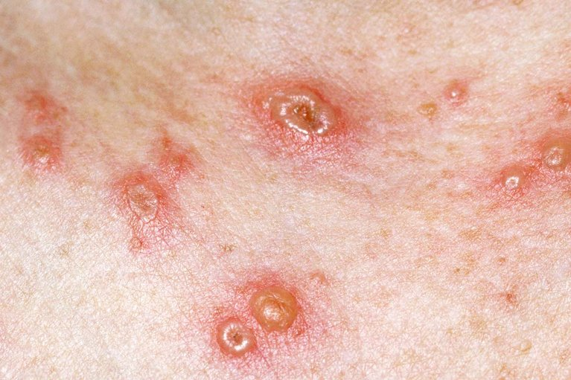
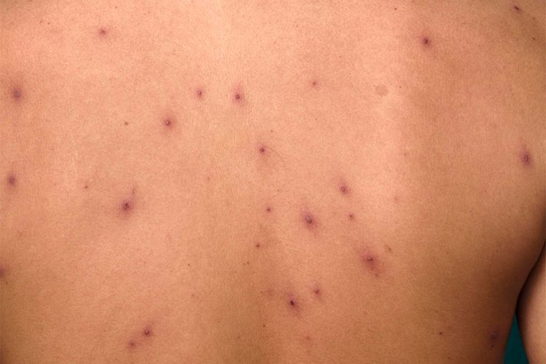
The introduction of the case that is related to chicken pox
Before we start, I would like to explain the meaning of chicken pox.
Chickenpox is a highly contagious and viral infection, which is caused by the varicella-zoster virus. It mainly affects children but can also affect any age group.
The disease is characterised by an itchy, red rash that develops into fluid-filled blisters, along with symptoms such as fever, tiredness, headache, and loss of appetite. Chickenpox spreads easily through coughing, sneezing, or direct contact with the blisters of an infected person.
Exact national totals for Chickenpox between 2023 and 2026 in the United Kingdom are difficult to calculate precisely because chickenpox is not always a notifiable disease, so many mild cases are not formally reported. However, health data and estimates give a good picture of how many people are affected each year.
During this investigation, we found out that around 600,000 cases of chickenpox occur each year in the UK, mostly in children. (NHS England)
Gila - 2510697

Slide 3
What are the main approaches and strategies that could be used to measure an infectious disease outbreak?
That can include surveillance, data analysis, and epidemiological investigation. Public health authorities collect information about reported cases through hospitals, laboratories, and clinics to monitor how the disease spreads within a population.
The chickenpox outbreak in Roma’s school demonstrates how infectious diseases can be monitored and measured using several epidemiological strategies.
Epidemiological surveillance and case detection are used to identify infected individuals. This involves recognising symptoms such as fever and itchy spots, counting confirmed and suspected cases, and conducting contact tracing to identify people who may have been exposed.
Another key strategy is the use of surveillance systems. These systems monitor outbreaks through data such as school absence records, GP consultations, and public health reporting systems. Surveillance helps authorities track trends and respond quickly to outbreaks.
Overall, these strategies help public health authorities measure the size and spread of an outbreak, identify transmission patterns, and implement control measures such as vaccination programmes and health education.
Gila - 2510697
Gila-2510697

Slide 4
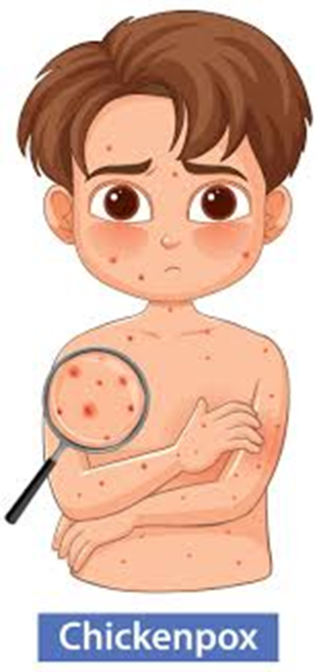
What are the many approaches and strategies that could be used to monitor an infectious disease outbreak?
Monitoring is an continuous examination of gathered surveillance information in an attempt to identify abnormal increases (Bardsley et al., 2023). The unusual spikes can be identified based on the patterns of baseline incidence. Weeks 13-15 seasonal highs are anticipated an unique can be a sign of outbursts (Bardsley et al., 2023). Quick diagnosis in schools eliminates the spread (Duncan, 2019). Surveillance allows timely health intervention to the population (UK Government, 2024).
Types of Surveillance is based on passive GP reporting systems where regular consultation data are gathered (Bardsley et al., 2023). In the event of an outbreak, active surveillance is intensified by finding the cases and contact tracing. The guard GP networks offer representative epidemiological samples by regions (Bardsley et al., 2023). Syndromic surveillance monitors trends in symptoms, e.g. presentations of rash and fever. Schools also report any suspected clusters to local health protection teams (UK Government, 2024). The integration of the types of surveillance enhances the sensitivity of detection of the outbreak.
Esther - 2510499

Slide 5
The monitoring role of schools at the first line is related to monitoring absences connected with the rash (Duncan, 2019). Timely interaction with health protection teams guarantee a quick response. Until wounds crust, parents need to be given exclusion guidance (NHS, 2025). Pregnant employees or weak immune system students need specific attention because they are at risk of complications (RCOG, 2023). Accountability and evaluation are done through maintaining systematic outbreak records (UK Government, 2024).
The initial step in outbreak investigation is clinically confirming the diagnosis (NHS, 2025). Epidemiologists confirm that the cases are higher than the baseline seasonal levels (Bardsley et al., 2023). The detection of the index case makes it clear how transmission functions. Close classroom contacts are followed up and traced with the development of symptoms (UK Government, 2024). The process of surveillance is followed until no new cases are detected, which implies containment.
Esther - 2510499

Slide 6
Continue…
Data Analysis & Evaluation: Epidemic curves visualise the progress of the outbreak (Bardsley et al., 2023). Attack rates are measures of the proportion infected in a specified group. Transmission intensity is evaluated when reproduction potential is evaluated. The vulnerable groups are identified through demographic analysis (NICE, 2025). Lastly, the outcomes of the intervention are assessed to make further policy (UK Government, 2024).
Strengths & Limitations: The UK has well-developed surveillance systems (Bardsley et al., 2023). Guidance on exclusion is consistent and comprehensive (NHS, 2025). Nevertheless, mild severity might not manifest to GPs, who underreport (Bardsley et al.,2023). The attitude of parents towards vaccines affects the vaccine uptake (Jordan and Rowland, 2024). Responsive policy is maintained through continual review.
Esther - 2510499

Slide 7
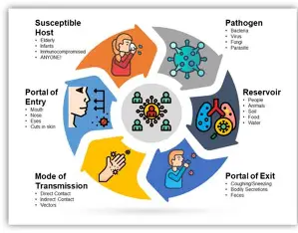
What are the main approaches and strategies that could be used to control an infectious disease outbreak?
Controlling an outbreak involves a combination of medical, administrative, and environmental strategies designed to prevent the spread of infectious diseases.
Firstly, case identification and isolation Roma. The most immediate step is to identify the person with the symptoms and isolate the person from the population.
Infected individuals like Roma must stay home until they are no longer contagious, (Isolation).
Identifying who was in close contact with the infected student, Roma to monitor them for early symptoms.
Akua-2509126

Slide 8
Secondly, vaccination and immunisation are the primary long term strategy for controlling outbreaks. We have the pre-exposure to take the vaccine to prevent infectious diseases and the post exposure is to take the vaccine as an emergency when u have the infection.
Thirdly, environmental and hygiene measures
Enforcing strict hand washing protocols for students and staff.
Deep cleaning high touches surfacesing the school, (door, dests, handles, toys etc.)
Improving airflow in classrooms to dilute airborne particles.
Lastly, administrative control and policy. Schools must have clear protocols to manage health crises effectively.
Setting firm rules on when a child can return to school.
Providing clear guidelines letters to parents explaining the symptoms to be aware of and the actions being taken by the school.
Tracking absences to identify if the outbreak is spreading to other year groups or staff members in the school.
Akua-2509126

Slide 9
What policies and strategies are available to the UK government to maintain public health?
UK Health Security Agency (UKHSA) during chickenpox outbreak provides school and healthcare providers with health control guidance monitor, and advice on managing vulnerable contact.
Department of Health and Social Care(DHSC), ensures systems are in place to respond to infectious disease outbreak.
NHS diagnose , treat, and deliver MMRV vaccine chicken pox (varicella) most effective to reduce infection rate.
Local councils work with schools and nurseries, provide public health education, lead to control outbreaks in communities.
Health and promotion strategies such as government public health campaigns which raise awareness of symptoms, promote hygiene practices, advise to stay at home, and give clear guidance via NHS websites and school communications.
Tanya - 22508552

Slide 10
What health education will you give to the school to address the chicken pox outbreak?
Simple clear information must be provided to staff, parents and pupils
Explaining how highly contagious chickenpox is, how it is spread through respiratory droplets( cough, sneezing), or direct contact.
Staff and parents should be educated to look out for symptoms such as fever, tiredness, itchy red spots that turn into fluid- filled blisters.
Inform persons it can be contagious1-2 days before the rash appears
And that the incubation period is 10-21 days.
School hygiene and Infection controls measures must be daily reinforced regular hand washing, use of tissues for cough or sneeze, clean touched surfaces frequently.
Parents and staff should be informed that chickenpox can be serious if individual is pregnant, those with weaken immune systems or a newborn baby, so avoid contact with high risk groups.
Tanya -22508552

Slide 11
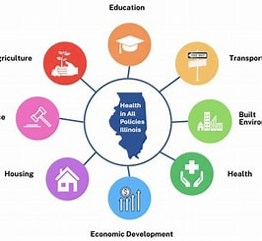
Attendance and exclusion guidance
School exclusion advice must be clearly given to reduce classroom transmission.
The school should be immediately informed if a child is diagnosed.
Monitor for any complications, seek medical help if needed.
Children should be kept out of school until all their spots have crusted over to prevent the spread. (at least 5 days after rash appears).
Staff with chickenpox should stay off work until non- infectious.
Tanya - 22508552

Slide 12
Common questions about chickenpox
What causes chickenpox?
Chickenpox is caused by the varicella-zoster virus, which spreads easily from person to person.
Who is most at risk of chickenpox?
Children under 10 years old are most commonly affected, but adults who have never had chickenpox can also get it.
How is chickenpox diagnosed?
Doctors usually diagnose it by examining the typical rash and symptoms. Laboratory tests may be used in some cases.
How can chickenpox be treated?
Treatment usually focuses on relieving symptoms, such as using paracetamol for fever, antihistamines for itching, and keeping the skin clean.
Can chickenpox be prevented?
Vaccination, avoiding close contact with infected individuals, and good hygiene can help prevent the spread.
When can a child return to school or nursery after chickenpox?
A child can usually return when all blisters have dried and crusted over.
Can you get chickenpox more than once?
Most people only get chickenpox once because the body develops immunity, although it is possible in rare cases.
Are there complications of chickenpox?
Complications can include skin infections, pneumonia, or brain inflammation, especially in adults or people with weakened immune systems.

Slide 13
References
Bardsley, M., Loveridge, P., Bednarska, N.G., Smith, S., Morbey, R.A., Amirthalingam, G., Elson, W.H., Bates, C., de Lusignan, S., Todkill, D. and Elliot, A.J. (2023). The Epidemiology of Chickenpox in England, 2016–2022: An Observational Study Using General Practitioner Consultations, Viruses, 15(11), 2163. Available at: https://researchportal.UKSHA.gov.uk/en/publications/the-epidemiology-of-chickenpox-in-england-20162022-an-observation/ (Accessed: 19 Feb. 26).
Chickenpox | Health topics A to Z | CKS | NICE
DHSC (2024). Department of Health and Social Care. [online] GOV.UK. Available at: https://www.gov.uk/government/organisations/department-of-health-and-social-care [Accessed 8 Mar. 2026].
Duncan, D.L. (2019) ‘Chickenpox: presentation, transmission, complications and prevention’, British Journal of School Nursing, 14(10), pp. 482–485.
Harford, J. (2025) ‘Chicken pox vaccination: implications for nursing practice and MMR uptake’, Journal of General Practice Nursing (GPN), 11(4).
Jordan, Z. and Rowland, E. (2024) ‘Parental perceptions of chickenpox and the varicella vaccine: a qualitative systematic review’, Vaccine, 42(2), pp. 75–83.
National Institute for Health and Care Excellence (NICE) (2025) Chickenpox: background information, prevalence. Available at: https://cks.nice.org.uk/topics/chickenpox/background-information/prevalence/ (Accessed: 19 Feb. 26).
NHS UK (2025) Chickenpox. Available at: https://www.nhs.uk/conditions/chickenpox/ (Accessed: 19 Feb. 26)
NHS (2025). Chickenpox. [online] NHS. Available at: https://www.nhs.uk/conditions/chickenpox/ [Accessed 8 Mar. 2026].
O’Mahony, E., Sherman, S.M., Marlow, R., Bedford, H. and Fitzgerald, F. (2024) ‘UK paediatricians’ attitudes towards the chicken pox vaccine: the SPOTTY study’, Vaccine, 42(22), p. 126199.
Royal College of Obstetricians and Gynaecologists (RCOG) (2023) Chickenpox and pregnancy. Available at: https://www.rcog.org.uk/for-the-public/browse-our-patient-information/chickenpox-and-pregnancy/ (Accessed: 19 Feb. 26).
UK Health Security Agency (2025) Chickenpox as a notifiable disease: information for health professionals. Available at: https://www.gov.uk/guidance/chickenpox-as-a-notifiable-disease-information-for-health-professionals (Accessed: 19 Feb. 26).
UK, G. (2024). Managing Outbreaks and Incidents. [online] GOV.UK. Available at: https://www.gov.uk/government/publications/health-protection-in-schools-and-other-childcare-facilities/managing-outbreaks-and-incidents [Accessed 8 Mar. 2026].

