Slide 1
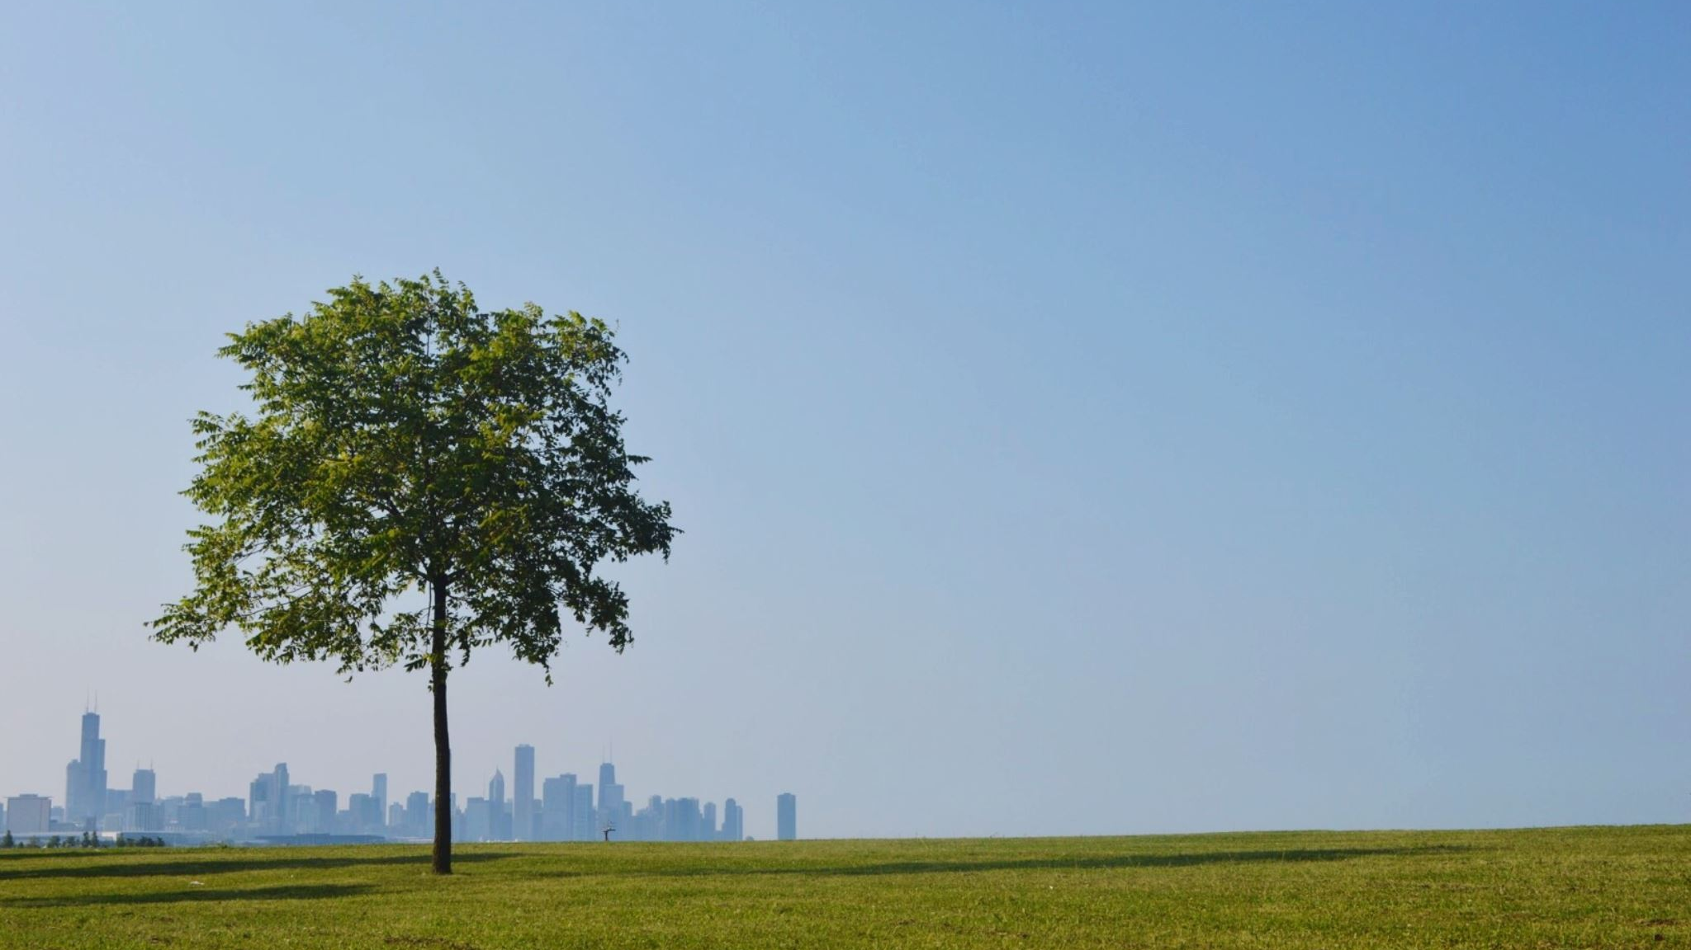
Natural Capital and Greenwashing
Laura James

Slide 2
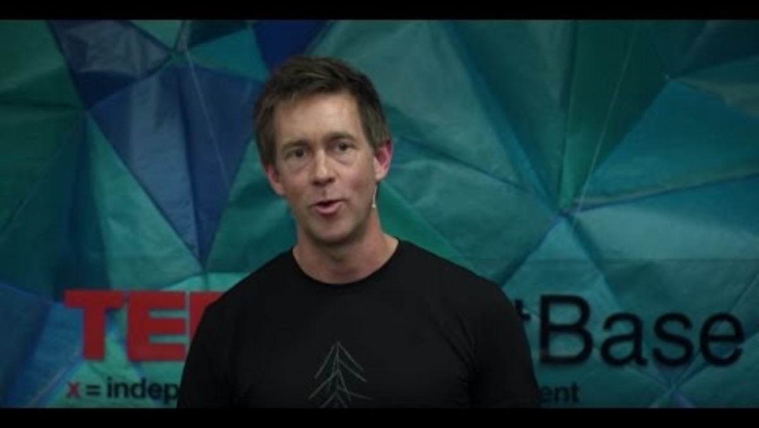
Coming to understand Natural Capital in your own organisation
In this video Jeremy Moon provides insight into how his Icebreaker company that supplies natural outdoor clothing started and the decisions he had to make about securing its Natural Capital (even though he doesn't mention the concept). He says that he took his inspiration from Simon Sinek's talk on how great leaders inspire action and his talk uses the same Why ... How ... What framework.

Slide 3
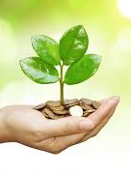
Once you have watched the video it may become clear that in order to make a business successful you have to answer two key questions.
The 'Why' question so that you know what is important for your business to succeed.
But also the 'How' to identify what is vital in your supply chain to make this happen.

Slide 4
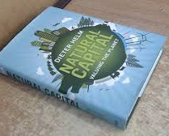
Your Pre-Lecture Activity
What strikes you as interesting and what sort of questioning and issues do you have with Professor Helm's compensation argument?
Do you see any flaws in his argument and/or do you feel that perhaps an economic perspective is only part of the picture.
Do you think that thinking about the Natural Capital of the world as assets to be managed is the way we should think about it?
What other considerations might you feel need to be taken into consideration in how we plan for the future.

Slide 5
Natural Capital Initiatives in your area
On a global level The World Bank works on Natural Capital initiatives across the world in its goal to reduce poverty. An example of this is in paying for ecosystem services in Mexico.
Other organisations such as the natural Capital Coalition have several projects operating internationally, and provide case studies of business approaches to natural Capitalism and How businesses evaluate natural capital.
On a National level governments such as the UK provide National data on their Natural capital and provide a How to do it: work-book to help businesses, organisations and communities assess their Natural Capital.
Examples of communities such as the County of Carmarthenshire (where you study) have produced Natural Capital audit reports.

Slide 6
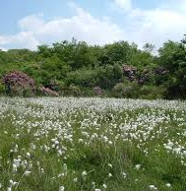
Activity
See if you can find out what is happening in your country or region in relation to Natural Capital. You might use the World Bank web site, and look at or search for your own national and local government attentions.
Are you surprised at what you have found or didn't find.
Is the information current?
Does it seem to provide any benefits to help business with assessing National Capital in your area.
What struck you as interesting

Slide 7
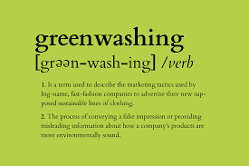
Greenwashing

Slide 8
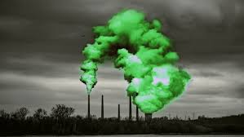
Getting Caught Greenwashing
Companies or organisations may have good initial intentions of showing that they are making efforts to 'Go Green', by identifying an aspect of their work that has at least the right intention. This selective 'Greening' often leads to problems of placing a spotlight on other less visible aspects of a company's operations that can wish an organisation had just stayed away from the idea of Greening in the first place. I am sure you have all have a case of this in your own head where this might be the case

Slide 9
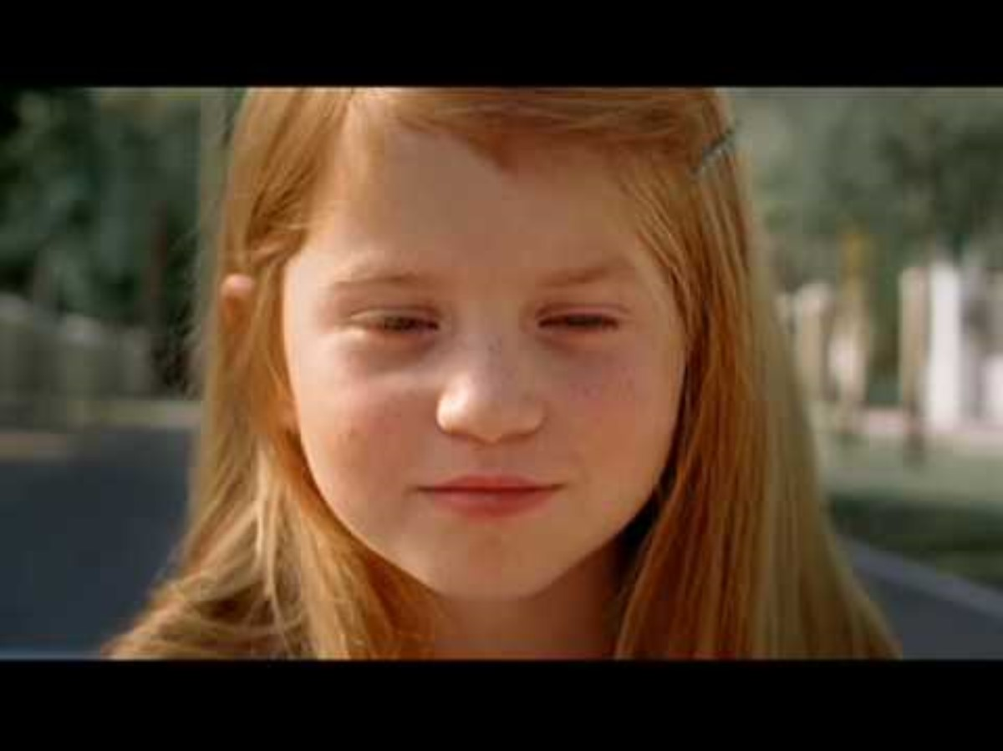
The Error

Slide 10
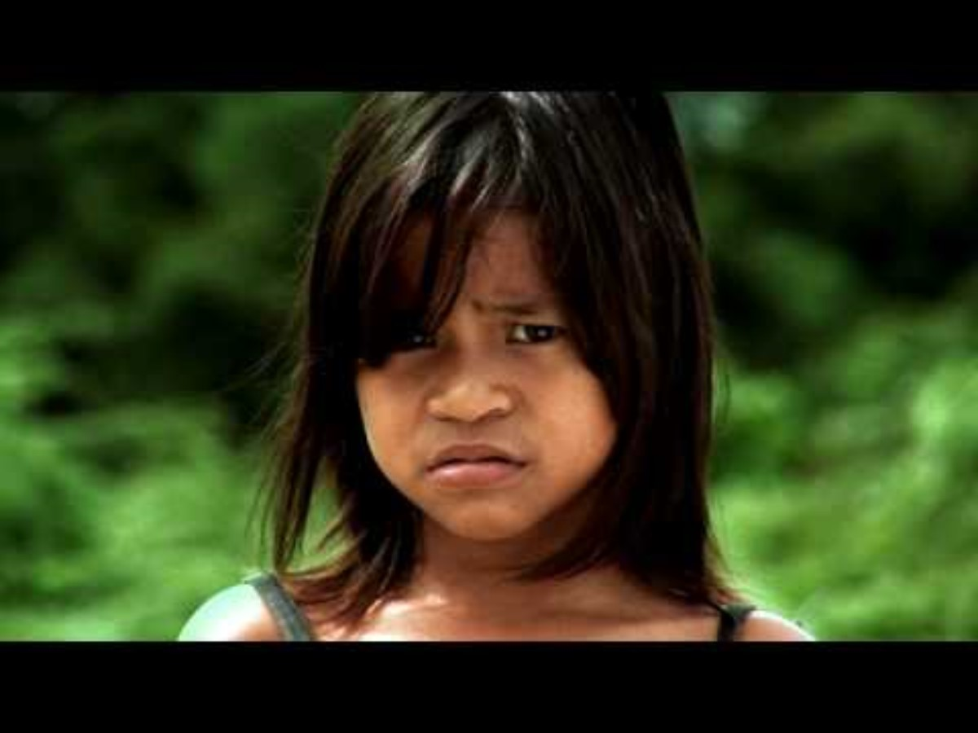
The Shaming

Slide 11
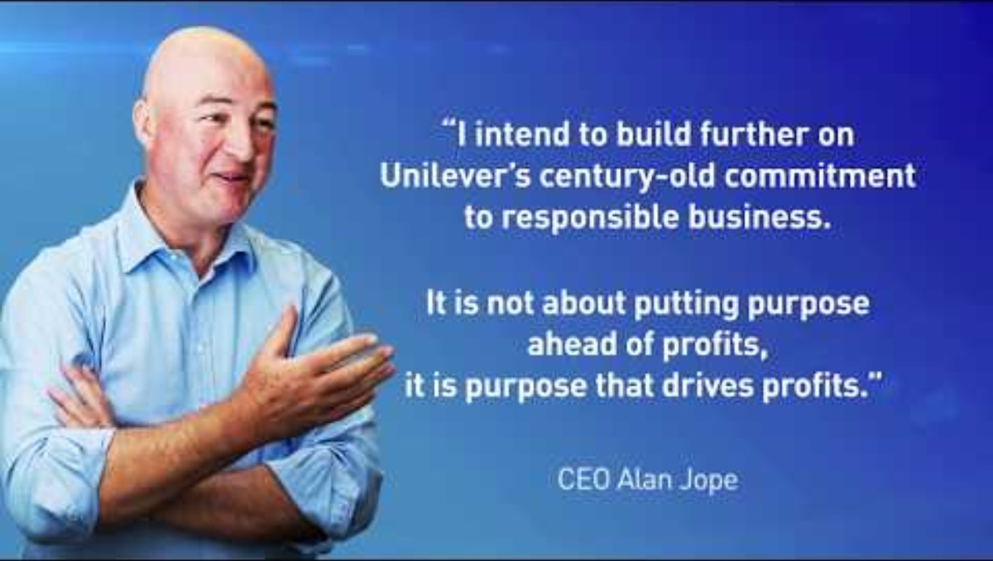
The Recovery

Slide 12

Activity
At the end of this 2018 video Unilever offer you the opportunity to visit their web-site www.unilever.com/sustainable-living/ to see if you're convinced.
Visit the website and examine what they are 'About', what their 'Sustainable Living Plan' is, and what they have to say to the world, their employees, stakeholders and investors.
Feedback:
What you find out about them and what you think that they now stand for now?
What key things can you find out about their promise or mission to everyone?
Have they become more modest or are they now signing about sustainability?
Also
Has this campaign had any impact on other products. See if you can find products that say 'No palm oil' or 'only uses sustainable palm oil'. Do some searching.

Slide 13
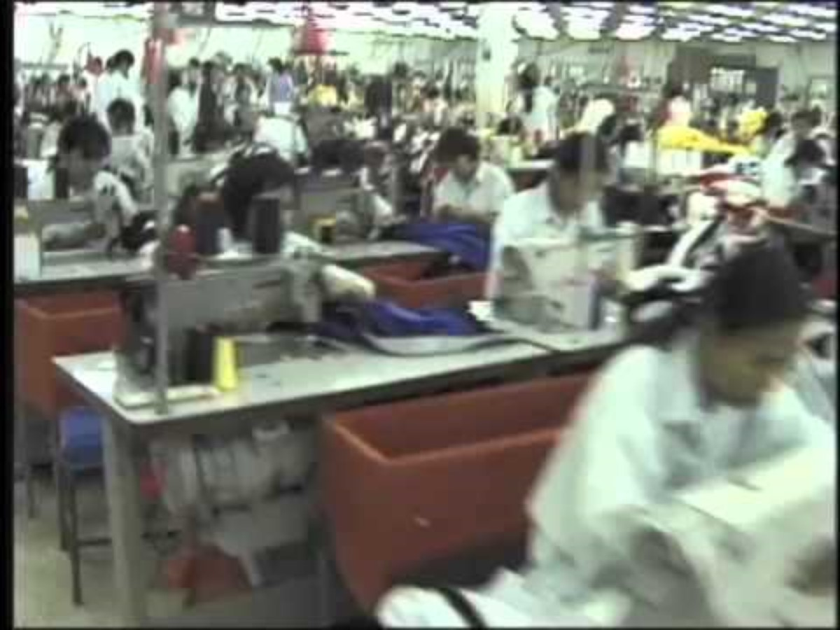
A personal journey - sustainability washing includes supply chain social issues
Here we have a more personal story about Greenwashing/Social-washing issues. We will watch only up to 4min and 30secs of the first video to get the roots of where it came from.

Slide 14
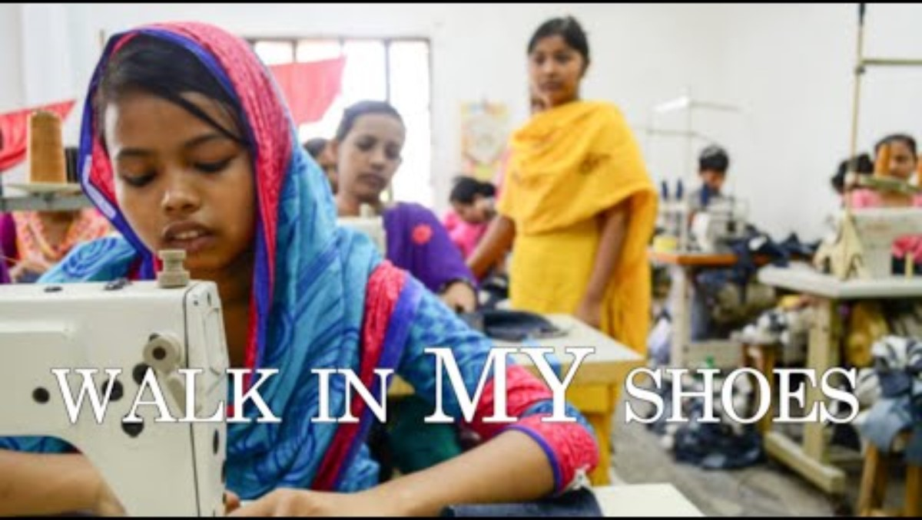
Here is what happened.

Slide 15
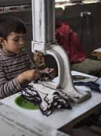
Is child labour acceptable and what is the impact on the company anyway?
What could Nike have done to make sure this didn't happen?
Is this the exception or do stories always get reported?

Slide 16

Getting on the side of right
Of course as organisations it isn't a sensible plan to get caught out 'sinning' in order to become 'religious' about greening or sustainability. Many organisations now offer companies a way of 'certifying' their products and services in managed steps and through a process of self-assessment and independent evaluation.
In this activity I want you to do some research on 'getting green accredited', either for your products or services for the organisation you have or currently work in.
How will you know where to go to to get your products or services certified?
Which is the right certification for your product or service in your sector or country?
What is the process and how rigorous do you feel it is?
Is there a particular 'mark' that is used on products or with services in your sector?
Is it reasonable or effective and will your stakeholders believe in it from your perspective?

