Slide 1

Reflective Practice
Geraint Forster

Slide 2
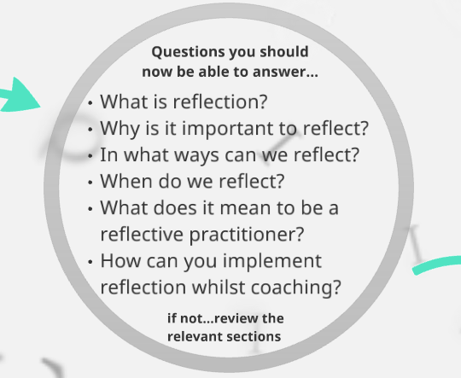

Slide 3
Outline
Recap - what is reflection (different fields)
Johns model of structured reflection
Reflection - case studies from research

Slide 4
What is Reflective Practice
A process of reviewing an experience of practice in order to describe, analyse and evaluate and so inform learning from practice
Reid, B (1993) ‘But we’re doing it already!’ Exploring a response to the concept of reflective practice in order to improve its facilitation. Nurse Education Today, 13 305-309
The process of internally examining and exploring an issue of concern, triggered by an experience, which creates and clarifies meaning in terms of self and results in a changed conceptual perspective
Boyd, E and Fales, A (1983) Reflective learning: Key to learning from experience. Journal of Humanistic Psychology, 23, 99-117

Slide 5
What is Reflective Practice?
It is about asking questions about one’s practice
What is my practice like?
Why is it like this?
How has it come to be this way?
What aspects of it would I like to improve?
Whose interests are being served (or denied) by my practice?
What nourishes or constrains what I do?
What pressures prevent/limit me from practicing in alternative ways?
What alternatives are available to me right now?
Well-established within the fields of education and nursing

Slide 6

What is Reflective Practice?
Reflecting on your values
Reflecting on your practice
Reflecting on your knowledge
Reflecting on your ability to learn
Learning through reflection
Reflecting on the impact of reflection on your practice!!

Slide 7
Introduction/Recap
Reflection in Coach Education
  Overused & lost meaning
  Taken for granted

Slide 8

Reflection
“the active, persistent and careful consideration of any belief or supposed form of knowledge in the light of the grounds that supports it, and further conclusions to which it tends” (Dewey, 1933).
The ability to look back on previous performance (Self-evaluation & causal attribution) (Zimmerman, 2000)
The ability to use new information in subsequent learning situations (Adaptive inference) (Zimmerman, 2000)

Slide 9
Reflection (cont)
Reflection as a driver of learning
Reflective practice – reflecting on everyday events that occur as part of coaching (noticing)
Critical reflection – very personal and driven by the need to understand why events occur as they do, our assumptions about why they occur this way, and how these influence our behaviours and attitudes towards others
                (Gilbert & Trudel, 2013)

Slide 10

Reflection as a driver to Deliberate Practice
Real learning requires “checking in” or “checks for understanding” (Gilbert & Trudel, 2013)
Noticing occurs through reflection (Rosenshine, 2012)

Slide 11
Disucssion Task
What are the barriers to critical reflection?
Self, colleague/peer, team/group
What would limit/hinder reflective practice?

Slide 12
Johns (1992) Model of Structured Reflection
Description of Experience
Reflection
Influencing Factors
Could I have dealt with the situation better
Learning

Slide 13
Model of Structured Reflection
(Johns 1992)
Core Question
What information do I need access to in order to learn through this experience?
Cue Questions
1 Description of Experience
Phenomenon - Describe the here and now experience
Causal - What essential factors contributed to the
experience?
Context - What are the significant background actors to
the experience
Clarifying - What are the key processes (for reflection) in
this experience?

Slide 14
Model of Structured Reflection
(Johns 1992)
2 Reflection
What was I trying to achieve?
Why did I intervene as I did?
What were the consequences of my actions for:
myself?
the participant?
Others I work with?
How did I feel about this experience when it was happening?
How did the participant feel about it?
How do I know how the participant felt about it?

Slide 15
Model of Structured Reflection
(Johns 1992)
3 Influencing Factors
What internal factors influenced my decision making?
What external factors influenced my decision making?
What sources of knowledge did / should have influenced my decision making
4 Could I have dealt better with the situation?
What other choices did I have?
What would be the consequences of these choices?
5 Learning
How do I NOW feel about this experience?
How have I made sense of this experience in light of past experiences and future practice?
How has this experience changed my ways of knowing:
Ethics? Personal?

Slide 16
Driscoll (2000)
What?
So What?
Now What?

Slide 17
Gibbs 1988
Description – What happened?
Action Plan – If it arose again what would you do?
Feelings – What were you thinking about?
The Reflective Cycle
Conclusion – What else could you have done?
Evaluation – What was good and bad about the experience?
Analysis – What sense can you make of the situation?

Slide 18
Reflective Practice with athletes (Neil et al., 2013)
Case Study 1:
Reflective practice intervention designed to improve the self-efficacy of an elite, male cricketer
Case Study 2:
Effect of individual and shared written reflection of international age grade rugby squad on team goals.

Slide 19
Reflective Practice with athletes (Neil et al., 2013)
Value of working on
Key skills:
Problem solving
Critical thinking
Attributes
Open-mindedness
Mindfulness
Merely asking someone to engage with reflective practice is not enough
Need to develop the ability to effectively reflect – Reflective Disposition

Slide 20
Learning to Coach Through Experience (Gilbert & Trudel, 2001)
Data collected over an entire sport season
  Semi-structured interviews, observations, and documents
Six components characterised reflections:
  Coaching issues
  Role frame
  Issue setting
  Strategy generation
  Experimentation
  Evaluation

Slide 21
Learning to Coach through experience (Gilbert & Trudel, 2001) (cont.)
Selection of options at each stage depended on in a reflective conversation depended on:
  Access to peers
  Coach stage of learning
  Issue characteristics
  environment
Types of reflection:
  Reflection - in – action
  Reflection – on – action
  Retrospective reflection – on – action

