Slide 1

Case Formulation
A Counsellors Approach to Case Work
Rachel Walters-Jones 1809488

Slide 2
Say Hello to Matt
Physical health is poor – Hep C and Diabetes
Risk of homlessness
Psychosis
Low mood and anxiety
Unstable upbringing
Poor life choices – attachment issues/schemata?
Substance misuse issue
Unable to budget

Slide 3
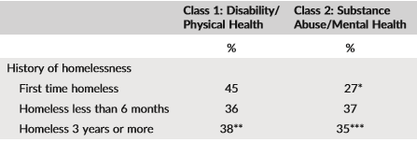
Homelessness
Macro-level are structural
Micro-level are individual
Physical and mental health conditions will deteriorate
Increase in risk behaviour
Physical 45% more likely
Substance Misuse 27% more likely
Referal to TSU
Supported living accomidation
(Barlie, 2018, p. 102)

Slide 4
Physical Health
Work collaberativley if possible
Contact and create referrals to the appropriate medical professionals
Support network
Diagnosis of HCV impacting mental health - (NHS, 2017)
Treatment sideaffects and non-adehrence - (Sublette, 2015, p. 987)
Resistance to insulin - (Kuwashiro, 2014, p. 317)
Drug use

Slide 5
Psychosis
Serious impairment of thought, emotions and behaviour
Clinical interview
Individual symptom maifistation
Antipsychotic medications efficacious treatments for psychosis
However – 50% aherence rate
93% relapse rate in year 1
(Pyne, 2014, p. 315)

Slide 6

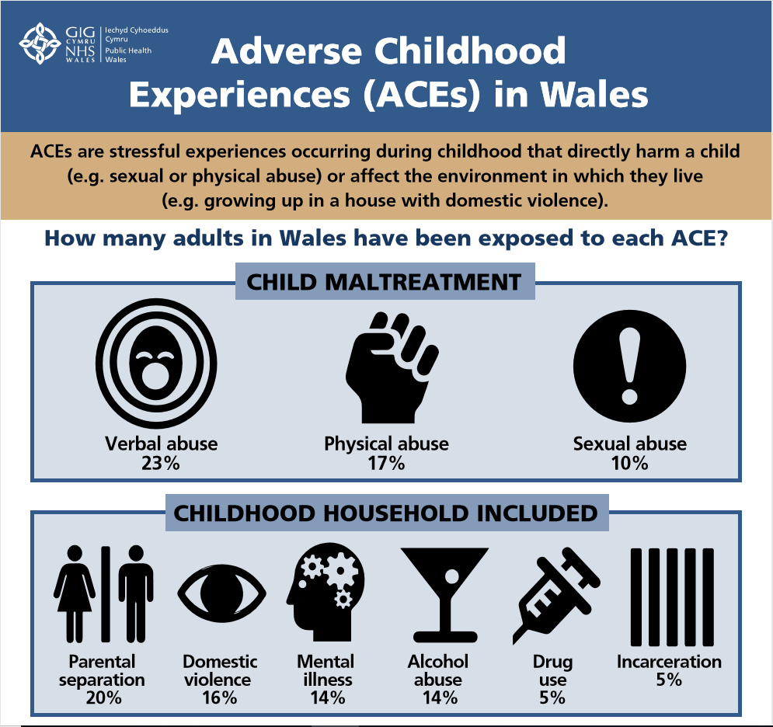
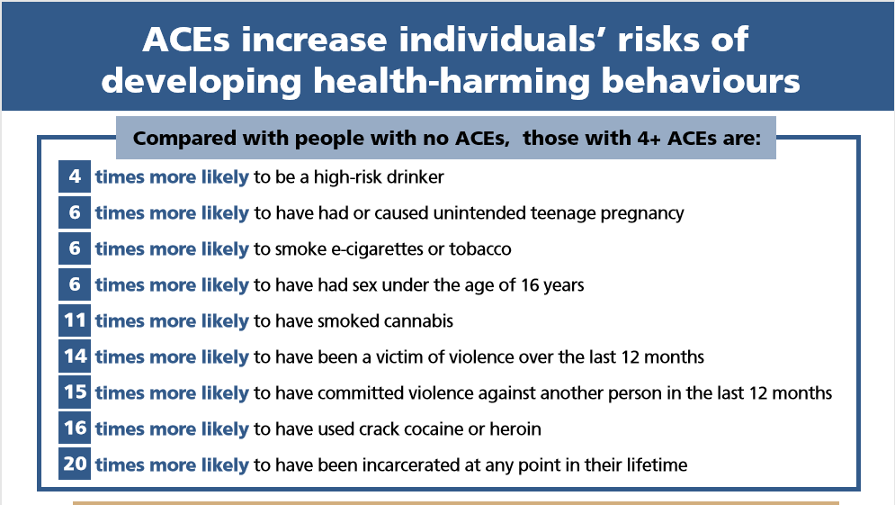
ACE – Adverse Chidhood Experience
(NHS, 2016)

Slide 7
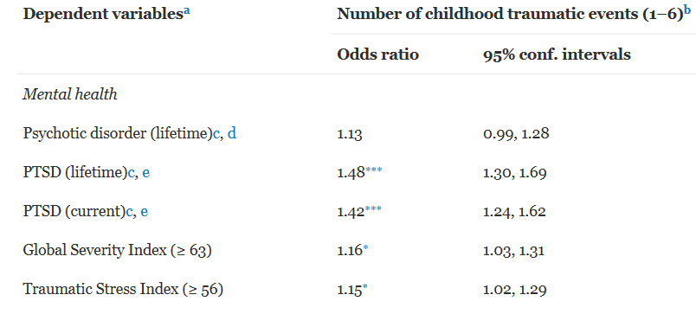
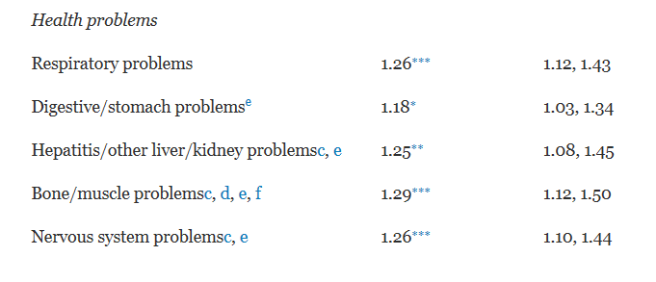
CTE – Childhood Traumatic Events
Strong link between CTEs and negative health, risk beahviours and diseses
Exposure to CTE’s among some of the sample were high
Greater exposure to CTEs increase the likelihood of adult mental, behavioural, and physical health problems
(Wu et al, 2010)

Slide 8
The Humanistic Counsllor
ACEs may trigger existential reactions
Evident in clients behaviour
Conceptulising through an existential lense
Messages embedded in client suffering
Subjective meaning systems are given a voice
Not much research or literature
(Zyromski et al, 2018)

Slide 9
Voice Hearers and EFC
Relating to voices to resolve trauma
Multiple traumas are likely to predict Psychosis risk
Voices conceptualised as unresolved trauma
EFC is distinct from other novel approaches
Focusses on trauma not just as a general stressor
(Schnackenberg, 2018, p. 998)

Slide 10
TF-CBT – Trauma Focused
Quick fixes can be more damaging - (Herbert, 2017, p. 466)
Reconnect clients with trauma
Re-living these memories hold fear - (McLeod and McLeod, 2007, p. 265)
Psychoeducation - (Herbert, 2017, p. 467)
Recognise stress, self sooth and self-regulate - (Harding-Jones, 2019, p. 21)
May help to break re-ocurring patterns

Slide 11
Substance Misuse
Can only be addressed if Matt is ready
Replaced with healthier coping mechanism
Maintenance therapy – Methadone or Buprenorphine
Detox – Gradually withdraw from both
Self-detox – can be risky
Harm reduction – SMART Recovery, client led
Minnesota Model – 12 steps, abstinence
Continue with therapy
(NHS, 2017)

Slide 12
Recomendations and Review
Diversionary activities
Continue with any intervention with positive outcomes
Progress in Matts life skills and discovery
Exit level should be considered carefully
Interventions are fulid and flexible
Low mood and anxiey, hopefully, has been resolved
Matt has the potential to reach his full potential

Slide 13
Thanks
Any questions?

Slide 14
References -
Barlie, J. P., Pruitt, A. S. and Parker, J. L. (2018) ‘A latent class analysis of self‐identified reasons for experiencing homelessness: Opportunities for prevention’, Journal of Community & Applied Social Psychology, 28(2), pp. 94-107. DOI: 10.1002/casp.2343
Cellar, D. F. et al. (2016) ‘Personality, Coping and Well-being for People Living with Chronic Hepatitis C’, Psychological Report, 118(2), pp. 649-667. DOI: 10.1177/0033294115625557
Harding-Jones, C. (2019) ‘Counselling Survivors of Sex Trafficking’, Therapy Today, 30(1), pp. 21-24.
Herbert, C. (2017) ‘Post-Traumatic Stress Disorder’, in Feltham, C., Hanley, T. and Winter, L. A. (ed.) The SAGE Handbook of Counselling and Psychotherapy. London: SAGE Publications Ltd.
Kuwashiro, T. et al. (2014) ‘Impairment of health-related quality of life in patients with chronic hepatitis C is associated with insulin resistance’, Journal of Gastroentero, 49(2), pp. 317-323. DOI: 10.1007/s00535-013-0781-6
Marie-Mitchell, A., Studer, K. R. and O’Conner, T. G. (2016) ‘How Knowledge of Adverse Childhood Experiences Can Help Pediatricians Prevent Mental Health Problems’, American Psychological Association, 34(2), pp. 128-135. DOI: 10.1037/fsh0000179
McLeod, J. and McLeod, J. (2007) Counselling Skills: A Practical Guide for Counsellors and Helping Professionals. 2nd Ed. Maidenhead: Open University Press.
National Health Service (2016) Ace Report 1. Available at: http://www.wales.nhs.uk/sitesplus/888/page/88504 (Accessed: 06th December 2019)
National Health Service (2018) Overview: Hepatitis C. Available at: https://www.nhs.uk/conditions/hepatitis-c/ (Accessed: 06th December 2019).

Slide 15
References Continued -
National Health Service (2017) Heroin Addiction: Get Help. Available at: https://www.nhs.uk/live-well/healthy-body/heroin-get-help/ (Accessed: 06th December 2019).
Pepping, C. A., MacDonald, G. and Davis, P. J. (2018) ‘Toward a Psychology of Singlehood: An Attachment-Theory Perspective on Long-Term Singlehood’, SAGE Journals, 27(5), pp. 334-331. DOI: 10.1177/0963721417752106
Pyne, J. M. et al. (2014) ‘Development of a Patient-Centred Antipsychotic Medication Adherence Intervention’, SAGE Journals, 41(3), pp. 315-324. DOI: 10.1177/1090198113515241
Schnackenberg, J. K., Fleming, M. and Martin, C. R. (2018) ‘Experience Focussed Counselling with Voice Hearers as a Trauma-Sensitive Approach. Results of a Qualitative Thematic Enquiry’, Community Mental Health Journal, 54(7), pp. 997-1007. DOI: 10.1007/s10597-018-0294-0
Sublette, V. A. et al. (2015) ‘The Hepatitis C Treatment Experience: Patients’ Perceptions of the Facilitators of and Barriers to Uptake, Adherence and Completion’, Psychology and Health, 30(8), pp. 987-1004. DOI: 10.1080/08870446.2015.1012195
Wolff, K. et al. (2018) ‘The Effects of Neighborhood Context on Exposure to Adverse Childhood Experiences (ACE) Among Adolescents Involved in the Juvenile Justice System: Latent Classes and Contextual Effects’, Journal of Youth and Adolescents, 47(11), pp. 2279-2300. DOI: 10.1007/s10964-018-0887-5
Wu, N. S. et al. (2010) ‘Childhood Trauma and Health Outcomes in Adults with Comorbid Substance Abuse and Mental Health Disorders’, Addictive Behaviors, 35(1), pp. 68-71. DOI: 10.1016/j.addbeh.2009.09.003
Zlotnick, C., Tam, T. and Robertson, M. J. (2004) ‘Adverse childhood events, substance abuse, and measures of affiliation’, Addictive Behaviors, 29(6), pp. 1177-1181. DOI: 10.1016/j.addbeh.2004.01.005
Zyromski, B. et al. (2018) ‘Beyond Complex Trauma: An Existential View of Adverse Childhood Experiences’, Journal of Humanistic Counselling, 57, pp. 156-171. DOI: 10.1002/johc.12080

