Slide 1

The Analects of Confucius論語
Presented by : Kwong Bee Ling
(2017146)

Slide 2
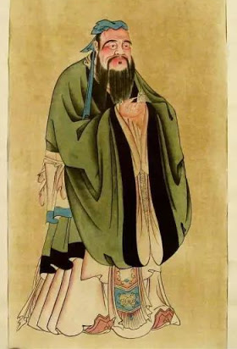
孔子 CONFUCIUS
551 – 479BC
A profound philosopher, political thinker and greatest educator of ancient China, whose influence is still felt across the world today.

Slide 3
論語 ANALECTS OF CONFUCIUS
Compiled by the disciples of Confucius.
It records the words and conversations of Confucius and his disciples, and covers a wide variety of subjects mainly on politics, philosophy, arts, education and moral cultivation.

Slide 4
1.學而時習之， 不亦說乎？
2.學而不思則罔，思而不學則殆。
Method
3.溫故而知新，可以為師矣。
4.三人行，必有我師焉；擇其善者而從之，其不善者而改之。

Slide 5
1.學而時習之，不亦說乎？
It is indeed a pleasure to acquire knowledge and, as you go on acquiring, to put into practice what you have acquired. Chapter I.1 Ku Hung-Ming’s Translation
2.學而不思則罔，思而不學則殆。
Study without thinking is labour lost. Thinking without study is perilous.“ Chapter II.15 Ku Hung-Ming’s Translation

Slide 6
3. 溫故而知新，可以為師矣。
If a man will constantly go over what he has acquired and keep continually adding to it new acquirement, he may become a teacher of men.“ Chapter II.11 Ku Hung-Ming’s Translation

Slide 7
4.三人行，必有我師焉；擇其善者而從之，其不善者而改之。
When I walk along with two others, they may serve me as my teachers. I will select their good qualities and follow them, their bad qualities and avoid them.“
Book VII Chapter XXI James Legge’s Translation

Slide 8
Attitude
1.敏而好學，不恥下問。
2.知之為知之，不知為不知，是知也。

Slide 9
1.敏而好學，不恥下問。
He was of an active nature and yet fond of learning, and he was not ashamed to ask and learn of his inferiors! Book V Chapter XIV James Legge’s Translation
2.知之為知之，不知為不知，是知也。
When you know a thing, to hold that you know it; and when you do not know a thing, to allow that you do not know it;—this is knowledge.“
Book II Chapter XVII James Legge’s Translation

Slide 10
Reference :
《論語英譯》（《辜鴻銘文集》本）
Confucian Analects. Confucius’s Students, translated by James Legge

