Slide 1
Introduction
Good behavioural management is achieved by applying strategies which allow children to take responsibility for their actions, as evident in John Dewey’s theory of ‘Social Learning’ (Sikandar, 2015).
According to Williams (2017), social learning is utilised within the classroom to promote pupils’ engagement via a Responsive Classroom.
A Responsive Classroom supports social learning by delivering education in environments which are happy and secure as endorsed in the framework ‘The Right Way: A Children’s Rights Approach in Wales’.
Restorative justice is a strategy identified within the framework for dealing with issues of behaviour in accordance with Article 12 of the United Nations Convention on the Rights of the Child (UNCRC) (Children’s Commissioner for Wales, 2017).

Slide 2
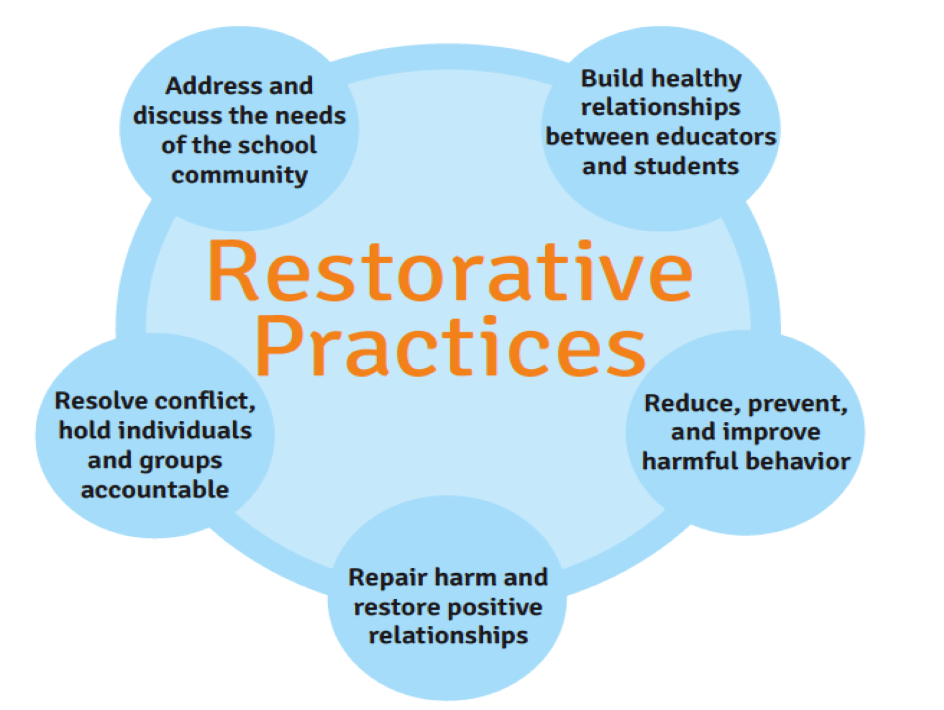
Restorative Justice
A strategy used to manage and reduce the impact of negative behaviour opposing the traditional approach of punitive exclusion practices.
Shifts the spotlight from punishment and blame to focus on nurturance, responsibility and restoration.
Develops social awareness and emotional literacy (Noetzli, 2015).
A whole school approach that involves the interaction of the community, to repair any damage to relationships following conflict (Johnston, 2002).
Repairs relationships involved in negative behaviour, without assigning punishment and blame (Hopkins, 2002).
(Tes, 2020).

Slide 3
Key elements of Restorative Justice
Strategies are needs-led and value-based to develop respectful and cohesive relationships throughout the community, fostering learning (Network Autism, 2017).
Respective relationships are fundamental to establishing an engaging, inclusive environment (Noetzli, 2015).
Building relationships and developing empathy are key skills, replacing humiliation, blame and fear (Drewery, 2014).
Emotional engagement is key to developing socially acceptable behaviour.
Emotional literacy develops social conscience (Morrison and Vaandering, 2012).
Children who engage with emotional literacy become successful academics who positively contribute to society as individuals (Noetzli, 2015).

Slide 4
Emotional Literacy
The ability to accurately perceive, assess and express emotive feelings.
Promotes knowledge, compassion and communication skills to underpin a whole school and community approach, adopting values-based concepts.
Involves the use of self-discipline to control emotions and effectively manage episodes of conflict.
Circle time is an effective strategy which supports the development of emotional literacy.
Circle time is a structured intervention that develops self-discipline through group interaction (Roffey, 2008).
Circle time is not theoretically underpinned (Glazzard, 2016).
Lown (2002) advocates the use of circle time to develop effective group work.
Limited evidential research to justify the benefits (Lown, 2002).

Slide 5

Circle time
Delivered at least once a week for thirty minutes.
Principles that form the foundations of the Circle Time framework include: democracy, respect, empathy, community, inclusion, choice, safety and positive emotionality.
Develops:
Self-discipline.
An awareness and understanding of peers.
Feelings of connectedness and a sense of belonging.
Focuses on the positive aspects of life.
Improves well-being.
Collective decision-making process (Roffey, 2008).
(Google images, 2020).

Slide 6
Self-discipline
A key strategy to managing discipline as children are encouraged to develop self-discipline by regulating their own behaviour.
Children need to take responsibility for their own learning to value self-discipline (Rogus, 1985).
Self-discipline enhances the student’s development of valuable relationships with their peers, allowing them to take moral responsibility for their actions.
To develop, teachers need to perceive the behavioural incident from the child’s perspective (Ziatdinov, 2016).
It reduces stress and promotes empathy whilst enhancing feelings of positivity.
Modelling positive behaviour is key to the promotion of self-discipline in children (Brundrett and Lungka, 2019).

Slide 7
Facilitating Self-discipline
Whole school approach, parental involvement and a sense of community are key to developing self-discipline.
In contrast, the attitudes of personnel in school and the wider community can be perceived as a barrier to learning self-discipline (Rogus, 1985)
The role of teachers is key to modelling good behaviour to children (Ziatdinov, 2016).
Coercion and persistent persuasion promotes internalisation.
Persistent persuasion repairs damaged relationships with the the adult displaying a caring disposition towards the child.
Restorative Justice is a strategy that utilises persistent persuasion.
Limited evidential research available to compliment this theory, due to the complexity of analysing behavioural changes which are time consuming (Bergin and Bergin, 1999).

Slide 8
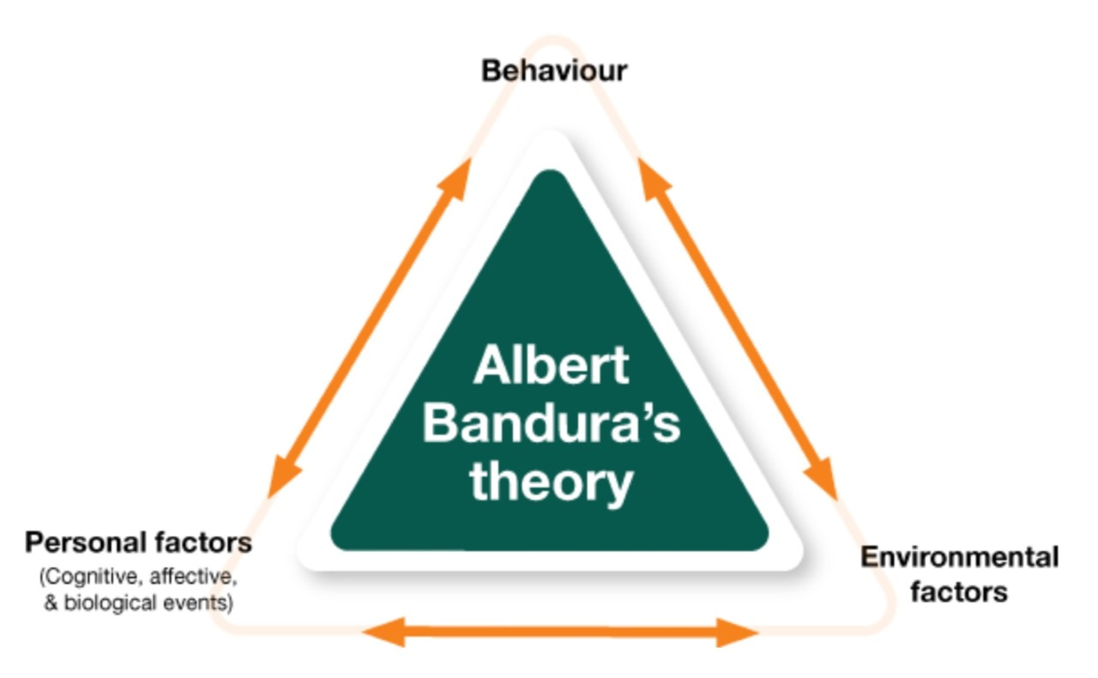
The Sound Learning Theory
Restorative justice is based upon the Sound Learning Theory (Hendry et al. 2010).
Self-discipline is central to the Sound Learning Theory.
Promotes positive behaviour.
Based upon the concept that individuals cognitively learn from social interaction.
Three concepts:
Behaviour
Environmental factors
Personal factors (Nabavi, 2012).
Utilisation of low arousal as a strategy is considered key to managing behaviour, focusing on reducing stress, frustration and fear within the designated setting (McDonnell et al., 2015).
(Google images, 2020).

Slide 9
Low Arousal
Behavioural management strategy which focuses on reducing physiological arousal and antecedent triggers.
Prevents crisis strategies and aggression by reducing the children stress, frustration and fear.
Uses low intensity strategies to avoid punitive consequences for the child.
Four key components which address behavioural and cognitive elements:
Reduces the rate of conflict incidences by minimising requests and demands.
Avoids potential arousal of triggers.
Averts non-verbal behaviour which could potentially lead to conflict.
Questions individual staff approaches regarding behavioural management (McDonnell, et al., 2015).

Slide 10
Facilitating Low Arousal
Three key elements:
Pre-crisis distraction - divert attention by utilising activities which are meaningful and build upon self-esteem.
Managing the critical incident – use verbal de-escalation to support behaviour management by purposefully interacting and communicating with the child.
Post incident recovery – debrief and maintain a positive relationship (McDonnell et al., 2015).
Low arousal strategies appear to be evident in the practices employed by Restorative Justice (Hopkins, 2002).
Limited research available regarding the effectiveness of adopting a low arousal approach (McDonnell et al., 2020).

Slide 11
Facilitating Restorative Justice
Utilising emotional literacy and needs cards educate children with the necessary language which will allow them to express their feelings during periods of behavioural incidences (see Restorative Justice Appendix 1).
Alongside needs cards replace retributive language with restorative (see Restorative Justice Appendix 2).
Engage in circle time activities for thirty minutes at least once a week.
Modelling of appropriate language during the school day by all staff.
Engage in restorative conferencing with affected pupils, to resolve episodes of conflict (see Restorative Justice Appendix 3) Phethean (2016).

Slide 12
Benefits of Restorative Justice
Personal learning is enhanced when appropriate behaviour is displayed by the individual.
Self-discipline involves the use of positive negotiation strategies, which are evident in Restorative Justice intervention programmes.
Children who display self-discipline develop into responsible, independent members of society (Brundrett and Lungka, 2019).
According to Hendry et al. (2010) The Sound Learning Theory encompasses feeling of trust and safety for those who employ their strategies.
Low arousal provides support to the individual to manage their own behaviour whilst promoting happiness and wellbeing (Network Autism, 2017).
Restorative justice is a collaborative approach which repairs damaged relationships whilst nurturing existing relationships, developing empathy (Hopkins, 2002).

Slide 13
Conclusion
One behavioural approach does not suit all individuals (Network Autism, 2017).
Restorative justice is a strategy used to manage behaviour, opposing punitive practises.
Focuses on nurturance, responsibility and restoration, developing social awareness and emotional literacy (Noetzli, 2015).
Emotional literacy uses self-discipline to control emotions (Roffey, 2008).
Self-discipline provides children with opportunities to regulate their own behaviour.
Self discipline involves collaboration from pupils, parents and the wider community (Rogus, 1985).
Modelling positive behaviour is key to promoting self discipline (Brundrett and Lungka, 2019).
Restorative justice is based upon The Sound Learning Theory, to which self-discipline is central (McDonnell et al., 2015).

Slide 14
Conclusion continued
Low arousal is a strategy utilised to manage behaviour in accordance with The Sound Learning Theory (McDonnell et al., 2015).
Adopting a low arousal approach would reduce the incidences of difficult behaviours within the school environment.
Low arousal adopts a transactional approach which provides opportunities for staff to examine their own personal behaviour and focus on reflection and change (Jones, 2019).
Restorative justice practices encompass self-discipline, emotional literacy, circle time, modelling of appropriate language by staff and restorative conferences to effectively manage behaviour with schools evidencing an overall 49% reduction in verbal, physical and disruptive behaviour (Phethean, 2016).
Limited research available to validate the success of restorative justice practices within a school environment.

Slide 15
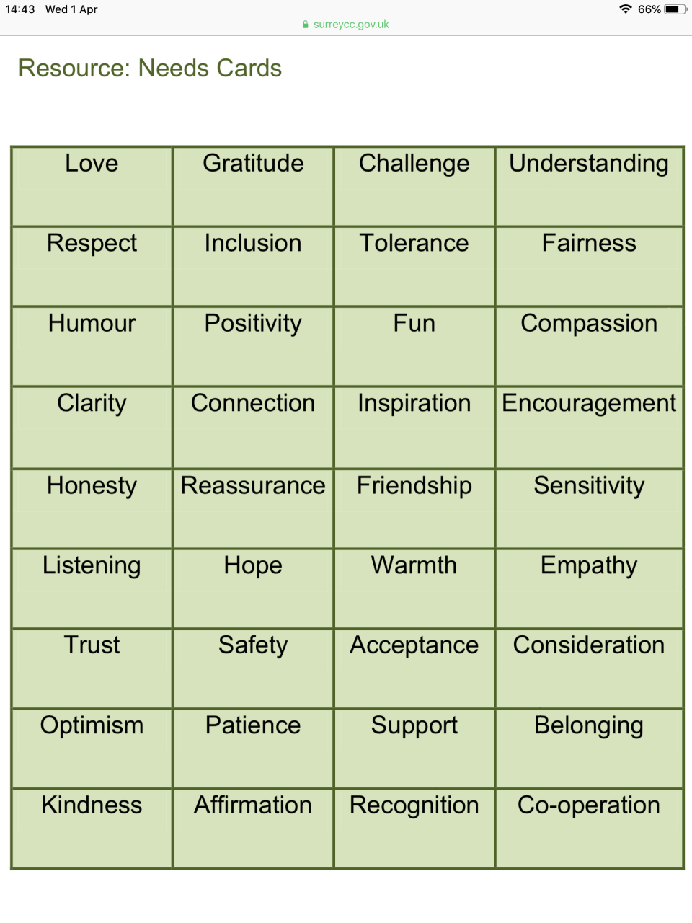
Restorative Justice Appendix 1
(Phethean, 2016).

Slide 16
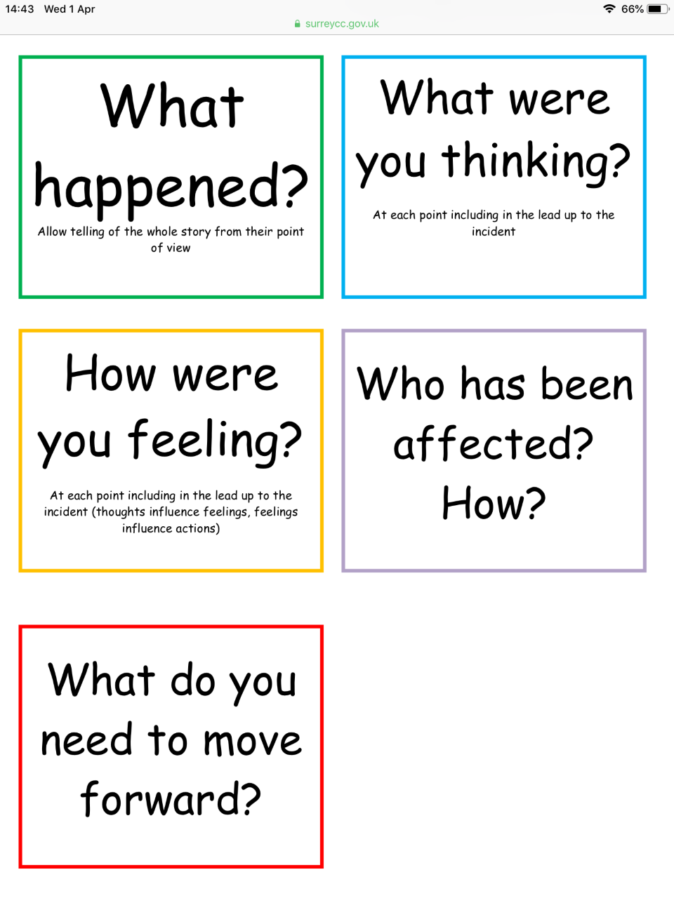
Restorative Justice Appendix 2
(Phethean, 2016).

Slide 17
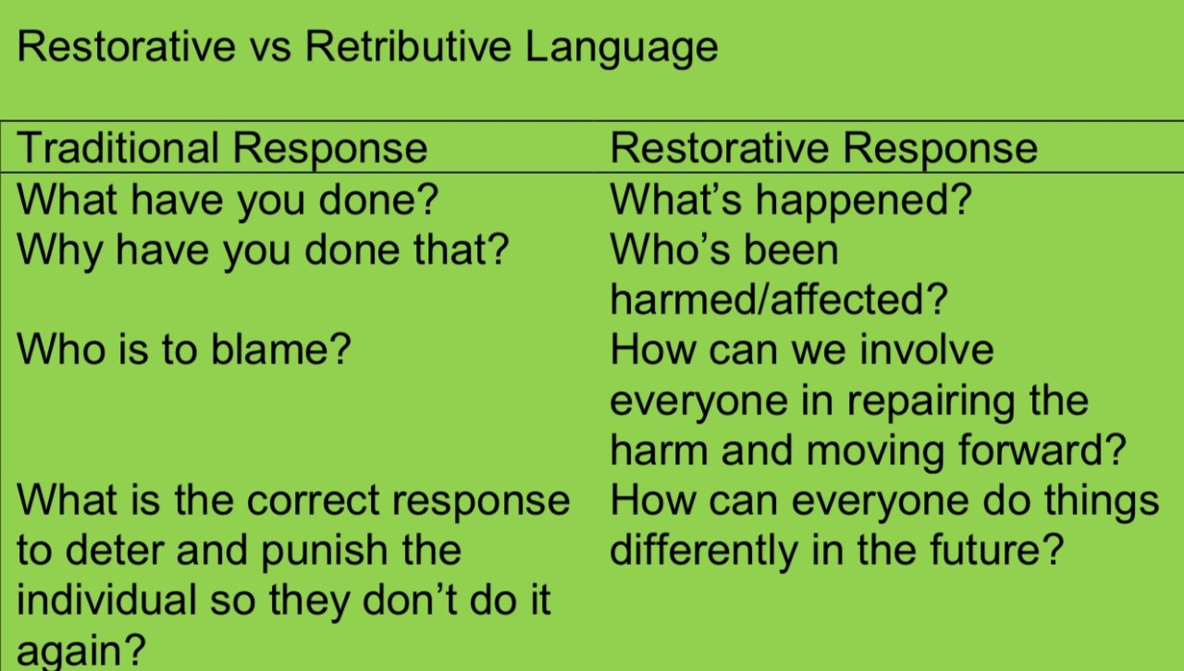
Restorative Justice Appendix 3
(Phethean, 2016).

Slide 18
References
Bergin, C. and Bergin, D. (1999) ‘Classroom Discipline That Promotes Self-Control’, Journal of Applied Developmental Psychology’, 20(2), pp. 189-206. Available at: https://www.academia.edu/34374666/Classroom_discipline_that_promotes_self-control (Accessed: 4th March 2020).
Brundrett, M. and Lungka, P. (2019) ‘The development of teachers’ knowledge and behaviour in promoting self-discipline: a study of early years teachers in Thailand’, Education, 47(4), pp. 462-474. Available at: https://www.tandfonline.com/doi/full/10.1080/03004279.2018.1498996 (Accessed: 4th March 2020).
Children’s Commissioner for Wales (2017) THE RIGHT WAY: A Children’s Approach for Education in Wales. Available at: https://www.childcomwales.org.uk/wp-content/uploads/2017/05/The-Right-Way-Education.pdf (Accessed: 14th March 2020).
Drewery, W. (2014) ‘Restorative Practice in New Zealand School: Social development through relational justice’, Educational Philosophy and Theory, 48(2), pp. 191-203. Available at: https://www.tandfonline.com/doi/full/10.1080/00131857.2014.989951?needAccess=true (Accessed: 14th March 2020).
Glazzard, J. (2016) ‘The value of circle time as an intervention strategy’, Journal of Educational and Developmental Psychology, 6(2), pp. 207-215. Available at: https://www.researchgate.net/publication/308833755_The_Value_of_Circle_Time_as_an_Intervention_Strategy (Accessed: 28th March 2020).
Hendry, R. et al. (2010) Restorative Approaches in Schools in the UK. Available at: https://www.educ.cam.ac.uk/research/projects/restorativeapproaches/RA-in-the-UK.pdf (Accessed: 21st March 2020).
Hopkins, B. (2002) ‘Restorative Justice in Schools’, Support for Learning, 17(3), pp. 144-149. Available at: https://www.researchgate.net/publication/227601084_Restorative_Justice_in_Schools (Accessed: 14th March 2020).
Johnston, G. (2002) Restorative Justice – Ideas, Values, Debates. Cullompton: Willan Publishing.

Slide 19
References
Jones, G. (2019) ‘The reflective journey: a practitioner’s guide to the Low Arousal approach’, Good Autism Practice, 20(2), pp. 90-92. Available at: https://content.ebscohost.com/ContentServer.asp?T=P&P=AN&K=140501230&S=R&D=eue&EbscoContent=dGJyMNLr40SeprE4y9fwOLCmsEieprRSsq24TK%2BWxWXS&ContentCustomer=dGJyMPGqtVGxp7FRuePfgeyx44Dt6fIA (Accessed: 3rd March 2020).
Lown, J. (2002) ‘Circle time: The perceptions of teachers and pupils’, Educational Psychologists in Practice, 18(2), pp. 93-102. Available at: https://www.researchgate.net/publication/308833755_The_Value_of_Circle_Time_as_an_Intervention_Strategy (Accessed: 26th March 2020).
McDonnell, A. (2020) The Reflective Journey. Available at: https://lagaffektivadagar.se/wp-content/uploads/2020/01/The-Reflective-Journey-Andrew-McDonnell.pdf (Accessed at: 3rd March 2020).
McDonnell, A. et al. (2015) ‘The role of physiological arousal in the management of challenging behaviours in individuals with autistic spectrum disorders’, Research in Developmental Disabilities, 36, pp. 311-322. Available at: https://www-sciencedirect-com.ezproxy.uwtsd.ac.uk/science/article/pii/S0891422214004028 (Accessed: 3rd March 2020).
Morrison, B. and Vaandering, D. (2012) ‘Restorative Justice: Pedagogy, Praxis, and Discipline’, Journal of School Violence, 11(2), pp. 138-155. Available at: https://www.researchgate.net/publication/233234044_Restorative_Justice_Pedagogy_Praxis_and_Discipline (Accessed: 14th March 2020).
Nabavi, R. T. (2012) Bandura’s Social Learning Theory & Social Cognitive Learning Theory. Available at: https://www.researchgate.net/publication/267750204_Bandura's_Social_Learning_Theory_Social_Cognitive_Learning_Theory (Accessed: 21st March 2020).
Network Autism (2017) Low Arousal Approaches to Help Reduce Aggression in Autistic People With Complex Needs. Available at: https://network.autism.org.uk/sites/default/files/ckfinder/files/Plenary%2010_30%20Geoff%20Evans.pdf (Accessed: 3rd March 2020).

Slide 20
References
Noetzli, V. (2015) ‘Implications of using restorative justice practices in schools to restore broken relationships’, Journal of Initial Teaching Inquiry, 1, pp. 57- 59. Available at: https://pdfs.semanticscholar.org/3c50/4a36272120986a719b91daaeaf346dcbdf96.pdf (Accessed: 14th March 2020).
Phethean, S. (2016) Restorative Approaches. Available at: https://www.surreycc.gov.uk/__data/assets/pdf_file/0019/101827/Introduction-to-restorative-approaches-for-schools.pdf (Accessed: 14th March 2020).
Roffey, S. (2008) ‘Emotional literacy and the ecology of school wellbeing’, Educational & Child Psychology, 25(2), pp. 29-39. Available at: https://www.researchgate.net/publication/285862577_Emotional_literacy_and_the_ecology_of_school_well-being (Accessed: 14th March 2020).
Rogus, J. (1985) ‘Promoting Self-Discipline: A Comprehensive Approach’, Theory Into Practice, 24(4), pp. 271-276. Available at: https://www.tandfonline.com/doi/abs/10.1080/00405848509543186?journalCode=htip20 (Accessed: 4th March 2020).
Sikandar, A. (2015) ‘John Dewey and His Philosophy of Education’, Journal of Education and Educational Development, 2(2), pp. 191-201. Available at: https://www.researchgate.net/publication/314967156_John_Dewey_and_His_Philosophy_of_Education (Accessed: 14th March 2020).
Tes (2020) Restorative Practices [Image]. Available at: https://www.tes.com/lessons/gmSgpPMLx9Xohw/restorative-practices-for-pbis-schools (Accessed: 14th March 2020).
Williams, M. (2017) ‘John Dewey in the 21st Century’, Journal of Inquiry & Action n Education, 9(1), pp. 91-102. Available at: https://files.eric.ed.gov/fulltext/EJ1158258.pdf (Accessed: 14th March 2020).”
Ziatdinov, K. (2016) ‘How Students Acquire Self-Control: Primary School Teachers’ Concepts from Turkey’, European Journal of Contemporary Education, 18(4), pp. 390-397. Available at: https://www.researchgate.net/publication/311614189_How_Students_Acquire_Self-Control_Primary_School_Teachers'_Concepts_from_Turkey

