Slide 1
Branding and
Brand Management
LCMB7024
Week 4 – Session 1

Slide 2
Content of the Session
Pioneer and follower
Advantages of pioneer and follower
A comparison for the PLC stages for Pioneer and follower
What is a brand?
Brand
Branding
Importance of brands to consumers
Importance of brands to organisations
Brand management
Brand equity
Components of brand equity

Slide 3

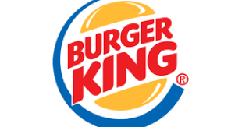



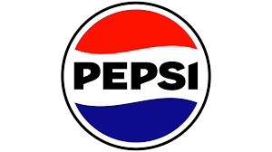

Pioneer versus Follower
A Pioneer (First Mover) is a company that introduces a new product, service, or technology to the market before competitors.
A Follower (Late Entrant) is a company that enters the market after the pioneer, learning from the pioneer’s successes and mistakes.

Slide 4
Advantages and disadvantages of Pioneer
✅ Advantage: Pioneers can establish strong brand recognition and customer loyalty, giving them a long-term competitive edge.
❌ Disadvantage: High R&D costs and market uncertainty can lead to financial risks if the product fails.

Slide 5
Advantages and Disadvantages of Follower
✅ Advantage: Followers can learn from pioneers' mistakes, reducing risks and development costs while improving product offerings.
❌ Disadvantage: They may struggle to gain market share against well-established pioneers with strong brand loyalty.

Slide 6
Introduction Stage
(Pioneer Leads, Follower Observes)
Pioneer is the first company to introduce a new product into the market. Example: Tesla (Electric Vehicles) -> First to popularise EVs with high-range batteries and self-driving tech.
Follower observes market trends before entering. Example: NIO (Chinese EV Brand) -> Entered the EV market after Tesla but targeted premium, tech-savvy consumers in China.
Notes:
Pioneer: The first company to introduce a new product into the market. Invests heavily in R&D, marketing, and customer education. Faces high risks and uncertainty but can create brand loyalty & industry standards.
Example: Tesla (Electric Vehicles)
First to popularize EVs with high-range batteries and self-driving tech.
Defined the benchmark for electric vehicles.
Follower: Observes market trends before entering. Avoids R&D costs and leverages pioneer’s learnings. Enters with better features, lower costs, or improved marketing strategies.
Example: NIO (Chinese EV Brand)
Entered the EV market after Tesla but targeted premium, tech-savvy consumers in China.
Benefited from Tesla’s groundwork in consumer education.

Slide 7
Growth Stage
(Pioneers Defend, Followers Attack)
Pioneer focuses on expansion and brand loyalty. Defends position using Fortress Strategy (strong branding, patents, and product improvements). Example: Apple iPhone -> Introduced smartphones with a touchscreen and established a loyal user base & strong ecosystem (App Store, iOS, iCloud).
Follower uses Attack Strategies and introduces a better, cheaper, or more accessible version of the pioneer’s product. Example: Samsung (Smartphones) -> entered after Apple’s iPhone but provided cheaper, customisable Android alternatives.
Notes:
Pioneer: Focuses on expansion, building a competitive moat, and brand loyalty. Defends position using Fortress Strategy (strong branding, patents, and product improvements).
Example: Apple iPhone
Introduced smartphones with a touchscreen UI.
Established a loyal user base & strong ecosystem (App Store, iOS, iCloud).
Follower: Uses Attack Strategies to steal market share (Frontal Attack, Flank Attack, Leapfrog). Introduces a better, cheaper, or more accessible version of the pioneer’s product.
Example: Samsung (Smartphones)
Entered after Apple’s iPhone but provided cheaper, customizable Android alternatives.
Focused on diverse models (budget, mid-range, premium) to undercut Apple’s dominance.

Slide 8
Maturity Stage (Pioneers Sustain, Followers Compete Aggressively)
Pioneer struggles with market saturation and fights competition. Example: McDonald's (Fast Food) -> started as a pioneer in fast food. Expanded globally, diversified menu (McCafé, salads.
Follower: Competes aggressively using pricing, marketing differentiation, and distribution. Example: Burger King (Fast Food) -> entered later than McDonald's but used aggressive marketing (Whopper vs. Big Mac rivalry). Focused on "flame-grilled taste" as a differentiator.
Notes:
Pioneer: Struggles with market saturation and fights competition through product extensions, price cuts, and global expansion.
Example: McDonald's (Fast Food)
Started as a pioneer in fast food.
Expanded globally, diversified menu (McCafé, salads, healthier options).
Follower: Competes aggressively using pricing, marketing differentiation, and distribution. Sometimes surpasses pioneers by offering better adaptability to market needs.
Example: Burger King (Fast Food)
Entered later than McDonald's but used aggressive marketing (Whopper vs. Big Mac rivalry).
Focused on "flame-grilled taste" as a differentiator.

Slide 9
Decline Stage (Pioneers Harvest, Followers Niche or Exit)
Pioneer: If unable to revive demand, shifts to Harvesting Strategy (profit maximisation with minimal investment). Example: Kodak (Photography) -> Invented digital cameras but failed to adapt. Shifted to niche markets & licensing patents.
Follower: Some followers outlive pioneers by focusing on niche markets or introducing modernised versions. Example: Fujifilm (Photography) -> Survived after Kodak’s decline by diversifying into healthcare & digital imaging.
Notes:
Pioneer:
If unable to revive demand, shifts to Harvesting Strategy (profit maximization with minimal investment).
Example: Kodak (Photography)
Invented digital cameras but failed to adapt.
Shifted to niche markets & licensing patents.
Follower:
Some followers outlive pioneers by focusing on niche markets or introducing modernized versions.
Example: Fujifilm (Photography)
Survived after Kodak’s decline by diversifying into healthcare & digital imaging.

Slide 10


Slide 11
What is a Brand?
Some analysts consider brands to be a company's most lasting asset, surpassing the longevity of its individual products and facilities.
A former McDonald's CEO once stated that even if all their assets, buildings, and equipment were wiped out by a natural disaster, they could swiftly secure funding to rebuild solely due to the strength and value of their brand.

Slide 12
Brand
A brand is a unique design, sign, symbol, word, or a combination of these elements used to create a distinct identity for a product, service, or organisation.
It helps differentiate it from competitors and establishes a recognisable image and position in the market.
Is a brand limited to an organisation or a product?

Slide 13
Branding
According to the Chartered Management Institute (CMI), "branding" refers to the process of establishing a distinct identity for a company or individual, encompassing their values, personality, and messaging, which is communicated through all interactions and helps differentiate them from competitors, essentially representing how they are perceived by their audience (2019).

Slide 14
Importance of Brands to Consumers
Brands serve as symbolic tools that help consumers meet both functional and emotional needs.
Consumption is now meaning-based, allowing individuals to express their personality and values through a collection of brands rather than just a single product (Chaplin & Lowrey, 2010; Lalaounis, 2020; Solomon, 1988).
Notes:
Over time, these brands become part of our ‘extended self’. As Belk explains “we learn, define, and remind ourselves of who we are by our possessions … we seek to express ourselves through possessions, and use material possessions to seek happiness, remind ourselves of experiences, accomplishments, and other people in our lives, and even create a sense of immortality after death. Our accumulation of possessions provides a sense of past and tells us who we are, where we have come from, and perhaps where we are going (Belk, 1988, p. 160).

Slide 15
Importance of Brands to Organisations
Brands help organisations identify and track their products while also providing legal protection for unique features.
They prevent competitors from using the same name, colours, or brand elements, as seen with legally protected brands like British Airways and EasyJet’s orange insignia.

Slide 16
Brand Management
Brand management is the process of creating, maintaining, and improving a brand’s identity, reputation, and value over time.
It involves strategies to shape consumer perceptions, build loyalty, and enhance brand equity.

Slide 17
Quick research and Discussion
BRAND IMAGE
BRAND IDENTITY
BRAND PROMISE
BRAND KNOWLEDGE
BRAND EQUITY

Slide 18
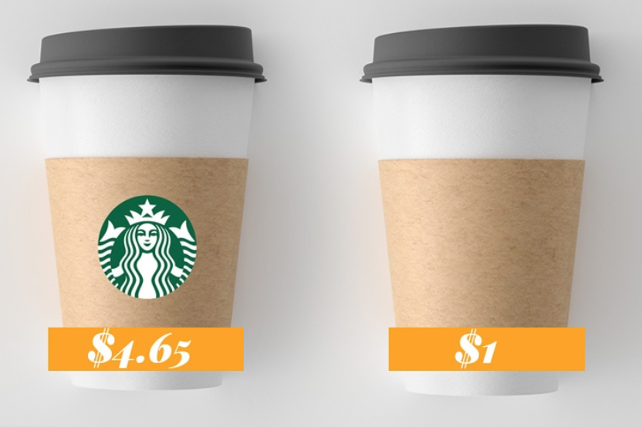
Brand Equity
Brand equity is the additional value a brand gives to a product or service beyond its inherent quality (Farquhar, 1989). Strong brand equity allows businesses to charge premium prices, reduce supplier costs, and increase profit margins, making the brand a key driver of financial returns (Lalaounis, 2020).

Slide 19
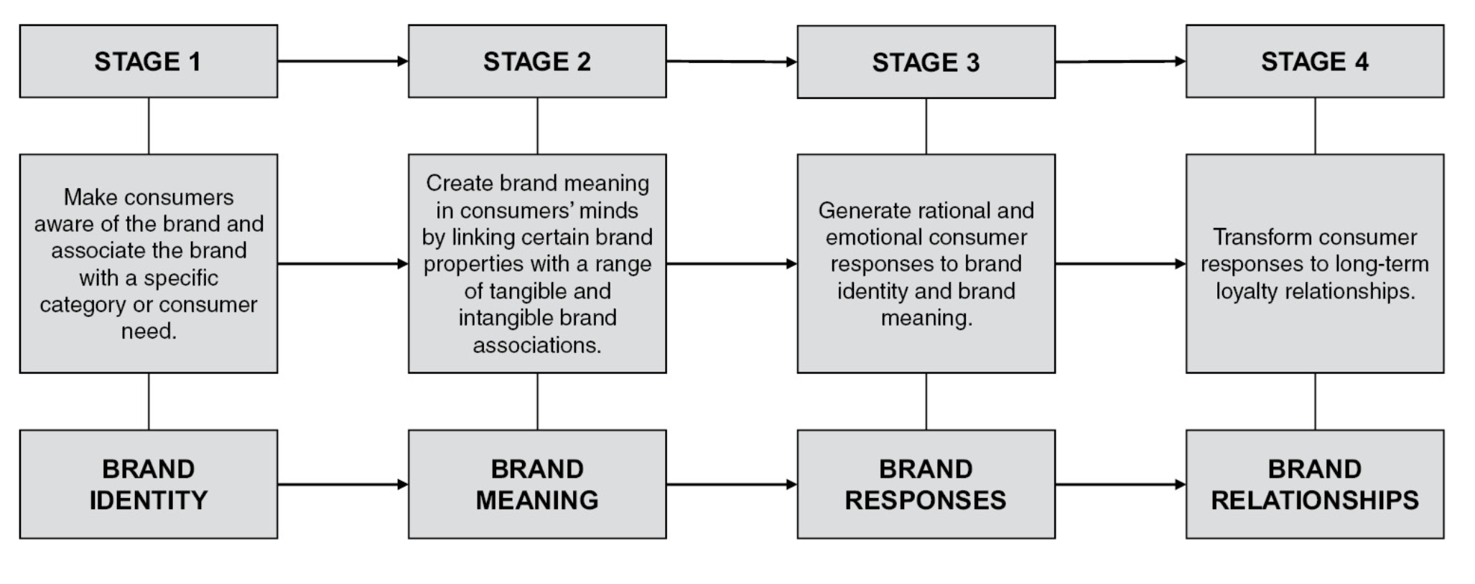
Stages of Brand Development
(Lalaounis, 2020)
Notes:
In order to develop strong brand equity, the organisation must follow four important stages: 1) make the consumer aware of the brand and associate the brand with a specific category or consumer need (brand identity), 2) create brand meaning in consumers’ minds by linking certain properties of the brand with a range of tangible and intangible brand associations (brand meaning), 3) generate rational and emotional consumer responses to this brand identity and brand meaning (brand responses), and 4) transform these consumer responses to intense and long-term loyalty relationships between the consumer and the brand (brand relationships).

Slide 20
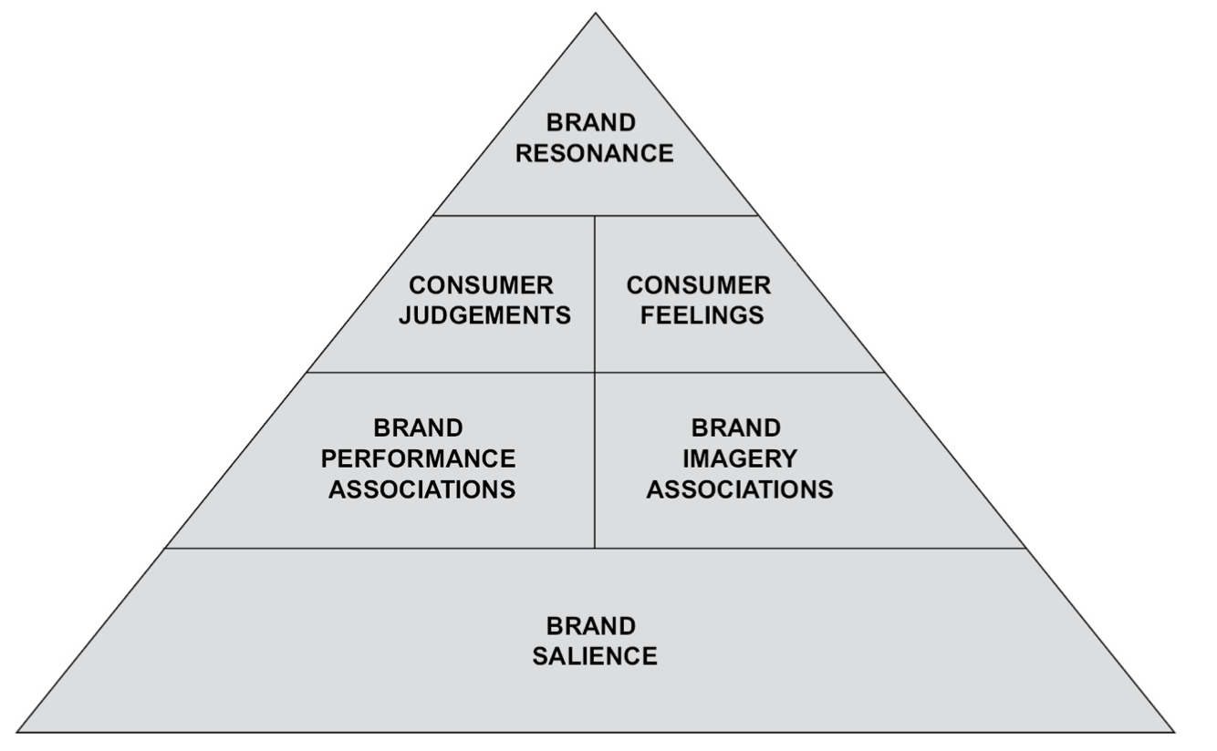
Customer-based brand equity pyramid model
(Lalaounis, 2020)
Notes:
Based on the previous figure “Stages of brand development” process, Keller (2001) proposed the Customer-Based Brand Equity (CBBE) pyramid model, which has four levels and six building blocks in the first level at the bottom, brand salience, in the second level, brand performance associations and brand imagery associations, then in the third level, consumer judgements and consumer feelings, and finally at the top-level brand resonance.

Slide 21

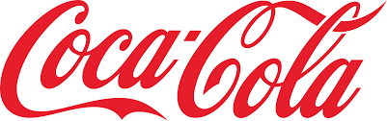
Brand Salience
(Who are you?)
Brand salience is the first level in building brand equity, focusing on consumer awareness.
To generate brand awareness, companies use a combination of Integrated Marketing Communications – traditional and digital marketing.
Example: Coca-Cola’s red and white logo and McDonald's golden arches are instantly recognisable worldwide.
Notes:
Brand Salience and Consumer Awareness: Brand salience is the first level in building brand equity, focusing on consumer awareness. It's crucial for consumers to recognize and recall the brand, making them aware of the product category and the specific needs the brand addresses.
Integrated Marketing Communications: To generate brand awareness, companies use a combination of traditional and digital marketing activities. These include advertising, sales promotions, and social media, with the balance between traditional and digital media varying based on the market.
Impact on Consumer Choice: Brand awareness influences brand perception and consumer choice. Consumers are more likely to choose a brand they recognize, even if it is of lower quality compared to other options, demonstrating the power of brand familiarity in decision-making.

Slide 22
Brand Performance & Brand Imagery (What are you?)
Brand Performance: Functional aspects like product quality, reliability, and price.
  Example: Tesla is known for high-performance electric cars with innovative technology.
Brand Imagery: Emotional and psychological associations with the brand.
  Example: Patagonia promotes an eco-conscious lifestyle through sustainability and environmental responsibility.

Slide 23
Consumer Judgments & Consumer Feelings (What about you?)
Consumer Judgments: Customers' personal opinions about a brand based on quality, credibility, relevance, and superiority.
  Example: Apple is judged as innovative.
Consumer Feelings: Emotional responses a brand evokes (e.g., joy, security, trust).
  Example: Disney creates a feeling of nostalgia and happiness.

Slide 24
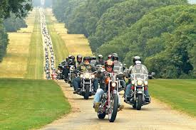
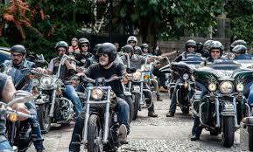
Brand Resonance
(What about you and me?)
This is the highest level, where customers feel a deep connection and loyalty.
Example: Harley-Davidson riders form strong brand communities and remain fiercely loyal.

Slide 25
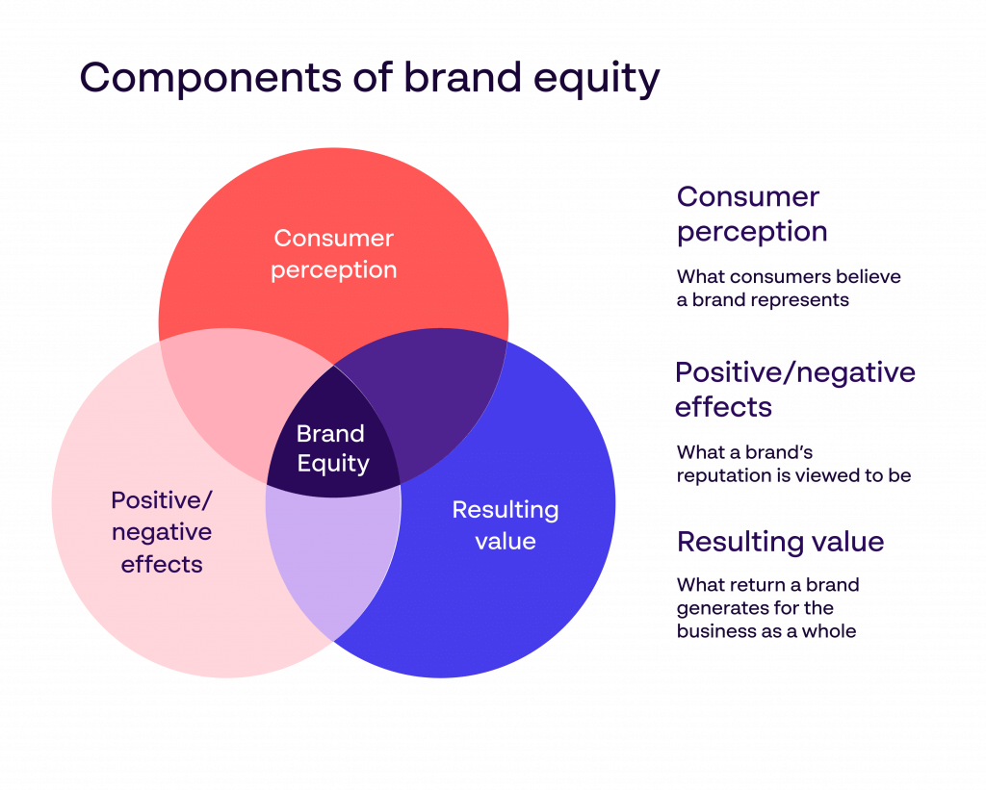
Components of Brand Equity
Brand equity is formed where consumer perception, brand reputation (positive/negative effects), and resulting business value overlap. Strong brand equity results in customer trust, brand loyalty, and competitive advantage.

Slide 26
Activity
In groups of 3-4, research and answer the following question.
Should businesses prioritise being a pioneer or a follower in a competitive market, and what factors determine the success of each strategy?

Slide 27
Reference
CMI (2019) How to Build Your Personal brand. Available at: https://www.managers.org.uk/knowledge-and-insights/article/build-your-personal-brand/ (Accessed: 27/02/2025).
Lalaounis, S.T. (2020) Strategic Brand Management and Development: Creating and Marketing Successful Brands. 1st edn. United Kingdom: Routledge. Available at: https://doi.org/10.4324/9780429322556.
Kotler, P. et al. (2020) Principles of marketing. Eighth European Edition. Harlow ; Pearson.

