Slide 1
NAME- EVA STEFAN
ID-2510915

Slide 2
DIGITAL SKILLS DEVELOPMENT: PORTFOLIO AND REFLECTIVE LEARNING JOURNEY

Slide 3
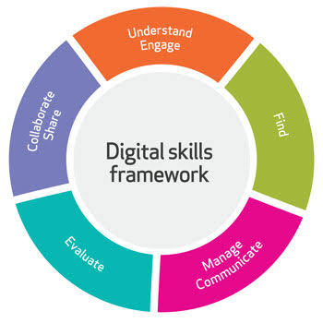
Introduction to My Digital Portfolio
Aim of my learning digital skills journey.
Development in selected portfolio throughout the module.
Reflective on development and growth.
Notes:
State the aim of the digital portfolio and the fact that it shows the chosen examples of work done during the module. Concisely, explain the contents in the portfolio and say that they show how you have developed digital skills, confidence and self-directed learning. Indicate that the presentation will be a reflection on personal development and the way the skills will be used in academic, professional, and daily life.

Slide 4
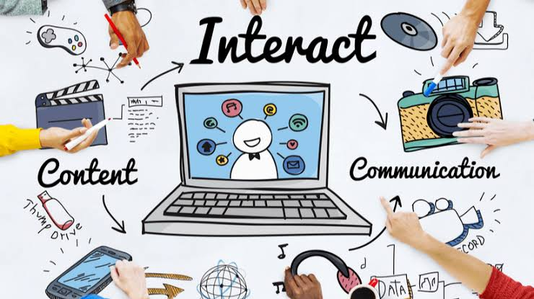
Portfolio Item 1: Digital Life (DS1)
Use everyday technologies to do daily activities.
Online learning, communication, and organisation (Pospíšilová and Rohlíková, 2023) skills.
Builded trust based on the necessary digital platforms (Weerakoon, 2023)
Notes:
Start with the first portfolio object the Digital Life activity, which was done at the start of the module. Use the example of how it exemplifies the application of digital technologies in communication, organisation and learning in universities. Discuss the internet features gained using online platforms, email, calendars and learning systems. Talk about what this exercise did in assisting you to bring to the fore what you are already strong in and what you need to work on more in the module.

Slide 5
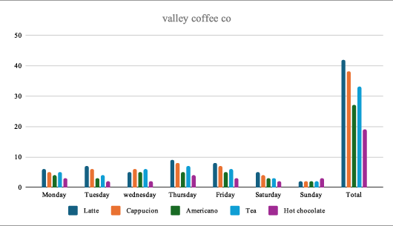
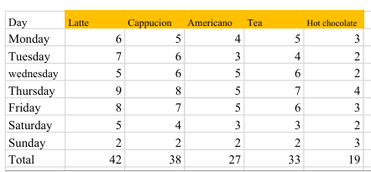
Portfolio Item 2: Coffee Sales Analysis
Organized the sales data in Microsoft Excel.
Created charts to analyse weekly sales (Zainuddin et al., 2026)
Determined the best and the worst selling products.
Notes:
Write about the Excel coffee sales analysis project and present the reasons why Microsoft Excel was chosen to arrange numerical data. Demonstrate how to enter the data, create the tables, insert totals and create charts to compare the sales performance. Talk about the fact that the activity helped to increase confidence in the skills of using spreadsheets, organising and visualising data and developing the skill of correctly interpreting information to make decisions.

Slide 6
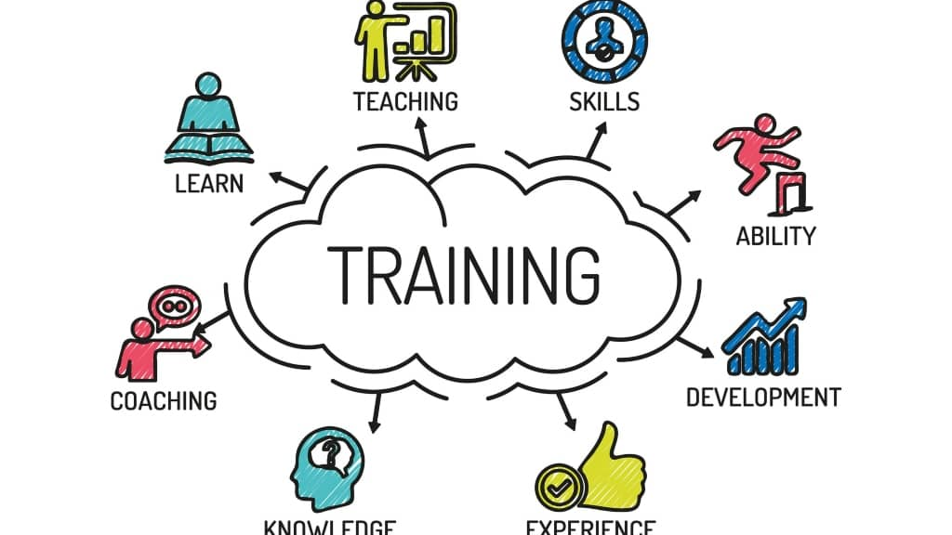
Skills Development and Independent Learning
Get
1
Get more confident by practicing digitally daily (Heymann et al., 2022)
Place
2
Place barriers through the support of advice and feedback (Hogan et al., 2026)
Perform
3
Independently perform all digital work confidently.
Notes:
Expound on the process of how digital skills learned throughout the module were built up over time due to frequent practice and positive feedback. Consider how difficult it has beento learn new software and explain how the difficulty was overcome. Discuss the increased confidence gained due to the ability to complete tasks without any control and explain how the process of lifelong learning has helped to increase the ability to address problems and use digital technologies in a more effective manner.

Slide 7
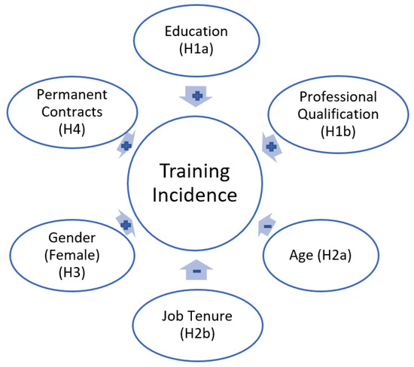
Digital Tools and Real-World Application
Knowledgeable in online applications and Microsoft office.
Digital skills aid in study and workplace achievement.
In our daily lives, technology improves the organisation and communication (Webb and Layton, 2023)
Notes:
Talk about the digital tools that can be now utilized with confidence such as Microsoft Excel, word, PowerPoint and university learning platforms. Discuss the ways these technologies can be used in academic work, assist in organising the work and enhancing communication. Reflect on the applicability of digital literacy in the coming generations, and how these transferable skills can be effectively applied in the workplace and everyday life that involves the necessity to use technology and information management.

Slide 8
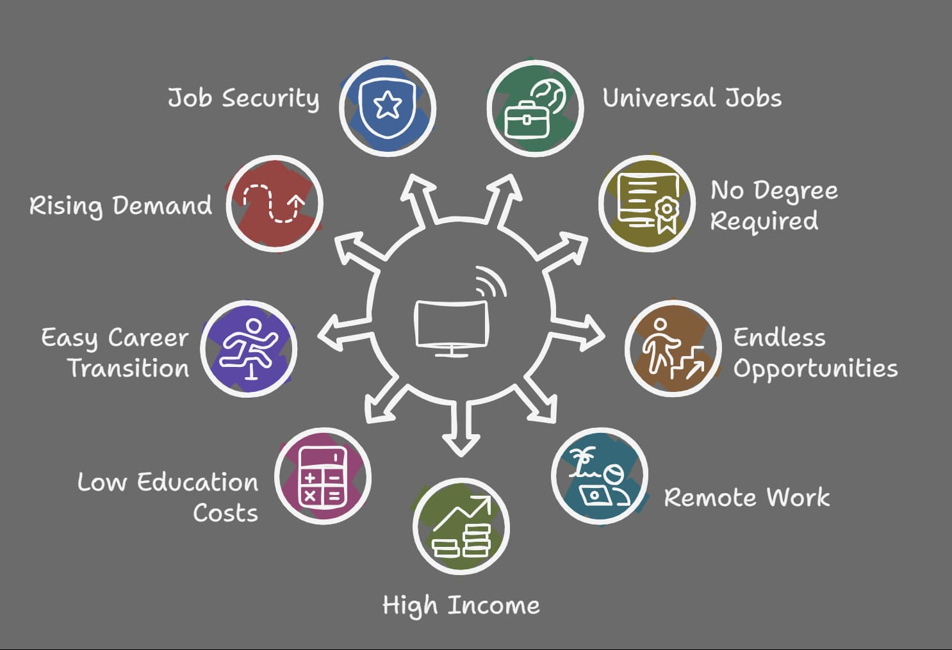
Future Development
Continuous learning and improvement is an expression of reflection.
More confidence with various digital technologies (Walland and Shaw, 2022)
Additional future goals are higher levels of digital skills.
Notes:
Consider how much you have made during the module to summarise the learning experience in general. Discuss the increase in confidence, independence and digital competence acquired during the completion of the various activities. Close with future ambitions, such as gaining more advanced digital skills, trying out more software and gaining more technology skills that can help to score academic success and decide the future career opportunities.

Slide 9
References
Chang, S.L. and Kabilan, M.K., 2024. Using social media as e-Portfolios to support learning in higher education: a literature analysis. Journal of computing in higher education, 36(1), pp.1-28.
Fu, H., Hopper, T., Sanford, K. and Monk, D., 2022. Learning with Digital Portfolios: Teacher Candidates Forming an Assessment Identity. Canadian Journal for the Scholarship of Teaching and Learning, 13(1), p.n1.
Heymann, P., Bastiaens, E., Jansen, A., van Rosmalen, P. and Beausaert, S., 2022. A conceptual model of students' reflective practice for the development of employability competences, supported by an online learning platform. Education+ Training, 64(3), pp.380-397.
Hogan, J., Penney, D., O’Hara, E. and Scott, J., 2026. Stakeholder perceptions of the feasibility of e-portfolio-based assessment of physical literacy in primary health and physical education. Physical Education and Sport Pedagogy, 31(2), pp.159-175.
Pospíšilová, L. and Rohlíková, L., 2023. Reforming higher education with ePortfolio implementation, enhanced by learning analytics. Computers in Human Behavior, 138, p.107449.
Shtaltovna, Y. and Muzzu, C., 2022. Enhancing students' digital competencies within the employability module of the University of Europe's skills-based curricula. Available at SSRN 5761063.
Walland, E. and Shaw, S., 2022. E-portfolios in teaching, learning and assessment: tensions in theory and praxis. Technology, Pedagogy and Education, 31(3), pp.363-379.
Webb, A. and Layton, J., 2023. Digital Skills for Performance: a framework for assessing current and future digital skills needs in the performing arts sector. Arts and the Market, 13(1), pp.33-47.
Weerakoon, C., 2023. Exploring the synergy of digital competence and photo-driven reflection: A pilot study on reflective thinking skill development in business education. Cogent Education, 10(2), p.2282304.
Zainuddin, Z., Churiyah, M., Rahayu, W.P., Pratikto, H. and Halili, S.H., 2026. E-portfolios as authentic assessment in pre-service teacher education: enhancing reflection, professional identity, and digital preparedness. Education and Information Technologies, pp.1-37.

Slide 10
THANK YOU

