Slide 1
Priyanka Gill
Student number: 2319375

Slide 2
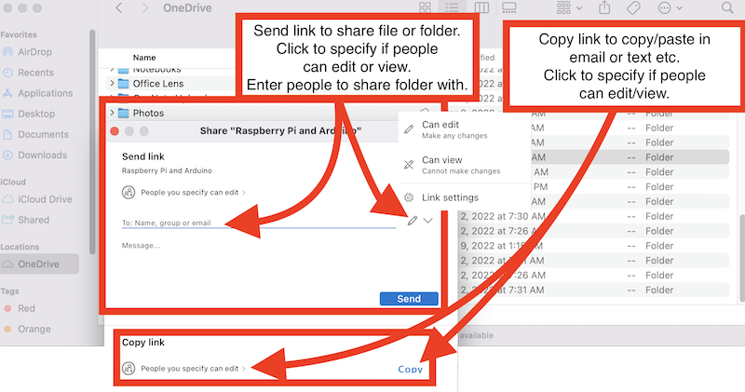
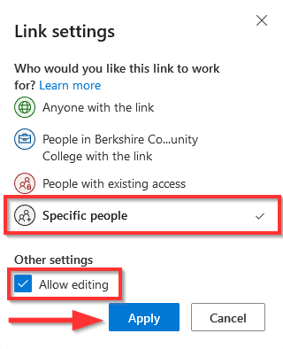
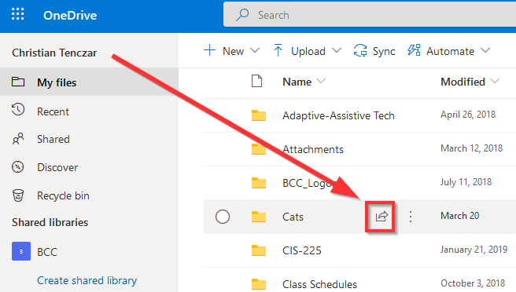
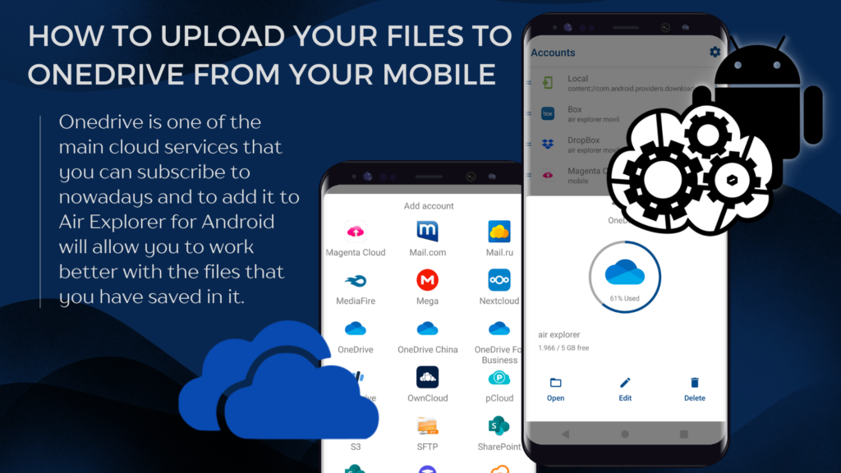
How to share a file via the one drive:
How to share on the web via one drive:
Go to onedrive.com and sign in with your Microsoft account.
Find the file or folder you want to share.
Click the circle to select it.
Click the “share” button. (near the top or next to the file).
In the sharing window:
“anyone with the link” (public link)
“people in your organization”
“specific people”
Permission:
Choose who has permission to have access’s and “can view” or “can edit”
Click copy link to get a shareable link, enter a email address to send direct.
Click send or paste the link and share it wherever it needs to be shared.
On a phone (one drive app for ios/android):
Open the one drive app
Tap the three dots (:) next to the file.
Select share.
Choose to create a link or send via email or other apps.
On windows file explorer if one drive is synced:
Open your one drive folder on your computer.
Right-click the file or folder you want to share.
Press share from the context menu.
A sharing box appears (linked to your Microsoft account).
Choose link settings (view/edit), then copy link or send via email.

