Slide 1

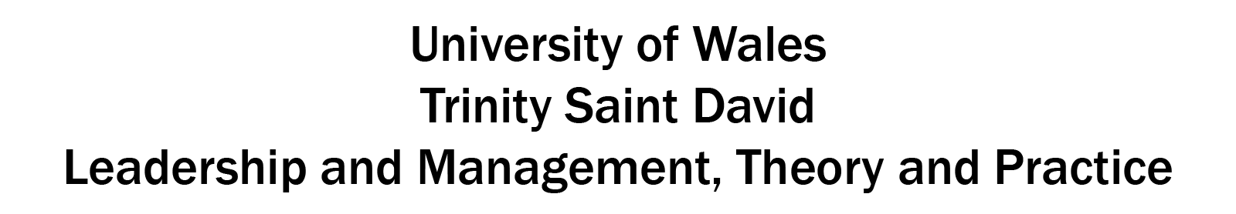
BA Business Management
Roxana Mara Niculita | 2021943
Lucian Ghita Pop | 2023565
Daniel-Florin Lazar | 2009160
Ionut Paul Marincu | 2009079

Slide 2

Roxana Mara Niculita

Slide 3
Introduction:
The presentation will focus on Jack Welch's legendary leadership as the former CEO of General Electric (GE). This presentation will assess Welch's leadership abilities, strategic choices, and the effect of his leadership style on GE's transition critically. From the contentious "Rank and Yank" system to his charismatic as well as demanding leadership style. It will investigate how Welch's management complemented other theories and viewpoints. The lecture will examine the accomplishments and difficulties of Welch's leadership and draw forth important lessons that present and future leaders may use to further their own ascents to success.

Slide 4
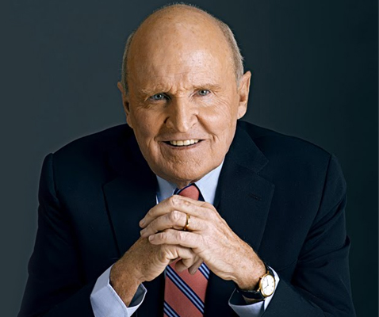
Background of Jack Welch
Born in Peabody, Massachusetts, 1935.
Graduated in chemical engineering.
Joined General Electric in 1960.
Became CEO in 1981.
Led GE to exceptional growth.
Awarded "Manager of the Century."
Notes:
On November 19, 1935, in Peabody, Massachusetts, the United States, Jack Welch was born. He graduated from the University of Massachusetts Amherst with a Bachelor of Science in chemical engineering before completing his doctoral work at the University of Illinois (Wachenje, 2014).Welch started working for General Electric in 1960, and throughout his tenure there, he progressively rose through the managerial ranks. He took over as CEO of GE in 1981, assuming the head of a business that was suffering several difficulties.
Jack Welch led GE to accomplish extraordinary feats while serving as CEO. The company's market valuation increased by nearly 4,000% under his direction, making it one of the most valuable businesses in the world. During Welch's tenure, GE further enhanced its position in a number of industries by smart acquisitions and divestitures (Dalrymple, 2023).
Jack Welch won several honours throughout his career, including being awarded "Manager of the Century" by Fortune magazine in 1999. His impact as a revolutionary leader in business is still well-known and much researched (Colvin, 2020).

Slide 5
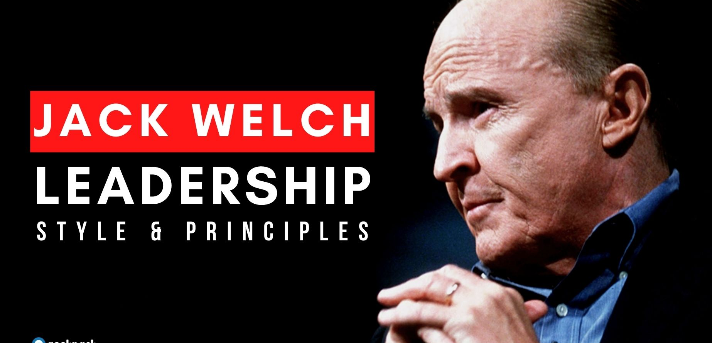
Jack Welch's Charismatic and Demanding Leadership Style:
The success of GE was significantly impacted by Jack Welch's charismatic as well as demanding leadership style, which inspired staff to produce outstanding outcomes. He had a highly motivated staff and a results-driven culture because of his charm, but there were also possible negative effects like employee fatigue and risk-aversion.

Slide 6
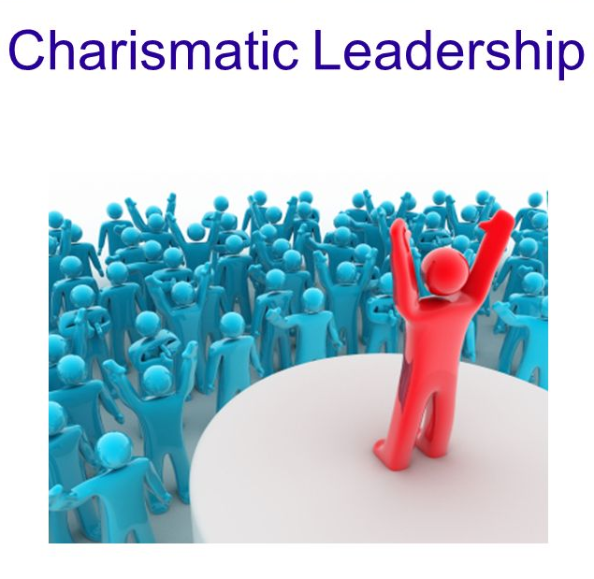
Jack Welch's Charismatic Leadership Style and its Impact on Employees
Jack Welch had a charismatic leadership style that was highlighted by his outgoing personality, effective communication abilities, and capacity to uplift and inspire his team (Cardona et al., 2019). Employees' feeling of direction and purpose was aided by Welch's vision for GE as well as his persuasive and compelling communication.
Notes:
His enthusiasm and vigour inspired the team to believe in the organization's goals and their part in attaining them. This led to a highly dedicated and motivated team that was ready to go above and beyond for the success of the business. Employee loyalty and commitment to the company were also nurtured by Welch's capacity to establish personal connections with them. He was personable and made an attempt to hear the opinions and concerns of the staff, which made them feel appreciated and valued. This strategy reinforced the connection between workers and the company even more, enhancing the work environment.

Slide 7
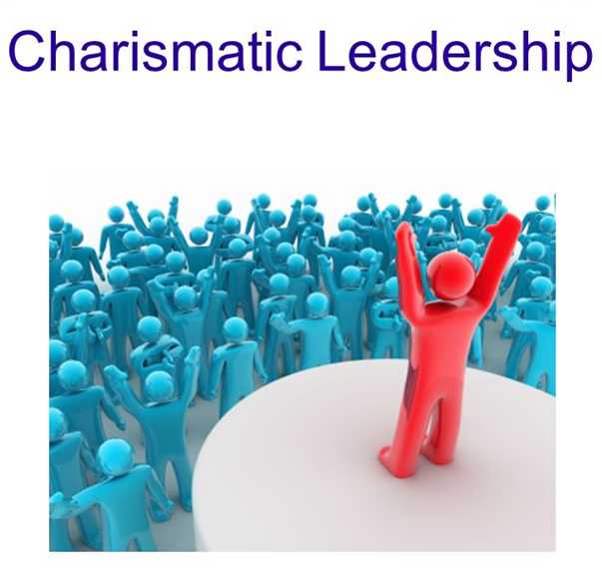
Advantages of Charismatic Leadership Style
Inspiration and Motivation.
Enhanced Communication.
Crisis Management.
Notes:
Inspiration and Motivation: Employees were motivated to assume responsibility for their responsibilities, desire excellence, and work towards continual improvement by Welch's charismatic leadership.
Enhanced Communication: His excellent communication abilities made it easier for information to flow clearly and consistently, which helped employees support the mission and goals of the business.
Crisis Management: Welch's charm aided in boosting staff morale and belief in the company's capacity to overcome hurdles during trying times.

Slide 8
Disadvantages of Charismatic Leadership Style
Overdependence on the Leader.
Lack of Critical Thinking.
Ego-Centric Leadership.
Notes:
Overdependence on the Leader: As a result of the charismatic aspect of leadership, there may be a tendency for followers to become dependent on the personality of the leader, which might impede long-term, sustainable growth and development (Sezer, 2022).
Lack of Critical Thinking: Employees could be so enthralled by the leader's vision that they fail to properly evaluate any dangers or plan faults.
Ego-Centric Leadership: Charismatic executives could be more likely to make choices based only on their personal convictions, ignoring different viewpoints inside the company.

Slide 9
Critical Evaluation of Welch's Demanding Nature:
Welch's demanding management style drove staff members to go above and beyond expectations and take calculated risks in order to realize their full potential. He inspired workers to pursue excellence as well as adopt a culture of continuous development by having high expectations for them (hbr.org, 2020). This high standard engendered a spirit of competition and urgency that elevated GE's performance.

Slide 10

Benefits of Welch's Demanding Nature:
Results-Oriented Culture: Because of Welch's high standards, there was a results-driven culture where success was celebrated.
Talent Development: Employees were motivated to grow their skills and talents to face the difficulties by the pressure to perform.

Slide 11

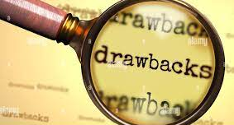
Potential Drawbacks of Welch's Demanding Nature:
Employee Burnout.
Short-Term Focus
Risk-Aversion.
Notes:
Employee Burnout: Employee burnout may have been a result of the demanding work environment, which also resulted in higher stress levels and a poorer work-life balance.
Short-Term Focus: It's possible that an excessive focus on achieving short-term goals has hampered long-term strategic planning as well as innovation.
Risk-Aversion: Employees could have been reluctant to take chances due to their concern about the possible negative effects of failing in a high-stress setting.

Slide 12
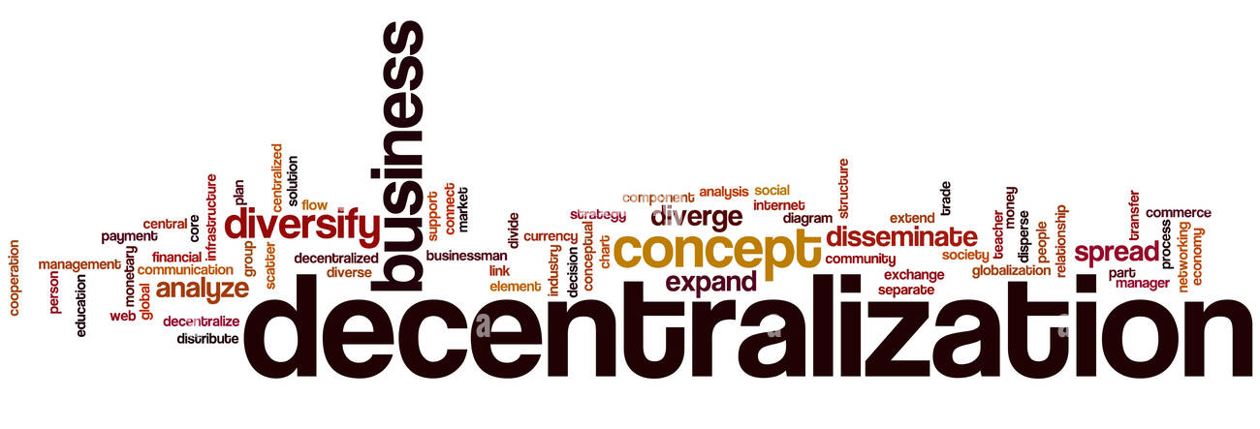
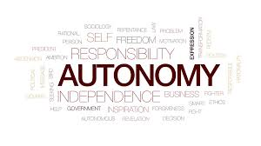
Decentralization and Autonomy:
When Jack Welch was the CEO of General Electric (GE), decentralization and giving managers autonomy were important tenets of his leadership style. Future leaders may learn a lot from Welch's implementation of decentralization and autonomy, which emphasizes the significance of striking the correct balance between centralized control and employee empowerment.
Notes:
When Jack Welch was the CEO of General Electric (GE), decentralization and giving managers autonomy were important tenets of his leadership style. Future leaders may learn a lot from Welch's implementation of decentralization and autonomy, which emphasizes the significance of striking the correct balance between centralized control and employee empowerment. Leaders may design a dynamic organizational structure that promotes innovation, develops agility, and accomplishes sustainable growth by taking lessons from the approach's advantages and disadvantages (López‐Gamero et al., 2023).

Slide 13
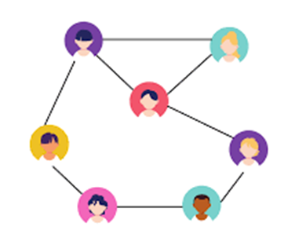
Analyzing the Concept of Decentralization and Alignment with Welch's Leadership Philosophy:
Dispersion of decision-making power.
Freedom for subordinate managers.
Boosting accountability and innovation.
Facilitating quicker decision-making.
Utilizing knowledge of connected managers.
Notes:
Decentralization is the dispersion of decision-making power among all levels of an organization, giving subordinate managers and staff the freedom to decide independently within their specific spheres of accountability (Martela, 2019). In contrast, centralized decision-making places the majority of the decision-making power at the top of the organizational structure.
Decentralization was favoured by Welch because he thought it would encourage innovation, boost accountability, and facilitate quicker decision-making. He recognized the possibility for decentralizing decision-making, which was consistent with his goal of building a more adaptable and flexible organization. Welch sought to draw on the knowledge and perceptions of people more intimately connected to the operations and consumers by assigning decision-making to managers at different tiers.

Slide 14
Lucian Ghita Pop

Slide 15
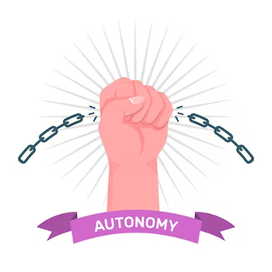
Examine the Contribution of Autonomy to a Culture of Innovation and Agility at GE:
At GE, developing an innovative and adaptable culture required giving managers authority. Welch promoted an entrepreneurial culture throughout the company by providing managers the opportunity to make choices and take charge of their business divisions. Managers were able to act quickly in response to market developments, grasp opportunities, and try out novel concepts because to their autonomy.

Slide 16

Benefits of Decentralization and Autonomy:
Encouraging Risk-Taking.
Faster Decision-Making.
Notes:
Encouraging Risk-Taking: Managers have the freedom to take calculated hazards without worrying about immediate consequences. As a result, experimenting and learning from both triumphs and errors became more prevalent.
Faster Decision-Making: Managers were able to act more rapidly and in response to market needs because to the reduction of bureaucratic red tape brought about by decentralisation.

Slide 17
Benefits of Decentralization and Autonomy:
Customized Solutions.
Employee Engagement.
Notes:
Customized Solutions: With greater autonomy, business units were able to modify their plans and tactics to suit their particular needs and the state of the market.
Employee Engagement: Decision-making authority increased managers' feeling of ownership as well as dedication to the success of the company by making them more involved and responsible for the results.

Slide 18

Potential Challenges and Risks Associated with Decentralization and Autonomy:
Decentralization and autonomy at GE brought a number of advantages, but there were also some dangers and obstacles that needed to be properly managed:
Coordination and Alignment.
Lack of Consistency.
Notes:
Coordination and Alignment: Decentralization could cause decision-making to become fragmented and less in line with the broader organizational plan. Coordination between corporate groups and upholding a unified vision became major obstacles.
Lack of Consistency: Without centralized oversight, there was a chance that separate units' practices, standards, and quality would vary. This may have an effect on GE's brand reputation as well as customer satisfaction.

Slide 19
Potential Challenges and Risks Associated with Decentralization and Autonomy:
Talent Development.
Information Asymmetry.
Risk of Micromanagement.
Notes:
Talent Development: It's possible that managers at lower levels don't always have the knowledge or expertise needed to manage autonomy well. It was crucial to make sure that these managers had access to appropriate training and development programmed.
Information Asymmetry: The company's information flow may not be ideal at all levels, which might result in poor decision-making or the passing up of chances.
Risk of Micromanagement: In some situations, managers could feel as though senior executives are micromanaging them if their actions are thoroughly scrutinized, which would inhibit creativity and innovation.

Slide 20
Impact on Overall Organizational Effectiveness:
At GE, decentralization and autonomy had varying effects on overall organizational performance. One the one side, GE was better able to respond to market developments due to the autonomy of managers, which enhanced creativity, agility, and adaptability. Additionally, quicker decision-making and increased employee involvement were made possible by business units' autonomy, which boosted the workplace environment. To ensure the efficient operation of the decentralized structure, it was necessary to solve the issues with coordination, consistency, as well as data flow. Furthermore, careful management was necessary to keep a proper equilibrium between autonomy and control due to the potential of micromanagement as well as talent development gaps.

Slide 21
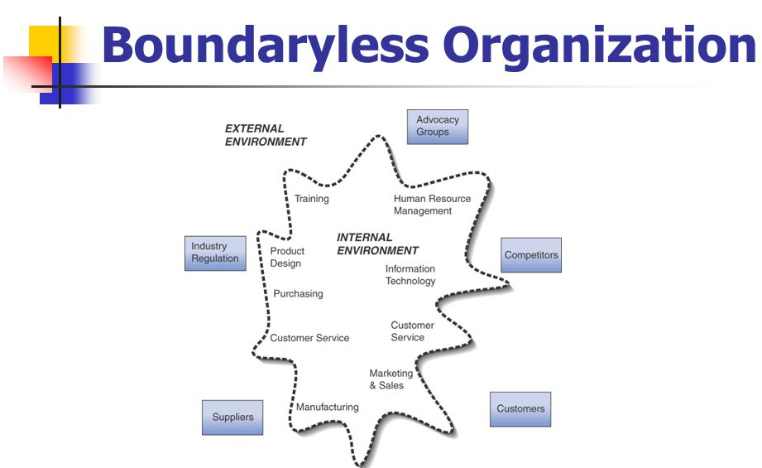
Boundaryless Organizations:
As CEO of General Electric (GE), Jack Welch introduced the idea of boundaryless organizations in an effort to eliminate organizational silos and foster cooperation and creativity. The boundaryless strategy, when carefully used and backed by a strong culture of cooperation, may position companies like GE for long-term success in the quickly changing business environment of today (hbr.org, 2015).

Slide 22

Benefits of Breaking Down Silos and Creating Boundaryless Organizations:
Enhanced Communication.
Cross-functional Collaboration.
Notes:
Enhanced Communication: Boundaryless organizations provide continuous communication, enabling the circulation of ideas and information across the organisation by removing barriers between various business units and divisions (Muller and Dekker, 2020.).
Cross-functional Collaboration: The boundaryless method fosters synergy and brings together experts from several fields to tackle challenging challenges and provide novel solutions by encouraging cooperation across varied teams.

Slide 23
Benefits of Breaking Down Silos and Creating Boundaryless Organizations:
Knowledge Sharing.
Agility and Adaptability.
Talent Mobility.
Notes:
Knowledge Sharing: Organizations without boundaries allow information and best practices to easily flow between units, promoting ongoing learning and development.
Agility and Adaptability: Because there are no strict hierarchical barriers, the organization may make decisions quickly and adjust to shifting market conditions, providing it a competitive advantage.
Talent Mobility: Employees have the chance to investigate positions in other departments of the company, fostering talent retention and skill growth.

Slide 24

Evaluation of Collaboration and Innovation under the Boundaryless Approach:
Cooperation and creativity were significantly impacted by the boundaryless organizational structure Welch developed at GE.
Collaboration.
Innovation.
Notes:
Cooperation and creativity were significantly impacted by the boundaryless organizational structure Welch developed at GE.
Collaboration: The dissolution of silos allowed for free communication and cooperation across departments, promoting a culture of teamwork as well as shared objectives. Employees were encouraged to seek advice and assistance from coworkers throughout the company, which resulted in more effective decision-making procedures.
Innovation: Innovation was able to flourish in boundaryless organizations due to the cross-fertilization of ideas and information. Workers were exposed to many viewpoints and encouraged to think creatively and unconventionally, which resulted in the development of innovative solutions.

Slide 25
Evaluation of Collaboration and Innovation under the Boundaryless Approach:
Flatter Hierarchy.
Increased Responsiveness.
Notes:
Collaboration: The dissolution of silos allowed for free communication and cooperation across departments, promoting a culture of teamwork as well as shared objectives. Employees were encouraged to seek advice and assistance from coworkers throughout the company, which resulted in more effective decision-making procedures.
Innovation: Innovation was able to flourish in boundaryless organizations due to the cross-fertilization of ideas and information. Workers were exposed to many viewpoints and encouraged to think creatively and unconventionally, which resulted in the development of innovative solutions.
Flatter Hierarchy: By removing bureaucratic layers, GE was able to make decisions with more agility and respond rapidly to market needs and new possibilities.
Increased Responsiveness: The boundaryless strategy gave GE the flexibility to respond quickly to developments in the outside world, placing the business at the forefront of market trends and technological breakthroughs (LaMarco, 2018).

Slide 26
Daniel-Florin Lazar

Slide 27
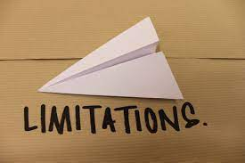
Critical assessment of limitations of boundaryless organizational structure:
The boundaryless organizational system had advantages, but it also had drawbacks.
Coordination Complexity.
Information Sharing Challenges.
Notes:
Coordination Complexity: Ensuring coordination and coherence across diverse business divisions grew more challenging when borders were removed. Confusion and inefficiency may result from unclear reporting boundaries and overlaps in duties.
Information Sharing Challenges: Information exchange may not be optimized in huge organizations like GE, which leaves pockets of knowledge or skills underutilized throughout the organization.

Slide 28
Critical assessment of limitations of boundaryless organizational structure:
Accountability Ambiguity.
Cultural Resistance.
Loss of Expertise.
Notes:
Accountability Ambiguity: With less hierarchical control, responsibility for decisions and results might become murky, opening the door to possible blame-shifting in the event of failures.
Cultural Resistance: In example, if the boundaryless method challenges pre-existing power structures or customary working practices, certain employees and supervisors could be resistant to change.
Loss of Expertise: Employees that switch between various business units may lose their in-depth knowledge of a certain field, which might have an effect on the caliber of work done in specialized fields.

Slide 29
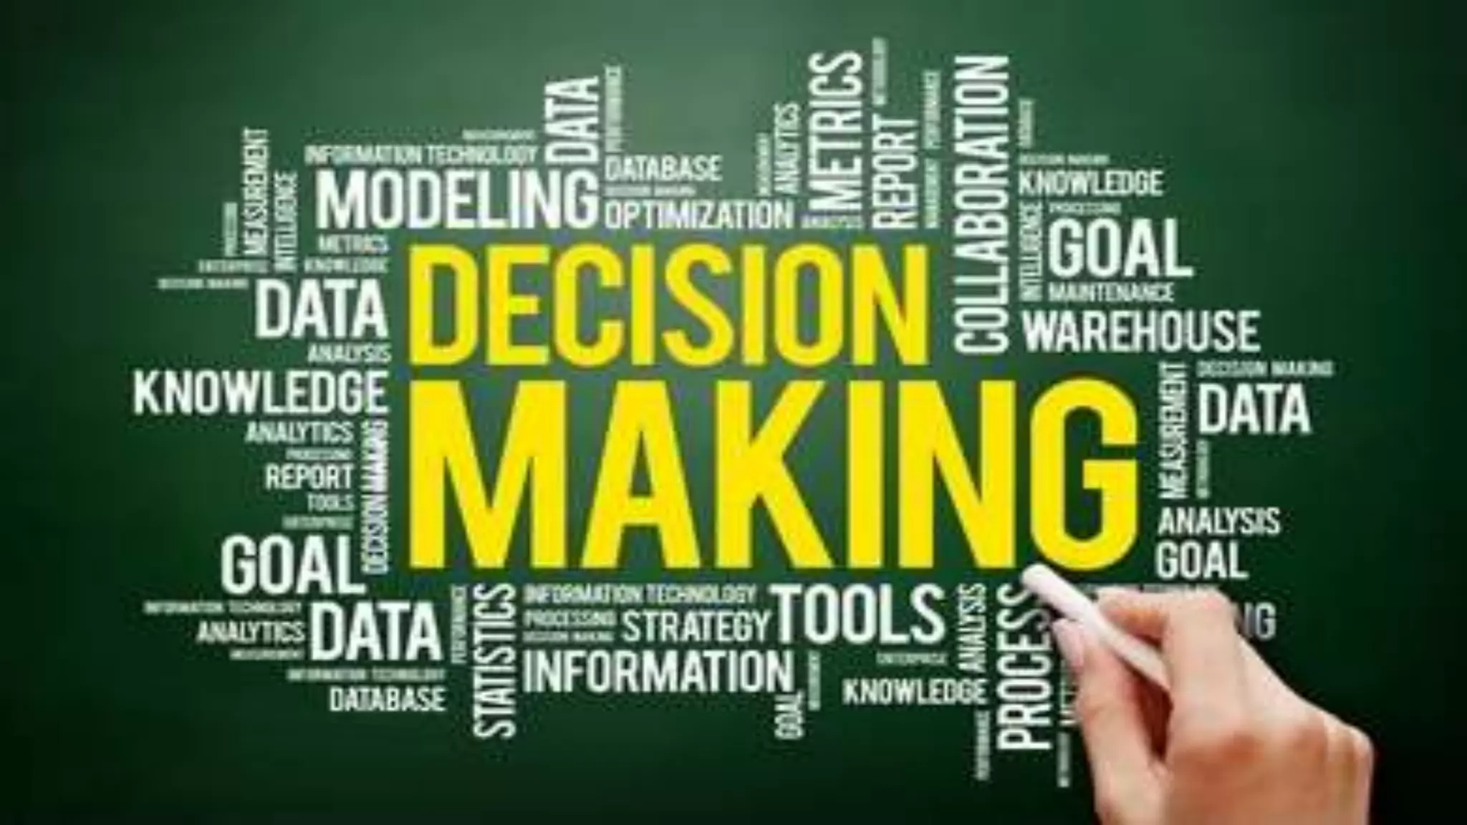
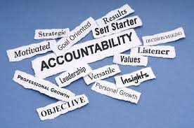
Implications on Decision-Making and Accountability:
Decision-Making.
Accountability.
Empowerment and Ownership.
Notes:
Decision-making and responsibility may be significantly impacted by the boundaryless approach.
Decision-Making: In order to minimize misunderstanding or competing agendas, the flatter organizational structure needs a heavy emphasis on good communication and cooperation.
Accountability: To establish responsibility in a boundaryless organization, roles, duties, and decision-making power must be clearly defined. In order to effectively assess and recognize both individual and group contributions, this calls for comprehensive performance management systems.
Empowerment and Ownership: Employees must have the authority to decide within their purviews while yet being held accountable for the results. To preserve responsibility without inhibiting innovation, leaders should establish a balance between autonomy and monitoring.

Slide 30
Performance Management and the "Rank and Yank" System:
As CEO of General Electric (GE), Jack Welch oversaw a strict performance management system well known as the "Rank and Yank" method. Both good and bad effects were experienced by GE's talent identification process and corporate culture as a result of Jack Welch's performance management system, which included the contentious "Rank and Yank" strategy (Stone et al., 2019). While it was successful in identifying and rewarding top talent, it also caused morale issues, had an influence on employee behavior, and could have hampered cooperation and creativity.

Slide 31
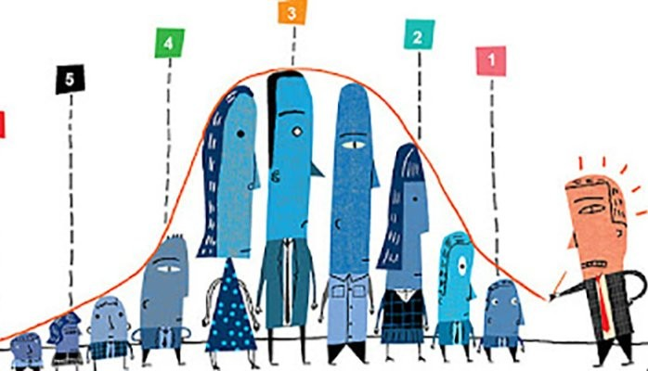
Analysis of Welch's Performance Management System and the "Rank and Yank" Approach:
Performance Metrics.
Forced Ranking.
Differentiation of Talent.
Notes:
The purpose of Welch's performance management system is to rate people according to both their individual performance as well as organizational contributions. According to their performance in comparison to their peers, individuals within a department or business unit were systematically ranked under the "Rank and Yank" technique (business.com. (2023). The organization then selected the worst 10% of staff as underperformers and, in certain circumstances, let them leave.
Performance Metrics: To analyse employees' contributions thoroughly, GE used a variety of performance criteria, such as financial success, customer happiness, leadership skills, and collaboration.
Forced Ranking: Because managers were forced to rate their staff members under the "Rank and Yank" system, there was a sense of competition among staff members as they were compared to one another.
Differentiation of Talent: In order to find and reward the finest talent while resolving difficulties with poor performers, the system sought to distinguish between high performers as well as underperformers.

Slide 32
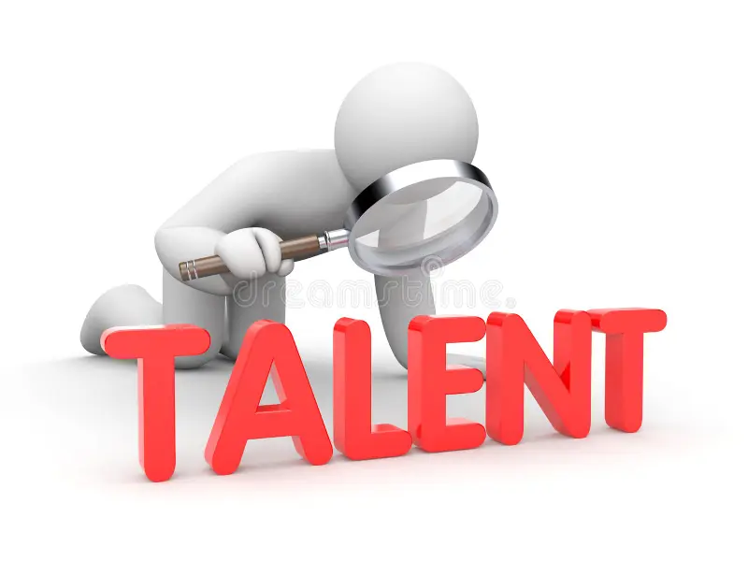
Evaluation of the Effectiveness in Identifying and Promoting Top Talent:
The "Rank and Yank" method had both advantageous and disadvantageous effects on finding and elevating elite talent at GE (linkedin.com, 2023).
Identification of High Performers.
Enhanced Accountability.
Notes:
Identification of High Performers: The imposed ranking made it possible for GE to recognize and promote high-performing workers, ensuring that top talent obtained opportunities for advancement.
Enhanced Accountability: The method promoted individual accountability and a meritocratic culture by encouraging individuals to accept responsibility for their work and strive for excellence.

Slide 33
Evaluation of the Effectiveness in Identifying and Promoting Top Talent:
Competitive Culture.
Potential Biases.
Fear of Risk-Taking.
Notes:
Competitive Culture: Employees were motivated to exceed their colleagues by the competitive character of the system, perhaps encouraging a high-performance culture inside the company.
Potential Biases: As workers were compared within their groups, the compulsory ranking approach may have produced biases, perhaps excluding the contributions of people in teams that performed very well.
Fear of Risk-Taking: Employees may have been reluctant to take chances or collaborate because they feared that if their ideas did not instantly produce favorable results, they would be rated lower.

Slide 34

Ethical Considerations of the "Rank and Yank" System and its Impact on Employee Morale and Company Culture:
The "Rank and Yank" method highlighted a number of moral questions and had a big impact on organizational culture and employee morale (Bates, 2018).
Employee Morale.
Lack of Individual Development.
Notes:
Employee Morale: Fear of falling into the bottom 10% and maybe losing one's job led to an anxious atmosphere at work that could worsen anxiety and lower employee morale.
Lack of Individual Development: Employees' specific development requirements may have been overlooked in the excessive focus on rating and eliminating underperformers, restricting prospects for progress.

Slide 35
Ethical Considerations of the "Rank and Yank" System and its Impact on Employee Morale and Company Culture:
Impact on Company Culture.
Erosion of Trust.
Impact on Innovation.
Notes:
Impact on Company Culture: The system's competitive character could encourage a brutal culture that discourages cooperation and teamwork among workers.
Erosion of Trust: The "Rank and Yank" method may cause employees to lose faith in management because they may think the system is arbitrary or unjust.
Impact on Innovation: Fear and competition-based cultures may discourage experimentation and creativity, which might stifle long-term growth and innovation.

Slide 36
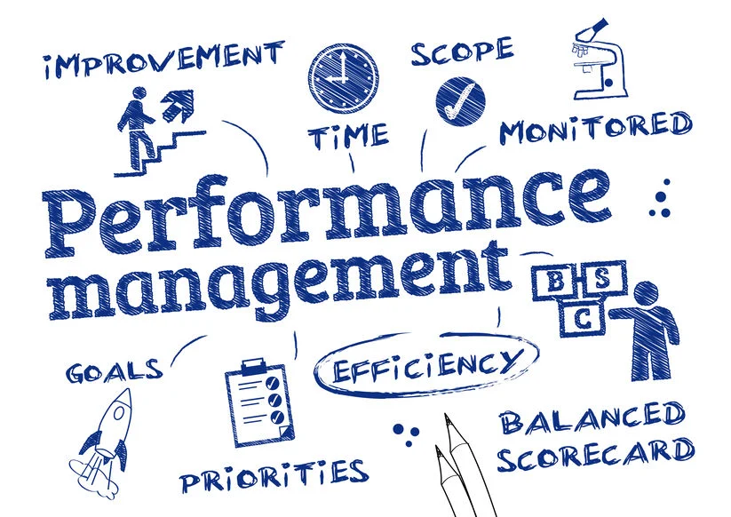
Mitigating Ethical Concerns and Improving Performance Management:
Organizations might think about the following tactics to handle the ethical issues and enhance performance management.
Focus on Development.
Frequent Feedback.
Notes:
Focus on Development: A culture that is supportive as well as growth-oriented may be developed by balancing the importance of performance assessment with that of personal growth.
Frequent Feedback: Employees who receive regular coaching and feedback are better able to identify their areas of strength and growth, which supports a culture of lifelong learning (Chanana and Sangeeta, 2021).

Slide 37
Mitigating Ethical Concerns and Improving Performance Management:
Multiple Metrics.
Transparent Process.
Emphasis on Collaboration.
Notes:
Multiple Metrics: A more thorough and impartial evaluation of employee contributions may be achieved by using performance indicators that go beyond only financial outcomes.
Transparent Process: The trust of employees and their comprehension of how rankings are calculated may both be improved by ensuring openness in the performance management procedure.
Emphasis on Collaboration: Recognizing and recognizing cooperative actions can promote cooperation and group achievement. In order to promote a friendly and cooperative culture that supports constant enhancement and long-term achievement, modern systems for performance management should place a priority on staff growth, regular feedback, and openness. To create an ethically sound workplace that supports both employee development and organizational excellence, managers must carefully assess the ethical consequences of their performance management procedures.

Slide 38
Ionut Paul Marincu

Slide 39
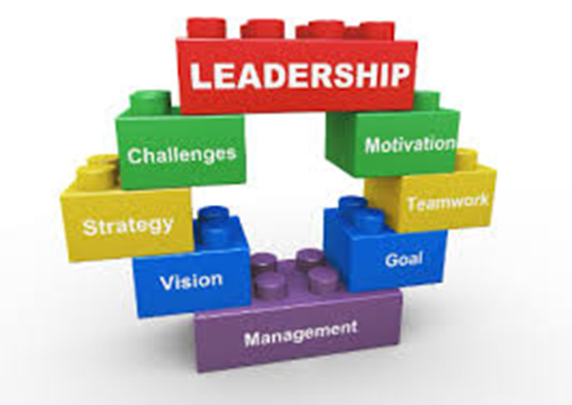
Long-Term Vision and Strategy:
Jack Welch adopted a long-term vision as well as strategic direction while serving as CEO of General Electric (GE), transforming the organization into one of the most valuable as well as diverse businesses in the world (Ruggie et al., 2021). Investment choices and portfolio optimization led to great financial success and development. The strategic approach's long-term viability is called into doubt by risks and obstacles, particularly given how heavily it relies on financial services.

Slide 40
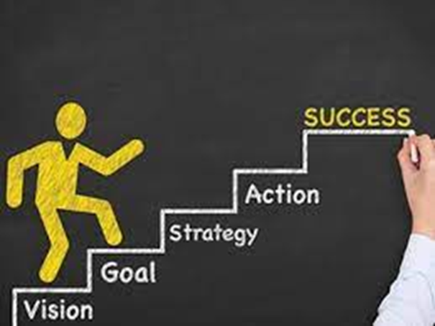
Examination of Welch's Long-Term Vision and Strategic Direction:
Portfolio Diversification.
Global Expansion.
Innovation and Technology.
Cost Efficiency.
Notes:
Welch's long-term goal for GE was to transform the company into a high-performance business that operated in a variety of industries while retaining a competitive edge in each one. He concentrated on the following essential components in an effort to promote an environment of excellence and ongoing improvement.
Portfolio Diversification: By entering high-growth markets and divesting non-core companies that did not support the firm's strategic goals, Welch aimed to maximize GE's portfolio.
Global Expansion: Under his direction, GE increased its global footprint by discovering fresh markets and business prospects outside of the US.
Innovation and Technology: Welch emphasized the value of technology and innovation in preserving GE's competitive advantage, investing in R&D to upgrade products and processes (Benedettini and Kowalkowski, 2021).
Cost Efficiency: He promoted productivity gains and the simplification of procedures to increase profitability. He also fostered a culture of cost restraint and operational efficiency.

Slide 41
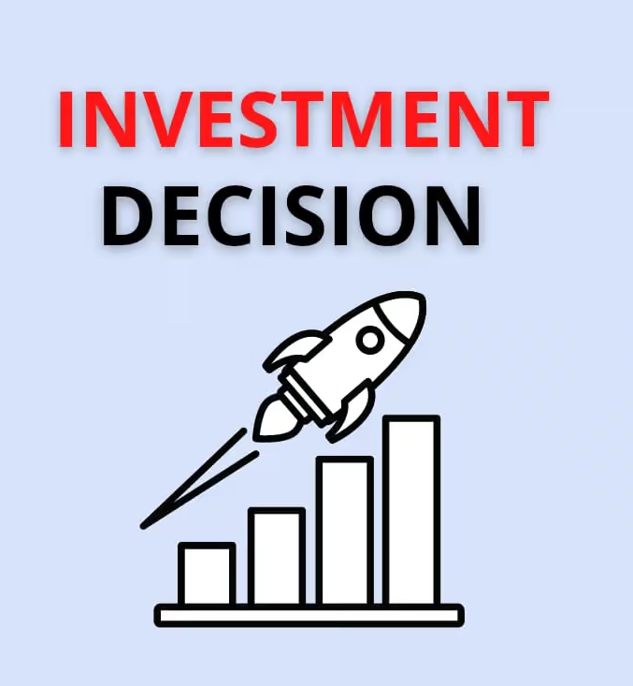
Analysis of Portfolio Optimization and Investment Decisions:
Portfolio Optimization.
Acquisitions and Investments.
Financial Services Expansion.
Notes:
Portfolio Optimization: In order to concentrate on sectors with greater growth potential and profitability, Welch's portfolio optimization plan involves divesting non-core or failing firms. Over 200 businesses were sold off by GE during his leadership, which helped to streamline operations and effectively reallocate resources.
Acquisitions and Investments: To diversify GE's income sources and seize new possibilities, Welch also made smart acquisitions as well as investments in high-growth sectors including financial services, healthcare, as well as media.
Financial Services Expansion: In terms of revenue creation, GE Capital, the company's financial services division, was essential. Later on, though, as the financial crisis of 2008 revealed vulnerabilities in this industry, the company's high reliance on GE Capital started to pose problems.

Slide 42
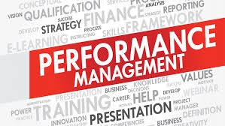
Critical Evaluation of the Alignment between Vision and Performance Successes:
Successes.
Challenges.
Long-Term Sustainability.
Cultural Impact.
Notes:
Welch's strategic strategy was highly successful, as seen by the nearly 4,000% increase in GE's market value under his leadership. The portfolio optimization initiatives enabled GE concentrate on its core businesses and take the lead in a number of sectors, including aviation, healthcare, and energy (Pratomo et al., 2021).
Challenges: Despite general success, Welch's idea wasn't entirely realised without problems. Due to GE Capital's strong focus on financial services, the corporation was more vulnerable to risks during recessions, as was evident during the 2008 financial crisis
Long-Term Sustainability: While Welch's vision led to success under his leadership, other choices, such as GE's excessive dependence on financial services, prompted concerns about the strategic direction's long-term viability.
Cultural Impact: Under Welch's direction, there may have been a strong emphasis on short-term outcomes and hitting financial goals, which may have contributed to a culture that is more risk-averse as well as short-term focused, which might have hampered long-term innovation as well as strategic thinking.
Welch's accomplishments and failures can serve as a lesson for future leaders, highlighting the need of striking a balance between short-term financial aims and long-term strategic vision.
To guarantee continuous development and flexibility in a quickly shifting business environment, organisations should work to increase resilience, promote an innovative culture, and cautiously manage risks.

Slide 43
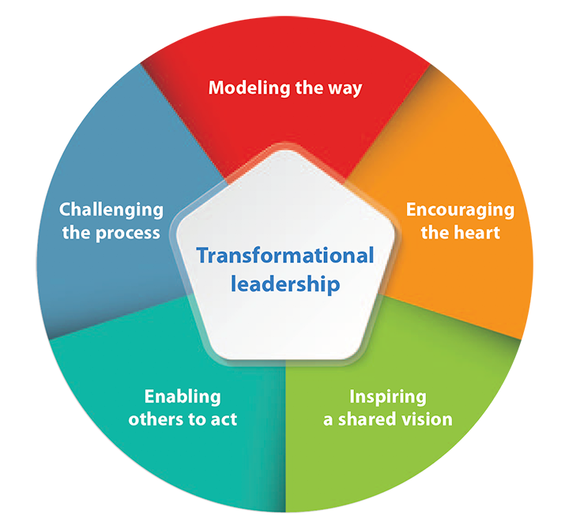
Welch's leadership qualities related to various leadership theories and perspectives:
Transformational Leadership.
Notes:
The extraordinary expansion of the corporation during Jack Welch's term as CEO of General Electric (GE) was a result of his distinctive leadership style.
The following leadership ideas and viewpoints are compatible with Welch's management style.
Transformational Leadership: Welch's management approach closely resembles the tenets of transformational leadership. He was a dynamic and forward-thinking leader who inspired and encouraged his team to produce outstanding outcomes. Welch inspired people to look beyond their own interests and contribute to the success of the company by being able to articulate a compelling vision for GE's future. This was made possible by his excitement and energy. His transformational leadership approach played a key role in propelling GE's expansion and transformation into a superpower (Stout, 2022).

Slide 44
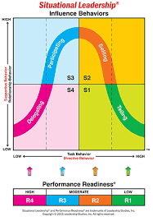
Welch's leadership qualities related to various leadership theories and perspectives:
Situational Leadership.
Notes:
The extraordinary expansion of the corporation during Jack Welch's term as CEO of General Electric (GE) was a result of his distinctive leadership style.
The following leadership ideas and viewpoints are compatible with Welch's management style.
Situational Leadership: Welch showed certain situational leadership traits in addition to his primary transformational leadership style. In line with situational leadership's focus on adjusting leadership style relying on the preparedness and advancement level of followers, he supported providing managers autonomy and decentralizing decision-making. Welch changed his strategy to encourage creativity and agility after realizing that various business units and managers could need different amounts of guidance and assistance.

Slide 45
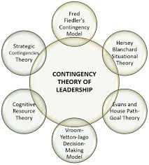
Welch's leadership qualities related to various leadership theories and perspectives:
Contingency Theory.
Notes:
The extraordinary expansion of the corporation during Jack Welch's term as CEO of General Electric (GE) was a result of his distinctive leadership style.
The following leadership ideas and viewpoints are compatible with Welch's management style.
Contingency Theory: According to the contingency hypothesis, a leader's ability to lead effectively depends on the context and how well their style complements the traits of their organization and its surroundings (Zelt et al., 2019). Welch's strategy is consistent with contingency theory since he customized his leadership style to meet the unique demands and problems of GE. He demonstrated his capacity to match his leadership approach with the context of the organization, for instance, by emphasizing portfolio optimization and diversification in response to the shifting business climate.

Slide 46
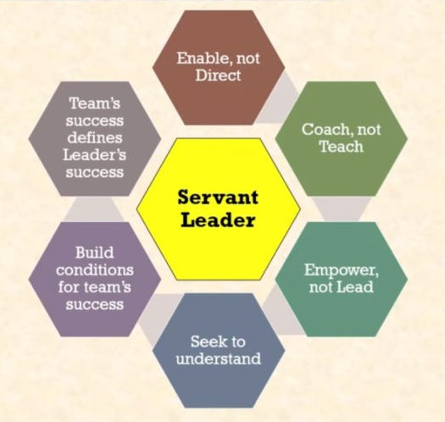
Welch's leadership style contrasts with different theoretical frameworks:
Servant Leadership.
Notes:
Welch's leadership style agrees with a number of leadership theories, but it also differs from several viewpoints.
Servant Leadership: Welch's strategy, although successful in generating development and results, contrasts with servant leadership, which emphasizes leaders' attention to meeting the needs of their subordinates and giving them the tools they need to reach their full potential. Welch was concerned about employee development, although his leadership approach tended to be more focused on motivating employees to perform well and hit financial goals (Pawar et al., 2020).

Slide 47
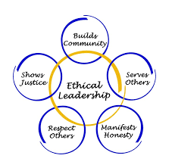
Welch's leadership style contrasts with different theoretical frameworks:
Ethical Leadership.
Notes:
Welch's leadership style agrees with a number of leadership theories, but it also differs from several viewpoints.
Ethical Leadership: The wellbeing of stakeholders, moral standards, and ethical decision-making are given top priority. Despite the fact that Welch's strategic choices considerably improved the value of GE, several detractors contend that his relentless cost-cutting and layoffs in the pursuit of immediate financial objectives posed moral questions regarding employee welfare.

Slide 48
Suitability in the Context of GE's Industry and Challenges:
The issues GE experienced under Welch were perfectly suited for his style of leadership. With activities across many industries and continents, the organization needed a flexible and creative leadership approach to successfully negotiate the complexity of each business unit. The industrial dynamics of GE and the requirement for ongoing market adaption were well-aligned with Welch's vision of a boundaryless organization, portfolio optimization, and emphasis on innovation.
Notes:
It is important to note, nevertheless, that Welch's management approach had certain disadvantages as well. The "Rank and Yank" system and the intensive focus on financial goals generated a competitive and high-pressure work atmosphere that might have an effect on staff morale and long-term creativity.

Slide 49
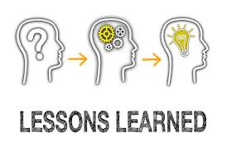
Lessons Learned for Future Leaders and Organizations:
Embrace Charisma with Authenticity.
Balance Demanding Expectations.
Empowerment through Decentralization.
Notes:
Future leaders and organizations aiming for success and long-term growth may learn a lot from Jack Welch's leadership at General Electric.
Embrace Charisma with Authenticity: Welch's charismatic leadership style served as a testament to the effectiveness of a strong, sincere personality in motivating and encouraging groups of people. Potential leaders ought to promote their individual traits while staying sincere and approachable with their staff.
Balance Demanding Expectations: High expectations can spur performance, but leaders must strike a balance between them and other factors like support and empathy. Long-term success may be facilitated by recognizing the unique requirements of employees and giving them with the tools they need to overcome obstacles.
Empowerment through Decentralization: Welch's decentralized strategy gave managers and teams the authority to make choices, promoting creativity and agility. Future leaders should think about granting brilliant people liberty while staying in line with the organization's ultimate strategy.

Slide 50

Lessons Learned for Future Leaders and Organizations:
Performance Management with Care.
Adaptability and Change.
Notes:
Performance Management with Care: While the "Rank and Yank" method is successful in eliminating underachievers, it should be used with discretion. Future leaders must place a high priority on honest and open performance reviews that encourage development rather than induce fear.
Adaptability and Change: With his boundaryless organizational paradigm, Welch emphasized the value of flexibility in a changing corporate environment. Future leaders should embrace innovation, be adaptable to change, and promote a culture of ongoing learning and development.

Slide 51
Lessons Learned for Future Leaders and Organizations:
Focus on Employee Engagement.
Long-Term Vision and Legacy.
Notes:
Focus on Employee Engagement: Under Welch, staff inspiration and engagement were crucial to GE's success. Future leaders should place a high priority on fostering a supportive and welcoming workplace environment that promotes cooperation, rewards success, and supports employee growth.
Long-Term Vision and Legacy: Leaders should concentrate on leaving a lasting legacy after their term in office. A long-lasting influence on the organization and its stakeholders may be ensured by investing in talent development, moral behaviour, and responsible decision-making.
Welch's accomplishments and failures can serve as a lesson for future leaders, highlighting the need of striking a balance between short-term financial aims and long-term strategic vision (Arthur, 2020).

Slide 52

Conclusion:
A combination of transformational, charismatic, as well as situational methods of leadership that were suitable for the organization's sector and difficulties may be seen in Jack Welch's management at GE. His strategic thinking, emphasis on decentralization, and attention on portfolio optimization propelled GE to substantial growth and success.
Notes:
However, other facets of his leadership, like the "Rank and Yank" system, generated moral questions and may have an impact on both long-term viability and employee morale. Future leaders must comprehend the benefits and drawbacks of many leadership theories in order to tailor their strategies to the particular demands of their organisations and environments. Leaders may create a balanced and successful leadership style that encourages innovation, encourages employee engagement, and supports sustainable development in today's changing corporate environment by taking lessons from Welch's triumphs and problems.

Slide 53

References
Arthur, M.B. (2020) Remembering Jack Welch-and his legacy over your career, Forbes Available at: https://www.forbes.com/sites/michaelbarthur/2020/03/06/remembering-jack-welch--and-his-legacy-over-your-career/ (Accessed: 23 July 2023).
Bates, S. (2018) Forced ranking, SHRM. Available at: https://www.shrm.org/hr-today/news/hr-magazine/pages/0603bates.aspx (Accessed: 23 July 2023).
Benedettini, O. and Kowalkowski, C., 2021. Servitization and innovation strategy: the trade-off between service-based differentiation and product R&D strength. Servitization: A Pathway Towards A Resilient, Productive And Sustainable Future, 10(12), p.36.
business.com. (2023) ‘rank and yank’ management practices business.com. Available at: https://www.business.com/articles/the-end-of-rank-and-yank-management-practices-revisited/ (Accessed: 23 July 2023).
Cardona, P., Rey, C. and Craig, N., 2019. Purpose-driven leadership. In Purpose-driven Organizations (pp. 57-71). Palgrave Macmillan, Cham.
Notes:
Chanana, N. and Sangeeta, 2021. Employee engagement practices during COVID‐19 lockdown. Journal of public affairs, 21(4), p.e2508.
Colvin, G. (2020) Jack Welch: For a time, the most valuable CEO on Earth, Fortune. Available at: https://fortune.com/2020/03/02/jack-welch-ge-ceo-death/ (Accessed: 22 July 2023).
Dalrymple, R. (2023) Jack Welch, Leaders.com. Available at: https://leaders.com/rankings/person/jack-welch/ (Accessed: 22 July 2023).
hbr.org, (2020) Jack Welch’s approach to leadership Harvard Business Review. Available at: https://hbr.org/2020/03/jack-welchs-approach-to-leadership (Accessed: 22 July 2023).
hbr.org, 2015. [Online] Jack Welch’s approach to breaking down silos still works Harvard Business Review. Available at: https://hbr.org/2015/09/jack-welchs-approach-to-breaking-down-silos-still-works (Accessed: 22 July 2023).
LaMarco, N. (2018) The structure of a boundaryless organization, Small Business - Chron.com. Available at: https://smallbusiness.chron.com/structure-boundaryless-organization-2764.html (Accessed: 22 July 2023).
linkedin.com. (2023) CEO-driven HR function - linkedin. Available at: https://www.linkedin.com/pulse/ceo-driven-hr-function-adedoyin-adebayo (Accessed: 22 July 2023).
Lohr, S. (2020) Jack Welch, G.E. chief who became a business superstar, dies at 84, The New York Times. Available at: https://www.nytimes.com/2020/03/02/business/jack-welch-died.html (Accessed: 22 July 2023).
López‐Gamero, M.D., Molina‐Azorín, J.F., Pereira‐Moliner, J. and Pertusa‐Ortega, E.M., 2023. Agility, innovation, environmental management and competitiveness in the hotel industry. Corporate Social Responsibility and Environmental Management, 30(2), pp.548-562.
Martela, F., 2019. What makes self-managing organizations novel? Comparing how Weberian bureaucracy, Mintzberg’s adhocracy, and self-organizing solve six fundamental problems of organizing. Journal of Organization Design, 8(1), pp.1-23.
Muller, G.J. and Dekker, L., 2020. Management competency development and pre-service and in-service training of tourism human resources aligned with industry revolution 4.0. Tạp chí Khoa học Đại học Văn Hiến, 7(1), pp.28-42.
Pattnaik, L. and Jena, L.K., 2020. Mindfulness, remote engagement and employee morale: conceptual analysis to address the “new normal”. International Journal of Organizational Analysis, 29(4), pp.873-890.
Pawar, A., Sudan, K., Satini, S. and Sunarsi, D., 2020. Organizational servant leadership. International Journal of Educational Administration, Management, and Leadership, pp.63-76.
Pratomo, T., Yulianto, E. and Zein, Z., 2021. Core values measurement: Case study of state-owned enterprises in Indonesia. International Journal of Research in Business and Social Science (2147-4478), 10(3), pp.456-461.
Ruggie, J.G., Caroline, R.E.E.S. and Davis, R., 2021. Ten years after: from UN Guiding Principles to multi-fiduciary obligations. Business and Human Rights Journal, 6(2), pp.179-197.
Sezer, A.Y.A.Z., 2022. Transformational Leadership and Dynamic Capabilities in Businesses: A Review. Uluslararası Yönetim Akademisi Dergisi, 5(3), pp.602-621.
Stone, T.H., Jawahar, I.M., Johnsen, G. and Foster, J., 2019. Cutting-edge performance management innovations: What do we know. World at Work Journal, 28(1-2), pp.26-44.
Stout, A.E., 2022. An Examination of Culturally Competent Transformational Leadership Influence of Student Achievement and Stake-holders Perception (Doctoral dissertation, Seattle Pacific University).
Wachenje, B. (2014) Jack Welch molds the model of the big-company CEO, CNBC. Available at: https://www.cnbc.com/2014/04/29/25-jack-welch.html (Accessed: 22 July 2023).
Zelt, S., Recker, J., Schmiedel, T. and vom Brocke, J., 2019. A theory of contingent business process management. Business Process Management Journal, 25(6), pp.1291-1316

Slide 54

Thank You

