Slide 1
Chapter 2
Approaches to organisation and management

Slide 2
The importance of management theory
It helps to view the interrelationships between theory, behaviour and management practice.
It helps understand the principles underlying the process of management.
Management theories are interpretive, and evolve as the organisational environment changes.
Earlier ideas are often incorporated into new ones and so are of continuing importance to the manager.

Slide 3
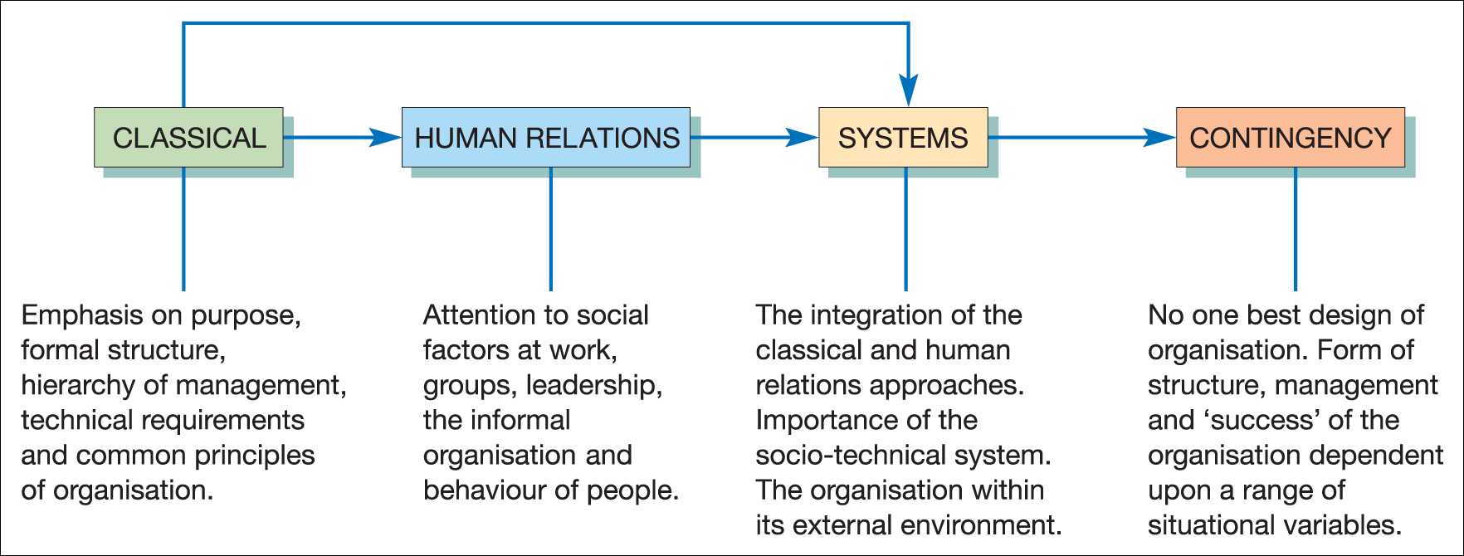
Main approaches to organisation, structure and management
Figure 2.1 Main approaches to organisation, structure and management

Slide 4
The classical approach
The organisation is considered in terms of:
  Purpose
  Formal structure
  Planning of work
  Technical requirements
  Rational behaviour
In order to find:
  The most effective structure

Slide 5
Fayol’s five managerial activities
Planning
Organising
Command
Co-ordination
Control

Slide 6
Sub-groups of classical approach
Common principles can be applied to all organisations, taking into account:
the particular situational variables of each organisation;
the social and psychological factors relating to members of the organisation.
Scientific management
F.W.Taylor
Bureaucracy
Max Weber

Slide 7
Scientific management
F.W. Taylor, 1856–1917
Belief in the possibility of a ‘best way’ to undertake a job
Analysis of work into discrete tasks
Identification of the ‘one best way’
Use of the ‘rational–economic’ concept of motivation

Slide 8
Principles to guide management
The principles are summarised as:
the development of a true science for each person’s work;
scientific selection, training and development of workers;
co-operation with workers to ensure work is carried out in the prescribed way;
hierarchical structures of authority and close supervision;
the division of work and responsibility between managers and workers.

Slide 9
Critique of Taylorism
Leads to hostility and suspicion among workers.
The ‘rationalisation’ of work results in the de-skilling of workers.
Creates excessive levels of managerial control which can endanger organisational purpose.
Views workers as ‘machines’ rather than social beings.

Slide 10
Taylor’s legacy
Work study systems
Payment by results
Management by exception
Production control
  e.g. the assembly line and Fordism
Systematic and procedural training
‘Taylor… shaped the first coherent school of thought with application to the industrialised world’.
Stern

Slide 11
Bureaucracy
Max Weber, 1864–1920
Concept arose from his sociological studies of power and authority.
Belief in the superiority of an organisational structure which can survive changes in individual personnel.
That it is a means of introducing order and rationality into social life.

Slide 12
Main characteristics of bureaucracies
Organisational tasks are allocated as duties between organisational positions.
Clear-cut division of labour and high degree of task specialisation.
A hierarchical authority system
Uniformity of decisions is achieved via rules and regulations.
Impersonal behaviour by officials when dealing with each other and with clients.
Employment is based on technical qualifications.

Slide 13
Four main features of bureaucracy
Specialisation
Hierarchy of authority
System of rules
Impersonal behaviour
Stewart

Slide 14
Criticisms of bureaucracy
They over-emphasise rules, procedures, record keeping and paperwork which become an end in themselves.
Officials may develop a dependence on status, symbols and rules.
Individual initiative can be stifled by rules.
People can become officious and conceal procedures from outsiders.
Behaviour can be unresponsive to individual incidents and problems.

Slide 15
Public sector organisations
The importance of:
Uniformity of treatment
Regularity of procedures
Public accountability for operations.
Means that bureaucracy probably remains relevant in the public sector.

Slide 16
The human relations approach
Elton Mayo, 1880–1949
The Hawthorne Experiments at the Western Electric Company.
Attention given to social factors at work rather than purely rational organisation.
Studies focus on individual psychological and social needs.
Recognised the informal organisation and group norms as an important influence on worker behaviour.

Slide 17
Evaluation of the
Hawthorne experiments
A flawed experiment?
  Failure to take environmental factors into account.
  Adoption of a unitary frame of reference to worker–employer relationship.
  Oversimplification of complex behaviours.
  Ignores external social factors on worker behaviour, e.g. the ‘sex-power’ differential.

Slide 18
The importance of the Hawthorne experiments
They emphasised the importance of the wider social needs of individuals and gave recognition to the work organisation as a social organisation… and the importance of group values and norms.
The classical school was about ‘organisations without people’ whereas the human relations school was about ‘people without organisations’.

Slide 19
Neo-human relations
Dates from the 1950s to 1960s
Psychological in background
Concerned with human personality and motivation
  Maslow; the hierarchy of needs
  Herzberg; the two-factor motivation theory
  McGregor; Theory X and Theory Y managers

Slide 20
The systems approach
A reconciliation of classical and human relations approaches.
Considers:
  The total work organisation
  The relationship between structure and behaviour
  The range of variables within an organisation.
The organisation as an ‘open system’.
The Tavistock Institute Studies of the 1940's mining industry.
Socio-technical system or technological determinism.

Slide 21
The contingency approach
Rejects the idea of ‘one best form or structure’ or ‘optimum state’ for an organisation.
Focus placed on examining situational variables.
Successful design is dependent (i.e. contingent) upon organisational:
  Purpose
  Culture
  Size
  Technology
  Environment.

Slide 22
The decision-making approach
Achievement of goals requires decision-making by managers.
Approach focuses on managerial decision-making, including:
  the use of information and processes to support decision making;
  how decisions are made;
  how conflicts are resolved.
In order to see how decision-making can be improved.

Slide 23
Social action
Sociologically based approach to organisational behaviour and management
Views the organisation from the standpoint of individual members (the ‘actors’).
Individual goals and interpretations of the work situation are important in explaining behaviour.
Conflict is seen as an organisational norm.

Slide 24
Unitarist or pluralist perspectives
‘With the unitarist perspective, the organisation is viewed as an integrated and harmonious whole with managers and other staff sharing common interests and objectives.
The pluralist perspective … views the organisation as made up of powerful and competing sub-groups with their own legitimate loyalties, objectives and leaders. These competing sub-groups are almost certain to come into conflict.

Slide 25
Action theory
A sociological approach which studies the relationship between meanings and actions.
Uses concepts from systems theory to analyse large-scale behaviour
  Role
  Relationships
  Structure
  Process

Slide 26
Postmodernism
‘Organisation (is) less the expression of planned thought and calculative action and more a defensive reaction to forces intrinsic to the social body which constantly threaten the stability of organised life’.
Cooper and Burrell

Slide 27
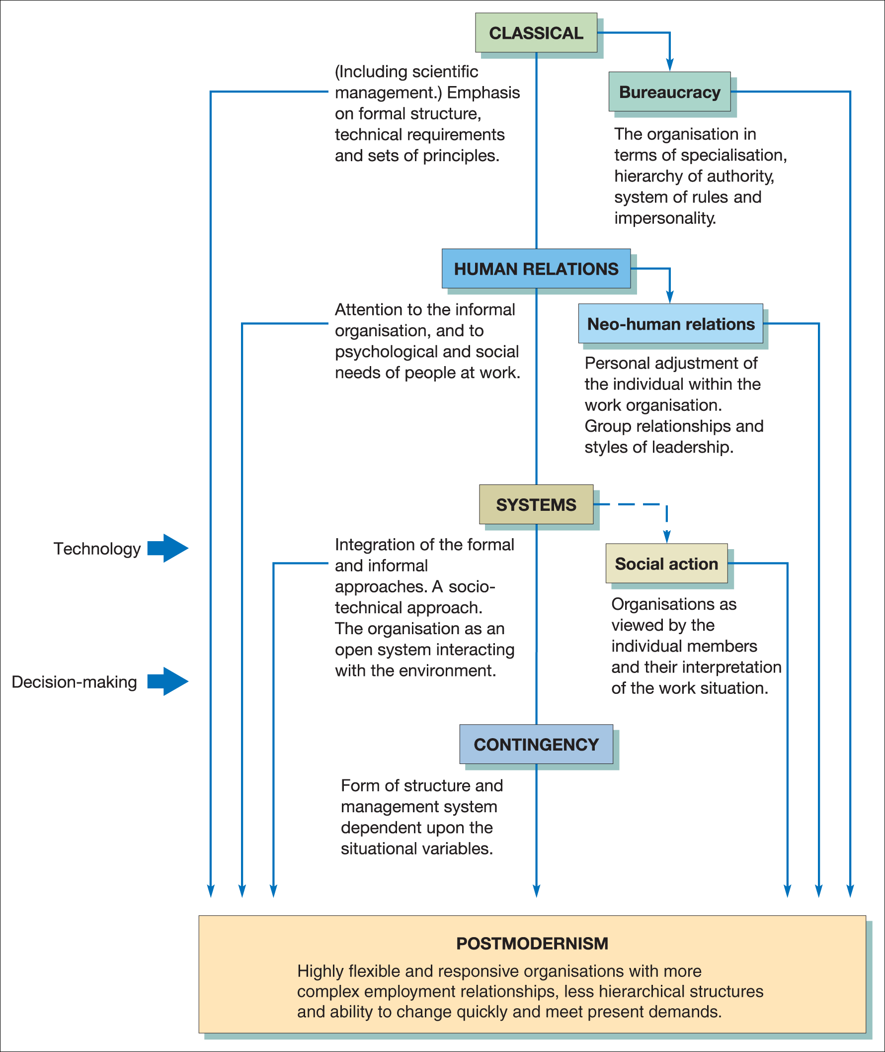
Developments in managerial theory
Figure 2.3 Outline of developments in management theory

Slide 28
Relevance to management and organisational behaviour
Different categorisations of theory illustrate the complex nature of the study and practice of management.
They provide a setting in which to view the field of management and organisational behaviour.
They assist in organisational analysis and the identification of problem areas.
They enable managers to select ideas from a range of approaches which best suit the requirement of the job.

Slide 29
Caveats to be noted
Various approaches represent a progression of ideas, not competing ideas.
Ideas of early writers may still have relevance.
Categorisations tend to be arbitrary.
Theoretical approaches may be based on cultural assumptions.

Slide 30
The importance of cultural contexts
‘Traditionally, the greatest aspiration of researchers is to discover objective, universalistic principles of behaviour. The tacit assumption behind this is that these principles may be discovered without reference to cultural contexts’.
Cheng et al.

Slide 31
Value of management theory
‘Management thinkers still have a lot to tell us. You don’t have to believe everything they say, but they may at least offer stimulation; they might provoke senior managers into abandoning complacency and trying to see problems in a new light’.
Stern

Slide 32
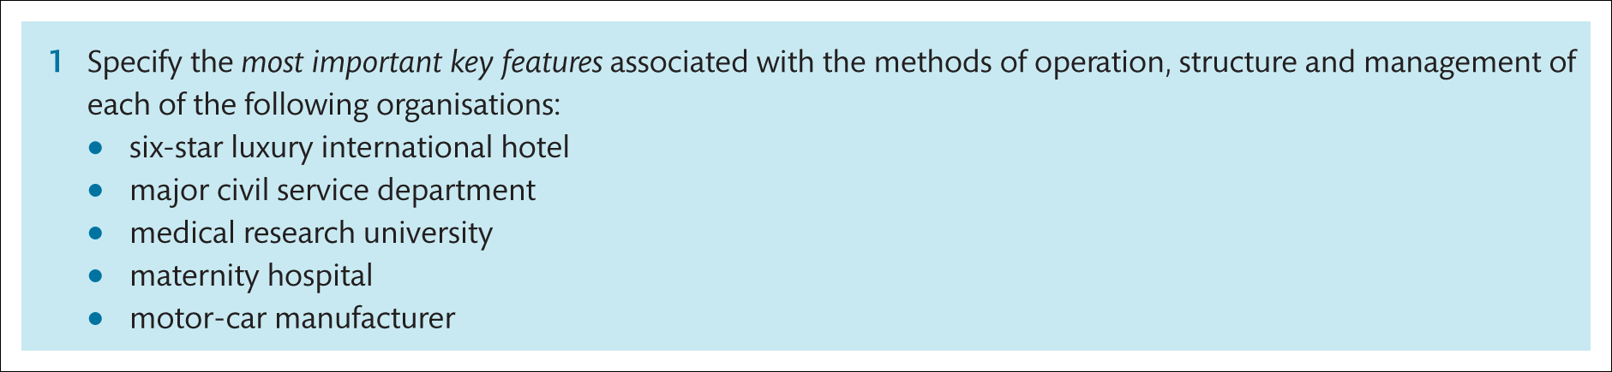
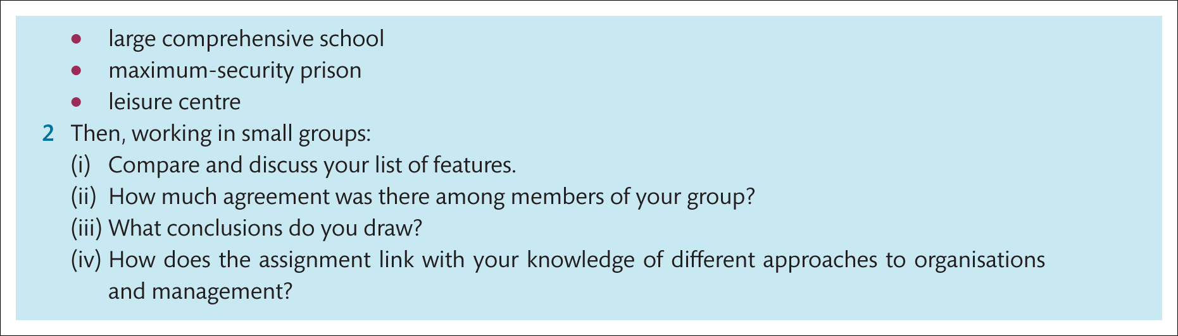
Assignment

