Slide 1
Multi-Sensory Resources
SJIE4003 Lloyd Andrew Jones 2011835

Slide 2

Why are Multi-Sensory Resources important?
The reason why Multi-Sensory resources are useful to the children we work with because it allows the young people who have Specific Learning Difficulties be able to feel like a part of the class.
According to (Morin. A) “All kids can benefit from multisensory lessons. If kids learn something using more than one sense, the information is more likely to stay with them. The engaging activities result in better memory of the skill.”
Notes:
By helping our pupils learn through multisensory we are using the neuroscience behind how they are able to use two or more senses without realizing they are doing so.

Slide 3
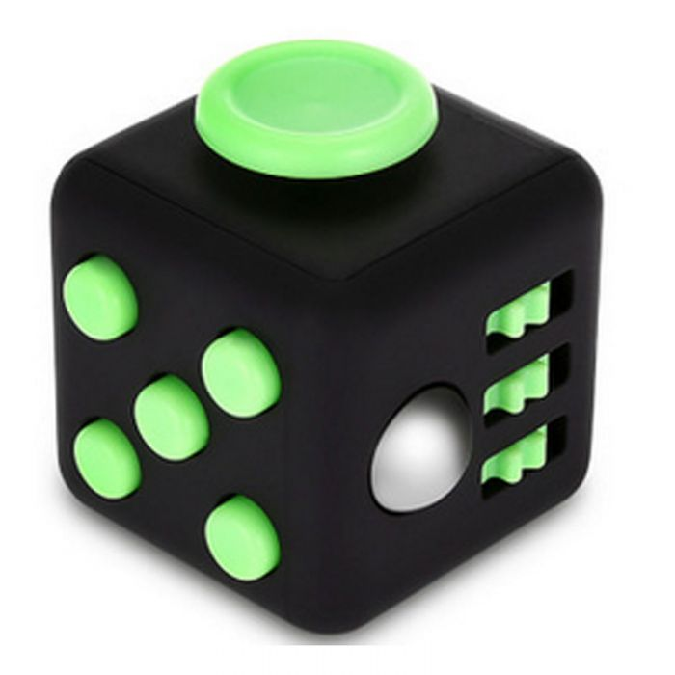
There are many different types of fidget resources that you can use for children with Autism and ADHD.
The resource that I have chosen to talk about it a Fidget Cube, this can be used in many ways. This allows the young people that we work with by clicking or moving any of the buttons and rolling the ball around.
Through using this resource, it helps those children with Autism and ADHD deal with the day-to-day stress and self regulate.
This particularly helps with Autistic children because they need to be on the go most of the day. So, whilst having a fidget cube they will be able to access more than two senses and will allow them to focus on the session.

Slide 4

I believe that this resource helps the children with Autism gain the full potential in a classroom because it is fulfilling their needs both physiological and the safety aspect.
As Maslow states in the Hierarchy of needs the first things that a child should feel, and gain is making sure that they allow themselves to feel safe within the environment.

Slide 5
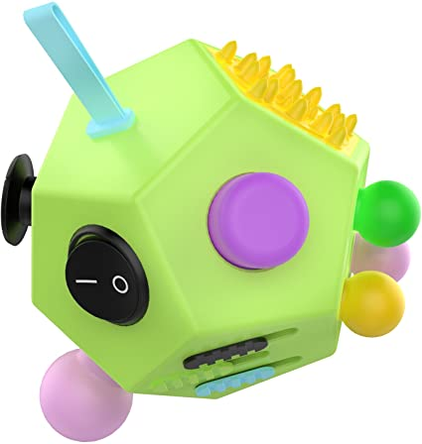
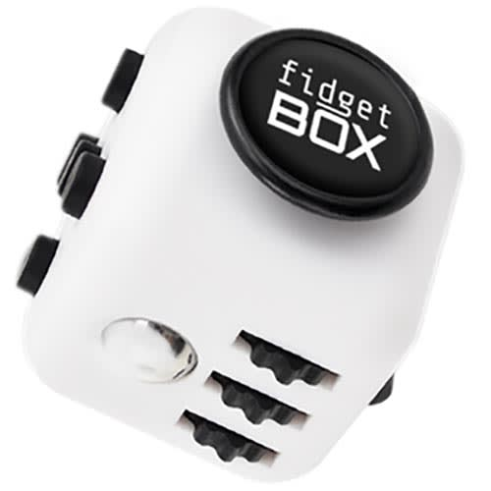
What is the emotional and social impact?
The emotional impact of this multi-sensory resource is that with this the children that we work with ease the anxiety of the day ahead and will help them self-regulate when they are unsettled.
On the social side of impact for the children we work this, having the ability to use this and be able to self-regulate makes them more approachable to some of their peers and will assist the members of staff with easing them back into the main classrooms if they need to have a few minutes.

Slide 6
Conclusion
From my research I have found that there are many different types of multisensory resources available for the specific learning difficulties that we see today. These resources are and have been proven to be a good tool to use in many schools and homelife, to help with the children we look after gain the most out of their education and social life at home.

Slide 7
Resource Slide
Morin, A. (No Date, Multisensoryinstruction: What you need to know, What Is Multisensory Instruction? | Understood - For learning and thinking differences, accessed 14 April 2021)
No author, No date, (Kids on Tour, Fidget toys and how they can be useful for children with Autism Spectrum Disorder (ASD) or Sensory Processing Disorder (SPD) – Kids on Tour (autismkidsontour.com) ,accessed 17 April 2021)
Images of fidget cubes – (fidget cubes - Google Search)

