Slide 1
Postgraduate Certificate in Professional Practice (Clinical Leadership): focus on DSAW7057
Dr Christine Davies
UWTSD

Slide 2
Module Code | Module Title | Credits
DSAW7057 | Reflection on Clinical leadership | 30 L7
DSAW7058 | Leading Service Improvement | 30 L7

Slide 3
20.6.17:
Re-visiting DSAW7057
Focus on reflective, critical writing

Slide 4
DSAW7057: Reflection on Clinical Leadership
AIM
To provide learners with the knowledge and skills necessary to deliver effective clinical leadership.

Slide 5
DSAW7057: LEARNING OUTCOMES
Evaluate and critically reflect upon the impact of their personal leadership style identifying strategies for development
Demonstrate advanced knowledge and application of clinical leadership strategies and influencing skills within their scope of responsibility
Demonstrate a critical appreciation of a wide range of leadership skills and apply them to complex collaborative leadership contexts within NHS Wales

Slide 6
DSAW7057: Assessment Components | Final % of mark
1: personal leadership analysis | 20
2: reflective accounts | 80

Slide 7
DSAW7057: Assessment
Assessment Component 1
A critical analysis of personal leadership style and a personal leadership development plan based on a Learning Log recording a wide range of learning experiences. (1,500 words or equivalent, 20%)
Assessment Component 2
A range of a minimum of five reflective accounts focusing on the application of all scheduled and independent aspects of learning. (6,000 words or equivalent, 80%)

Slide 8
DSAW7057: Assessment Components | What is involved?
1: personal leadership analysis | What sort of a leader are you? How do you know? What are your strengths and weaknesses? You will also need to include a log of learning activities, and a personal development plan
2: reflective accounts | 5 accounts which give examples of your reflection on how you have applied your leadership skills to particular situations. Could also include a more in-depth analysis of diagnostic tests (include References at end)

Slide 9
DSAW7057: a good assignment
deep, honest reflection
Critical analysis
Clear indication of specific contexts
Informed by range of leadership skills, strategies, theories
Evidence of ongoing leadership development
Discussion of team–working and collaboration
Evidence of learning
Writing which is clear, coherent, concise
Notes:
Honest analysis

Slide 10
Module | Deadline for draft submission of proposal | Draft submission feedback | Deadline for draft submission | Draft submission feedback | Date of oral presentation assessment | Deadline for final submission | Final submission Feedback
DSAW 7058 | 23.6.17 | 7.7.17 | 4.8.17 | Feedback provided by 25.8.17 | 12.7.17; 12.9.17; 13.9.17; Academi Wales will inform you of your allocated date for presentation. | 15.9.17 | Feedback provided by 13.10.17
DSAW 7057 | n/a | n/a | 20.10.17 | Feedback provided by 13.11.17 | n/a | 24.11.17 | Feedback provided by 22.12.17

Slide 11

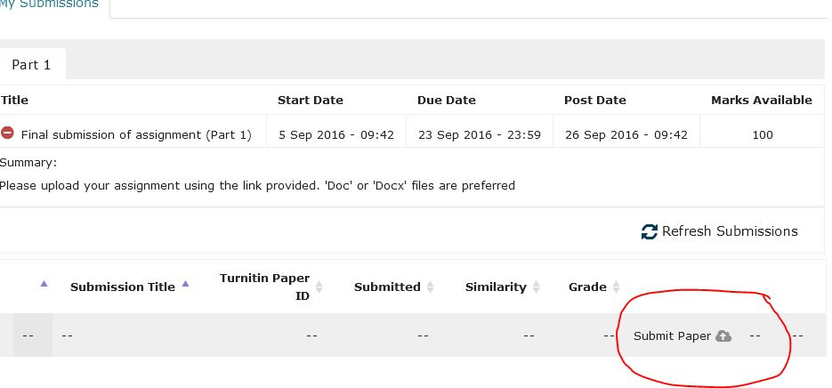
Submitting your assignment
Electronic submission using ‘Turnitin’ within Moodle
If this does not work for some reason, please email your assignment to ‘wbl@uwtsd.ac.uk’ before the deadline (ie. midnight on specified date).
NB: you will not be able to access Moodle or Turnitin if you are not enrolled

Slide 12
Questions??

Slide 13
contact
Christine.davies@uwtsd.ac.uk
01267 225148

